Slide 1


Synthesis of p-anisal acetophenone
By:
M.Sc. Hala Ayad M. R.

Slide 2
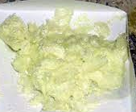
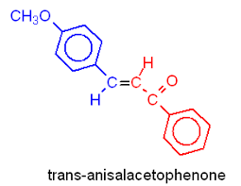
Before coming to synthesis …
IUPAC: f 1-(4-methoxyphenyl)-3-phenylprop-2-en-1-one
Dissolved in ethanol
Insoluble in water
Melting point: 73-76 °C
Solid, yellow

Slide 3
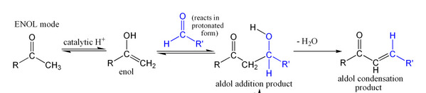
Theory:-
(Aldol condensation) :- Reaction between 2 aldehydes (have α-H) or 2 ketones (have α-H) in the presences of dilute base to form β-hydroxy carbonyl compound.
(claisen schmidt condensation):- When product of aldol condensation dehydration by using excess of base or higher temperature lead to form form α,β-unsaturated carbonyl compound which name

Slide 4
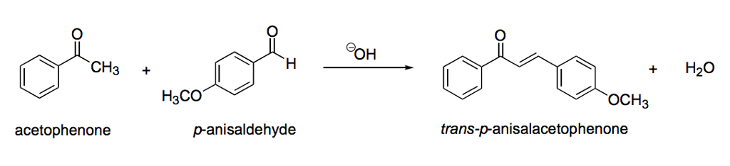

Chemical Equation

Slide 5
procedure
In beaker add (1ml) of anisaldehyde then (1 ml) acetophenone.
Add (3ml) of 96% ethanol solution , stir until dissolved the reactant.
Add (5 drops) of (50%) NaOH, observed formation yellowish solution.
Shake the solution for (15min) after that the solution became thick. Then shake (15min) in ice bath.
Filtrated the crude product and washed with cold ethanol. Determine the yield.
Crude produced re-crystallization with minimum amount of methanol. Determine the yield.

Slide 6

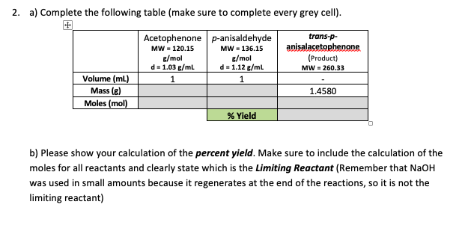
Calculate the yield % :-

Slide 7


