Slide 1

Cannizaro Reaction
M.Sc. Hala Ayad

Slide 2
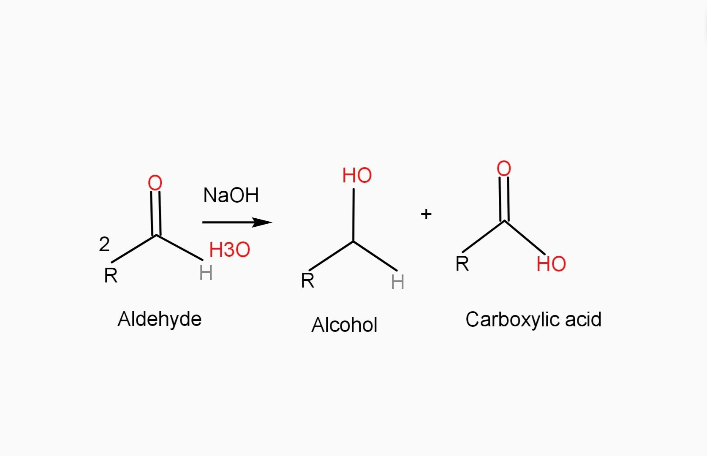

What is Cannizaro reaction ???
Reaction between 2 same carbonyl compounds (no have α-H) in the presences of concentrate base to form 1° alcohol & carboxylic acid compounds.

Slide 3
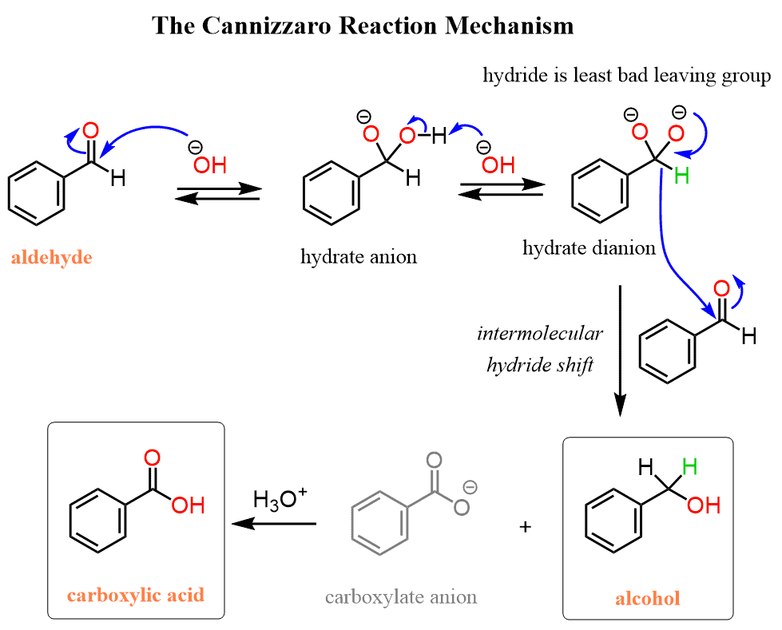

Slide 4


