Slide 1

Synthesis of benzoic acid from benzyl chloride
Dr. Hala Ayad

Slide 2

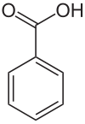

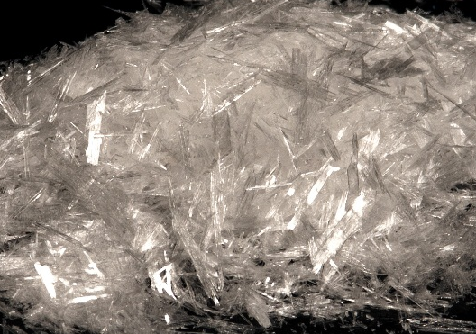
What is benzoic acid ???
IUPAC name: Benzene carboxylic acid
White powder or crystals
Soluble in: acetone, chloroform, alcohol, ether
Melting point: 122 °C

Slide 3




What are uses of benzoic acid in pharmacy ???
in the early 20th century Benzoic acid was used as an analgesic and antiseptic
As ointment which is used for the treatment of fungal skin diseases

Slide 4
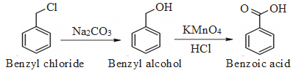

Chemical equation
Hydrolysis step
Oxidation step

Slide 5
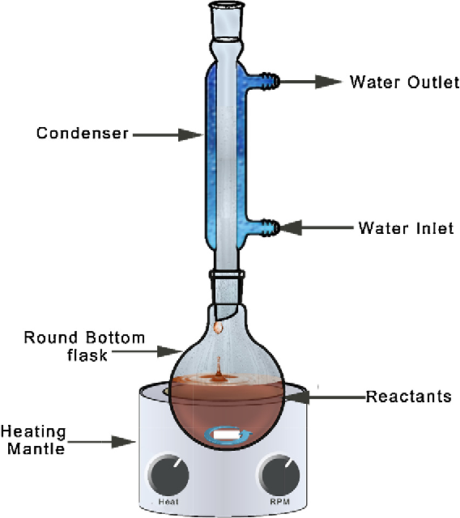
Procedure
(2 ml) of benzyl chloride is added to a solution of (2 g) of anhydrous sodium carbonate (Na₂CO₃) that dissolved in 20 ml of distilled water in a round bottom flask.
The round bottom flask is fitted with a water reflux condenser and heated.
(4 g) of potassium permanganate (KMNO₄) in 80 ml of water is added in small quantities through the water condenser.
It is boiled for about 1 hour (formed dark brown precipitate) . Then flask cooled
Add hydrochloric acid (con.) to this solution until the solution is acidic. Then add (4 g) of sodium sulfite are added to this mixture. The precipitated benzoic acid is filtered and washed.
The acid is recrystallized from boiling water.
Why???
Why???
Why???

Slide 6

Question
Why is dark brown precipitate formed through the reaction ?????
because formation of manganese dioxide (MnO₄) oxidation reduction reaction.
Why is HCl (con.) added?????
because benzoic acid as salt is formed and soluble in solution so add acid to formed benzoic acid which is insoluble in solution.
Why is sodium sulfite added ??????
to removed manganese dioxide (MnO4)

Slide 7


