Slide 1
Irritable bowel syndrome
Done by
Assist. lec. Shaymaa Hasan Abbas

Slide 2
Aims of treatment
The treatment of IBS is focused on symptom control, in order to improve quality of life

Slide 3
Aggravating factors
Stress can precipitate and exacerbate symptoms.
Caffeine often worsens symptoms and its stimulant effect on the bowel and irritant effect on the stomach are well known in any case.
The sweeteners sorbitol and fructose aggravate IBS.
Other foods that have been implicated are milk and dairy products, chocolate, onions, garlic, chives and leeks.

Slide 4
Treatment timescale
Symptoms should start to improve within 1 week.

Slide 5
Non-drug treatment
Diet
Fluid
lifestyle changes

Slide 6
Drug treatment
1- Antispasmodics
Anti muscarinic
Dicycloverine HCL
Tertiory amines atropine sulfate
Quaternary ammonium coupounds
Hyocine butylbromide
Other Antispasmodics
Alverine citrate
mebeverine hydrochloride
peppermint oil

Slide 7
Drug treatment continue
2- Laxatives
3- Anti – motility drugs
4- Tricyclic antidepressant (e.g. amitriptyline (HCL)
5- Selective serotonin reuptake inhibitor (SSRI)

Slide 8
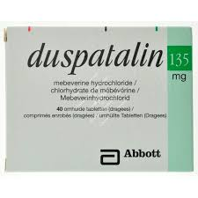
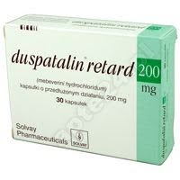


Slide 9

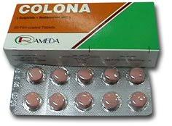

Slide 10
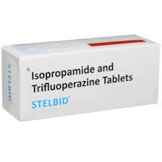
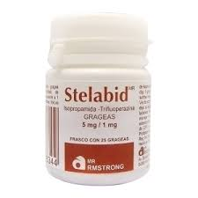

Slide 11
Isopropamide is an inherently long-acting synthetic anticholinergic agent that provides 12-hour antisecretory-antispasmodic activity.
Trifluoperazine is a piperazine phenothiazine derivative with antipsychotic, anxity, and antiemetic properties. The mode of action of phenothiazines has not been definitely established. Like most phenothiazines, trifluoperazine possesses weak anticholinergic and possibly alpha-adrenergic blocking activities.

Slide 12
Since both components of Stelabid are inherently long-acting, a single tablet twice daily (every 12 hours) can provide continuous 24-hour control of symptoms of ulcer and other gastrointestinal disorders
Stelabid is particularly indicated where anxiety, tension, worry, or other emotional factors are thought to be wholly or partially responsible for the digestive dysfunction.

Slide 13
Contra-Indications:
In comatose states
glaucoma,
cardiospasm,
obstructive uropathy (e.g., bladder neck obstruction due to prostatic hypertrophy)
or obstructive lesions of the gastrointestinal tract (as in achalasia, obstructive or paralytic ileus, pyloroduodenal stenosis, etc.),
intestinal atony of the elderly or debilitated patient,
severe ulcerative colitis,
toxic megacolon complicating ulcerative colitis.

Slide 14
Adverse Reactions:
anticholinergic side effects
Iodine skin rash may occur rarely.

Slide 15
caution
in elderly patients,
in patients with cardiac impairment, hyperthyroidism,
or hiatal hernia associated with reflux esophagitis (anticholinergic drugs may aggravate this condition).
patients with impaired cardiovascular function.
angina

Slide 16
Pregnancy and Lactation:
Use during pregnancy should be restricted to those cases where the potential benefit to the mother outweighs the potential risk to the fetus.
Adequate human data on use during lactation and adequate animal reproduction studies are not available

Slide 17
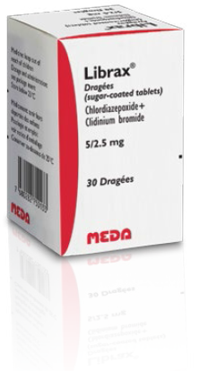

Slide 18
Librax
Librax is a capsule containing a combination of chlordiazepoxide and clidinium bromide .
Chlordiazepoxide is a benzodiazepine
Clidinium reduces stomach acid and decreases intestinal spasms.
Librax is usually taken before meals and at bedtime

Slide 19
Librax is a medicine that may be effective in treating stomach ulcers, irritable bowel syndrome, or symptoms related to intestinal infection.
Caution: glaucoma, enlarged prostate, bladder obstruction, or problems with urination
Do not drink alcohol while taking Librax. This medication can increase the effects of alcohol.
The sedative effects of may last longer in older adults. Accidental falls are common in elderly patients who take benzodiazepines

Slide 20
side effects: ataxia, amnesia, drowsenes, dependance, may impair thinking and reactions.
Pregnancy: Librax can cause birth defects in an unborn baby. Do not use this medicine if you are pregnant.
Lactation: may decrease breast milk production, manufacture advice avoide

Slide 21
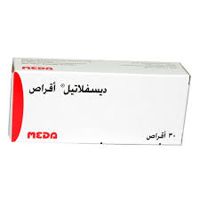


Slide 22
Gastro-oesophageal reflux disease

Slide 23
Precipitating or aggravating factors.
Diagnosis of GERD can be helped greatly by asking about the Precipitating factors. These are:
A-Bending or lying down(e.g. at night).
B- Overweight.
C- After large meal.
D- Pregnancy(mechanical and hormonal
influence).
E -It can be aggravated or even caused by belching.

Slide 24
Management
A-Non-pharmacoIogical advices:
1-Eat small and frequent meals( to avoid distending the stomach).
2-Do not eat within 3 hours of going to bed and do not lie down for about 3 hours after eating.
3-Use extra pillow to elevate the head of the bed.
4-Do not wear tight fitting clothing.
5-Avoid smoking , alcohol, caffeine and foods that exacerbate symptoms of GERD.
6-Weight reduction should be advised.

Slide 25
Management continue
B-pharmacological therapy
Antacids:
(AL salts, Mg salts, Ca-carbonate, Na-bicarbonate,...):

Slide 26
Management continue
Alginates
Alginate-containing Antacids form a sponge -like matrix that float on the top of the stomach contents, so when reflux occurs , alginate rather than acids will be refluxed ands irritation is minimized.

Slide 27
Practical points:
1- They are best given after each main meal and before bedtime, although they can be taken on as needed basis.
2-Tablets must be chewed and followed by a full glass of water so that foam can float on water in the stomach.
3-Alginate work when the patient in the upright position and , therefore, must not be taken just before lying down.
4-they can be given in pregnancy.

Slide 28
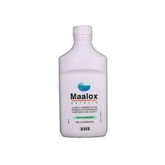
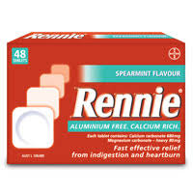

Slide 29
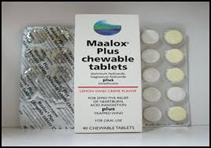

Slide 30
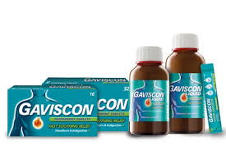

Slide 31
Management continue
Proton pump inhibitors
(omprazole cap)

Slide 32
Proton pump inhibitors
omeprazole 10 mg is now available for sale over the counter for heartburn sufferers (18 years or over) who experience intermittent and relapsing symptoms.
The initial starting dose is 20mg once daily and may need to be taken for 3 to 4 days to obtain symptom relief.
Patients requiring immediate symptomatic relief can be advised to take a simple antacid or antacid/alginate at the same time for the first few days of treatment if necessary.

Slide 33
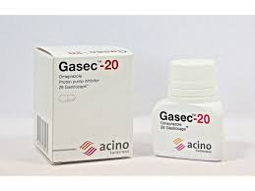


Slide 34
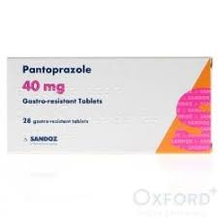
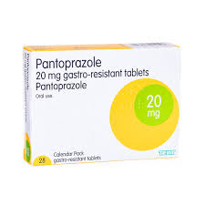

Slide 35


Slide 36
Management continue
Histamine 2 receptor antagonists (H2RA):

Slide 37
Histamine 2 receptor antagonists
OTC use of H2RA is restricted to adults and children over the age of 16 years
Patient can take 1 tablet when symptoms occur, but when food is known to precipitate symptoms, H2RA should be taken an hour before food.
OTC use of H2RA is restricted for short -time use only ( not more than 2 weeks)

Slide 38
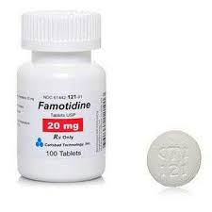

Slide 39
