Slide 1
Clinical pharmacy lab
4 th stage cough
Assistant lecturer
Sura abbas
Zahra Abdulghani

Slide 2
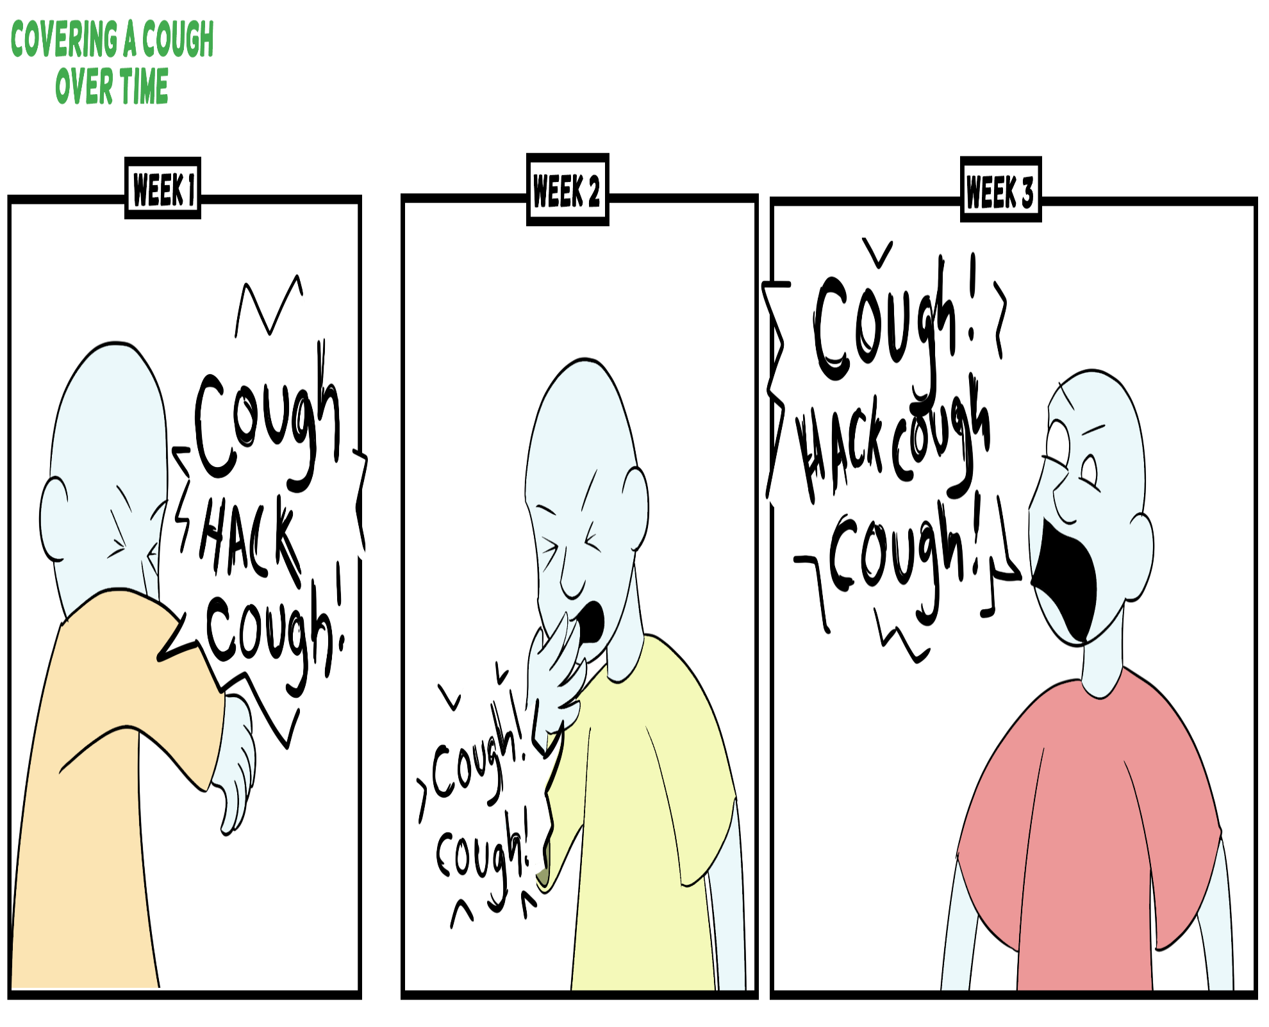

Slide 3
outlines
Definition
Type of cough
Questions to ask and Conditions to be referred
Management
Examples on cough preparations
Restriction on the use of cough and cold medicines in children
Best practice for treating cough and cold in children

Slide 4

cough
Coughing is a protective reflex action caused when the airway is being irritated or obstructed. Its purpose is to clear the airway so that breathing can continue normally.

Slide 5
Types of cough
Productive (wet) cough
Nonproductive (dry) cough
Chesty-Nonproductive: Many patients say that they are not producing sputum where there is congestion on and they say that they can "feel it on their chest “.

Slide 6
Questions to ask
Age
Duration: most coughs are self-limiting and will be better within a few days with or without treatment. In general, a cough of longer than 2 weeks’ duration should be referred.
Nature of cough if wet ask about color of sputum

Slide 7
Questions to ask (cont.)
Associated Symptoms:
Chronic cough with hemoptysis associated with chronic fever, weight loss and . Patient with night sweats are classical symptoms of tuberculosis (TB) suspected TB required referral.

Slide 8
Questions to ask (cont.)
2-Cough with clear frothy sputum, breathlessness (especially in bed during the night) may indicate heart failure and required referral for further investigations.
(Note: other symptom of heart failure may be swollen ankles). (if there is a history of heart disease especially with a persisting cough, then referral is advisable.

Slide 9
Questions to ask (cont.)
3. A recurrent night-time cough especially in children with or without wheezing may indicates asthma and should be referred. Especially if there is a family history of eczema, asthma, hay fever

Slide 10
Questions to ask (cont.)
4-Upper airways cough syndrome (UACS) (previously referred to as postnasal drip; also referred to as rhinosinusitis):
It is a common cause of cough in which discharge that flows behind the nose and into the throat . Patient present with swallowing mucus or frequent clearing of the throat more than usual. Allergies are one cause of UACS. If UACS is present, it is better to direct treatment at the cause of the UACS (e.g. antihistamines or decongestants) rather than just treat the cough)

Slide 11
Questions to ask (cont.)
5-Chest pain, shortness of breath (SOB), wheezing, whooping). These symptoms required referral for further investigations
6-Croup:
Croup usually occurs in infants. The cough has a harsh barking quality It develops 1 day or so after the onset of cold-like symptoms. It is often associated with difficulty in breathing and an inspiratory stridor (noise in throat on breathing in. Referral is necessary

Slide 12
7-Coughing during the recumbent (supine, lying down), with heartburn may indicate Gastro esophageal reflux disease (GERD) which may be improved by with acid lowering drugs
8-Smoking: Patient who smokes is more prone to chronic recurrent cough. Over time this might be develops into chronic bronchitis or emphysema

Slide 14
Medication
If one or more appropriate remedies have been tried without success (failed medication) ------------- referral for further investigations .
Effective product for similar previous cough: the pharmacist should consider patient's satisfaction or dissatisfaction with specific products i.e. patient's preferability .
Drug-induced cough: e.g.:
Angiotensin-converting enzyme (ACE) inhibitors: (e.g. captopril, lisinopril, Enalapril ……) can induce cough in about 10% of patients (especially women), the cough is usually nonproductive, occurs within the first few months of therapy-----------refer and suggest the alternative: Angiotensin –II receptor antagonists (valsartan, losartan, ….).

Slide 15
Treatment timescale
Depending on the length of time the patient has had the cough and once the pharmacist has recommended an appropriate treatment, patients should see their doctor 2 weeks after the cough started if it has not improved

Slide 16
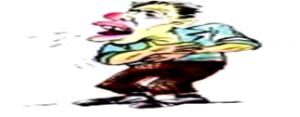
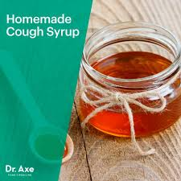
Non-pharmacological Treatment

Slide 17
Management:
Non-drug measures:
slowly dissolving hard candies or other lozenges in the mouth may sooth the irritated throat and decreases the dry cough.
Demulcent: (They don’t contain an active ingredient and considered to be safe in children and pregnant women) .If recommended they should be given 3-4 times daily .e.g: honey, lemon(for dry and wet cough)
General advice to patient with cough and cold is to increase fluid intake to about 2Ls / day .(About 8 to 10 glasses daily).
Steam inhalation

Slide 18
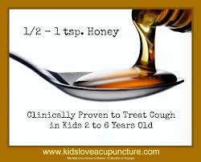

Slide 19
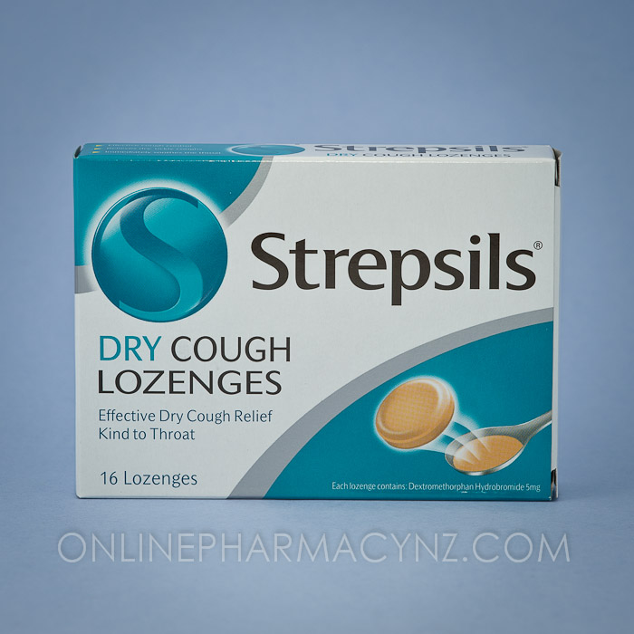
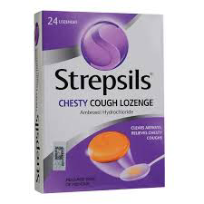

Slide 20
Additional Constituents:
1-Theophylline: which is one of the bronchodilators, and it is available in some OTC products but it is best avoided because patients requiring medication to help with shortness of breath (SOB) or wheeze are best referred .
2-Sympathomimetics (e.g. Pseudoephedrine and Phenylephrine): these are commonly included in cough and cold remedies for their bronchodilator and decongestant actions .
They may be useful if the patient has blocked nose as well as cough, but they can increase the BP ,stimulate the heart, and alter the diabetic control therefore they are not recommended for patients with :
Coronary artery diseases (Angina, MI, ….), Hypertension, Diabetes mellitus, and Hyperthyroidism .
3-Sedating Antihistamine: like Diphenhydramine, and chlorpheniramine,…., which may be added to antitussives ( combination with expectorant is illogical) and they are effective especially if the dry cough is disturbing sleep.
S/Es: include sedation and drowsiness and anticholinergic S/Es (i.e. dry mouth, urinary retention, constipation, …..).
They are not recommended (or used with caution ) for patients with:
Glaucoma or prostate hypertrophy.

Slide 21

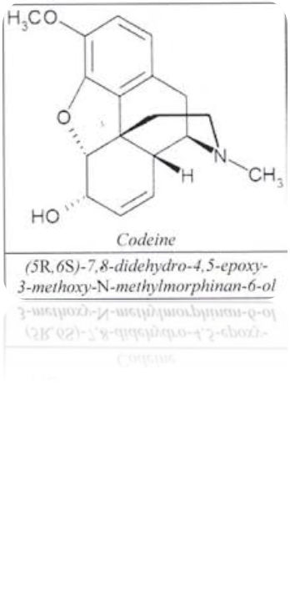
Pharmacological management(OTC)
ANTITUSSIVE( Cough suppressant): (dry cough)
Pholcodine, codeine, dextromethorphan

Slide 22
codiene
1-Codiene:
ملاحظة: إن هذا الدواء لا يتوفر حاليا في العراق منفردا ولكنه موجود ضمن الـ :
cough mixtures
e.g. of codeine containing cough mixtures available in Iraq are:
Tussiram® syrup, Pulmocodin® syrup…
S/Es: even at OTC doses codeine can cause constipation, drowsiness and at high doses, respiratory depression, therefore it is best avoided in patients with impaired respiratory function e.g. Asthma .
More than 18 years
(Note: Codeine is well known as a drug of abuse and sales must be refused because of knowledge or likelihood of abuse) .
Pregnancy – best avoided in 3rdtrimester
Short periods OK in breastfeeding.

Slide 23
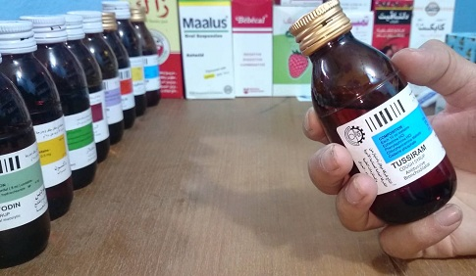

Slide 24
Tussiram
Each 10 ml contains:
Chlorpheniramine maleate 2 mg
Phenyl phrine HCL 5mg
Ephidrine HCL 15mg
Codiene phosphate 8 mg

Slide 25
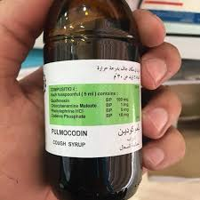
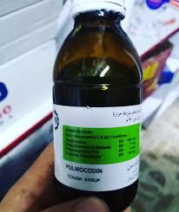

Slide 26
Pulmocodien
Each 5ml contain :
Glycerylguaicolate 100mg
Chlorpheniramine maleate 1 mg
Phenylphrine HCL 5mg
Codeine phosphate 10mg
Ascorbic acid 12.5mg

Slide 27
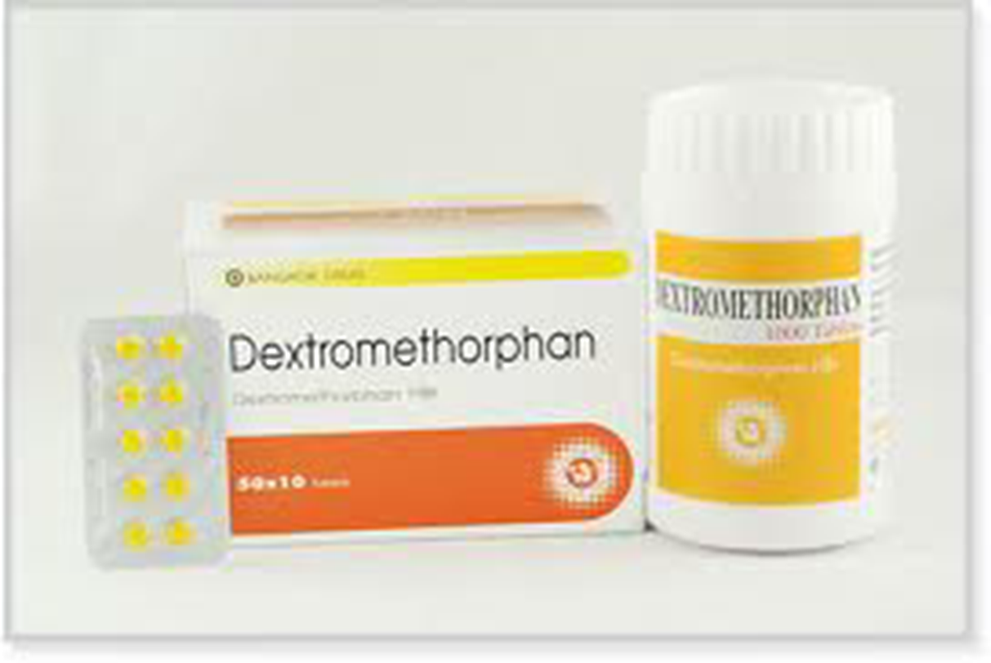
Dextromethorphan…

Slide 28
dextromethorphan
Generally it is considered non-sedating and has fewer side effects and thought to have a low potential for abuse
6 years
Adults: 10-20 mg every 4 hours or 30 mg every 6-8 hours (maximum 120 mg/ day). children aged 6–12 years: 5-10 mg every 4 hours or 15 mg every 6-8 hours (maximum 60 mg/day).

Slide 29
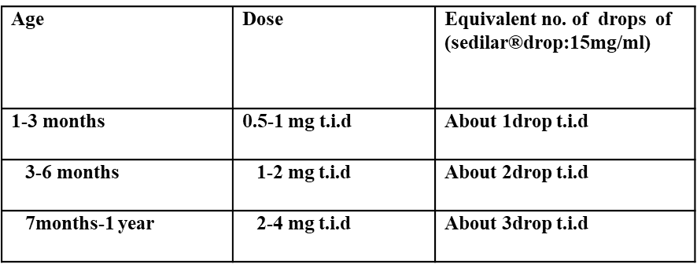
) للاطلاع) Pediatric Dextromethorphan doses:
كثيرا ماتوصف قطرات الـSedilar بجرع خاطئة وكبيرة لان اغلب المصادر لاتعطي جرعته تحت السنة وكما يلي فيرجى الانتباه لها رجاءا:

Slide 30
Expectorants and Mucolytics
which are used for wet cough
1-Glyceryl guaiacolate (also called Guaifenesin): Which is the only FDA approved OTC expectorant .
Doses :
Adults: 200-400 mg every 4 hours (maximum 2.4 g/day). children aged 6–12 years: 100-200 mg every 4 hours (maximum 1.2 g/day).

Slide 31
mucolytics
2-Bromohexine (Solvodin® syrup, and tablet): which is one of the mucolytic drugs, used for wet cough

Slide 32
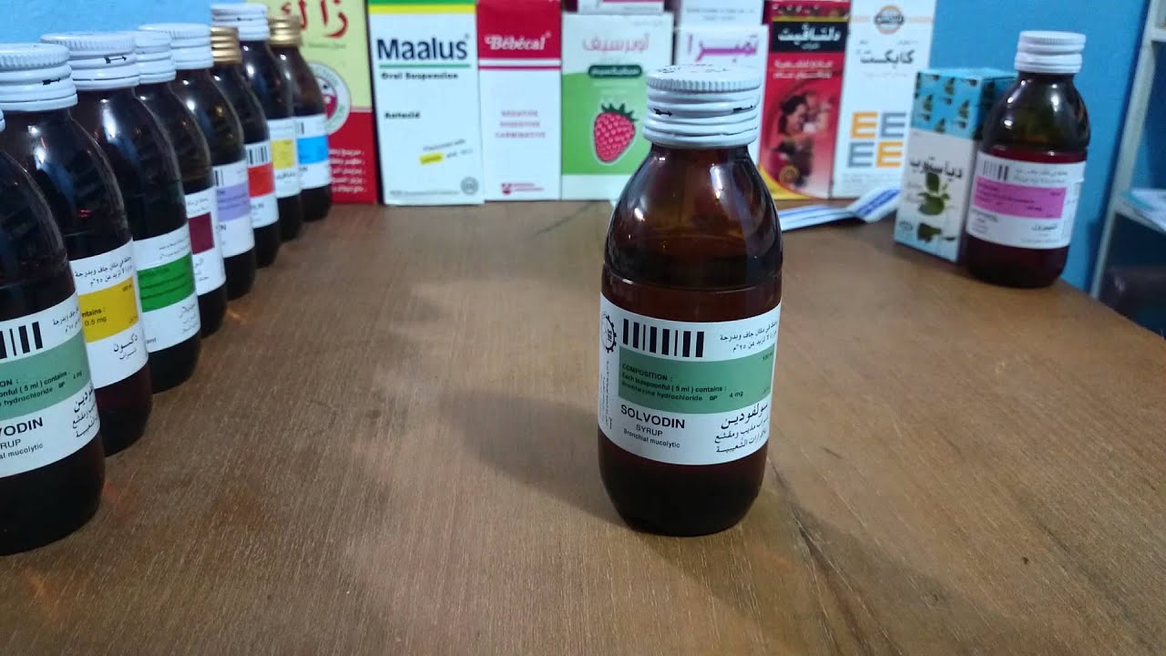

Slide 33
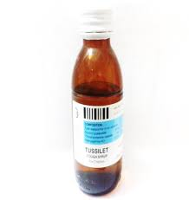

Slide 34
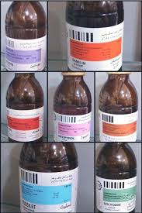
Tussilet
Each 5ml contain :
Glycerylguaicolate 50mg
Chlorpheniramine maleate 1 mg
Phenyl phrine HCL 2.5mg

Slide 35
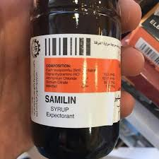

Slide 36
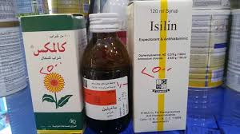
Samilin :
Diphenhydramine 13.5mg
Ammonium chloride 131.5mg
Sod.citrate 55mg
Menthol 1mg

Slide 37
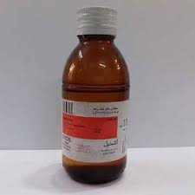

Slide 38
Exidil
Theophyllin 150mg
Glycerylguaiacolate 90mg

Slide 39
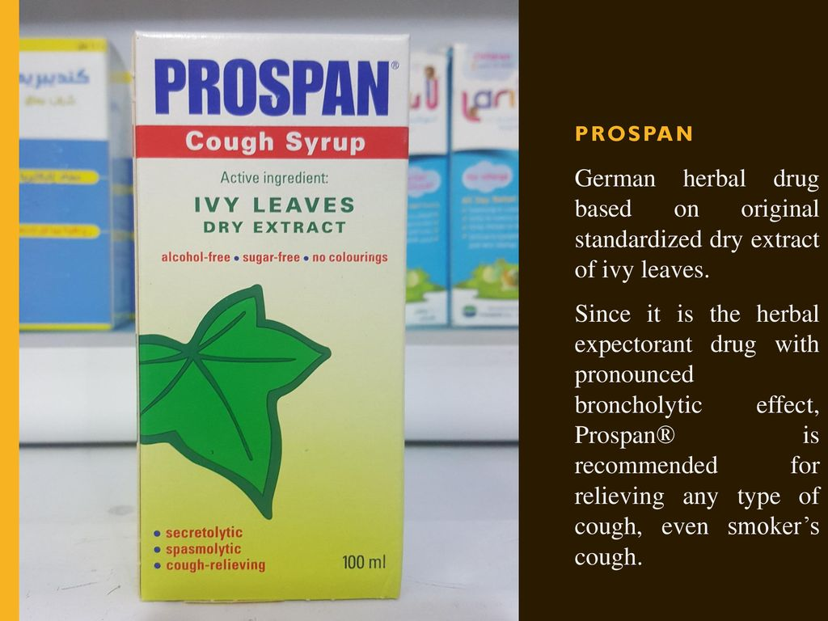
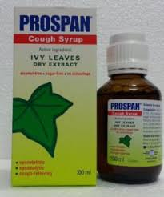


Slide 40
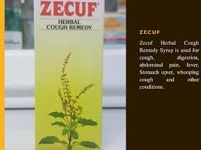


Slide 41
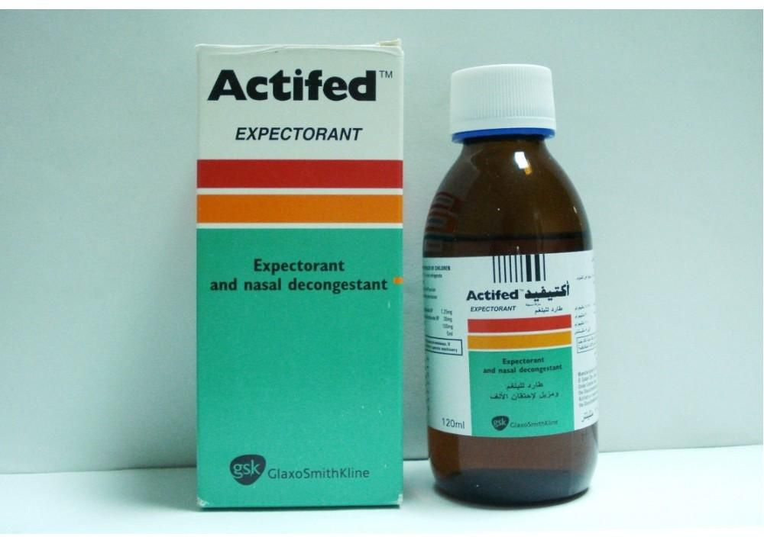

Slide 42
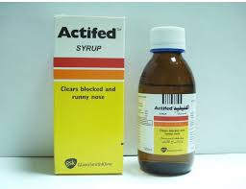
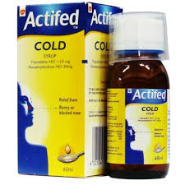
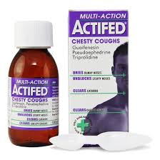
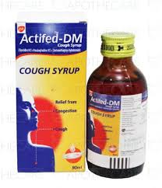

Slide 43
Actifed DM each 5 ml contain:
Pseudoephidrie HCL 30mg
Triprolidine HCL 1.25mg
Dextromethorphan 10mg
Actifed expectorant each 5 ml contain:
Pseudoephidrie HCL 30mg
Triprolidine HCL 1.25mg
Guaiphensin 100mg

Slide 44
Restriction on the use of cough and cold medicines in children
1-Children under 6 years should not be given OTC cough and cold medicines containing the listed ingredients in the following table:

Slide 45
2-Children should not be given more than 1 cough or cold preparation at a time because different brands may contain the same active ingredient
3-OTC cough and cold medicines can be considered for children aged 6–12 years after basic principles of best care have been tried, but treatment should be restricted to five days or less

Slide 46
Best practice for treating cough and cold in children
Current advice on treating colds and coughs in children includes:
1-Giving fluids.
2-Ttreating fever and pain with paracetamol or ibuprofen.
3-The use of saline drops to loosen dried nasal secretions or help a stuffy nose in young children and babies.
4-Simple cough mixtures containing a demulcent, for example glycerin, and syrup can have a soothing effect by coating the throat and relieving the irritation which causes the cough.
5-A child over the age of one may also be helped by a warm drink of lemon and honey.

Slide 47
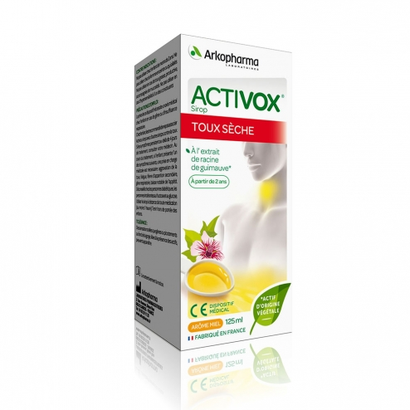
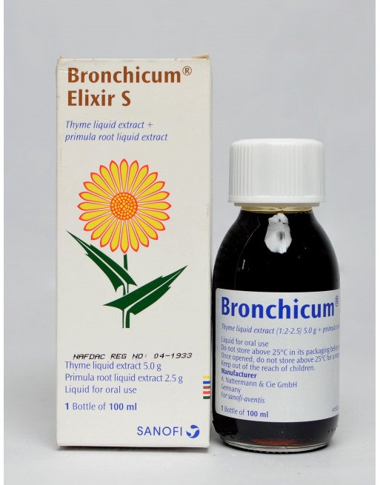
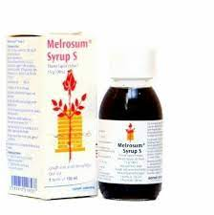

Slide 48
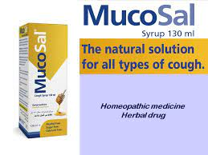
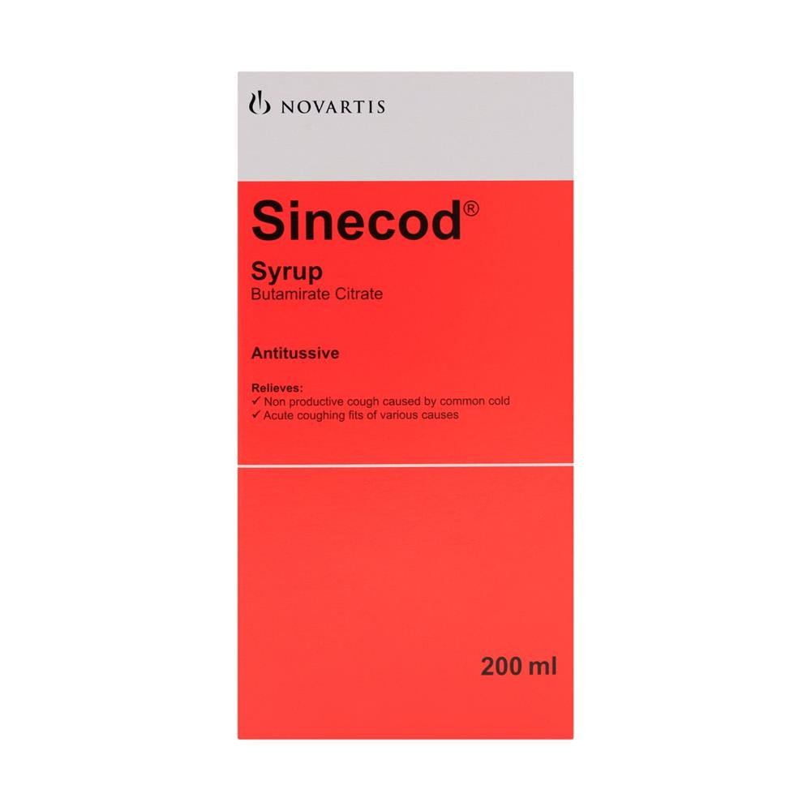
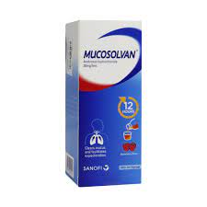

Slide 49
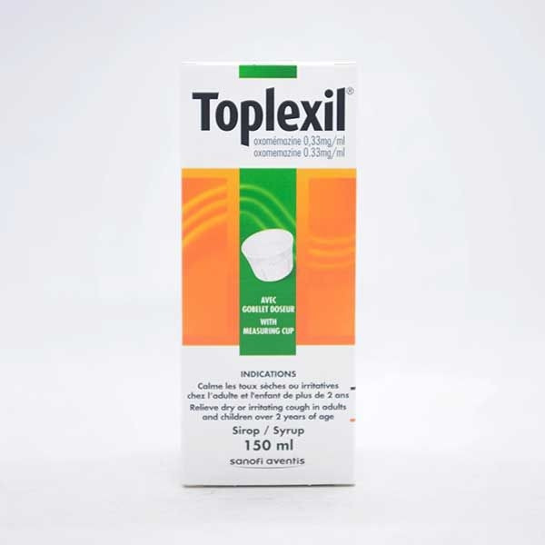
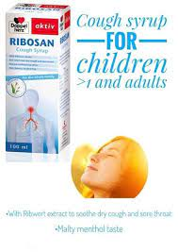
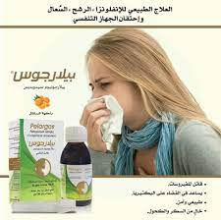

Slide 50


