Slide 1
ANTI HYPERTENSIVE DRUGS

Slide 2
Diuretics

Slide 3
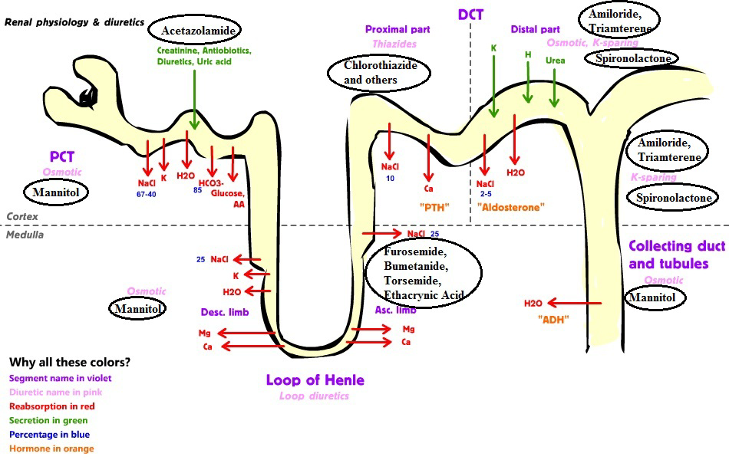

Slide 4
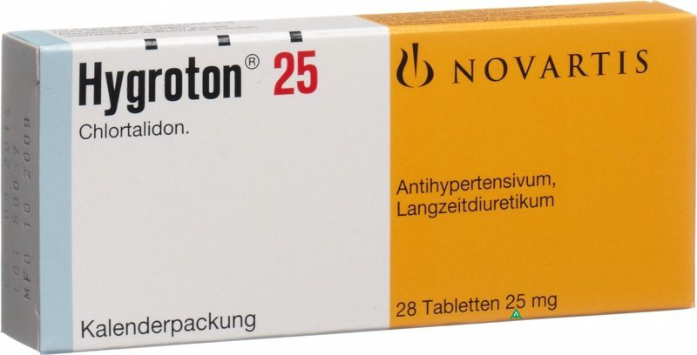
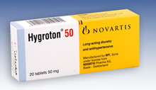
Onset 1-2 hr.
Duration 12-24 hr.
(In the morning)

Slide 5
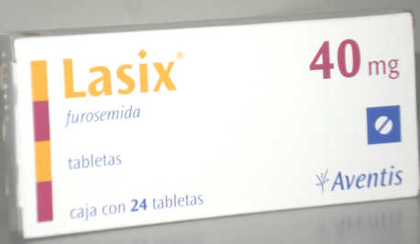

Oral; Act within 1 hr.
Inj.; Act within 30 min.
Complete action within 6 hr.
Can be given twice daily.

Slide 6
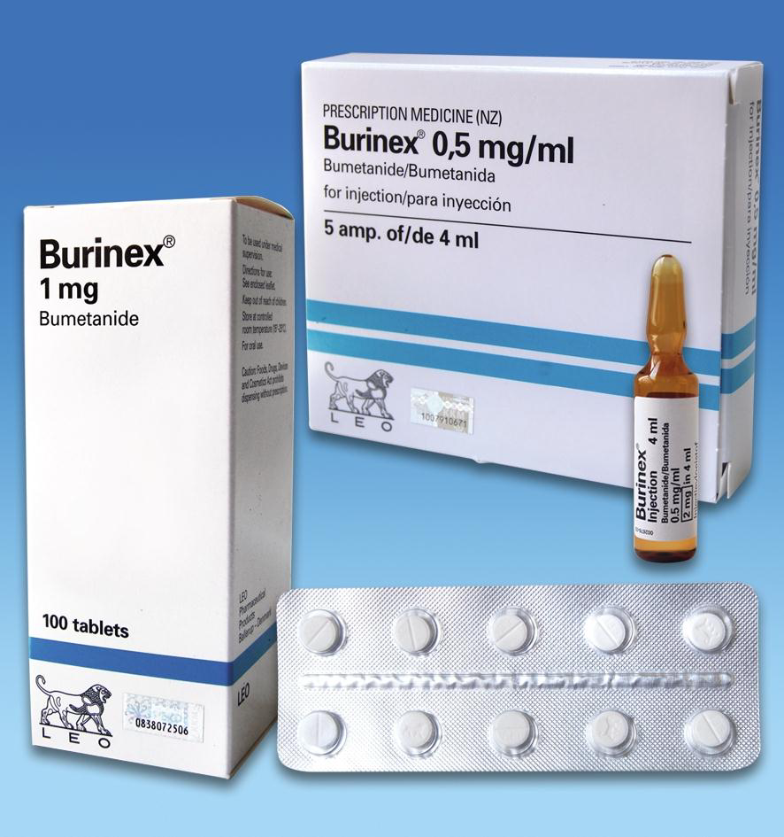

Slide 7



Slide 8
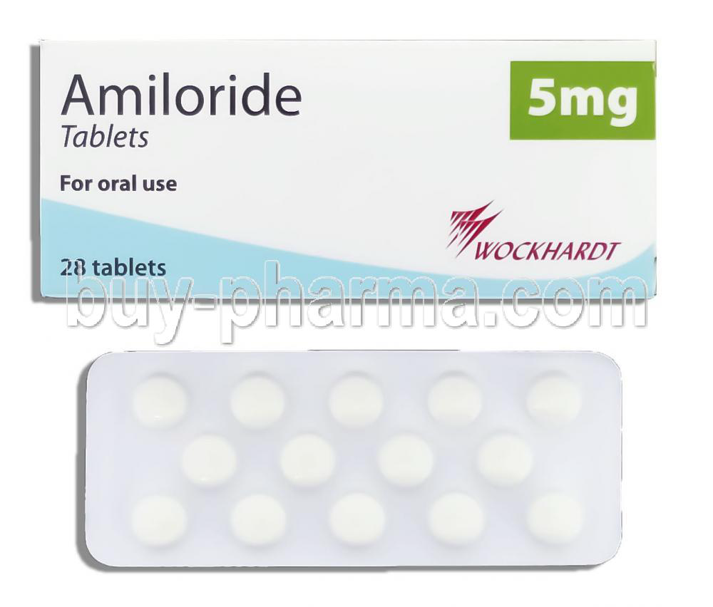

Slide 9


Slide 10
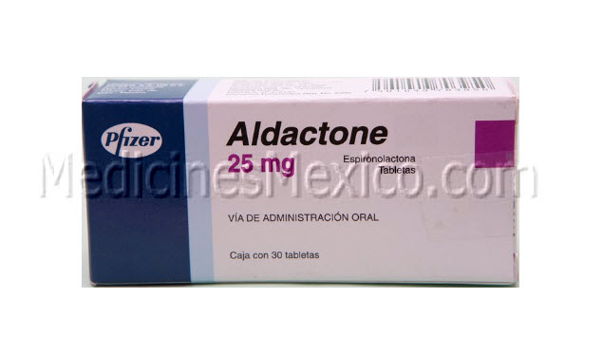
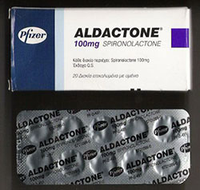
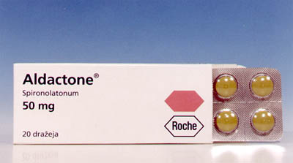

Slide 11
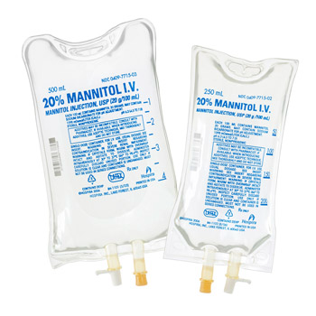

Slide 12

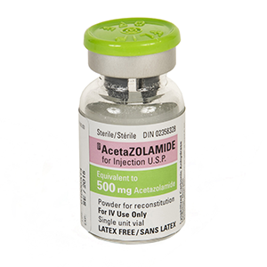

Slide 13


Slide 14
ACE Inhibitor

Slide 15
Angiotensin-converting enzyme inhibitors (ACE inhibitors)
inhibit the conversion of angiotensin I to angiotensin II.
The main indications of ACE inhibitors are shown below.
Heart Failure
ACE inhibitors are used in all grades of heart failure, usually combined with a beta-blocker.
Potassium supplements and potassium-sparing diuretics should be discontinued before introducing an ACE inhibitor because of the risk of hyperkalaemia. However, a low dose of spironolactone may be beneficial in severe heart failure and can be used with an ACE inhibitor provided serum potassium is monitored carefully.
Profound first-dose hypotension may occur when ACE inhibitors are introduced to patients with heart failure who are already taking a high dose of a loop diuretic 80 mg daily or more

Slide 16
Temporary withdrawal of the loop diuretic reduces the risk,
but may cause severe rebound pulmonary oedema.
Therefore, for patients on high doses of loop diuretics, the
ACE inhibitor may need to be initiated under specialist supervision. An ACE inhibitor can be initiated in the community in patients who are receiving a low dose of a diuretic or who are not otherwise at risk of serious hypotension; nevertheless, care is required and a very low
dose of the ACE inhibitor is given initially.

Slide 17
Hypertension
An ACE inhibitor may be the most appropriate initial drug for hypertension in younger Caucasian patients; Afro- Caribbean patients, those aged over 55 years, and those with primary aldosteronism respond less well. ACE inhibitors are particularly indicated for hypertension in patients with type 1 diabetes with nephropathy.
Diabetic nephropathy
ACE inhibitors have a role in the management of diabetic nephropathy.
Prophylaxis of cardiovascular events
ACE inhibitors are used in the early and long-term management of patients who have had a myocardial infarction. ACE inhibitors may also have a role in preventing cardiovascular events.

Slide 18
ACE Iintiated under supervision in patients:
1-receiving multiple or high-dose diuretic therapy (e.g. more than 80 mg of furosemide daily or its equivalent)
2- receiving concomitant angiotensin-II receptor antagonist or aliskiren
3- with hypovolaemia
4- with hyponatraemia (plasma-sodium concentration below 130 mmol/litre);
5-with hypotension (systolic blood pressure below 90 mmHg)
6- with unstable heart failure
7-receiving high-dose vasodilator therapy
8- known renovascular disease.

Slide 19
Concomitant treatment with NSAIDs increases the risk of renal damage, and potassium-sparing diuretics (or potassium-containing salt substitutes) increase the risk of hyperkalaemia.
In patients with severe bilateral renal artery stenosis (or severe stenosis of the artery supplying a single functioning kidney), ACE inhibitors reduce or abolish glomerular filtration and are likely to cause severe and progressive renal failure. They are therefore not recommended in patients known to have these forms of critical renovascular disease.

Slide 20

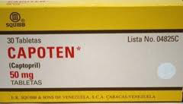
Captopril tab. 12.5 mg,25mg,50mg
Oral sol. 1mg/ml

Slide 21
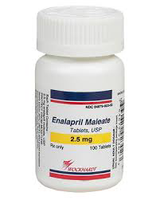
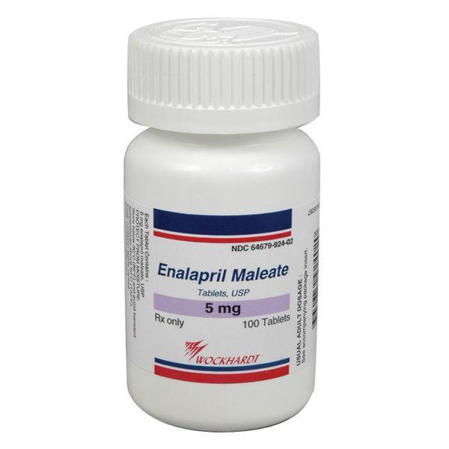
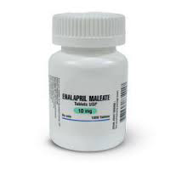
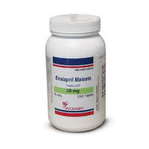

Slide 22
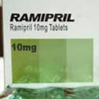
1,25mg-2,5mg-5mg-10mg tab.
1,25mg-2,5mg-5mg cap.
Oral sol.500 Mg

Slide 23
Angiotensin-II receptor antagonists
Unlike ACE inhibitors, they do not inhibit the breakdown of bradykinin and other kinins, and thus are less likely to cause the persistent dry cough which can complicate ACE inhibitor therapy. They are therefore a useful alternative for patients who have to discontinue an ACE inhibitor because of persistent cough.
An angiotensin-II receptor antagonist may be used as an alternative to an ACE inhibitor in the management of heart failure or diabetic nephropathy. Candesartan cilexetil and valsartan are also licensed as adjuncts to ACE inhibitors under specialist supervision, in the management of heart failure when other treatments are unsuitable.
Renal effects Angiotensin-II receptor antagonists should be used with
caution in renal artery stenosis

Slide 24
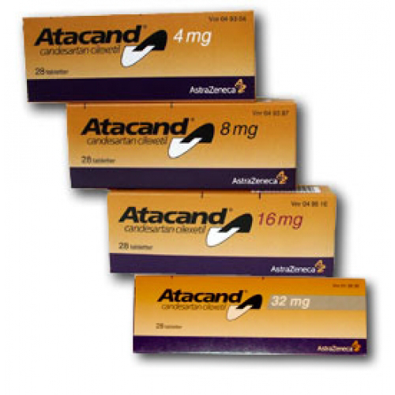

Slide 25
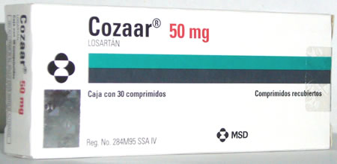
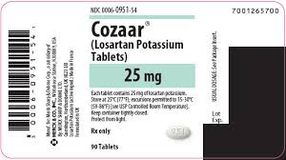

Slide 26
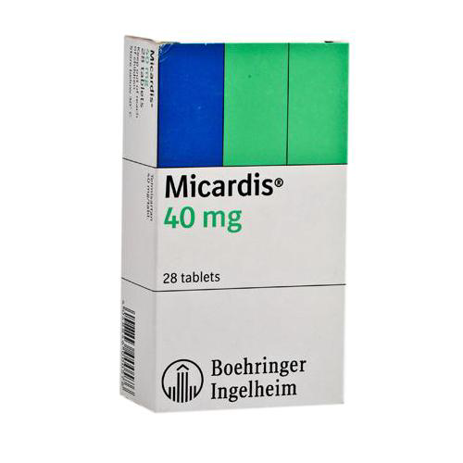
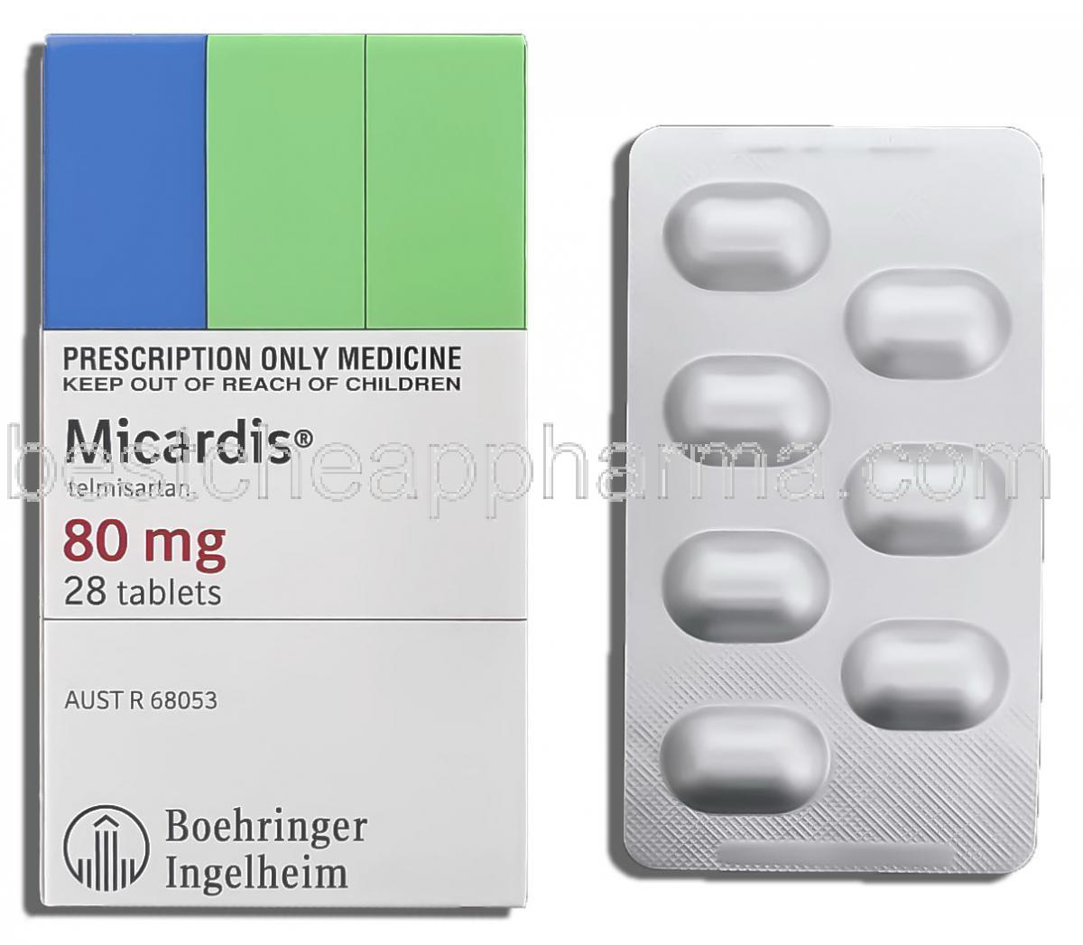

Slide 27
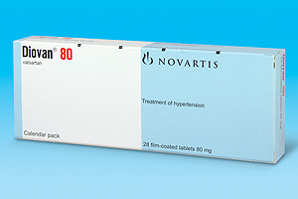
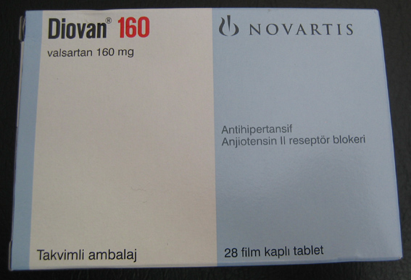


Slide 28
