Slide 1

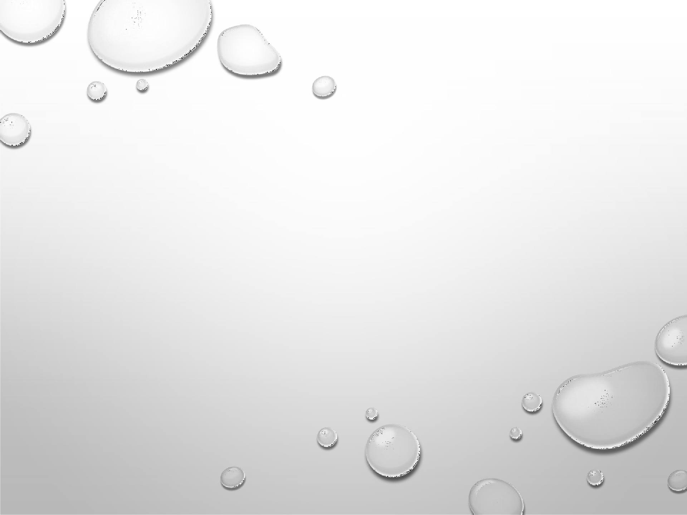

Calibration curve and saturated solubility determination
(UV and HPLC)
Lect. Dr. ibtihal
Lect. Zahraa Amer assist.lec.Mustafa assist. Lec. lamyaa

Slide 2
Blank solution:
It's the solution which contain all the constituents of the sample except the active ingredient which is required to be measured

Slide 3
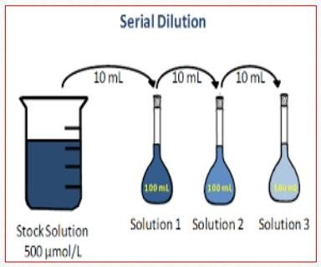
Stock solution:
Solution of known and high conc. from which we prepare standard solution
Solution of known conc. Prepared from stock solution using dilution equation:
C1*V1=C2*V2

Slide 4
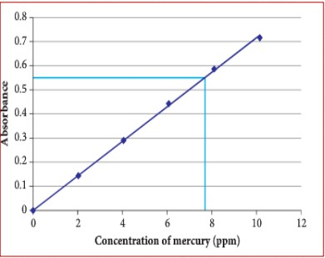
Calibration curve:
It is the curve prepared from
a series of standard solutions
It used as a reference curve to Obtain the concentration of unknown sample of the same drug
X axis is the conc. of sample
Y axis is the absorbance

Slide 5
What is a Calibration Curve?
Graph of concentration (X-axis) vs. Light Absorbance (Y-axis).
Reference curve to calculate unknown concentrations.
Applied in UV-Vis, HPLC, fluorimetry.

Slide 6
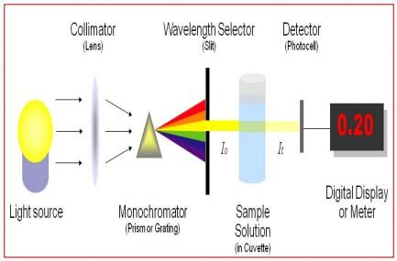
SPECTROPHOTOMETRY
It is a method to measure how much a chemical substance absorbs
light
The basic principle is that each compound absorbs or transmits
light over a certain range of wavelength.
In our work usually the analysis concerned with the absorbed
amount of light

Slide 7
SPECTROPHOTOMETRY
Depending on the range of wavelength of light source, it can be classified into two different types: 1.UV-visible spectrophotometer:
uses light over the ultraviolet range (200- 400 nm) and
Visible range (400 - 700 nm) of electromagnetic radiation spectrum.
2.IR spectrophotometer:
uses light over the infrared range (700 - 15000 nm) of electromagnetic radiation spectrum

Slide 8
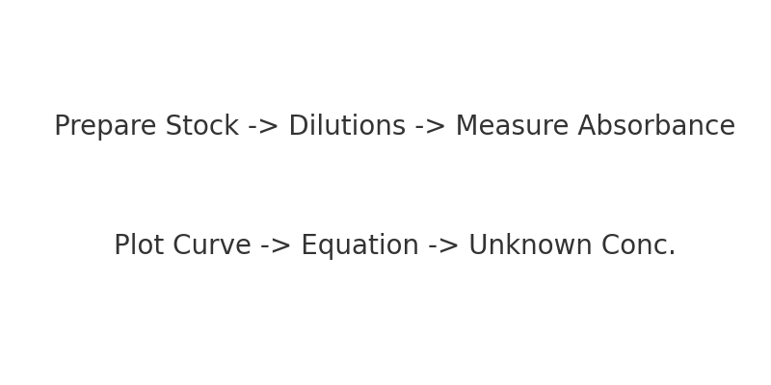
Steps to Construct Calibration Curve
1. Prepare stock solution (high concentration).
2. Prepare serial dilutions (10–50 mg/10 mL).
3. Measure Light Absorbance at λmax.
4. Plot concentration vs. absorbance.
5. Add trend line and equation (y = mx + c).

Slide 9
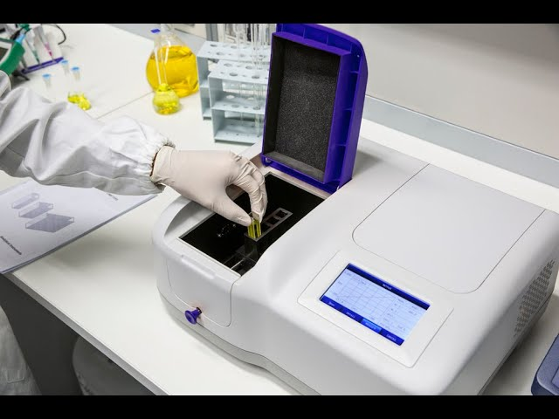
Spectrophotometer
Measures how much light is absorbed by solution.
Types: UV-Visible (200–700 nm), IR (700–15000 nm).

Slide 10
Features of a Good Calibration Curve
Linearity within the working range.
Correlation coefficient (R²) close to 1.
Sufficient number of data points.
Reproducibility and accuracy.

Slide 11
Common Mistakes to Avoid
Inaccurate preparation of standards – always use calibrated equipment.
Measuring outside the linear range – dilute samples if necessary.
Changing conditions between measurements.
Forgetting to use a blank (baseline correction).

Slide 12
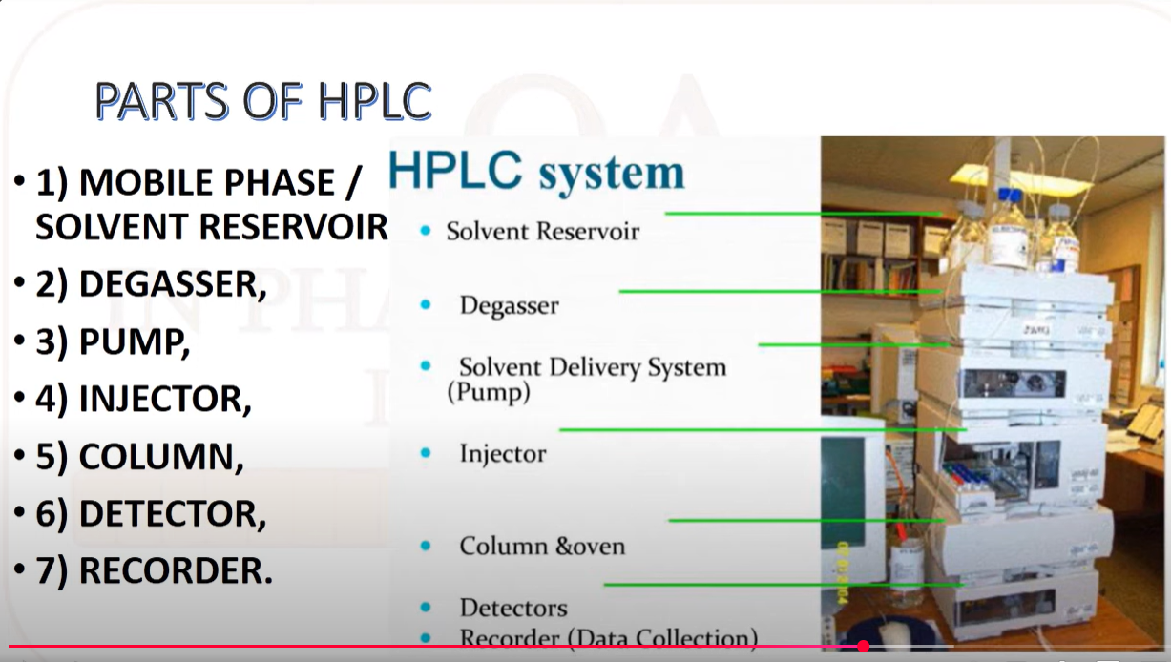
High Performance Liquid Chromatography (HPLC)
Separates and quantifies compounds.
Components: Pump, Injector, Column, Detector, Software.
Types: RP-HPLC, NP-HPLC, Ion-exchange, Size-exclusion.

Slide 13
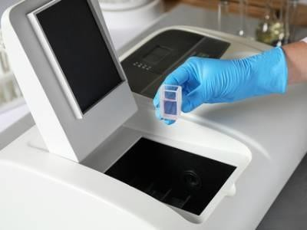
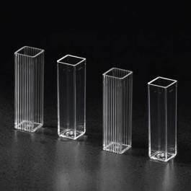

Slide 14
Saturated Solubility
Maximum drug dissolves at given temp.
Affected by: pH, solvent, temperature, excipients.
Important for formulation and stability.

Slide 15
Key Factors Affecting Solubility
Nature of the drug – polarity, crystalline structure, ionization.
Temperature – most drugs dissolve more at higher temperatures (except some like calcium salts).
pH – weak acids/bases have pH-dependent solubility.Example: Midazolam stays soluble at pH < 4.2; at higher pH it precipitates
.

Slide 16
Key Factors Affecting Solubility
Solvent type – aqueous vs. non-aqueous (e.g., ethanol, glycerol).
Presence of excipients – co-solvents, surfactants, or complexing agents can increase solubility

Slide 17
Advantages of Knowing Saturated Solubility
Helps select the correct vehicle (water, syrup, buffer, co-solvent).
Guides dose strength limits for oral liquids.
Supports stability testing and shelf-life assignment.
Prevents precipitation during storage or after administration.

Slide 18


