Slide 1
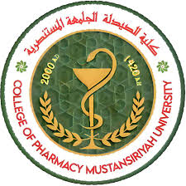

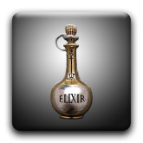
Elixir
Lect. Dr. ibtihal
Lect. Zahraa Amer
assist.lec.Mustafa
assist. Lec. lamyaa

Slide 2
Elixir is clear, sweetened hydro-alcoholic solution. Alcoholic content vary from 10% to 12% and up to 40% Intended for oral use usually flavoured to enhance palatability. Usually less sweet than syrups and less viscous.
They are classified into two classes,
Medicated /Non-Medicated
Medicated elixir is used for therapeutic effects. Examples of medicated elixirs are
1. Antihistamine Elixir: Diphenhydramine HCl
2. Analgesic Elixir: acetaminophen
3. Antispasmodic Elixir: hyoscyamine sulfate
4. Sedative Elixir: phenobarbital

Slide 3
Non medicated elixirs
Do not contain any therapeutic agent can be used for dilution of an existing medicated elixir. These only contain Water, alcohol, sweetening agent and coloring agent
Most common non medicated elixir is following:
1- Aromatic elixir perfumes
2- Compound benzaldehyde elixir
3- Isoalcoholic elixir

Slide 4
Advantages of Elixirs
1-Better able to maintain both water-soluble and alcohol-soluble components in solution.
2-Has a stable characteristic.
3-Easily prepared by simple solution.
Disadvantages
1-Less effective than syrups in masking taste of medicated substances.
2-Contains alcohol, accentuates saline taste of bromides

Slide 5
Elixirs
Components of an elixir
Purified water and alcohol are the main component of the elixir. This is employed as a co-solvent to ensure solubility of all ingredients.
the concentration of alcohol varies depending on the formulation. Generally, the concentration of alcohol is 8-10% v/v (Low alcoholic Elixir); however, in some preparations, the concentration of alcohol may be greater than 40% v/v.(High alcoholic Elixir)

Slide 6
Polyol co-solvents, e.g. propylene glycol, glycerol, may be employed to enhance the solubility of the therapeutic agent and associated excipients.
Sweetening agents as Sucrose , saccharine, and sorbitol . Less concentration is required as compared to syrups
Flavors and colors.
All pharmaceutical elixirs contain flavors and colors to increase the palatability and enhance the aesthetic qualities of the formulation.
Preservatives Elixirs containing more than 10 to 12% of alcohol are usually self-preserving and do not require the addition of an antimicrobial agent. Otherwise Parabens and Benzoates added.

Slide 7
Method of preparation:
Dissolve the water-soluble ingredients in part of the water,
Dissolve the sucrose in it.
Dissolve the other ingredients in the alcohol (5-40%)
The aqueous solution is then added to the alcoholic solution with constant stirring and make up the volume with the solvent or vehicle specified in the formulation.
Sucrose increases viscosity but decreases the solubility properties of water so in addition of viscosity-enhancing agents, e.g. hydrophilic polymers, may be required to optimize the rheological properties of elixirs.
Elixirs should be brilliantly clear and therefore strained or filtered, if necessary, subjected to clarifying action of purified talc.
Elixirs should be stored in tight ,light resistant containers and protected from excessive heat because of their usual content of volatile oil and alcohol.

Slide 8
Notes for Preparation of elixir
Elixirs are usually prepared by simple solution method with agitation and / or by the admixture of two or more liquid ingredients.
Alcohol soluble and water soluble components are generally dissolved separately in alcohol and purified water, respectively. Then the aqueous solution is added to alcoholic solution rather than the reverse, in order to maintain the highest possible alcoholic strength at all times so that minimal separation of alcohol- soluble components occurs.
When the two solutions are completely mixed the mixture is made to volume with specified solvent or vehicle.

Slide 9
Notes for Preparation of elixir
In preparation of elixirs frequently the final mixture will not be clear (cloud) due to separation of some flavouring oils by reduced alcoholic concentrations. If this occurs the elixir is usually permitted to stand for a prescribed number of hours , to ensure the saturation of hydro-alcoholic solvents and to permit the oil globules to coalesce so that they are more easily removed by filtration.

Slide 10
Phenobarbital elixir U.S.P
Rx
Phenobarbital 4 g
Tr. of orange peel 30 ml
Solution of amaranth 10 ml
Alcohol 125 ml
Glycerin 450 ml
Syrup 250 ml
D.W Q.S 1000 ml
Method:
Dissolve the phenobarbital in alcohol
Add the tincture of orange peel ,glycerin, syrup, amaranth solution and add sufficient water to produce 1000 ml ,mix well and filter.
Notes :
The phenobarbital elixir used as sedetive and hypnotic.
Glycerin used as thicknening agent ,also increase the solubility of phenobarb .
Tr.of orange peel used as flavouring agent.
Solution of ammaranth used as colouring agent.
Syrup used as sweetening agent.

Slide 11
Pediatric paracetamol elixir B.P
Rx
Paracetamol 120 mg
Alcohol 0.5 ml
Chloroform spirit 0.1 ml
Propylene glycol 0.5 ml
Conc. rose berry juice 0.125 ml
Amaranth solution 0.01 ml
Invert syrup 1.375
Glycerol Q.S 5ml
Method:
Dissolve paracetamol in alcohol.
Add chloroform spirit ,propylene glycol, juice, amaranth solution, invert syrup.
Complete the volume by addition of glycerol.

Slide 12
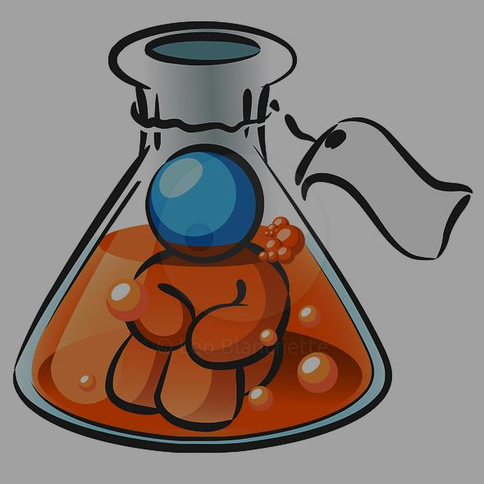
Thank you

