Slide 1


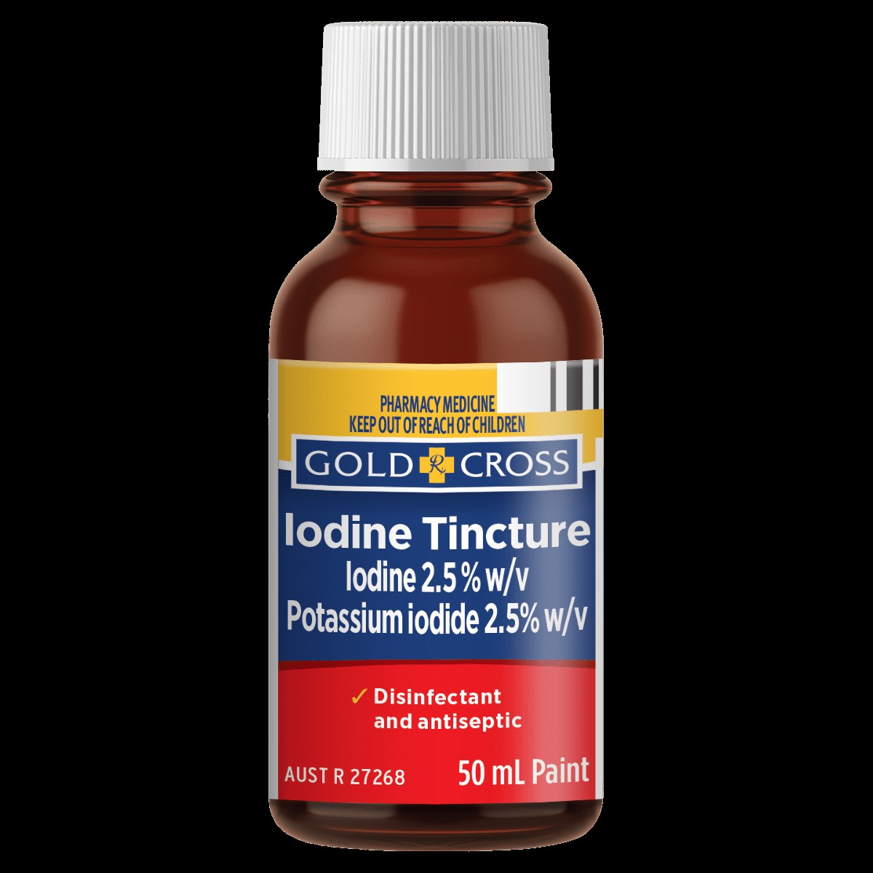
Tinctures: Materials, Preparation Methods, and Quality Evaluation
Lect. Dr. ibtihal
Lect. Zahraa Amer
assist.lec.Mustafa
assist. Lec. lamyaa

Slide 2
Tinctures
Tinctures are alcoholic or hydroalcoholic extracts prepared from plant or chemical materials. They are used widely for oral, topical, or sublingual administration and are a key dosage form in traditional and modern pharmacy.

Slide 3
Advantages and Disadvantages
Advantages:
• Easy to prepare and dose.
• Long shelf-life due to alcohol.
• High extraction efficiency.
Disadvantages:
• Alcohol not suitable for all patients.
• Flammable and volatile.
• Taste may be unpleasant.

Slide 4
Types of Tinctures
1. Simple Tinctures – prepared from single crude drugs.
2. Compound Tinctures – contain multiple active ingredients.
3. Chemical Tinctures – prepared from pure chemical substances.
4. Fresh or Dried Herb Tinctures – depending on the starting material.

Slide 5
Materials Required
• Active ingredient (plant or chemical substance)
• Ethanol or hydroalcoholic solvent (60–90%)
• Purified water
• Amber glass bottles for storage
• Filters, percolators, and measuring apparatus

Slide 6
Solvents Used
Ethanol is the most common solvent due to its ability to extract both polar and non-polar compounds. The strength of alcohol varies depending on solubility and stability of the active compound.

Slide 7
Methods of Preparation
There are three main methods:
• Maceration
• Percolation
• Simple Solution

Slide 8
Maceration Process
1. The drug is coarsely powdered.
2. Soaked in alcohol or hydroalcoholic solvent in a closed vessel.
3. Shaken occasionally for 7–14 days.
4. Filtered and adjusted to final volume with solvent.

Slide 9
Percolation Process
1. Moisten the powdered drug with solvent.
2. Allow to stand for uniform penetration.
3. Pack in a percolator and add solvent slowly.
4. Collect percolate until the desired volume is obtained.

Slide 10
Simple Solution Method
Used for readily soluble substances.
The chemical is directly dissolved in alcohol or hydroalcoholic solvent with stirring and filtered if necessary.

Slide 11
Quality Evaluation Parameters
• Appearance and clarity
• Odour and colour
• Alcohol content determination
• Identity and assay of active constituents
• Microbial limit testing (if applicable)

Slide 12
Stability and Shelf-life
• Store in amber glass containers, tightly closed.
• Protect from light and excessive heat.
• Alcoholic tinctures: 1–2 years stability.
• Record date of manufacture and expiry on label.

Slide 13
Classical Pharmacy Examples
1. Tincture of Iodine – Topical antiseptic and disinfectant.
2. Tincture of Opium (Laudanum) – Analgesic and antidiarrheal (controlled use).
3. Belladonna Tincture – Antispasmodic, used historically for GI disorders.
4. Digitalis Tincture – Historical cardiotonic.
5. Capsicum Tincture – Counter-irritant used in liniments.

Slide 14
Thank you

