Slide 1
Blood Urea

Slide 2
What is urea?
Urea is the main end product of protein metabolism.
It is formed by removal of amino group from amino acids in liver and excreted in urine.
Urea represents 50% of non protein nitrogen of normal blood.

Slide 3
Normal blood contains 15-40 mg/dl of urea
In adults over 60 years it rises to 50 mg/dl
During pregnancy it is 15-20 mg/dl
Raised values are seen in dehydration
In renal failure it rises up to 500 mg/dl
In sever liver disease blood urea is decreased

Slide 4
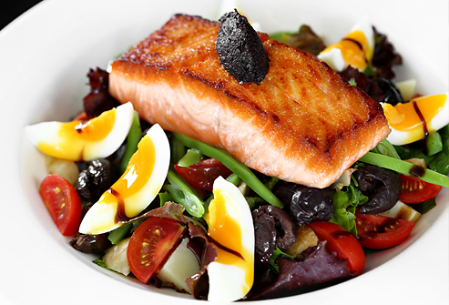
Reference values:
Newborns (< 10 days) : 6.4-53.5 mg/dl
Adults (12-60 years) : 15-40 mg/dl
Physiological:
Increase:
It occurs in normal people on high protein diet.

Slide 5


Decreases
In infants
Pregnancy
Low protein and high carbohydrates diet

Slide 6


Pathological:
Increase:
Excessive formation: increased protein catabolism in fever and sepsis.

Slide 7
Faulty excretion:
Pre-renal failure: a low renal blood supply leads to reduced GFR ex: CHF
Renal failure: damage to nephrons leads to decreased urine formation and excretion ex: nephritis
Post-renal failure: urinary tract obstructions

Slide 8
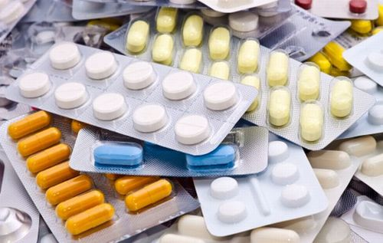
Decrease:
In transfusion of glucose solution due to dilution of body fluids and reduced protein catabolism
What are medicines that increase blood urea?
Amphotericin B
Nafcilline
Gentamicin
Diuretics
Corticosteroids

