Slide 1
Uric acid

Slide 2
Introduction
Uric acid is formed from the breakdown of nucleic acids and is an end product of purine metabolism.
Uric acid is transported by the blood from the liver to the kidney, where it is filtered.
Renal excretion accounts for 75% of uric acid elimination; the remainder of uric acid passes into the GI tract.

Slide 3
Normal range
In human blood plasma
Female: 2.4-6.1 mg/dl (140-360 µmol/L)
Male: 3.4-7.2 mg/dl (200-430 µmol/L)

Slide 4
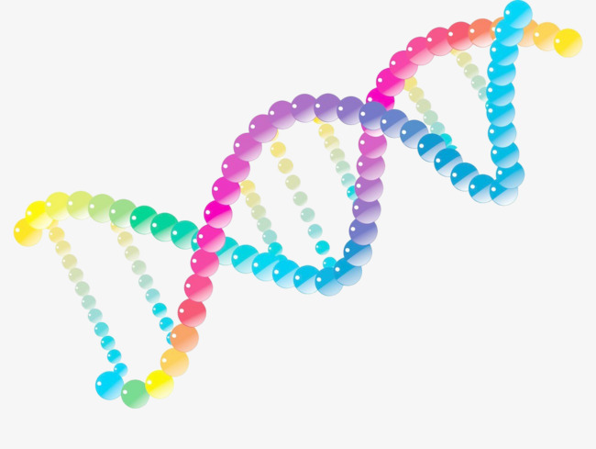


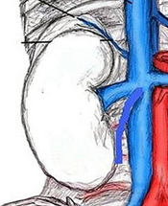
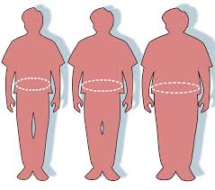
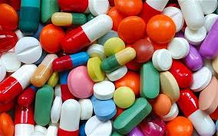
Hyperurecemia
Causes of hyperurecemia
Urate Pool
Hereditary reasons
High intake of dietary purine
Reduced excretion by kidney
Fasting or rapid weight loss can temporary elevate uric acid level
Drugs e.g. thiazide diuretics

Slide 5
Hypourecemia
is less common than hyperuricemia and is usually secondary to severe liver disease or defective tubular reabsorption, as in Fanconi syndrome.

Slide 6
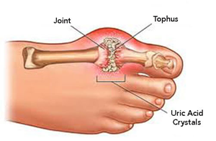
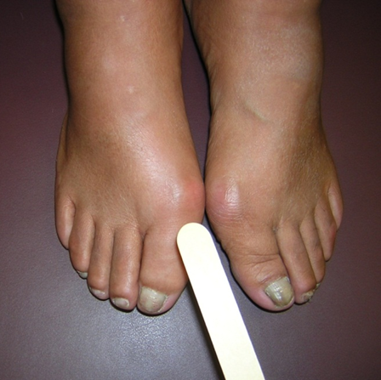
Clinical significance
Disease states with increased
plasma uric acid
Gout (increased serum levels of
uric acid lead to formation of
monosodium urate crystals
around the joints)
Increased catabolism of nucleic acids
Renal disease

Slide 7
Why it is done
Uric acid test is useful to
Assess for gout
Monitor patients with renal failure and see if kidney stone may be caused by high uric acid level
Monitor if uric acid levels are too high after chemotherapy or radiation
See if medicine that decreases uric acid level is working

Slide 8
The end

