Slide 1
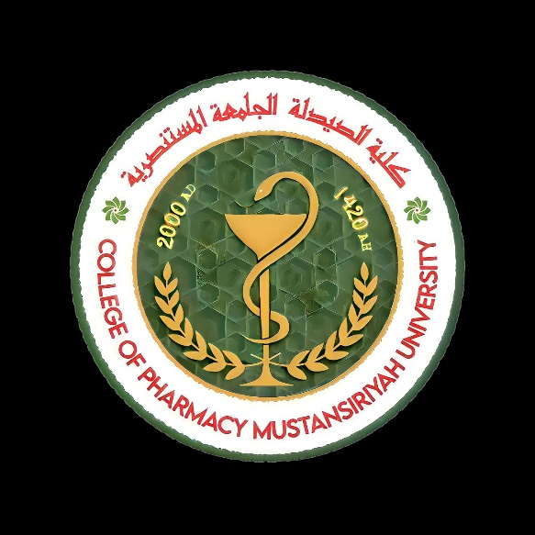

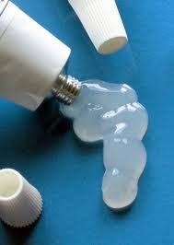
Ointments
Lecturer : Nora Zawar Yousif
Lecturer : Zeina Dawood
Assistant Lecturer : Mustafa Mohammed Noori

Slide 2
Ointments
Ointment can be defined as a semisolid preparation intended for external application to the skin or mucous membranes medically, ointments may be divided into:
Non _medicated ointment: This may be used as a protector, emollient, lubricant or may be used as a vehicle for topical application of therapeutic agent
Medicated ointment: Used for topical therapeutic effects.

Slide 3
Classification of ointment bases:
Absorption bases.
Water removable bases.
Hydrocarbon bases (oleaginous bases).
Water soluble bases.

Slide 4
Hydrocarbon bases (oleaginous bases).
Hydrocarbon bases are also termed oleaginous bases, on application to the skin they have an emollient effect, protect against the escape of moisture , effective as occlusive dressing and can remain on the skin for prolonged periods of time without drying out and because of their immiscibility with water are difficult to wash off. Water and aqueous preparations may be incorporated in to them but only in small amounts and with some difficulty.
Petrolatum , white petrolatum , white ointment and yellow ointment are examples of hydrocarbon ointment bases

Slide 5
Absorption bases
Absorption bases are of two types:
1.Those that permit the in corporation of aqueous solutions resulting in the formation of w/o emulsions e.g. Hydrophilic petrolatum.
2.Those that are w/o emulsions(emulsion bases)permit the incorporation of additional quantities of aqueous solutions.e.g.Lanolin
These bases may be used as emollients although they don’t provide the degree of occlusion afforded by the hydrocarbon bases. Absorption bases are note easily removed from the skin, since the external phase of the emulsion is oleaginous.

Slide 6
Water-removable.Bases
Water-removable bases are o/w emulsions resembling creams in appearance and because the external phase of the emulsion is aqueous , they are easily washed from the skin and are often called ‘water-washable bases’. They may be diluted with water or aqueous solutions.
Hydrophilic ointment USP , is an example of this type of base.

Slide 7
Water-soluble.Bases
Water soluble bases don’t contain oleaginous components, they are completely water-washable and often referred to as ‘greaseless ’. Since they soften greatly with the addition of water, large amounts of aqueous solutions are not effectively incorporated into these bases Polyethylene glycol ointment, is an example of water-soluble base.

Slide 8
Factors that affect selection of appropriate bases
Desired release rate of the drug substance from the ointment base
Desirability for topical or percutaneous drug absorption
Desirability of occlusion of moisture from the skin.
Stability of the drug in the ointment base.
Effect of the drug on the consistency or other features of the ointment base.
The desire for a base that is easily removed by washing the water.

Slide 9
Method of preparation of ointment:
Incorporation.
Fusion

Slide 10

Note:
Methods used for preparation of ointment depend on the nature of ingredients.

Slide 11
Incorporation:
By this method, the components are mixed until a uniform preparation is attained; this is done by using mortar and pestle or slab and spatula. We can sub divided this method into:
A) Incorporation of solids
B) Incorporation of liquids:

Slide 12
A) Incorporation of solids:
The ointment base is placed on one side of the working surface and the powdered components (previously reduced to fine powders and thoroughly blended in a mortar) on the other side
a small portion of the powder is mixed with a portion of the base until uniform ;the process is continued until all portions of the powder and the base are combined and thoroughly and uniformly blended.

Slide 13
Notes
When an ointment is prepared by spatulation ,the pharmacist works the ointment using a stainless steel spatula having a long ,broad blade and periodically removes the accumulation of ointment on the large spatula with a smaller one.
If the components of the ointment are reactive with the metal of the spatula (as in phenol for example) , hard rubber spatula may be used.
Solids that are soluble in a common solvent that will NOT affect the stability of the drug or the efficacy of the product may first be dissolved in the solvent and the solution added to the ointment base by spatulation or by using a mortar and pestle.
It is desired to reduce the particle size of a powder or crystalline material before incorporation into the ointment base so that the final product will not be gritty. This may be done by levigation (mixing the solid material in a vehicle which it is insoluble to make smooth dispersion).

Slide 14
NOTE
The levigating agent used for example: mineral oil for oleaginous bases where oils are the external phase or glycerin for bases where water is the external phase.
The levigation is done using mortar and pestle.

Slide 15
B) Incorporation of liquids:
When it is necessary to add an aqueous preparation to hydrophobic base.
The solution first may be incorporated into a minimum amount of a hydrophilic base and then that mixture added to the hydrophobic base.

Slide 16
Notes:
Liquid substances or solutions are added to an ointment due consideration of an ointment bases capacity to accept the volume required .e.g.: only very small amounts of an aqueous solution may be incorporated into an oleaginous ointment whereas hydrophilic ointment bases readily accept aqueous solutions.
Mortar and pestle are used when we want to incorporate large quantity of liquid or if large quantity of ointment is wanted to be prepared.

Slide 17
Fusion
By fusion method, all or some of the component of an ointment are combined by being melted together and cooled with constant stirring until congealed. Component not melted are added to the congealing mixture as it is being cooled and stirred.

Slide 18
Melting of the substances is done by one of the following three methods
the material with the highest melting point are heated to the lowest required temperature to produce a melt, the additional materials then are added with constant stirring during cooling of the melt until the mixture is congealed.
Melting the component having the lowest melting point first then adding the remaining components in order of their melting points.
Melting the entire component together under slowly increasing temperature.

Slide 19
Notes
Heat –labile substances and any volatile components are added last when the temperature of the mixture is low enough not cause decomposition or volatilization of the components.
Solutions and insoluble powders (levigated with portion of the base) may be added to the congealing mixture.
The fusion process may be conducted in a porcelain dish or glass beaker.
The fusion method is used when we have waxes ,paraffin ,fatty alcohol ,fatty acids, or any hard waxes in the prescription and also used when we have medicament soluble in melts base.
The fusion process may be conducted in a porcelain dish or glass beaker.

Slide 20
Rx
Simple ointment (B.P)
Wool fat 50g
Hard paraffin 50g
Ceto acetyl alcohol 50g
Yellow soft paraffin 850g
Method of preparation:
We weight the ingredients ,then we take the one with the highest melting point, put it in the beaker and in water bath till it melt (hard paraffin) then we add another ingredient with the lower m.p.(ceto acetyl alcohol) then wool fat, soft paraffin .After they melt we leave the beaker to cool ,then the content will be semisolid.

Slide 21
Rx
Zinc oxide ointment (B.P)
Zinc oxide 150gm
Simple ointment 850gm
Method of preparation :
We put the ointment base on the slab and gradually add to it a powder of zinc oxide ,then mix the quantity of the ointment base with powder mix until it will be homogenized.
*zinc oxide as astringent and protective action used in napkin rash.

Slide 22
Rx
Zinc and caster oil ointment (body cream) (B.P)
Zinc oxide 7.5gm
Caster oil 50gm
Cetostearyl alcohol 2gm
White bees wax 10gm
Arachis oil 30.5gm
This Rx is ointment rather than cream but due to the present of caster oil it gives them smooth appearance.

