Slide 1
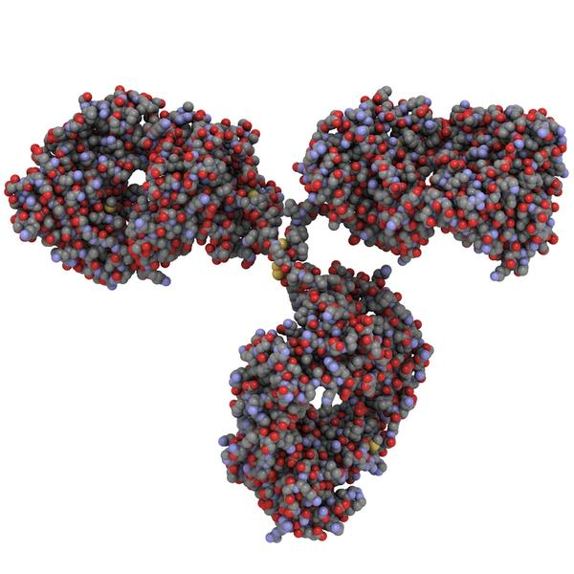
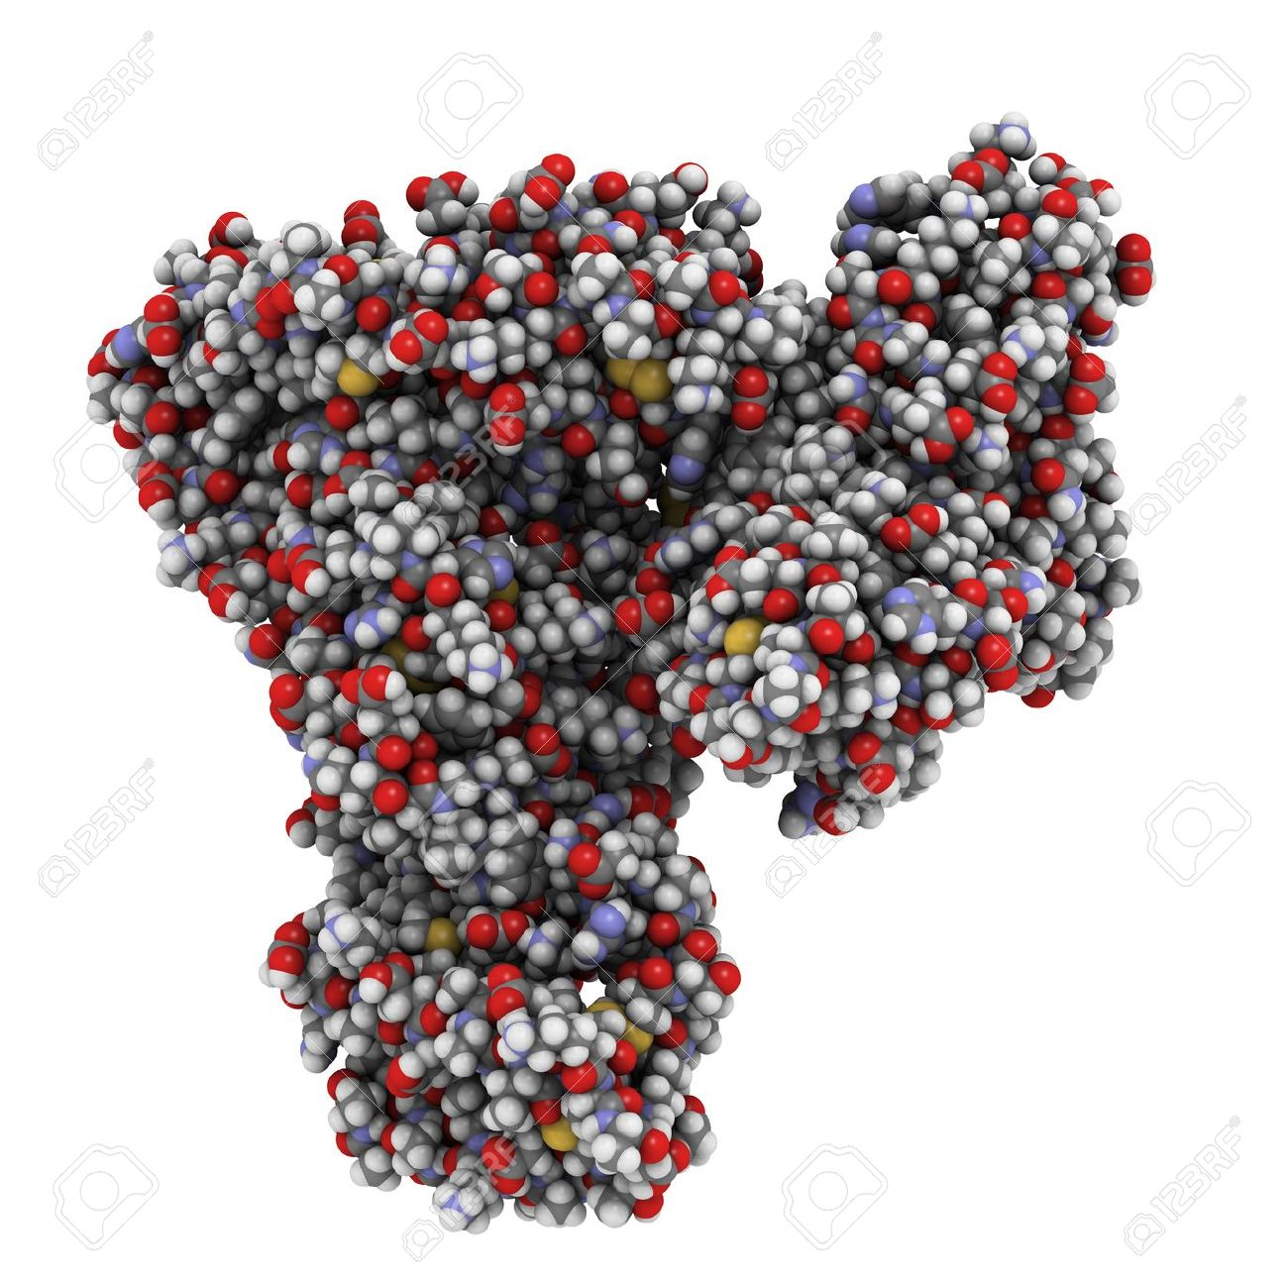
Total plasma protein

Slide 2
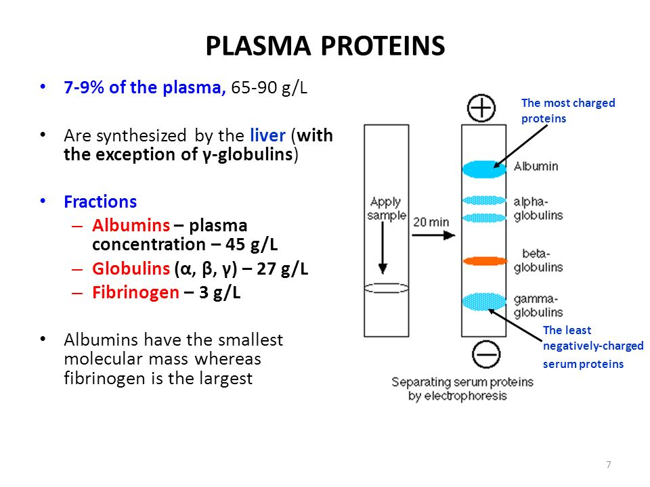

Slide 3
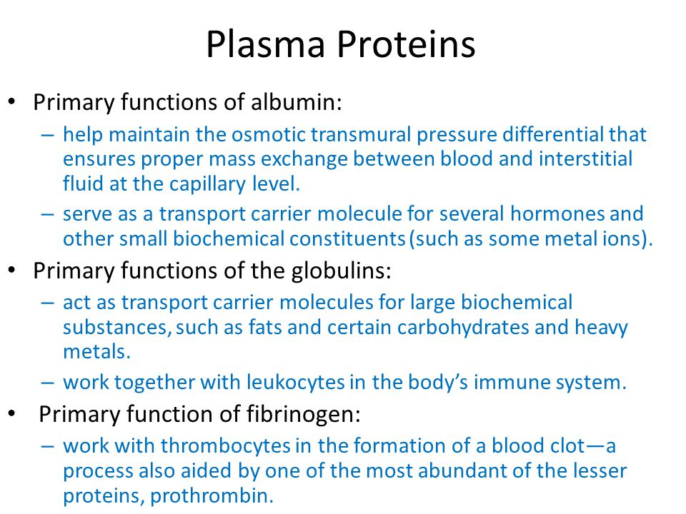

Slide 4
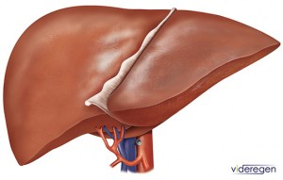
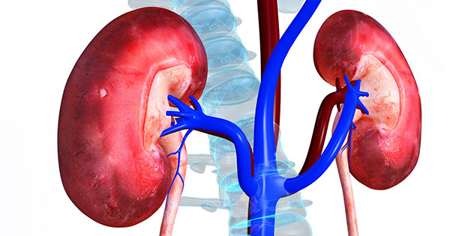
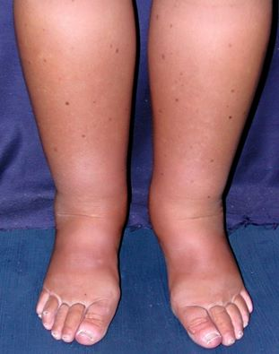

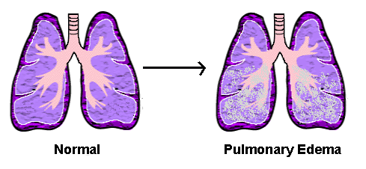
Causes of albumin test:

Slide 5
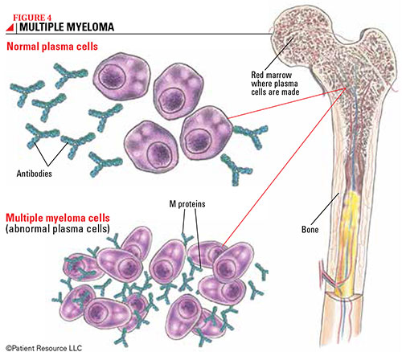
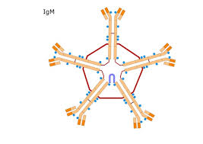

Causes of globulin test:
Blood diseases : multiple myeloma, macroglobulinemia
Determine chances of developing an infection

Slide 6
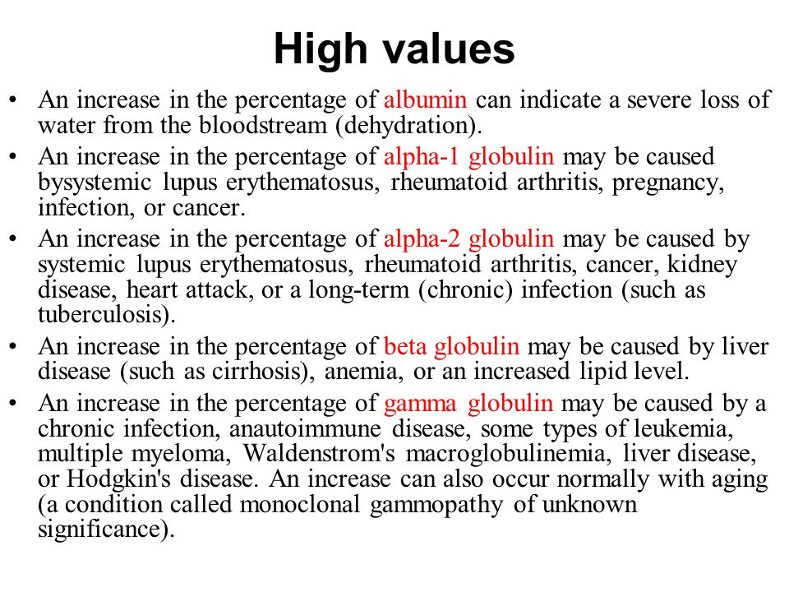

Slide 7
What are causes of hypoalbuminemia?
Malnutrition
Impaired protein digestion
Sever burns
Kidney disease
Liver disease
Autoimmune disease ex: SLE
GI malabsorption syndroms ex: sprue
Uncontrolled DM
Hyperthyroidism
HF

Slide 8



When should the test done?

Slide 9


