Slide 1
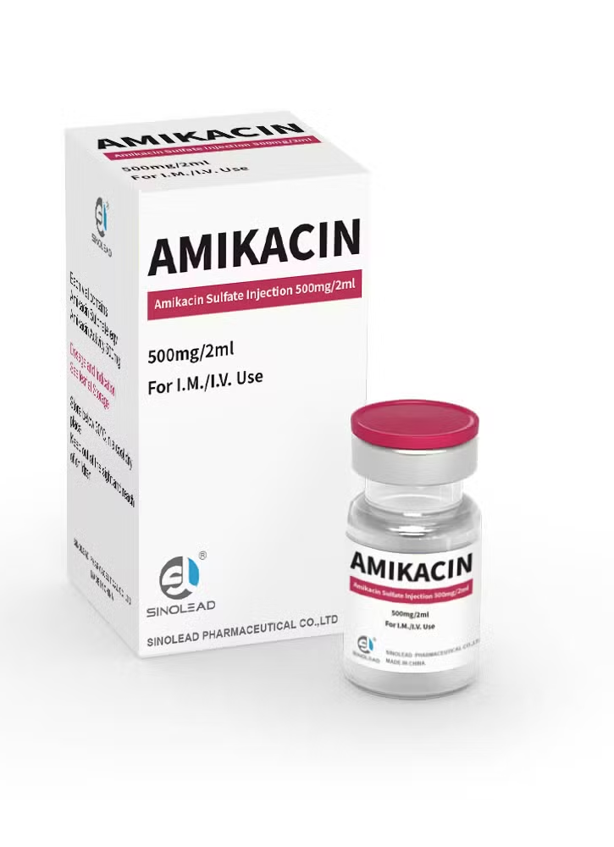
Physicochemical Evaluation of Amikacin Sulfate (An Aminoglycoside Antibiotic) with Structural–Activity Considerations
BY
M.SC. : MOHAMMED AL-DAHLAKI

Slide 2

Chemical Perspective of Amikacin
Amikacin is a semisynthetic aminoglycoside antibiotic characterized by a highly functionalized polyhydroxylated and polyaminated structure.Chemically, it consists of an aminocyclitol core linked to multiple aminosugar moieties, which together confer a strongly basic and polycationic character to the molecule.The presence of several primary and secondary amino groups makes amikacin capable of protonation and salt formation, which explains why it is formulated clinically as a sulfate salt to improve aqueous solubility and stability.In addition, these amino and hydroxyl groups provide electron-donating sites that enable coordination with divalent metal ions, influencing its physicochemical behavior in solution.Amikacin is obtained by chemical modification of kanamycin A, where acylation of the 1-amino group with an L-hydroxyaminobutyryl (L-AHBA) side chain alters both its chemical reactivity and resistance profile.

Slide 3
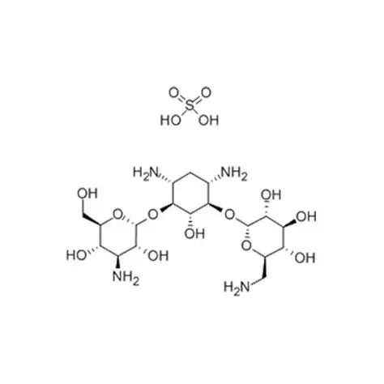
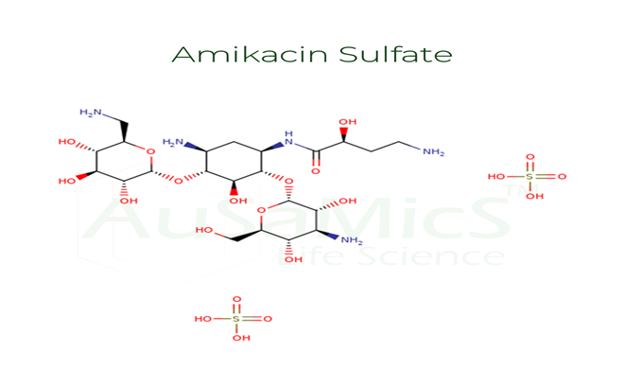
Kanamycin Sulfate

Slide 4
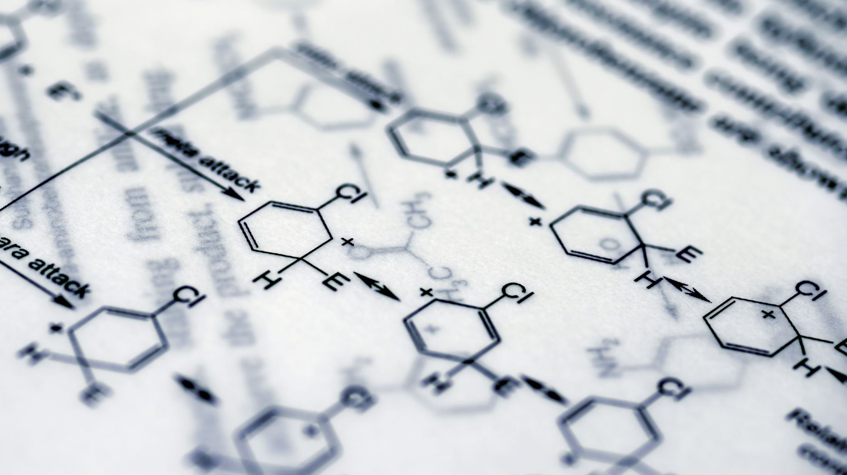
Role of L-AHBA Side Chain in Amikacin
Provides steric hindrance against aminoglycoside-modifying enzymes (AMEs).
Prevents enzymatic inactivation (acetylation, phosphorylation, adenylation).
Reduces nucleophilicity of the N-1 amino group via amide formation.
Protects key functional groups targeted by AMEs.
Preserves binding to the bacterial 30S ribosomal subunit.
Maintains antibacterial activity against resistant bacterial strains.
Plays a critical role in the structure–activity relationship (SAR) of amikacin.

Slide 5
Why is Sulfate used for Amikacin salt formation (and not other salts)
Amikacin is a polybasic molecule containing multiple protonatable amino groups.
Sulfate (SO₄²⁻) is a divalent, strong, and stable counter-ion that efficiently balances the polycationic nature of amikacin.
Formation of amikacin sulfate results in:
Higher aqueous solubility
Greater chemical and physical stability
Stable ionic lattice suitable for injectable formulations
Sulfate is non-volatile, non-reactive, and pharmaceutically safe, making it ideal for IV/IM use.
Other salts (e.g., chloride, acetate, phosphate) are theoretically possible but are less preferred due to lower stability, reduced solubility, or formulation limitations.

Slide 6

Experimental
Coordination Chemistry
Procedure
1. Preparation of the Sample Solution
Accurately weigh 0.1 g of Amikacin Sulfate.
Dissolve the weighed amount in 4 mL of CO₂-free distilled water, mixing well until a clear solution is obtained.
2. Chelation Test
Add 2 drops of CuSO₄ test solution (12.5% w/v) to the prepared Amikacin solution.
Mix thoroughly.
Observation:
The development of a purple/violet color, indicating the formation of a coordination complex between Cu²⁺ ions and the amino groups of Amikacin.
Note:
If no color change is observed, add one drop of 0.1 N NaOH to slightly basify the solution and enhance the availability of free amine lone pairs.

Slide 7
Experimental 1
Coordination Chemistry
Procedure
3. Equilibrium Displacement
Add 1 mL of CuSO₄ test solution (12.5% w/v) to the mixture.
Shake well and observe the color change.
Observation:
An increase in color intensity or a shift toward a blue color.
Conclusion
The appearance of a violet complex confirms the presence of multiple amine groups in Amikacin capable of chelating Cu²⁺ ions. The subsequent color change upon increasing CuSO₄ concentration demonstrates the concentration-dependent nature of metal–ligand complex stability and equilibrium behavior.

Slide 8
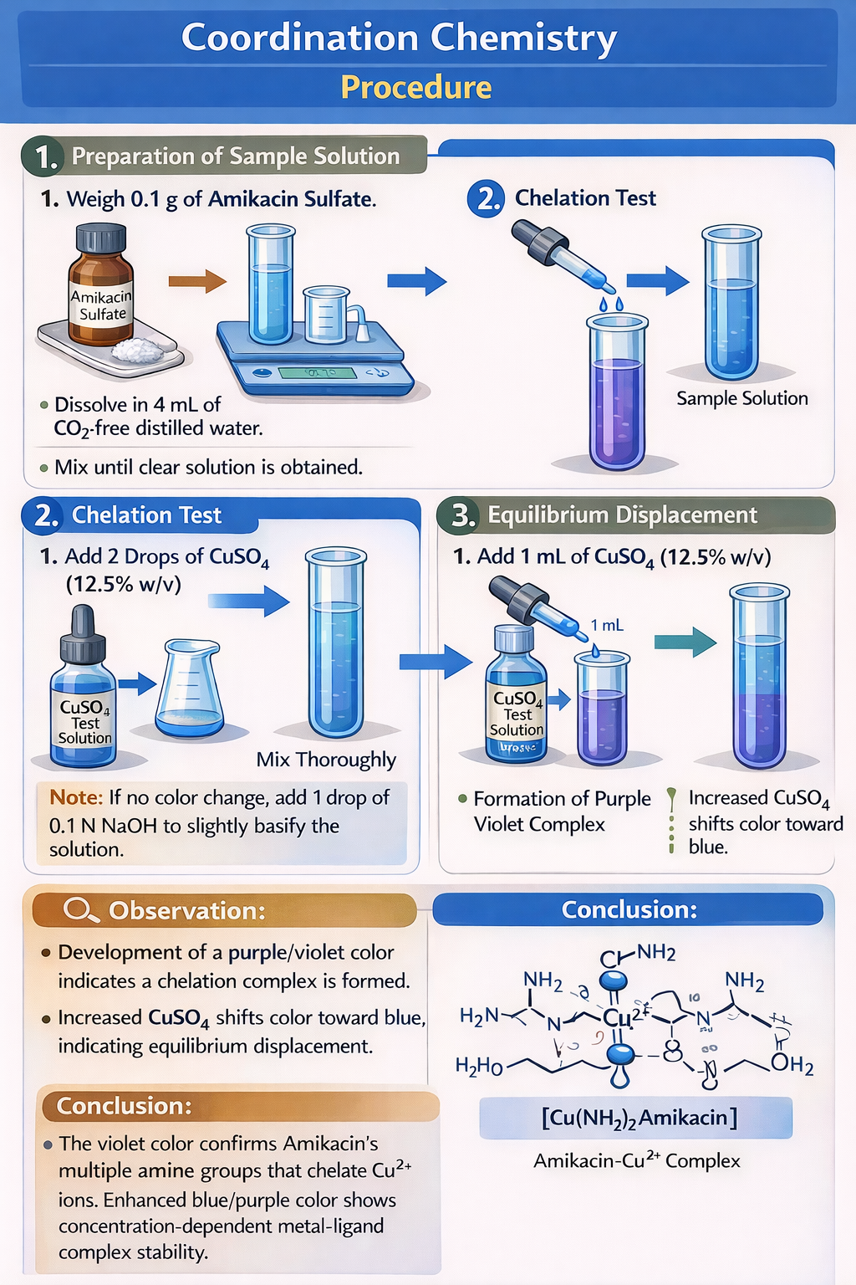

Slide 9
Experimental 2
Counter-Ion and Salt Analysis) Test for Sulfate Ion (BaCl₂ Test(
Identification of Sulfate Ion
Transfer 2 mL of the sample solution into a clean test tube.
Add 3 drops of barium chloride (BaCl₂) solution and mix gently.
Observe the formation of a white precipitate.
Add 5 drops of dilute hydrochloric acid (HCl) to the mixture.
Observation:
A dense white precipitate is formed and persists after the addition of dilute HCl.
Interpretation:
The formation of an insoluble white precipitate that remains unchanged in acidic medium confirms the presence of sulfate ions (SO₄²⁻) due to the formation of barium sulfate (BaSO₄). This result indicates that the drug is present in the sulfate salt form, consistent with amikacin sulfate.

Slide 10
