Slide 1
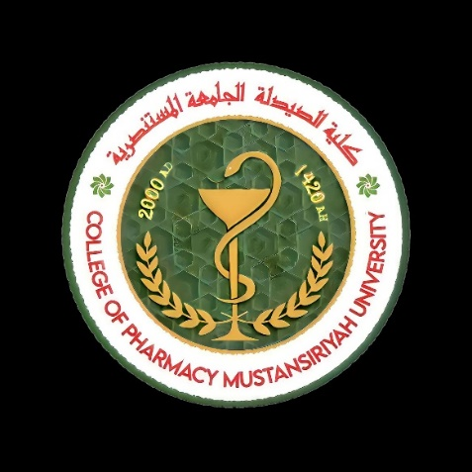

Ophthalmic Ointments
Formulation, Applications, and Clinical Considerations
Lecturer : Nora Zawar Yousif
Lecturer : Zeina Dawood
Assistant Lecturer : Mustafa Mohammed Noori

Slide 2
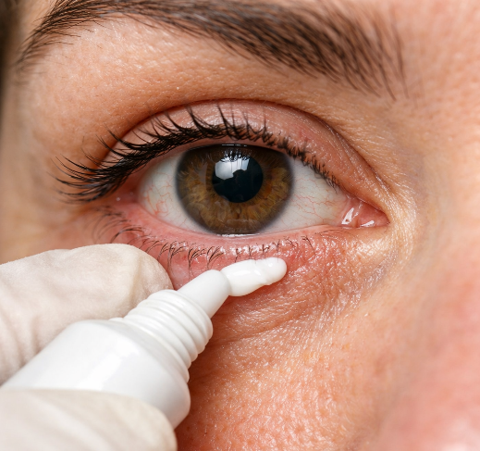
Definition & Purpose
Semisolid topical preparations designed to prolong ocular drug residence time and enhance therapeutic outcomes
Semisolid Formulations: Oleaginous or emollient bases with dispersed or dissolved drug
Primary Purpose: Extend contact time on ocular surface compared to eye drops
Clinical Goal: Improve local drug bioavailability and reduce dosing frequency

Slide 3
Key Ingredients & Composition
Ointment Base
Petrolatum, mineral oil, or hydrocarbon matrices provide the semisolid foundation
Active Pharmaceutical Ingredient
Drug particles dissolved or suspended in the base for therapeutic effect
Auxiliary Agents
Emulsifiers, softening agents, preservatives, and antioxidants ensure stability
Critical Variables
Drug loading, particle size distribution, and base rheology control performance
Bao & Burgess, 2018

Slide 4
Clinical Benefits & Limitations
Advantages Disadvantages
Prolonged Contact: Longer tear-film residence vs. aqueous drops
✗ Blurred Vision: Temporary visual disturbance after application
Reduced Dosing: Less frequent administration needed
✗ Variable Penetration: May limit deep ocular penetration for some drugs
Good Tolerability: Safe for many topical indications
✗ Contamination Risk: Handling concerns during use
Sustained Release: Modified drug delivery profile
✗ Application Restrictions: Not suitable for open ocular wounds

Slide 5
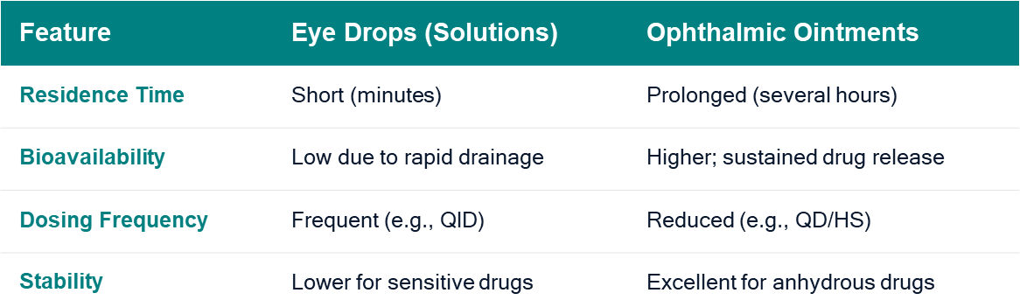
Advantages vs. Eye Drops

Slide 6
Common Clinical Uses
Ocular Lubrication
Dry eye treatment and nighttime protection for prolonged relief
Antimicrobial Therapy
Antibiotic ointments for superficial infections and prophylaxis
Antiviral Treatment
Acyclovir ointment for herpes simplex keratitis management
Anti-inflammatory
Corticosteroid ointments like dexamethasone and fluorometholone
Postoperative Care
Wound lubrication and prolonged drug contact after surgery

Slide 7
The Foundation: Ointment Bases
The Foundation: Ointment Bases
1
Hydrocarbon Bases
White Petrolatum (soft paraffin) + Liquid Petrolatum (mineral oil) to adjust consistency for spreadability at eye temp (~34°C).
2
Lanolin Derivatives
Anhydrous Lanolin is often added (up to 10%) to facilitate the incorporation of aqueous solutions and improve wetting.
3
Plastibase (Polyethylene/Mineral Oil Gel)
A synthetic base that maintains constant consistency over a wide temperature range, providing stable drug release.

Slide 8
Ensuring Stability and Sterility
Preservatives Antioxidants
Benzalkonium Chloride (0.01%)
Most common; effective against Gram+/- bacteria.
Sodium Metabisulfite
Prevents oxidation of drugs like adrenaline.
Chlorobutanol (0.5%)
Used in anhydrous bases; provides fungal coverage.
Disodium Edetate (EDTA)
Chelating agent that synergizes with preservatives.

Slide 9
Manufacturing Sterile Ointments
1. Sterilization
Base: Dry Heat (160°C / 2h) API: Aseptic Filtration or Gamma
2. Mixing
Grade A environment. API micronized (<10 µm) and dispersed in base.
3. Filling
Aseptic filling into sterile collapsible tubes under laminar flow.
→
→

Slide 10
Packaging & Labeling
Primary Container
✔ Collapsible aluminum or plastic tubes (3.5g - 5g).
✔ Narrow applicator tip for precise delivery.
✔ Tamper-evident, sterile caps.
Mandatory Labeling
STERILE
FOR OPHTHALMIC USE ONLY
Keep out of reach of children. Discard 28 days after opening. Exp: 12/2026

Slide 11
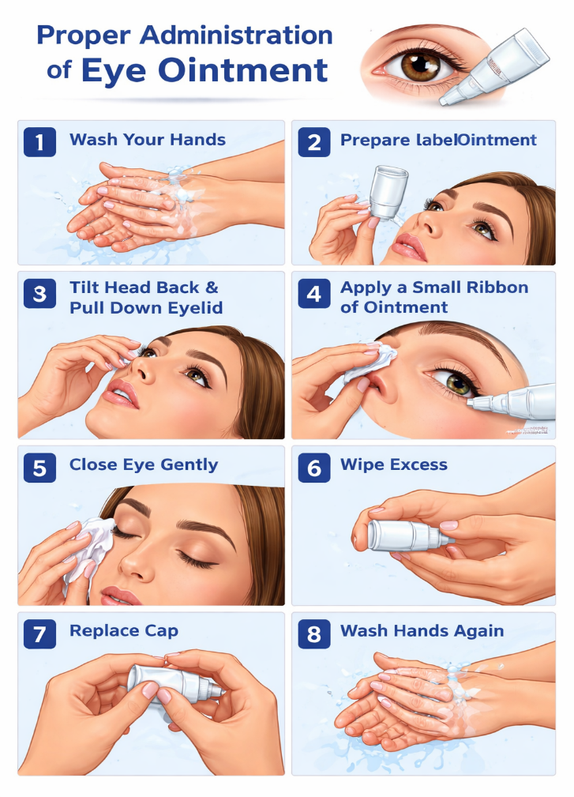
Patient Counseling
1
Wash hands thoroughly. Tilt head back.
2
Pull down lower eyelid to form a small pouch.
3
Squeeze a 1 cm ribbon into the conjunctival sac.
Close eye gently for 1-2 mins. Blink to spread.
4
Counseling Tip: Apply at bedtime to minimize the impact of blurred vision.

Slide 12


Key Takeaways
1
Ophthalmic ointments offer prolonged ocular contact and sustained drug release compared to conventional eye drops
2
Formulation variables including base type, particle size, and rheology critically affect therapeutic performance
3
Clinical trade-offs exist between longer drug action and temporary vision blur after application
4
Wide therapeutic applications span lubrication, antimicrobials, antivirals, and anti-inflammatory treatments
5
Modern innovations focus on nanotechnology integration and predictive PBPK modeling for optimized delivery

Slide 13
References
Bisen, A. C., Dubey, A., Agrawal, S., et al. (2024). Recent updates on ocular disease management with ophthalmic ointments. Therapeutic Delivery. DOI: 10.1080/20415990.2024.2346047
Bao, Q., & Burgess, D. J. (2018). Perspectives on Physicochemical and In Vitro Profiling of Ophthalmic Ointments. Pharmaceutical Research. DOI: 10.1007/S11095-018-2513-3
Kumar, N., Kumar, R., Malhotra, M., et al. Ophthalmic Ointment & Formulation: A Review. International Journal of Medical, Pharmacy and Drug Research. DOI: 10.22161/ijmpd.8.2.6
Nikalje, A. P. (2015). Nanotechnology and its Applications in Medicine. Medicinal Chemistry. DOI: 10.4172/2161-0444.1000247

