Slide 1
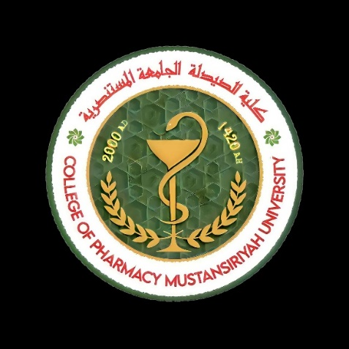

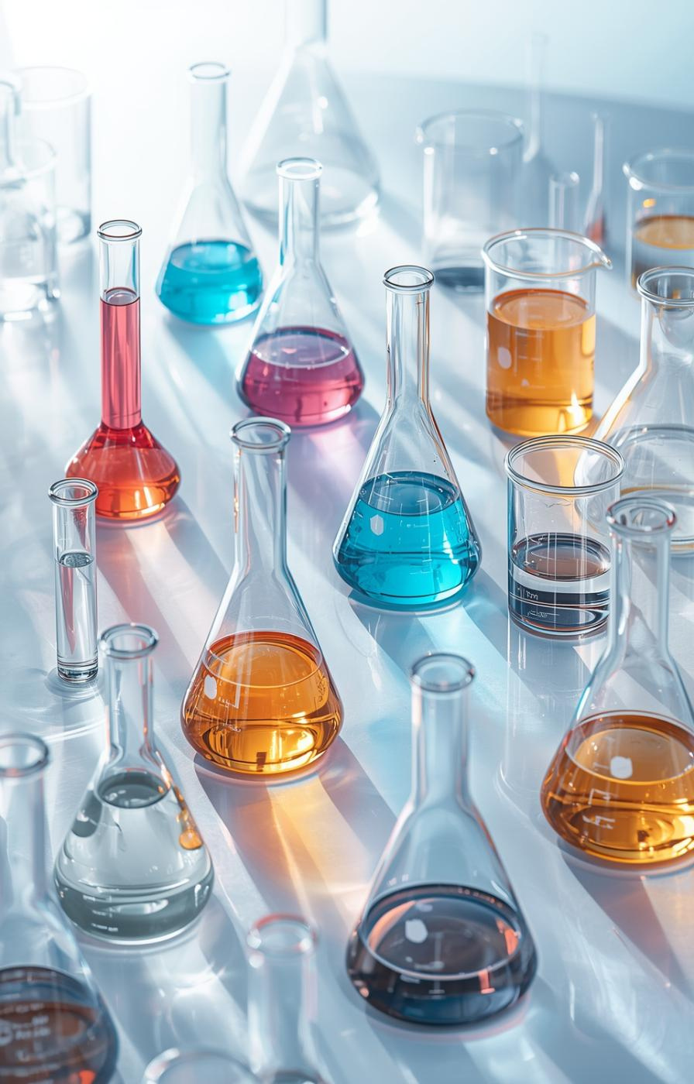

Pharmaceutical Creams
Lecturer : Nora Zawar Yousif
Lecturer : Zeina Dawood
Assistant Lecturer : Mustafa Mohammed Noori

Slide 2

Introduction to Creams
Definition and Basic Properties of Creams
Creams are semisolid dosage forms designed for external application, typically characterized by their opaque, viscous nature, containing more than 20% water and less than 50% hydrocarbons or waxes.
2

Slide 3
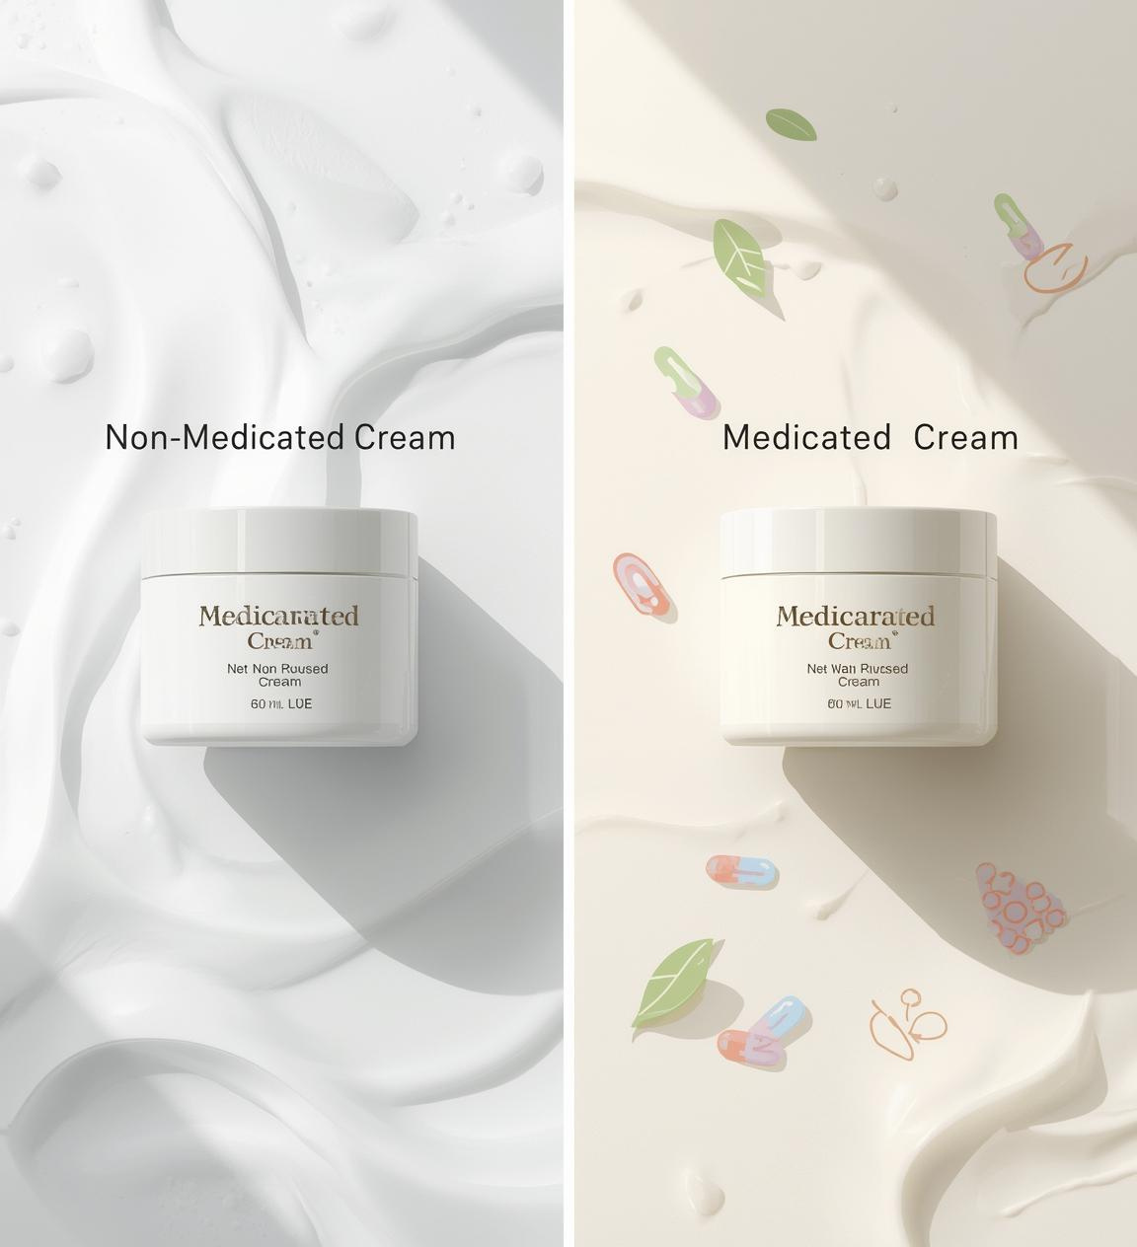
Classification of Creams
Creams are categorized into two main types: non-medicated creams used as emollients and moisturizers, and medicated creams that contain active ingredients for therapeutic applications, primarily for topical treatments.

Slide 4
Emulsion Systems
Understanding Oil-in-Water and Water-in-Oil
Creams are emulsions consisting of oil and water phases. Oil-in-water (o/w) creams contain more water, while water-in-oil (w/o) creams are richer in oil, affecting texture and absorption.
4

Slide 5
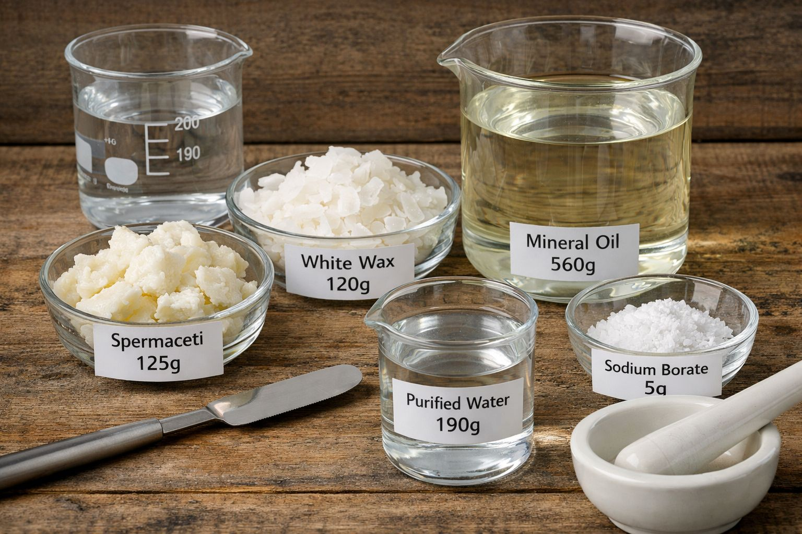
Cold Cream
Reduce spermaceti and white wax to small pieces and melt them on steam bath with mineral oil (liquid paraffin) and raise temperature to 70C°.
Dissolve borax (sodium borate) in water and heat to 73C°.
Gradually add warm solution to the melted mixture and stir rapidly and continuously until congealed.
5

Slide 6
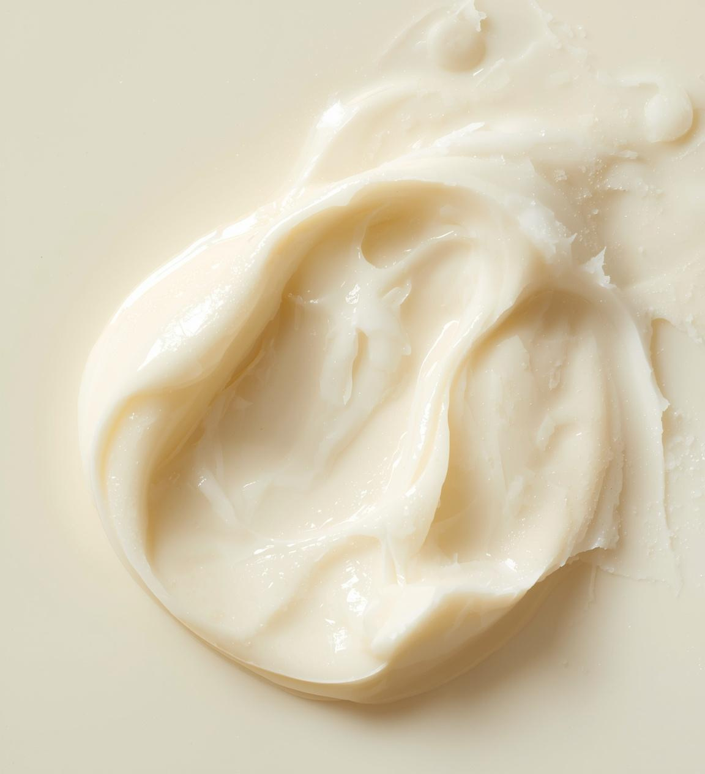
Cold Cream Characteristics and Uses
Cold cream is a water-in-oil emulsion containing less than 45% water, providing a cooling effect upon application. It serves as an effective emollient and moisturizer for dry skin.

Slide 7
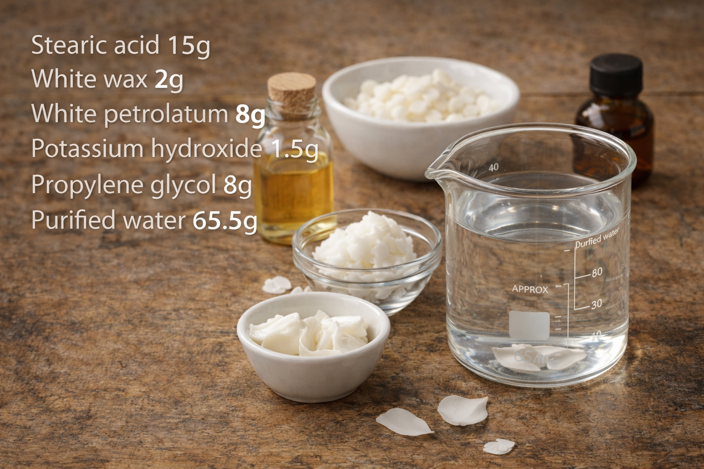
Vanishing Cream
Stearic acid is melted in water bath
and heated up to 85Ċ.
The oil soluble or miscible substances are added to melted stearic acid.
Water containing the alkali or any other water soluble ingredient is also heated to 85Ċ then adds it to the oil with stirring.
The temperature should be maintained 10-15 min.to ensure completion of reaction between stearic acid and alkali.
Cool the cream slowly with stirring.
Add perfume.
7

Slide 8
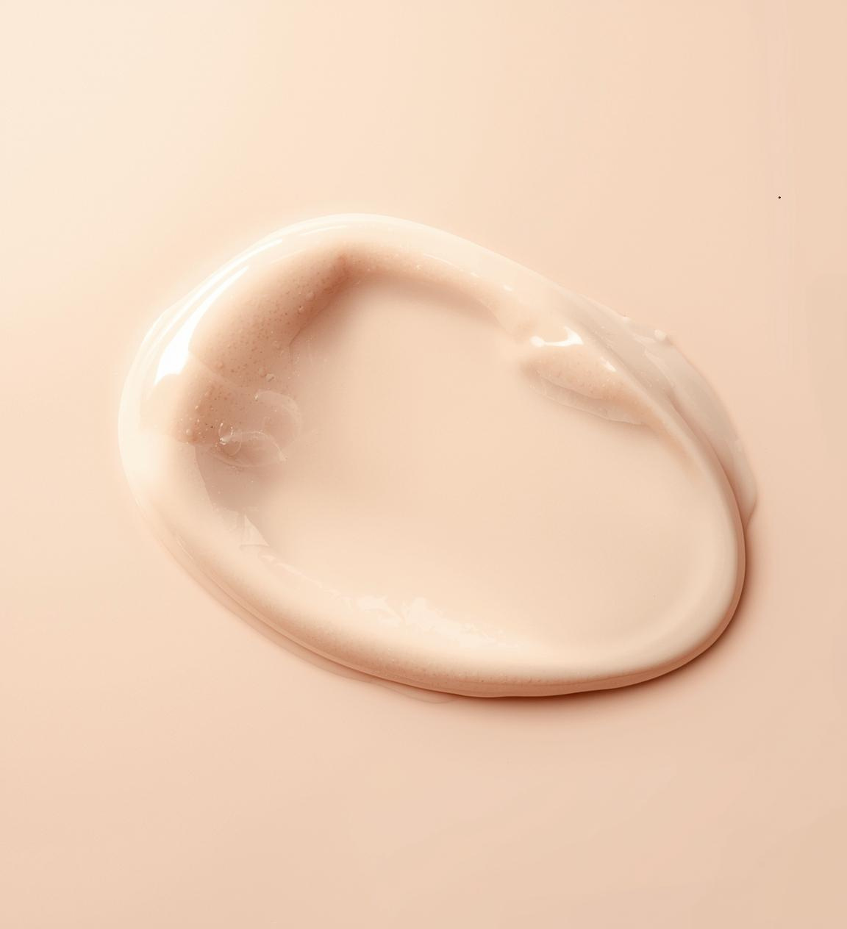
Vanishing Cream Properties and Uses
Vanishing cream is an o/w emulsion, containing over 45% water. It features potassium stearate as an emulsifier, providing a smooth, non-greasy finish, making it ideal as a cosmetic base for skin applications.

Slide 9

Comparison of Creams
Key Differences Between Cold and Vanishing
Cold Cream
Vanishing Cream
Cold cream is a water-in-oil emulsion with less than 45% water, providing rich hydration and a cooling effect due to evaporation; it is ideal for moisturizing dry skin.
Vanishing cream is an oil-in-water emulsion containing more than 45% water, designed to absorb quickly, leaving a smooth, non-greasy finish, perfect for cosmetic applications.
9

Slide 10
Incompatibilities in Creams
Understanding Chemical Stability Issues
Both cold and vanishing creams are soap emulsions, making them sensitive to acidic substances that can degrade the emulsifier, disrupting the formulation's stability and effectiveness.
10

Slide 11

Laboratory Demonstration Overview
  Prepare Cold Cream and Vanishing Cream as per formulas
  Observe emulsion types, textures, and cooling effects
  Handle all materials carefully, ensuring temperature control

Slide 12
Key Takeaways
Important Concepts in Pharmaceutical Creams
Cream Properties
Types of Creams
Emulsion Systems
Creams are semisolid emulsions designed for topical application, characterized by their spreadable texture and high water content, making them suitable for various skin treatments.
Creams are classified as either medicated for therapeutic use or non-medicated for moisturizing; each type serves different purposes in skincare and treatment.
Creams can be oil-in-water (o/w) or water-in-oil (w/o), with the emulsion type impacting their texture, absorption, and overall effectiveness on the skin.
12

Slide 13
Quiz and Discussion
What determines a cream's emulsion type?
Water content
Color of cream
Active ingredients
Test your understanding of pharmaceutical creams with the following questions. Consider the properties, preparation, and classification of creams as you formulate your answers.
Preparation method

Slide 14

Sources for deeper understanding
The following references provide essential insights into pharmaceutical creams and their formulations:
  United States Pharmacopeia (USP)
  Pharmaceutical Dosage Forms: Disperse Systems
  Lecture notes and lab manuals on semisolid formulations
  Articles on emulsion systems and cream formulation techniques
  Research papers discussing efficacy and safety of topical applications
  For practical guidance, consult standard laboratory protocols and pharmaceutical formulation textbooks to enhance your knowledge in cream preparation and application.

Slide 15
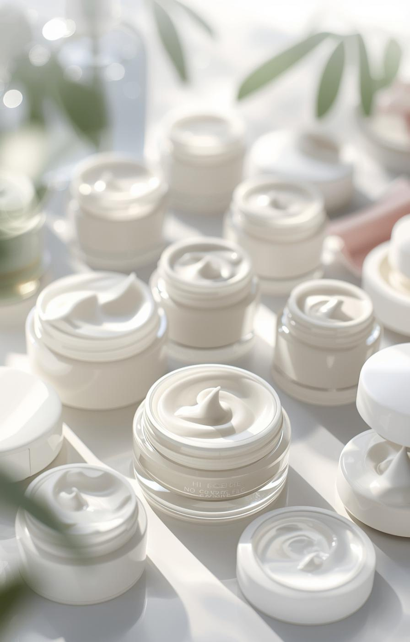

Thank You
Your observations and questions welcomed!

