Slide 1


Pharmaceutical calculations
Lect. one

Slide 2
Introduction
Pharmaceutical calculations is the area of study that applies the basic principles of mathematics to the preparation of safe and effective use of pharmaceuticals
Success in performing pharmaceutical calculations is based on:
An understanding of the purpose or goal of the problem;
An assessment of the arithmetic process required to reach the goal
Implementation of the correct arithmetic manipulations.

Slide 3
The following steps are suggested in addressing the calculations problems
Step 1. Take the time necessary to carefully read and thoughtfully consider the problem prior to engaging in computations. An understanding of the purpose or goal of the problem and the types of calculations that are required will provide the needed direction and confidence.
Step 2. Estimate the dimension of the answer in both quantity and units of measure (e.g., milligrams) to satisfy the requirements of the problem.
Step 3. Perform the necessary calculations using the appropriate method both for efficiency and understanding
Step 4. Before assuming that an answer is correct, the problem should be read again and all calculations checked.
Step 5. Consider the reasonableness of the answer in terms of the numerical value, including the proper position of a decimal point, and the units of measure.

Slide 4
Fundamentals of Pharmaceutical Calculations
Upon successful completion of this chapter, the student will be able to:
• Convert common fractions, decimal fractions, and percentages to their corresponding equivalent
expressions and apply each in calculations.
• Utilize exponential notations in calculations.
•Apply the method of ratio and proportion in problem-solving.

Slide 5
Common and Decimal Fractions
Common fractions are portions of a whole, expressed at 1/3 , 7/8 , and so forth. They are used only rarely in pharmacy calculations nowadays.
It is recalled, that when adding or subtracting fractions, the use of a common denominator is required. The process of multiplying and dividing with fractions is recalled by the following examples.

Slide 6

Example:
If the adult dose of a medication is 2 teaspoonful (tsp.), calculate the dose for a child if it is 1⁄4 of the adult dose.
Example:
If a child’s dose of a cough syrup is 3⁄4 teaspoonful and represents 1⁄4 of the adult dose, calculate the corresponding adult dose.

Slide 7
A decimal fraction
NOTE: When common fractions appear in a calculations problem, it is often best to convert them to decimal fractions before solving.
Decimal fraction is a fraction with a denominator of 10 or any power of 10 and is expressed decimally rather than as a common fraction. Thus,
1/10 is expressed as 0.10 and
45/100 as 0.45

Slide 8


To convert a common fraction to a decimal fraction, divide the denominator into the numerator.
To convert a decimal fraction to a common fraction, express the decimal fraction as a ratio and reduce.

Slide 9
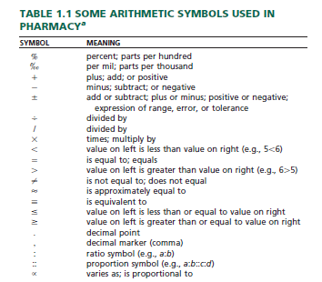
Common arithmetic symbols used in pharmaceutical calculations

Slide 10


Percent
The term percent and its corresponding sign, %, mean ‘‘in a hundred.’’ So, 50 percent (50%) means 50 parts in each one hundred of the same item
Common fractions maybe converted to percent by dividing the numerator by the denominator and multiplying by 100.
Decimal fractions may be converted to percent by multiplying by 100.

Slide 11
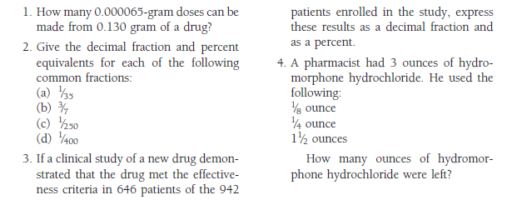
Practice problems

Slide 12
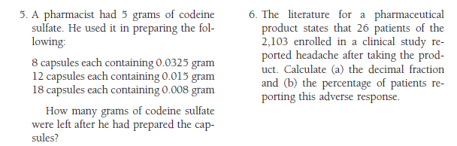

Slide 13
Ratio
The relative magnitude of two quantities is called their ratio.
Since a ratio relates the relative value of two numbers, it resembles a common fraction except in the way in which it is presented.
Whereas a fraction is presented as, for example, 1⁄2, a ratio is presented as 1:2 and is not read as ‘‘one half,’’ but rather as ‘‘one is to two.’’
All the rules governing common fractions equally apply to a ratio. Of particular importance is the principle that if the two terms of a ratio are multiplied or are divided by the same number, the value is unchanged, the value being the quotient of the first term divided by the second.
For example, the ratio 20:4 or 20⁄4 has a value of 5; if both terms are divided by 2, the ratio becomes 10:2 or 10⁄2, again the value of 5.

Slide 14


When two ratios have the same value, they are equivalent.
An interesting fact about equivalent ratios is that the product of the numerator of the one and the denominator of the other always equals the product of the denominator of the one and the numerator of the other; that is, the cross products are equal:

Slide 15
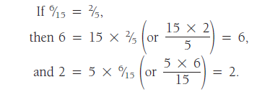

We discover further that the numerator of the one fraction equals the product of its denominator and the other fraction
And the denominator of the one equals the quotient of its numerator divided by the other fraction:

Slide 16
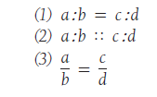
An extremely useful practical application of these facts is found in PROPORTION
A proportion is the expression of the equality of two ratios. It may be written in any one of three standard forms:
Each of these expressions is read: a is to b as c is to d, and a and d are called the extremes (meaning ‘‘outer members’’) and b and c the means (‘‘middle members’’).

Slide 17
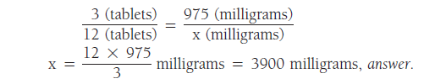

Example:
If 3 tablets contain 975 milligrams of aspirin, how many milligrams should be contained in 12 tablets?
If 3 tablets contain 975 milligrams of aspirin, how many tablets should contain 3900 milligrams?

Slide 18
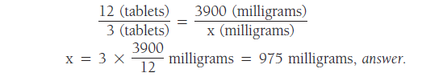

Example:
If 12 tablets contain 3900 milligrams of aspirin, how many milligrams should 3 tablets contain?
If 12 tablets contain 3900 milligrams of aspirin, how many tablets should contain 975 milligrams?

Slide 19
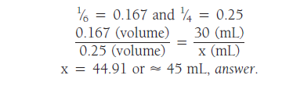
Proportions need not contain whole numbers. If common or decimal fractions are supplied in the data, they may be included in the proportion without changing the method.
For ease of calculation, it is recommended that common fractions be converted to decimal fractions prior to setting up the proportion.
Example: If 30 millilitres (mL) represent 1⁄6 of the volume of a prescription, how many millilitres will represent 1⁄4 of the volume?

Slide 20
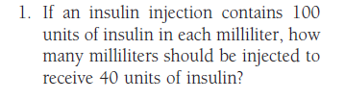
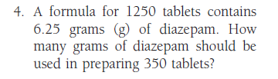
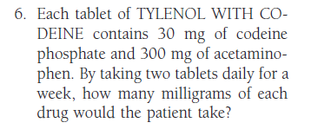

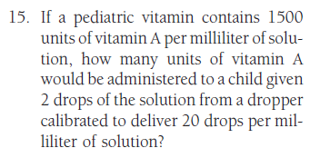
Practice problems

Slide 21
Interpretation of Prescriptions and
Medication Orders
Prescription
is an order for medication issued by a physician, dentist ,or other properly licensed medical practitioner.
A prescription designates a specific medication and dosage to be prepared by a pharmacist and administered to a particular patient.
A prescription is usually written on preprinted forms containing the traditional symbol (meaning ‘‘recipe,’’ ‘‘take thou,’’ or ‘‘you take’’), name, address, telephone number, and other pertinent information regarding the physician or other prescriber.
In addition, blank spaces are used by the prescriber to provide information about the patient, the medication desired, and the directions for use.

Slide 22
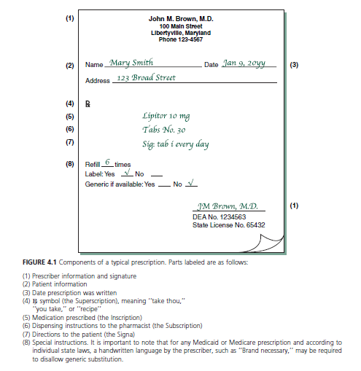

Slide 23
Components of a typical prescription
(1) Prescriber information and signature
(2) Patient information
(3) Date prescription was written
(4) symbol (the Superscription), meaning ‘‘take thou,’’
‘‘you take,’’ or ‘‘recipe’’
(5) Medication prescribed (the Inscription)
(6) Dispensing instructions to the pharmacist (the Subscription)
(7) Directions to the patient (the Signa)
(8) Special instructions.
It is important to note that for any Medicated or Medicare prescription and according to individual state laws, a handwritten language by the prescriber, such as ‘‘Brand necessary,’’ may be required to disallow generic substitution.

Slide 24
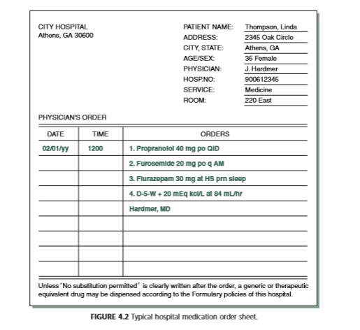
In hospitals and other institutions, the forms are somewhat different and are referred to as medication orders.
The orders shown in this example are typed; typically, these instructions are written by the physician in ink

Slide 25
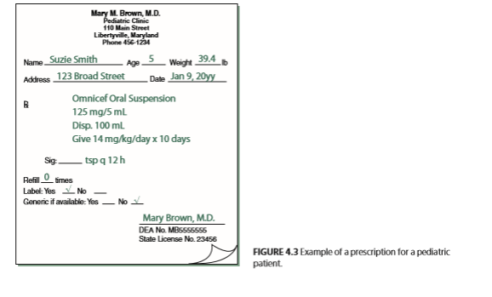
A prescription or medication order for an infant, child, or an elderly person may also include the age, weight, and/or body surface area (BSA) of the patient
This information is sometimes necessary in calculating the appropriate medication dosage.

Slide 26
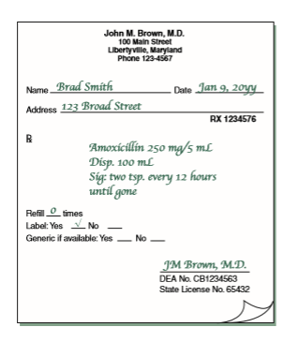
It is important to recognize two broad categories of prescriptions:
those not requiring compounding or admixture by the pharmacist
A prescription may include the chemical or non proprietary (generic) name of the substance or the manufacturer’s brand or trademark name

Slide 27
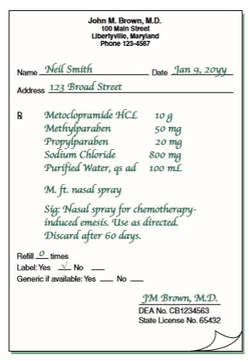
(2) those requiring compounding
Prescriptions requiring compounding contain the quantities of each ingredient required

Slide 28
The quantities of ingredients to be used almost always are expressed in SI metric units of weight and measurement.
In rare instances, units of the apothecaries’ system may be used.
In the use of the SI(metric system),the decimal point may be replaced by a vertical line that is imprinted on the prescription blank or hand drawn by the prescriber. In these instances, whole or subunits of grams of weight and milliliters of volume are separated by the vertical line.
Sometimes the abbreviations g (for gram) and mL (for milliliter) are absent and must be presumed.

Slide 29
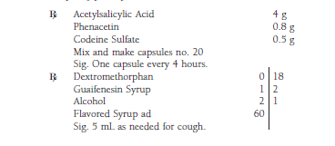
Examples of prescriptions written in SI metric units:

Slide 30
e-prescriptions
The use of electronic means for the generation and transmission of prescriptions is accepted throughout the United States.
In the inpatient or outpatient setting, a medication order, for a patient is entered into an automated data entry system (PC)or a handheld device loaded with e-prescribing software and sent to a pharmacy as an e-prescription. When received, a pharmacist immediately reduces the order to a hard copy and or stores it as a computer file.
Among the advantages cited fore e–prescriptions over traditional paper prescriptions are:
reduced errors due to prescription legibility;
concurrent software screens for drug interactions;
reduced incidence of altered or forged prescriptions;
efficiency for both prescriber and pharmacist;
convenience to the patient, whose prescription would likely be ready for pick-up upon arrival at the pharmacy

