Slide 1


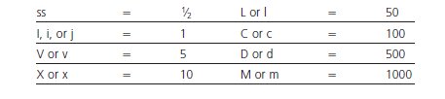
Roman numerals
Roman numerals commonly are used in prescription writing to designate quantities, as the:
(1) quantity of medication to be dispensed and/or
(2) quantity of medication to be taken by the patient per dose.
The eight letters of fixed values used in the Roman system

Slide 2
The following rules apply in the use of Roman numerals:
A letter repeated once or more, repeats its value (e.g., xx = 20 ; xxx =30).
One or more letters placed after a letter of greater value increases the value of the greater letter (e.g., vi =6 ; xij=12 ; lx =60).
A letter placed before a letter of greater value decreases the value of the greater letter (e.g., iv = 4 ; xl =40).

Slide 3
Use of Abbreviations and Symbols
The use of abbreviations is common on prescriptions and medication orders. Unfortunately, medication errors can result from the misuse, misinterpretation, and illegible writing of abbreviations
Specific recommendations to help reduce medication errors:
A whole number should be shown without a decimal point and without a terminal zero (e.g., express 4 milligrams as 4 mg and not as 4.0 mg).
A quantity smaller than one should be shown with a zero preceding the decimal point (e.g., express two tenths of a milligram as 0.2 mg and not as .2 mg).

Slide 4
3- Leave a space between a number and the unit (e.g., 10 mg and not 10mg).
4- Use whole numbers when possible and not equivalent decimal fractions (e.g., use 100 mg and not 0.1 g).
5- Use the full names of drugs and not abbreviations (e.g., use phenobarbital and not PB).
6- Use USP designations for units of measure (e.g., for grams, use g and not Gm or gms; for milligrams, use mg and not mgs or mgm).
7- Spell out ‘‘units’’ (e.g., use 100 units and not 100 u or 100 U

Slide 5
8- Certain abbreviations that could be mistaken for other abbreviations should be written out (e.g., write ‘‘right eye’’ or ‘‘left eye’’ rather than use o.d. or o.l., and spell out ‘‘right ear’’ and ‘‘left ear’’ rather than use a.d. or a.l.)
.9- Spell out ‘‘every day’’ rather than use q.d.; ‘‘every other day,’’ rather than q.o.d; and ‘‘four times a day,’’ rather than q.i.d to avoid misinterpretation.
10- Avoid using d for ‘‘day’’ or ‘‘dose’’ because of the profound difference between terms, as in mg/kg/ day versus mg/kg/dose.
11- Amplify the prescriber’s directions on the prescription label when needed for clarity (e.g., use ‘‘Swallow one (1) capsule with water in the morning’’ rather than ‘‘one cap in a.m.’’).

Slide 6
B1 disp. div. d.t.d. NR tsp mOsm
B2 sig aa. M. ft. tbsp. gtt
B3 ad. no q.s.
BSA tbsp d.t.d

Slide 7
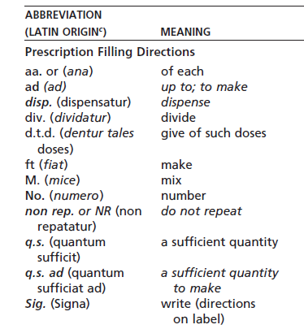
SELECTED ABBREVIATIONS, ACRONYMS, AND SYMBOLS USED IN PRESCRIPTIONS AND MEDICATION ORDERS

Slide 8
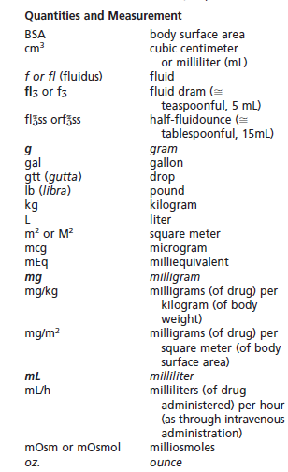


Slide 9
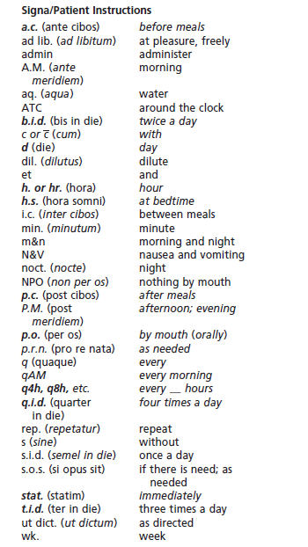

Slide 10

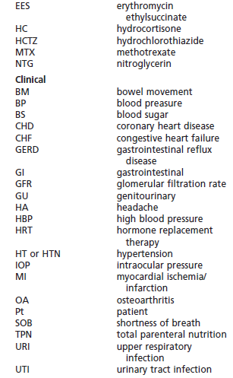

Slide 12
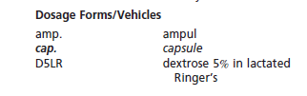
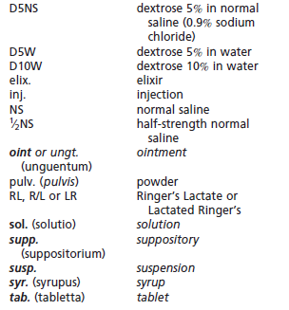

Slide 13
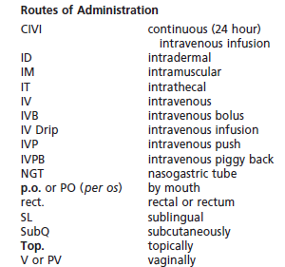

Slide 14
Examples of prescription directions to the pharmacist:
M. ft. ung.
Mix and make an ointment.
Ft. sup. no xii
Make 12 suppositories.
M. ft. cap. d.t.d. no. xxiv
Mix and make capsules. Give 24 such doses.
Examples of prescription directions to the patient:
Caps. i. q.i.d. p.c. et h.s.
Take one (1) capsule four (4) times a day after each meal and at bedtime.
gtt. ii rt.eye every a.m.
Instill two (2) drops in the right eye every morning.
tab. ii stat tab. 1 q. 6 h.
7 d. Take two (2) tablets immediately, then take one (1) tablet every 6 hours for 7 days

Slide 15
