Slide 1

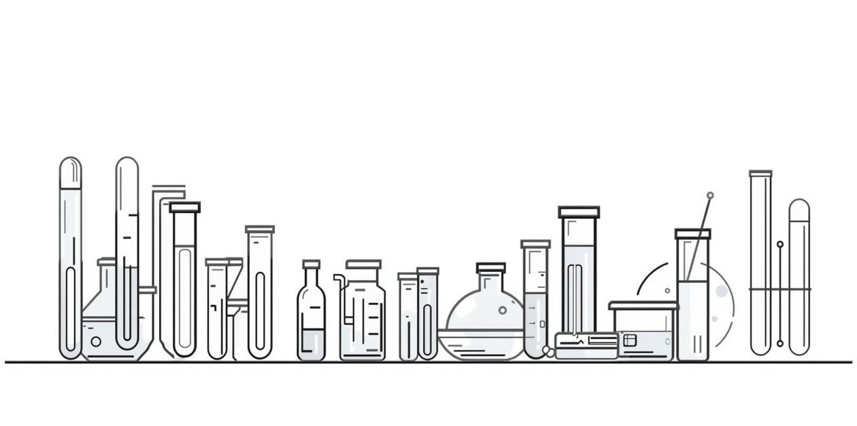
GELS: Materials, Preparation Methods
Lecturer : Nora Zawar Yousif
Lecturer : Zeina Dawood
Assistant Lecturer : Mustafa Mohammed Noori
]

Slide 2
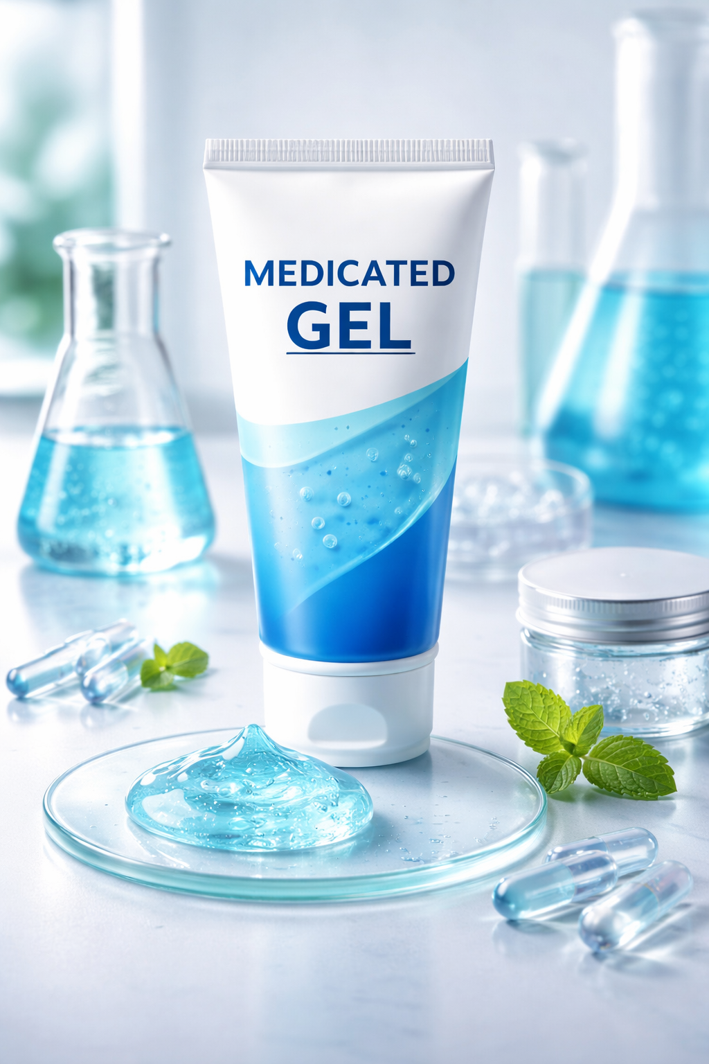
Introduction to Gels
01
Definition of Gels
Gels are semi-solid systems containing either small or large molecules, providing unique properties for various applications.
02
Structure of Gels
They consist of a liquid phase entrapped in a 3D polymeric network, allowing them to maintain their shape and consistency.
03
Applications of Gels
Gels find use in pharmaceutical, cosmetic, and biomedical fields, offering versatility in formulation and delivery of active ingredients.

Slide 3
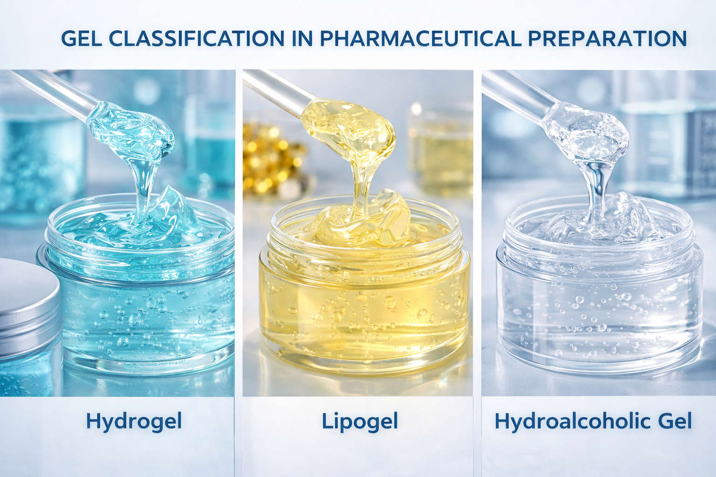
Classification of Gels
01
By Phase
Gels can be classified as single-phase systems, where the liquid and solid phases form a uniform mixture, or two-phase systems, which consist of larger aggregates.
02
By Solvent Type
Gels can be categorized into hydrogels, which use water as a solvent, and organogels, which utilize organic solvents for their structure and properties.
03
By Application
Gels are utilized in various fields, such as topical, oral, and ophthalmic applications, depending on their formulation and intended use.

Slide 4
Materials Used in Gel Formulation
01
Gelling Agents
Gelling agents are essential polymers that provide structure and viscosity to gels, ensuring desired consistency and stability.
02
Solvents for Gels
Common solvents include water and alcohol, which help dissolve gelling agents and facilitate uniform gel formation during preparation.
03
Preservatives
Preservatives are added to prevent microbial growth and extend the shelf life of gels, ensuring safety and efficacy during use.

Slide 5
Common Gelling Agents
01
Natural Gelling Agents
Include substances like gelatin, agar, and pectin, which are derived from natural sources and widely used in formulations.
02
Semi-synthetic Gelling Agents
Examples are HPMC and MC, which are modified cellulose derivatives offering excellent gelling properties and stability.
03
Synthetic Gelling Agents
Carbopol and Poloxamer are examples that provide controlled viscosity and robust gel formation for various applications.

Slide 6
Other Excipients
01
Preservatives
Parabens are commonly used to prevent microbial growth, ensuring longer shelf life and safety of gel formulations.
02
Humectants for Moisture Retention
Glycerin and propylene glycol are added to attract moisture, keeping the gel hydrated and enhancing skin feel.
03
Neutralizers
Triethanolamine is used to adjust the pH of Carbopol gels, ensuring optimal consistency and stability for topical applications.

Slide 7
Weigh Ingredients
Disperse Gelling Agent
Accurately measure all components needed for gel preparation.
Mix the gelling agent thoroughly in the chosen solvent.
Allow Swelling
Add Other Ingredients
Let the mixture sit to enable full hydration and swelling.
Gradually incorporate additional ingredients while continuously stirring the mixture.

Slide 8
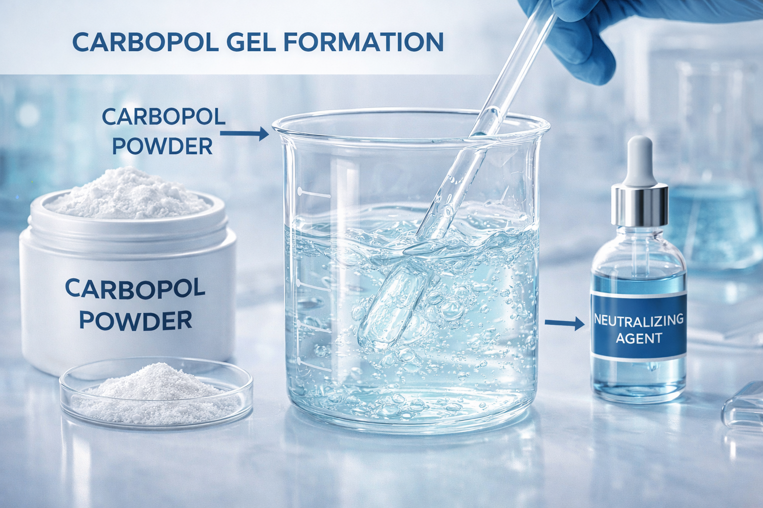
Example – Preparation of Carbopol Gel
01
Dispersing Carbopol
Disperse Carbopol in purified water, ensuring it breaks down thoroughly before any further steps are taken.
02
Hydration and Mixing
Allow the Carbopol to hydrate completely, then slowly add the drug solution while stirring continuously for uniformity.
03
Final Adjustments
Add the neutralizing agent to form gel and adjust the pH to the ideal range of 5–7 for topical use.

Slide 9
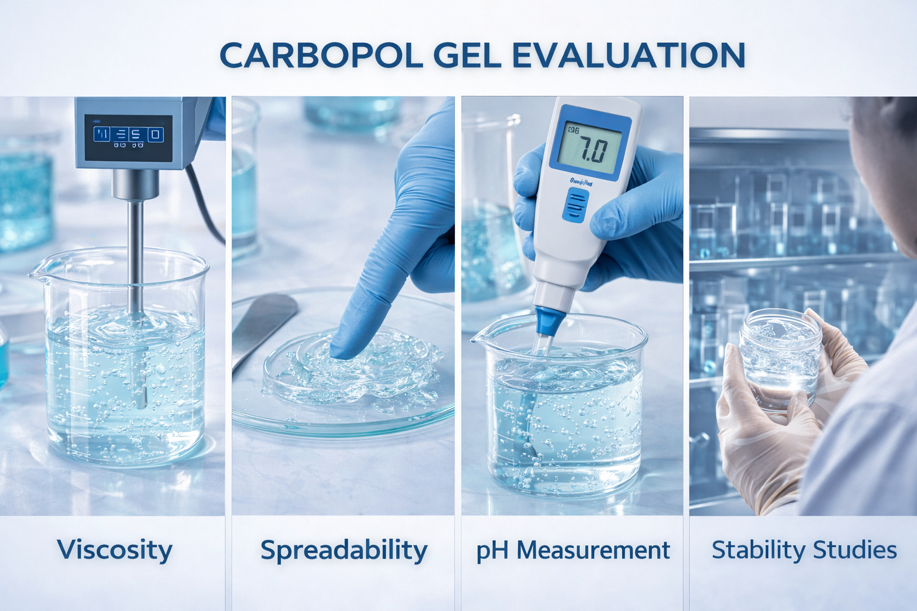
Quality Evaluation of Gels
01
Physical Appearance
The gel's clarity and color should be visually assessed for consistency and any signs of separation.
02
pH Measurement
Ideal pH ranges between 5–7 ensure stability and compatibility for topical applications and patient safety.
03
Viscosity Testing
Using a Brookfield viscometer, the gel's viscosity is measured to determine its flow properties and usability.

Slide 10
Conclusion
01
Importance of Gels
Gels serve as versatile semi-solid dosage forms, facilitating drug delivery in various pharmaceutical applications.
02
Material Selection Matters
Choosing the right components is crucial to ensure the efficacy, stability, and safety of gel formulations.
03
Evaluation Confirms Quality
Rigorous testing and quality evaluation confirm that gels meet the necessary standards for safety and effectiveness.

Slide 11
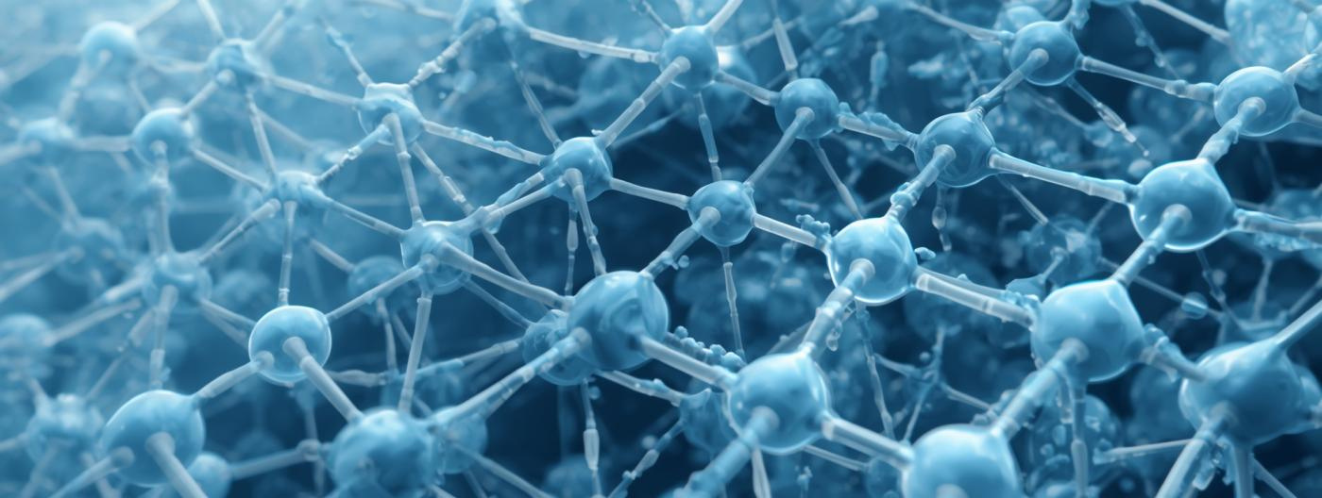
Gel Network Structure

Slide 12

Lab Experiment Summary
Overview of the Carbopol gel preparation process and key materials
This experiment focuses on the preparation of Carbopol gel, which is widely used.

