Slide 1
The International System of Units (SI)
Formerly called the metric system, is the internationally recognized decimal system of weights and measures.
Today, the pharmaceutical research and manufacturing industry, the official compendia, the United States Pharmacopeia—National Formulary, and the practice of pharmacy reflect conversion to the SI system. The reasons for the transition include
The simplicity of the decimal system,
The clarity provided by the base units and prefixes of the SI
The ease of scientific and professional communications through the use of a standardized and internationally accepted system of weights and measures

Slide 2
guidelines for the correct use of the SI
• Unit names and symbols generally are not capitalized except when used at the beginning of a sentence or in headings. However, the symbol for liter (L) may be capitalized or not.
Examples: 4 L or 4 l, 4 mm, and 4 g; not 4 Mm and 4 G.
• In the United States, the decimal marker (or decimal point) is placed on the line with the denomination and denominate number; however, in some countries, a comma or a raised dot is used. Examples: 4.5 mL (U.S.); 4,5 mL or 4⋅5 mL (non-U.S.).
• Periods are not used following SI symbols except at the end of a sentence.
Examples: 4 mL and 4 g, not 4 mL. and 4 g.
• A compound unit that is a ratio or quotient of two units is indicated by a solidus (/) or a negative exponent.
Examples: 5 mL/h or 5 mL⋅h1, not 5 mL per hour.

Slide 3
• Symbols should not be combined with spelled-out terms in the same expression.
Examples: 3 mg/mL, not 3 mg/milliliter.
• Plurals of unit names, when spelled out, have an added s. Symbols for units, however, are the same in singular and plural.
Examples: 5 milliliters or 5 mL, not 5 mLs.
• Two symbols exist for microgram: mcg (often used in pharmacy practice) and μg (SI).
• The symbol for square meter is m²; for cubic centimeter, cm³; and so forth. In pharmacy practice, cm³ is considered equivalent to milliliter. The symbol cc, for cubic centimeter, is not an accepted SI symbol.
• Decimal fractions are used, not common fractions.
Examples: 5.25 g, not 51⁄4 g.

Slide 4
• A zero should be placed in front of a leading decimal point to prevent medication errors caused by uncertain decimal points. Example: 0.5 g, not .5 g.
• To prevent misreadings and medication errors, ‘‘trailing’’ zeros should not be placed following a whole number on prescriptions and medication orders.
Example:5 mg not 5.0mg.
However, in some tables (such as those of the SI in this chapter), pharmaceutical formulas, and quantitative results, trailing zeros often are used to indicate exactness to a specific number of decimal places.
• In selecting symbols of unit dimensions, the choice generally is based on selecting the unit that will result in a numeric value between 1 and 1000.
Examples: 500 g, rather than 0.5 kg; 1.96 kg, rather than 1960 g; and 750 mL, rather than 0.75 L.

Slide 5
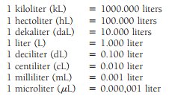
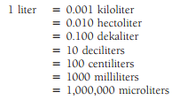
Measure of Volume
The liter is the primary unit of volume
The United States Pharmacopeia—National Formulary2 states: ‘‘One milliliter (mL) is used here in as the equivalent of 1 cubic centimeter (cc).’’

Slide 6
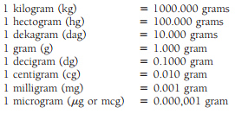

Measure of Weight
The primary unit of weight in the SI is the gram

Slide 7
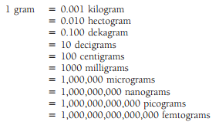

This table may also be written:
Equivalencies of the most common weight denominations:

Slide 8
Fundamental Computations
1.Reducing SI Units to Lower or Higher Denominations by Using a Unit-Position Scale
The metric system is based on the decimal system; therefore, conversion from one denomination to another can be done simply by moving the decimal point.
1- To change a metric denomination to the next smaller denomination, move the decimal point one place to the right.
2-To change a metric denomination to the next larger denomination, move the decimal point one place to the left.

Slide 9
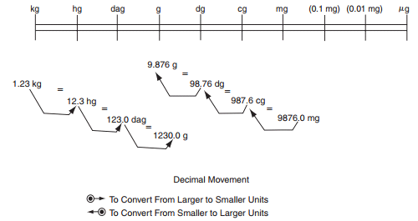
Examples: Reduce 1.23 kilograms to grams.
1.23 kg = 1230 g, answer.

Slide 10
Reduce 85 micrometers to centimeters.
85 mcm = 0.085 mm = 0.0085 cm, answer.
Reduce 2.525 liters to microliters.
2.525 L = 2525 mL = 2,525,000 L, answer

Slide 11
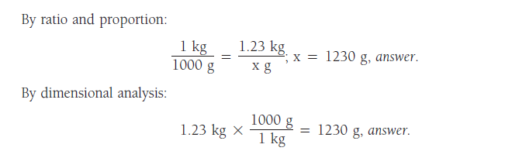
2- Reducing SI Units to Lower or Higher Denominations by Ratio and Proportion or by Dimensional Analysis
Examples: Reduce 1.23 kilograms to grams.
From the table: 1 kg =1000 g

Slide 12
Reduce 62,500 mcg to g.
From the table: 1 g = 1,000,000 mcg

Slide 13
Common Systems of Measurement and Intersystem Conversion
Common systems of measurement are divided into two types:
The apothecaries’ system of measurement
It is the traditional system of pharmacy, and although it is now largely of historic significance, components of this system are occasionally found on prescriptions

Slide 14

Apothecaries’ Fluid Measure

Slide 15

Apothecaries’ Measure of Weight

Slide 16

2.The avoirdupois system
is the common system of commerce, employed along with the SI in the United States. It is through this system that items are purchased and sold by the ounce and pound.
Avoirdupois Measure of Weight

Slide 17
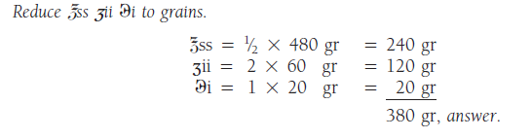
Only one denomination has a value common to the apothecaries’ and avoirdupois systems of measuring weight: the grain. The other denominations bearing the same name have different values.
If we want to change from one system to another first we need to change to grain then to the other system.
Examples:

Slide 18
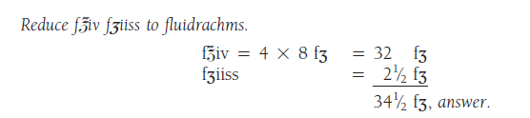
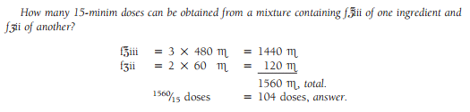

Slide 19
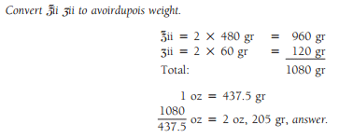
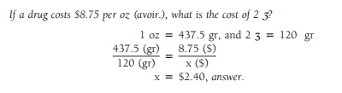

Slide 20
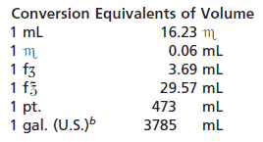
Intersystem Conversion
On occasion it may be necessary to translate a weight or measurement from units of one system to units of another system.
This translation is called conversion. The translation of a denomination of one system to that of another system requires a conversion factor or conversion equivalent.

Slide 21
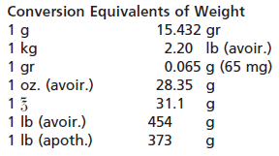



Slide 22
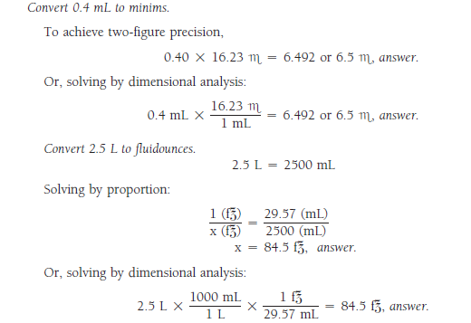

Slide 23
