Slide 1


Lecture 1
Introduction to Human Physiology
Physiology I
First stage, 2nd semester (2025-2026)
by
Dr Mustafa Riyadh Abdullah

Slide 2
1.1 The Scope of Human Physiology
Physiology: Study of function: how living organisms work. Focuses on processes (what happens) and mechanisms (how/why it happens). Looks at functions from tiny to complex levels. It answers the question:
🔹 How does the body work?
Physiology covers a wide range:
Molecular level: e.g., a protein’s shape/charge lets it act as an ion channel
Whole-body level: e.g., after salty food, heart + kidneys + glands coordinate to increase Na⁺ excretion in urine
Key idea: physiology connects small parts → big outcomes
Pathophysiology: study of disease states. Many diseases are physiological “gone wrong”. This is called pathophysiology (physiological dysfunction). Understanding normal physiology is essential for:
medicine
pharmacy
diagnosis and treatment concepts

Slide 3
1.1 The Scope of Human Physiology
Why This Matters for Pharmacy
Drugs often work by changing physiological mechanisms
  ion channels
  receptors
  hormones
  kidney transporters, etc.
If you understand normal function, you can predict:
  drug effects
  side effects
  What goes wrong in disease
Anatomy: It is the study of the structures of body parts, a related field of science to physiology
Anatomy = structure (what it looks like / where it is)
Physiology = function (what it does / how it works)
They are linked:
  Structure determines function
  Example: thin alveolar walls → efficient gas exchange (later topics)

Slide 4
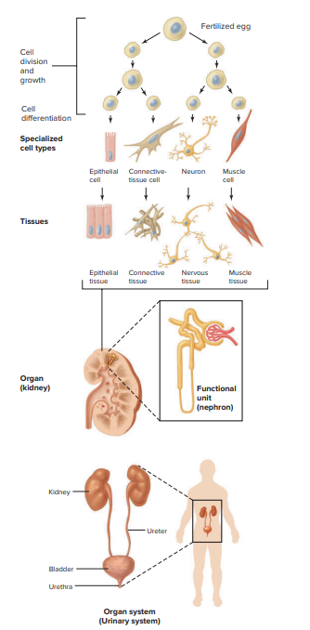
1.2 How Is the Body Organized?
The Cell: Basic Unit of Life
The cell is the simplest structural unit that can still perform life functions
Every human starts as one cell (fertilized egg / zygote)
That cell divides: 1 → 2 → 4 → 8 → … (cell multiplication)
Why We Don’t Become a Ball of Identical Cells
If only division happened, we’d get: a spherical mass of identical cells
But during development, cells change to become specialised. How?.
Cell differentiation: an unspecialized cell becomes a specialised cell. Specialisation allows different functions, for example: producing force and movement, generating electrical signals.
Key idea: Differentiation creates many cell types with different jobs
Major Categories of Cells (4 Groups)
Even though there are ~200 distinct cell types, most fit into 4 main functional categories:
1- Muscle cells
2- Neurons (nerve cells)
3- Epithelial cells
4- Connective-tissue cells

Slide 5
1.2 How Is the Body Organized?
In each of these functional categories, several cell types perform variations of the specialised function. For example, Muscle Cells Have Subtypes.
Muscle cells share the ability to contract
Three main types:
  Skeletal muscle (movement), Cardiac muscle (heart pumping) and Smooth muscle (walls of organs/vessels)
They differ in:
  Shape, control mechanisms and location
  But they are all still “muscle cells.”
Building Multicellular Structures
During development, cells also:
migrate to new locations
form selective adhesions (stick to the right cells)
organise into a hierarchy of structures

Slide 6
1.2 How Is the Body Organized?
Tissue = a group (aggregate) of similar specialised cells
Because we have 4 major cell categories, we also have 4 major tissue types:
  Muscle tissue, Nervous tissue, Epithelial tissue and Connective tissue
Important Note: “Tissue” Has Two Meanings
Formal definition: tissue = mostly one type of specialised cell
Common use: “kidney tissue” or “lung tissue”
  These organs usually contain all four tissue types
So, “kidney tissue” in everyday talk ≠ one cell type only
Organ: Different tissues combine to form an organ (for example., heart, lungs, kidneys)
Organs work together as an organ system
  example: urinary system

Slide 7
1.2 How Is the Body Organized?
Muscle Cells and Tissue
As noted, there are 3 types of muscle cells. They form 3 types of muscle tissue. All muscle cells generate mechanical force (they contract)
1- Skeletal Muscle: Attached (through tendons/other structures) to bones
Move limbs and trunk
Also attached to skin (e.g., facial expression muscles)
Voluntary control: you can decide to contract it (like., lift your hand, smile)
2- Cardiac Muscle: Found only in the heart
Involuntary control
When it contracts:
  the heart squeezes
  blood is pumped into circulation
  3- Smooth Muscle Found in the walls of many tubes in the body, such as:
  blood vessels
  gastrointestinal tract (stomach/intestine)

Slide 8
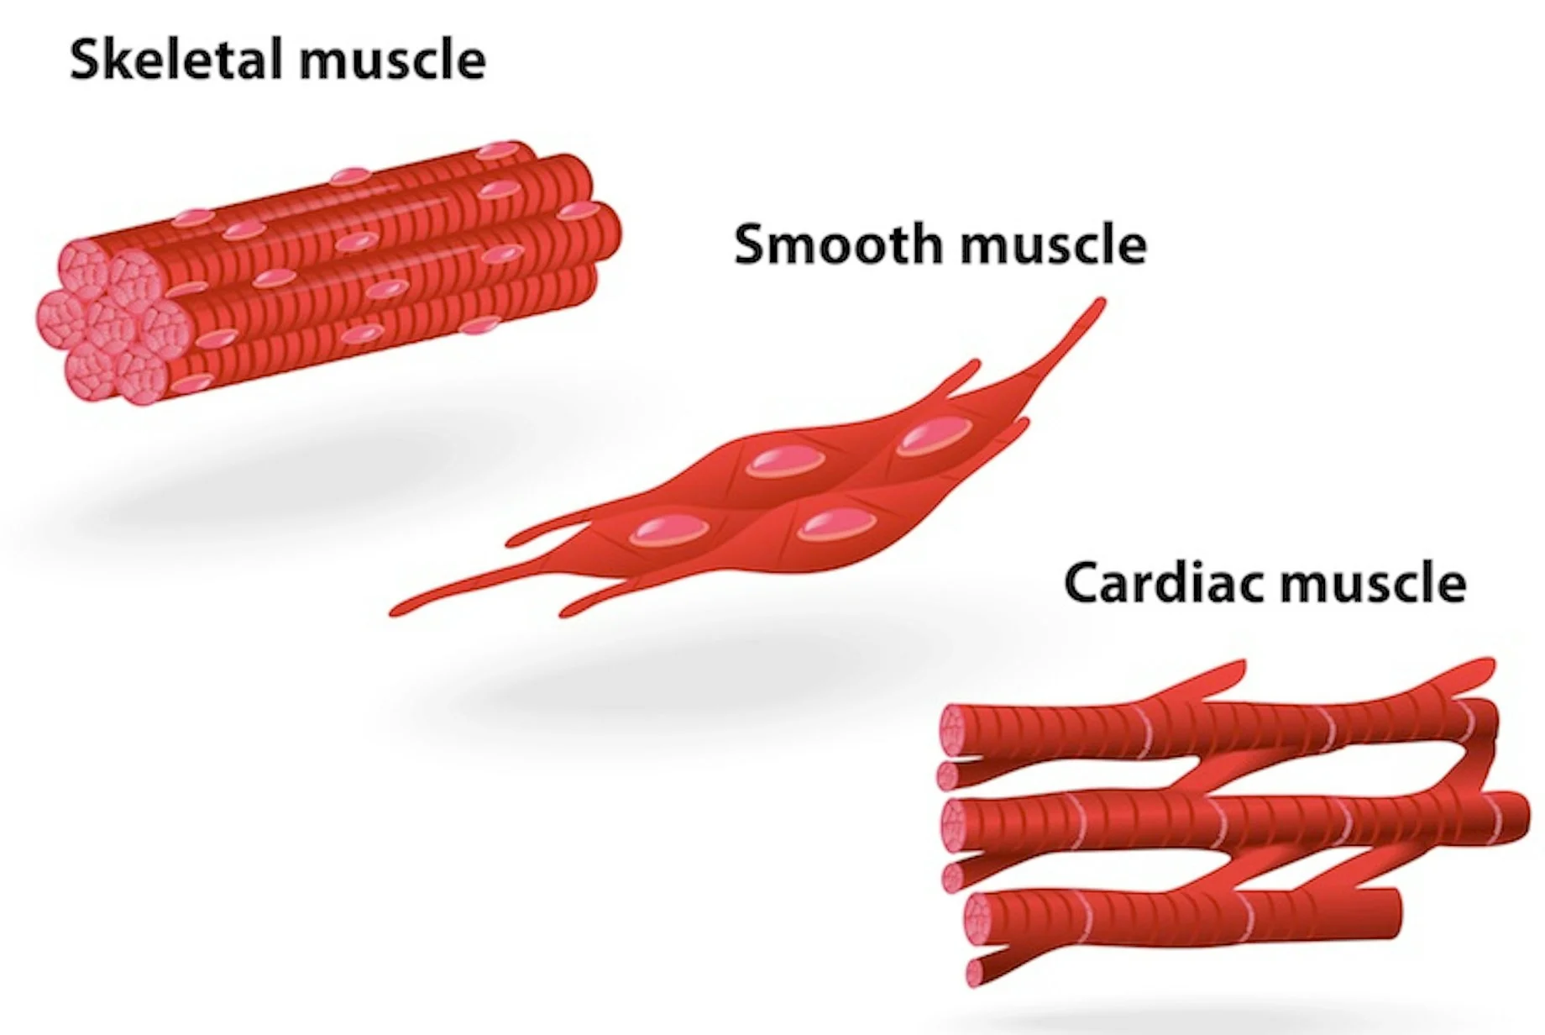
1.2 How Is the Body Organized?
Contraction causes:
  decreased diameter (narrowing)
  shortened length of the tube
In the esophagus (tube from pharynx to stomach)
Smooth muscle contraction helps push/squeeze food toward the stomach(this is part of coordinated movement in the GI tract).
Involuntary control

Slide 9
1.2 How Is the Body Organized?
Neurons and Nervous Tissue
A neuron is a nervous system cell specialized to:
  initiate electrical signals, integrate information, conduct electrical signals to other cells (often long distances)
Note: electrical signals = the main communication method in the nervous system
What Do Neurons Control?
A neuron’s signal can:
trigger signals in other neurons, stimulate gland cells to secrete substances, stimulate muscle cells to contract
✅ So, neurons are a major way the body controls other cells.
Why Neurons Are So Important
Neurons form highly complex networks
Their many connections support higher functions like:
  consciousness
  perception (sensing and interpreting the world)
(Keep it simple: “complex wiring = complex behavior.”)

Slide 10
1.2 How Is the Body Organized?
Nervous Tissue: a collection of neurons
Examples:
  brain tissue
  spinal cord tissue
What is a Nerve?
In some parts of the body:
  long cellular extensions from many neurons are bundled together
  plus connective tissue for support
This bundle is called a nerve
Function: carries signals between:
  the nervous system
  and the rest of the body

Slide 11
1.2 How Is the Body Organized?
Epithelial Cells and Epithelial Tissue (Epithelium)
Epithelial cells are specialised for: Selective absorption (ions + organic molecules), Selective secretion, Protection (barrier between environments)
Epithelial cells are named by their shape: Cuboidal = cube-shaped, Columnar = tall/elongated, Squamous = flat, Ciliated = with cilia (hair-like structures).
Epithelia may be arranged in single-cell-thick tissue, called a simple epithelium, or a thicker tissue consisting of numerous layers of cells, called a stratified epithelium.
The type of epithelium that forms in a given region of the body reflects the function of that particular epithelium. Example: Ciliated Epithelium in the Trachea
The trachea lining contains ciliated epithelial cells
Cilia beat to move mucus upward
This helps prevent dust/pollutants from reaching delicate lung tissue

Slide 12
1.2 How Is the Body Organized?
Epithelia: cover body surfaces and organ surfaces, line the inside of tubes and hollow structures (e.g., trachea, GI tract, kidney tubules)
Epithelial cells sit on a protein layer called the basement membrane
  helps anchor the tissue
Two “sides” of an epithelial cell:
  Basolateral side = attached toward basement membrane / body fluids
  Apical side = faces the lumen (inside space of a tube)
polarity = two sides with different roles.
Tight Junctions
Cells are joined along their sides by tight junctions
Tight junctions act as selective barriers
They regulate what can pass between cells (paracellular pathway)
They help maintain separation between apical vs basolateral environments

Slide 13
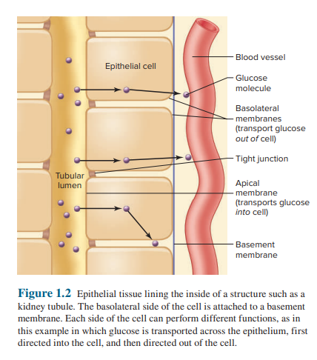
1.2 How Is the Body Organized?
Figure 1.2 (Kidney Tubule Example: Directional Transport)
Apical membrane transports glucose from the tubule lumen into the epithelial cell
Basolateral membrane transports glucose out of the cell toward the interstitial fluid/blood
Tight junctions prevent glucose from leaking backwards into the lumen
Result: glucose moves from the lumen → cell → blood

Slide 14
1.2 How Is the Body Organized?
Connective-Tissue Cells and Connective Tissue
Connective tissue connects, anchor and supports body structures
Types include: loose, dense, bone, cartilage, adipose, blood
An important function of some connective tissue is to form the extracellular matrix (ECM) around cells.
The ECM consists of a mixture of proteins and polysaccharides (chains of sugar molecules) and, in some cases, minerals, specific to any given tissue.
The ECM serves two general functions: ■ provides a scaffold for cellular attachments ■ transmits information in the form of chemical messengers to the cells to help regulate their activity, migration, growth, and differentiation
The ECM contains fibers (insoluble proteins), mainly collagen (rope-like, very strong) and elastin (rubber-band-like, stretch and recoil).

Slide 15
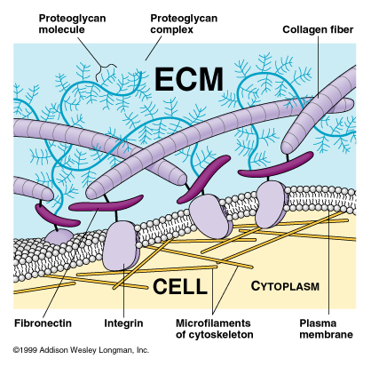
1.2 How Is the Body Organized?
It also contains non-fibrous proteins with carbohydrates.
The ECM can be compared to reinforced concrete:
  Collagen fibers act like the steel rods/mesh that strengthen concrete (collagen may form up to ~1/3 of body proteins).
  The carbohydrate-containing molecules are like the cement around the rods.
Unlike real cement, these molecules are active:
they help cells stick together (adhesion),
recognize each other, and support cell communication
by linking extracellular signals to cells.

Slide 16
1.2 How Is the Body Organized?
Organs and Organ Systems
Organs are made of 2 or more tissue types (epithelial, connective, muscle, nervous) arranged as sheets, tubes, layers, bundles.
Kidney example: includes epithelial tubules, blood vessels (smooth muscle + connective tissue), neuronal endings, and connective tissue (including a protective capsule).
Many organs contain repeating functional units; in the kidney the unit is the nephron, and total urine production is the sum of ~2 million nephrons.
An organ system is a group of organs working together (e.g., urinary system = kidneys, ureters, bladder, urethra).
Systems cooperate to maintain health (such as: blood pressure is controlled by the circulatory, urinary, nervous, and endocrine systems).

Slide 17
1.3 Body Fluid Compartments
Body Fluid Compartments
Body fluid is a watery solution containing dissolved substances (O₂, nutrients, wastes, ions) and forms the body’s internal environment.
Body water is distributed into 3 compartments:
  Intracellular fluid (ICF): inside all cells, ~67% of total body water
  Plasma: fluid part of blood, ~7%
  Interstitial fluid (ISF): fluid around/between cells, ~26%
Extracellular fluid (ECF) = plasma + ISF, so total ECF volume is their sum. Total body water is ~55–60% of adult body weight.
As blood flows through small vessels, plasma exchanges O₂, nutrients, and wastes with ISF, so their solute concentrations are almost identical, except proteins (higher in plasma).
ECF composition differs greatly from ICF, and maintaining this difference helps cells regulate functions (e.g., keeping many intracellular proteins inside cells).
Barriers create compartments:
  Plasma membranes separate ICF from ECF
  Blood vessel walls separate plasma from ISF and help keep proteins mainly in plasma

Slide 18
1.3 Body Fluid Compartments
Transport mechanisms that move water/solutes between compartments
Diffusion: small molecules move down their concentration gradient ( O₂, CO₂).
Facilitated diffusion: via channels/carriers (still down gradient; e.g., ions through channels, glucose via transporters).
Active transport: uses energy (ATP or ion gradients) to move substances against gradients; key for keeping ICF and ECF different (ion pumps).
Osmosis (water movement): water moves across a semipermeable membrane toward the side with higher effective solute concentration (higher osmolarity).
  Hypertonic ECF: water leaves cells → cells shrink
  Hypotonic ECF: water enters cells → cells swell
  Isotonic: no net water movement
Filtration (pressure-driven flow): fluid moves due to hydrostatic pressure across capillary walls; contributes to plasma ↔ ISF exchange (proteins limit their own movement and help retain fluid in plasma).

Slide 19
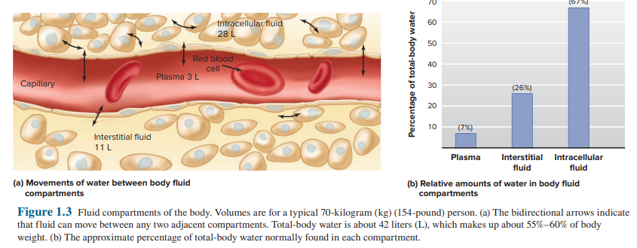

Slide 20
Thank you

