Slide 1


Lecture 2
Homeostasis
Physiology I
First stage, 2nd semester (2025-2026)
by
Dr Mustafa Riyadh Abdullah

Slide 2
2.1. Homeostasis: A Defining Feature of Physiology
Homeostasis = maintaining a stable internal environment that supports good health, even when the external environment changes.
Many variables in healthy humans are kept within a predictable range: blood pressure, body temperature, O₂, glucose, Na⁺, etc.
Homeostasis does not maintain a constant value all the time
Variables fluctuate during the day but stay within a normal range (dynamic constancy).
When a variable moves away from normal, the body activates compensatory mechanisms to bring it back
The correction usually occurs without major overshoot (does not go strongly to the opposite extreme)
For Example: Blood Glucose Over a Day
After meals: carbohydrates → glucose absorbed from intestine → blood glucose rises.
Then compensatory control brings it back toward pre-meal level by increase pruduce of the insulin hormone.
Main controller here: endocrine system (promotes glucose uptake into tissues like muscle).
So glucose can swing during the day but still be “homeostatic” because it returns to range.

Slide 3
2.1. Homeostasis: A Defining Feature of Physiology
Some variables are tightly controlled (very little variation): arterial O₂ and CO₂ change only slightly, even with exercise.
Others vary more short-term but are stable when averaged long-term: blood glucose varies after meals, but daily averages are predictable over days/years.
Homeostasis Is Variable-Specific (and Can Fail Selectively)
A person may be homeostatic for one variable but not another.
  Example: Na⁺ normal, but blood pH abnormal due to kidney disease → can be life-threatening.
Loss of homeostasis in one key variable can have serious consequences.
Variables Interact (One Change Can Trigger Others)
When one variable shifts, others may change too.
Example: during strenuous exercise:
  Sweating helps maintain temperature homeostasis
  but water loss can disrupt total-body water balance.

Slide 4
2.2. General Characteristics of Homeostatic Control Systems
Homeostatic control systems regulate and integrate cell/tissue/organ activity so that a change in the internal environment triggers a corrective response.
Homeostasis operates around a set point (target value). For thermoregulation, the set point is the steady-state body temperature (~37°C here).
Steady state ≠ equilibrium: In a steady state, the variable stays constant, but continuous energy input is required (metabolic reactions continuously produce heat to balance heat loss).
Stability is achieved by balancing inputs vs outputs:
  Input: metabolic heat production
  Output: heat loss to the environment
When room temperature drops quickly (e.g., 20°C → 5°C), heat loss increases,
body temperature tends to fall, and the body activates compensatory responses:

Slide 5
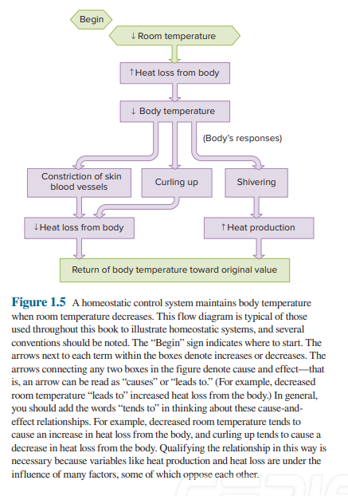
2.2. General Characteristics of Homeostatic Control Systems
Skin vasoconstriction → ↓ blood flow to skin → ↓ heat loss
Curling up → ↓ surface area → ↓ heat loss
If output cannot be reduced enough, the body increases input:
shivering (skeletal muscle activity) → ↑ heat production
These responses return body temperature
toward the original value (toward the set point).
In flow diagrams, arrows mean
“tends to / leads to” (cause → effect).

Slide 6
Feedback Systems
Negative feedback means: a change in a variable triggers responses that oppose the original change.
Goal: move the variable back toward its original value and set point.
Example from thermoregulation:
  ↓ body temperature → responses that increase body temperature.
Why Negative Feedback Is Essential
Negative feedback: reduces oscillations (prevents big swings), limits over-correction (stops responses from continuing too long) and provides “checks and balances” for most physiological variables
Negative Feedback Can Occur at Many Levels (Organ level (e.g., temperature regulation), Cellular level and Molecular level (e.g., enzyme pathways).
Enzyme Feedback (Figure 1.6 Idea)
Enzymes catalyze chemical reactions. In many pathways: the final product feeds back to inhibit an earlier enzyme. Result: the product helps control the rate of its own formation.

Slide 7
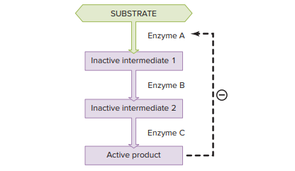
Feedback Systems
ATP Example
Cells break down glucose to release energy.
That energy is stored in ATP.
ATP is used for: muscle contraction, secretion and transport across membranes
Negative feedback control:
When ATP increases, it inhibits some enzymes in glucose breakdown → ATP production slows.
When ATP decreases, inhibition is removed → more glucose breakdown → ATP production increases.

Slide 8
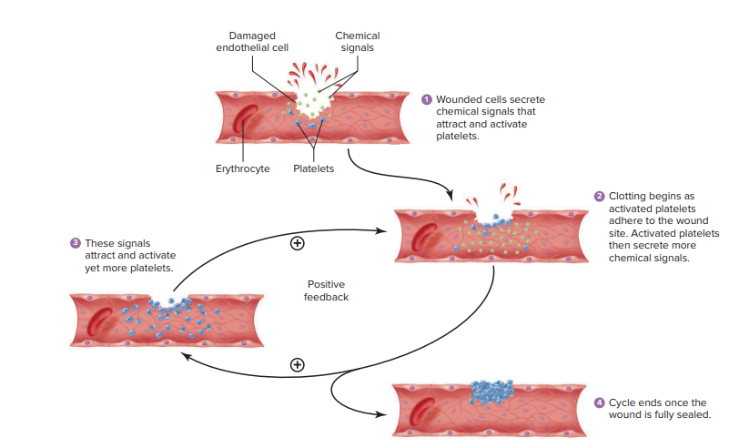
Feedback Systems
Positive feedback amplifies a change: an initial event causes responses that increase the same event, creating an “accelerating/explosive” cycle.
It is not homeostatic by itself because it has no built-in brake, so it is less common than negative feedback.
Blood clotting is a key physiological example of positive feedback:
  Blood vessel injury damages the vessel wall (endothelium).
  Damaged cells release chemical signals that attract and activate platelets.
  Activated platelets stick at the wound and release more activating chemicals.
  These chemicals recruit and activate more platelets → amplification continues.
  The cycle stops when the wound is fully sealed by a clot.

Slide 9
Resetting of Set Points and Feedforward Regulation
Resetting of Set Points
Homeostasis works around a set point (a target value), but sometimes the set point itself is reset.
Fever is the classic example: during infection, the body raises the temperature set point (like turning up a thermostat). The control system is still working, but it now maintains body temperature at a higher level, which can help fight some pathogens. This is why fever often starts with chills and shivering—the body is trying to reach the new, higher set point.
Set points can also change normally every day (circadian rhythm). For example, body temperature set point is higher during the day and lower at night.
Important: not everything can be kept constant at the same time. Keeping one variable stable may push another away from its usual level (clashing demands).
Usually, more than one system controls the same variable (redundancy) to improve fine-tuning and to maintain control even if one system is impaired.

Slide 10
Resetting of Set Points and Feedforward Regulation
Feedforward Regulation
Feedforward regulation means the body anticipates a change and starts corrective actions before the regulated variable actually changes.
Example (temperature): skin temperature sensors detect cold outside → send signals to the brain → brain activates vasoconstriction and shivering before core body temperature drops.
Example (digestion): smell of food triggers nervous signals → starts saliva secretion and stomach activity/acid before eating.
Why it matters: feedforward makes responses faster and reduces how much the variable deviates from the set point.
Some feedforward responses may develop through learning, where the nervous system becomes better at predicting repeated situations (e.g., an athlete’s heart rate rises before competition).

Slide 11
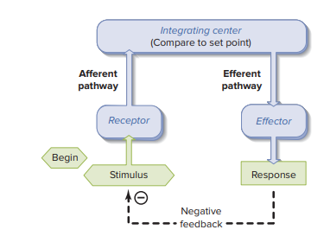
2.3 Components of Homeostatic Control Systems
Many homeostatic systems are reflexes (stimulus → response sequences).
A reflex is usually an involuntary, built-in response to a specific stimulus (e.g., knee-jerk).
Some “automatic” behaviors are actually learned (acquired reflexes) (e.g., experienced driving), and learning can modify many reflexes.

Slide 12
2.3 Components of Homeostatic Control Systems
A reflex pathway = reflex arc:
Stimulus = detectable change (internal or external)
Receptor detects the stimulus
Afferent pathway carries information to the integrating center
Integrating center compares to set point and “decides” output (often receives many inputs)
Efferent pathway carries commands from integrating center
Effector produces the response
If the response reduces the original stimulus, it creates negative feedback (typical homeostatic control).

Slide 13
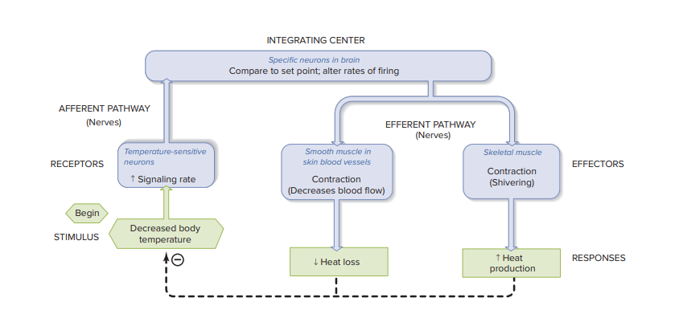
2.3 Components of Homeostatic Control Systems
Stimulus: decreased body temperature - Receptors: temperature-sensitive neuron endings
Afferent pathway: nerves carrying signals to the brain - Integrating center: specific brain neurons (compare to set point)
Efferent pathway: nerves to muscles and blood vessels - Effectors:
  smooth muscle in skin vessels → vasoconstriction → ↓ heat loss
  skeletal muscle → shivering → ↑ heat production
Result: temperature returns toward normal (negative feedback).

Slide 14
2.3 Components of Homeostatic Control Systems
Effectors: Who Performs the Response?
Almost any cell can be an effector, but the most common are:
  muscles
  glands
Glands may release hormones into the blood; hormones can affect many tissues at once.
Reflexes Can Use Nerves OR Hormones
Traditionally, reflex = all parts are nervous system.
But the same logic applies when:
  the efferent signal is a blood-borne messenger (hormone), or
  A gland acts as an integrating centre.
Example: ↑ blood glucose
  pancreas cells detect it (receptor) and release insulin (effector) → ↓ blood glucose.
Local Homeostatic Responses (Self-Regulation)
Local responses are homeostatic responses that happen only at the site of the stimulus (not body-wide).
Example: active tissue releases local chemicals → local vasodilation → ↑ blood flow → more O₂/nutrients, faster waste removal.
Importance: provides local self-regulation for specific areas.

Slide 15
2.4 The Role of Intercellular Chemical Messengers in
Homeostasis
Homeostasis depends on cell-to-cell communication, mainly through chemical messengers.
Hormones: Produced by endocrine glands (e.g., gonads, pancreas, thyroid) or scattered endocrine cells in organs → released into the blood → act on distant target cells (endocrine). Many hormones increase when homeostasis is threatened.
Neurotransmitters: released from neurons onto nearby neurons/muscle/glands → Diffuses across a small space (extracellular fluid), not via blood → Important for reflexes and rapid compensatory responses (e.g., ↑ heart and lung function during exercise).
Paracrine substances: released into extracellular fluid → act on neighbouring cells and are usually inactivated locally → fine-tuning stomach acid secretion after eating..
Autocrine substances: released by a cell and act on the same cell; a messenger can be both paracrine + autocrine → Common in the immune system.
Note 1: communication can also occur without secretion via gap junctions (direct cell-to-cell) or membrane-bound/juxtacrine contact.
Note 2: The same chemical can act as different messenger types depending on where/how it is released.
Example: norepinephrine
  neurotransmitter in the brain
  hormone from adrenal glands

Slide 16
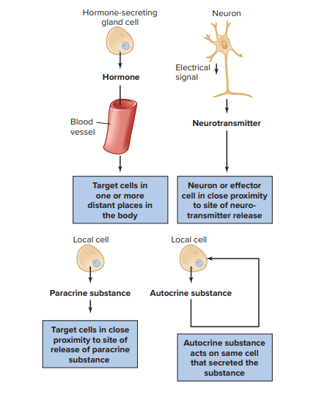
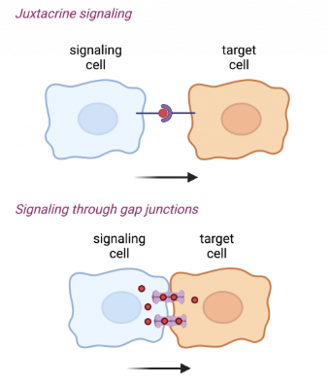
2.4 The Role of Intercellular Chemical Messengers in
Homeostasis

Slide 17
2.5 Processes Related to Homeostasis
Adaptation: inherited trait that improves survival in a specific environment (e.g., lactose digestion, dark skin vs UV).
Acclimatization: improved performance of an existing homeostatic system after repeated exposure (usually reversible).
Biological rhythms (circadian): daily (~24 h) internal timing that adds an anticipatory (feedforward-like) component.
Balance of substances: many systems maintain gain vs loss of chemicals (water, Na⁺, Ca²⁺, etc.).
Adaptation vs Acclimatization (Heat/Sweating Example)
Sweating in heat is an adaptive homeostatic response (helps increase heat loss).
With repeated heat exposure over days:
  sweating starts earlier
  sweating becomes more
  body temperature rises less → this is acclimatization (better response due to repeated exposure).
Usually reversible: stopping exposure → returns toward original state.
Mechanism often involves ↑ number/size/sensitivity of cells in the control system.

Slide 18
2.5 Processes Related to Homeostasis
Biological Rhythms (Circadian) and Homeostasis
Many functions show circadian variation: sleep–wake, body temperature, hormones, urine ion excretion.
Rhythms help homeostasis by pre-activating responses before a challenge occurs (anticipation).
  Example: body temperature rises before waking to support metabolism.
Rhythms are internally driven; environment mainly provides entrainment cues (light/dark) to set timing.
Brain pacemaker response to light/dark : suprachiasmatic nucleus (SCN) in hypothalamus; influences systems and helps control melatonin release (pineal gland). It has been hypothesized, therefore, that melatonin may act as an important mediator to influence other organs either directly or by altering the activity of the parts of the brain that control these organs.

Slide 19
2.5 Processes Related to Homeostasis
Balance of Chemical Substances
Many systems regulate the total-body balance of a substance using net gain vs net loss.
Pool = readily available amount (often ECF) and central distribution point.
Net gain pathways:
  GI tract (food), lungs (air), and synthesis in the body
Distribution within body:
  storage depots (can move in/out of pool)
  reversible incorporation into other molecules (e.g., into membranes)
Net loss pathways:
  excretion (kidneys, GI tract, lungs, skin, menstrual flow)
  metabolism (chemical alteration/removal)
Balance states:
  Negative balance: loss > gain, Positive balance: gain > loss and Stable balance: gain = loss
Example concept: Ca²⁺ balance changes across life (positive in growth; can become negative later, especially after menopause).

Slide 20
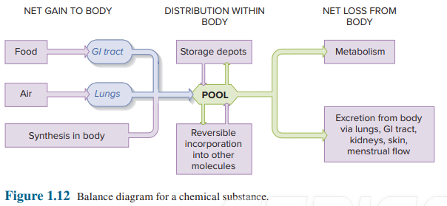

Slide 21
1- Distinguish between anatomy, physiology, and pathophysiology. How are they related?
2- All the fluid found outside cells is collectively called_______ fluid, and consists of _______and ________fluid.
3- The type of tissue involved in many types of transport processes are _______, and which often lines the inner surfaces of tubular structures, is called ___________ .
4- Plasma membranes separate __________ from ___________
A. Plasma from ISF B. ICF from ECF C. Bone from muscle
D. Organs from systems
5- Epithelial cell _______ side = attached toward basement membrane / body fluids

Slide 22
Thank you

