Slide 1
Parasitology Lab
Fecal Examination
• Introduction to fecal examination
• Specimen collection and preservation
• Examination methods

Slide 2
Specimen Collection
• Collect stool in clean, dry, leak-proof container
• Avoid contamination with urine or water
• Examine fresh stool immediately or preserve properly

Slide 3
Preservation of Stool Specimens
• Preserve as soon as possible
• Use 10% formalin if kits are unavailable
• Stool : preservative ratio = 1 : 3
• Mix well, especially formed stool

Slide 4
Staining Methods
Temporary stains:
• Saline
• Iodine
• Eosin
Permanent stains:
• Iron hematoxylin
• Trichrome stain

Slide 5
Fecal Examination
Macroscopic examination:
• Color and consistency
• Blood or mucus
• Proglottids or adult worms
Microscopic examination:
• Wet mount
• Concentration methods

Slide 6
Concentration Methods
Used to increase detection of parasites
• Sedimentation methods
• Flotation methods

Slide 7
Sedimentation Method
• Based on parasites being heavier than debris
• Parasite eggs and cysts settle at the bottom
• Example: Formalin–ether sedimentation
• Effective for heavy eggs (e.g. trematodes)

Slide 8
Formalin-Ether Sedimentation – Steps
1. Mix stool sample with formalin
2. Strain the mixture
3. Add ether
4. Centrifuge the sample
5. Discard supernatant
6. Examine sediment under microscope

Slide 9
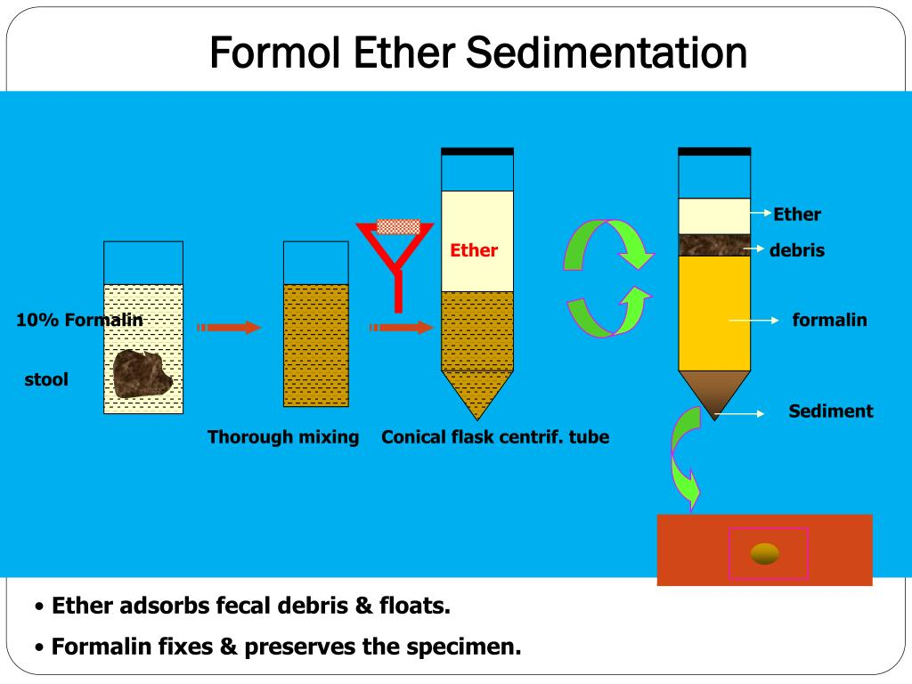

Slide 10
Flotation Method
• Based on difference in specific gravity
• Parasites float to surface in flotation solution
• Example: Zinc sulfate flotation , Saturated Salt Flotation – Steps , Baermann Technique – Steps
• Useful for protozoan cysts and light eggs

Slide 11
Zinc Sulfate Flotation – Steps
1. Mix stool with zinc sulfate solution
2. Strain the suspension
3. Centrifuge
4. Add more solution to form meniscus
5. Place coverslip
6. Examine microscopically

Slide 12
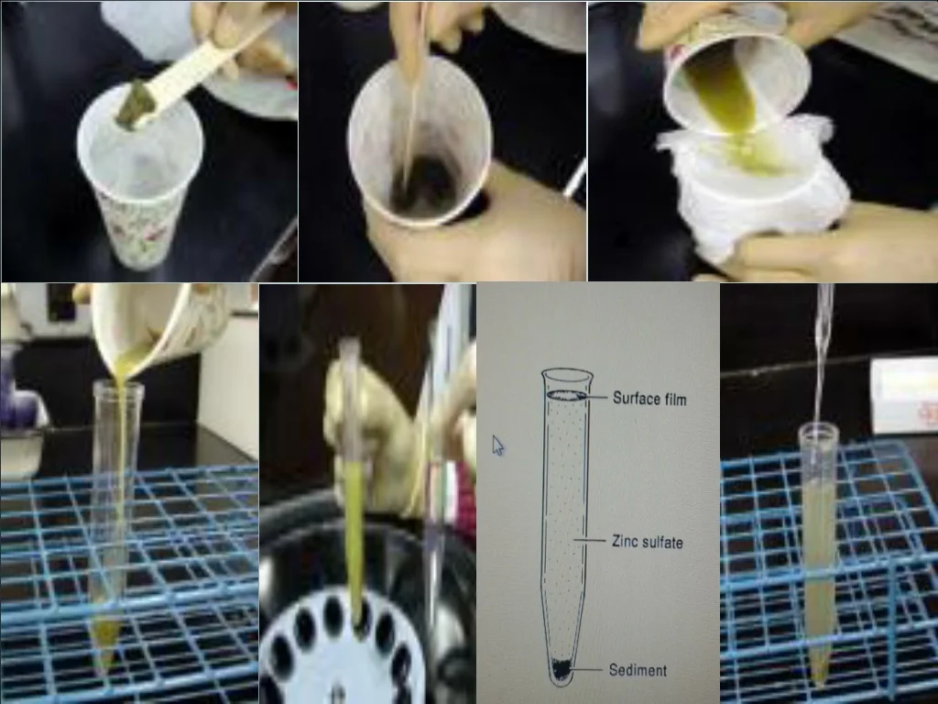

Slide 13
Sedimentation vs Flotation
Sedimentation:
• Good for heavy eggs
• High sensitivity
Flotation:
• Good for light eggs and cysts
• Cleaner background

