Slide 1


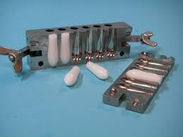
Suppositories
Lecturer : Nora Zawar Yousif
Lecturer : Zeina Dawood
Assistant Lecturer : Mustafa Mohammed Noori

Slide 2
Suppositories
Are solid dosage form intended for insertion into vaginal or rectal cavities where they melt, soften or dissolve and exert localized or systemic effects.
The shape and size of Suppositories must be such that it is capable of being easily insert into the intended body orifice without causing undue distention, and once inserted, it must be retained for appropriate period.

Slide 3
Types of suppository base
A- The fatty bases:
These bases melt at body temperature and consist of the naturally occurring theobroma oil (Cocoa – butter) and synthetic hard fats.
B- Water – soluble and water – miscible bases:
These bases dissolve or disperse in the body fluids. There are two groups of water – soluble bases:
Glycero – gelatin bases.
Macrogol (PEG) bases.

Slide 4
Preparation of Suppository
Suppositories are formulated in different shapes and sizes (usually 1 – 4 g). The suppository consists of a vehicle in which the drug is incorporated and in some cases, additives are co formulated.
Suppositories are manufactured by two general methods:
A- Fusion method (hot process):
The drug is added to the melted base and the mixture allowed cooling after pouring into molds.
B- Compression method (cold process):
The drug is incorporated with the un-melted base and the resulting mass shaped either by hand or by compression force in a metallic mold.

Slide 5
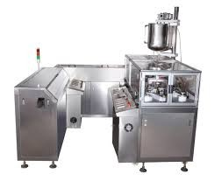
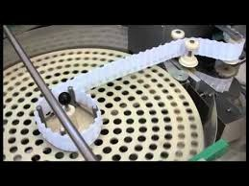
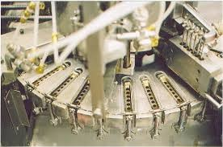
Manufacturing Suppositories

Slide 6
Mold calibration
The mold is generally made of melt in two halves which are clamped together with a screw.
The capacity of the mold is confirmed by filling the mold with the chosen base. The weight of the perfect products is taken and a mean weight calculated. This value is the calibration value of the mold for that particular base.

Slide 7
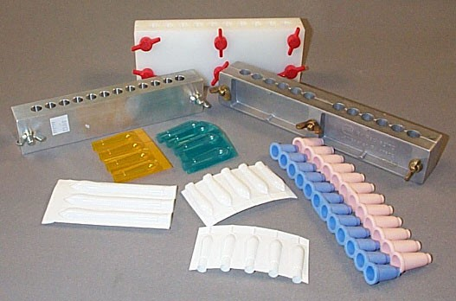
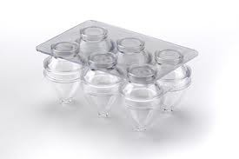
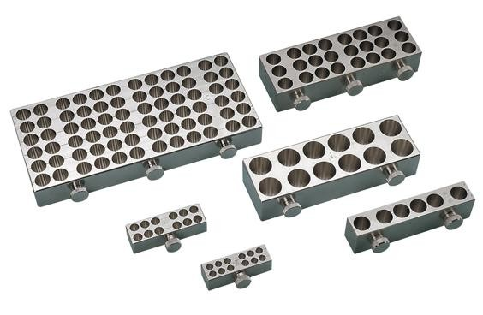
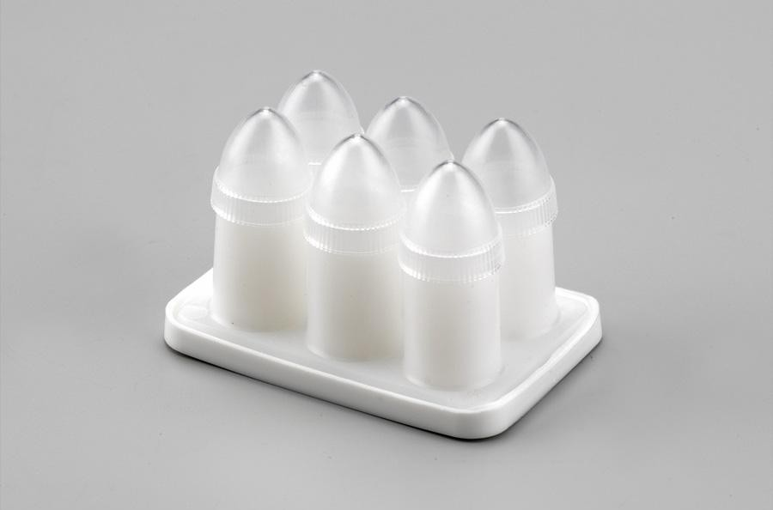

Slide 8
Displacement value (DVs)
The volume of a suppository from a particular mold is uniform but its weight will vary because the density of the medicaments usually differs from the density of the base.
The displacement value of a drug is the number of parts by weight of drug which displaces one part weight of the base

Slide 9
Rx
Bismuth subgallate = 300 mg per suppository
Cocoa butter = q.s. (quantity sufficient)
Prepare = 6 suppositories
Mold capacity = 1 g
So each mold holds 1 g of cocoa butter if no drug is added.
To allow for unavoidable wastage calculate for 8 suppositories
Each suppository contains 300 mg = 0.3 g
Number of suppositories = 8
0.3×8=2.4 g So total bismuth subgallate = 2.4 g
Each mold holds 1 g
8×1=8 g If there were no drug, we would need 8 g cocoa butter.
We use the displacement value (DV).
For bismuth subgallate, DV ≈ 2.7

Slide 10
Base displaced=Weight of drug/DV=2.4/2.7= 0.89 g
So 2.4 g drug displaces 0.89 g cocoa butter
Cocoa butter needed=Total base capacity−Base displaced =8−0.89=7.21 g
Final Formula for 8 suppositories
Bismuth subgallate = 2.4 g
Cocoa butter = 7.21 g

Slide 11
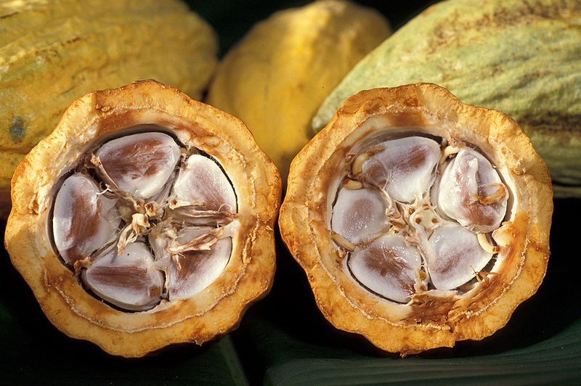
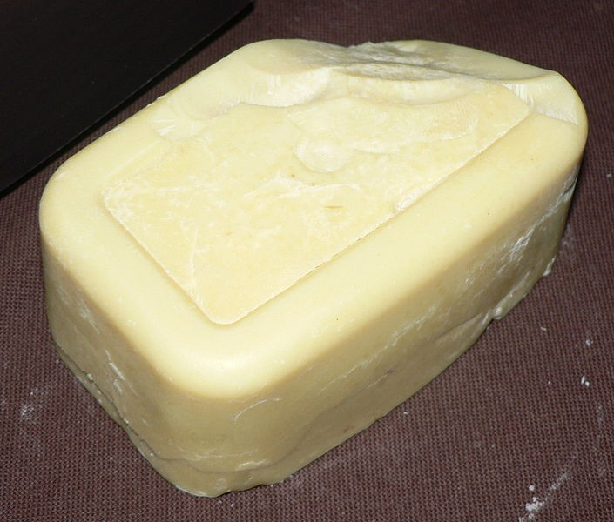
The Fatty Bases
The most important base is Theobroma oil (cocoa – butter) which exhibits many of the properties of an ideal suppository base:
It has melting point range of 30 – 36 0C and therefore, is solid at normal room temperature.
It readily liquefies on heating but sets rapidly when cooled.
It is bland, therefore, no irritation occurs.

Slide 12
Theobroma oil is no longer used because of many disadvantages:
Theobroma oil is polymorphic, i.e. when it is heated and cooled it solidifies in different crystalline forms (α, β, σ) which are differed in physical properties.
Theobbroma oil shrinks only slightly on cooling and therefore, may tend to adhere to the walls of the suppository mold. For this reason, the mold must be lubricated before use.
The relatively low melting point masks it unsuitable for use in hot climates.

Slide 13
The melting point is reduced if the active ingredients are soluble. This can be counteracted by adding bees wax.
theobroma oil deteriorates on storage.
It dose not have a high water – absorbing capacity.
Relatively high cost.

Slide 14
Thank You

