Slide 1


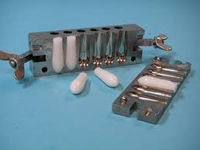
Suppositories
Lecturer : Nora Zawar Yousif
Lecturer : Zeina Dawood
Assistant Lecturer : Mustafa Mohammed Noori

Slide 2
Preparation of suppositories using theobbroma oil base
Accurately weigh required amount of base, place in beaker and put on water – bath, over gentle heat.
Allow approximately two – thirds of the base to melt and remove from the heat. The residual heat will be sufficient for the rest of the base to melt.
Reduce the particle size of the active ingredients, if necessary. This will be done by either grinding in a mortar and pestle or sieving.
Weigh the correct amount of medicament and place on a slab.
Add about half of the molten base to the powdered drug and rub together with a spatula.

Slide 3
scrap this mixture off the slab, using the spatula and place back into the beaker
If necessary, put the backer back over the water – bath to re-melt the ingredients
Remove from the heat and stir constantly until almost on the point of setting
Quickly pour into the mold, slightly overfilling each cavity.This is to allow for contraction on cooling
Leave the mold ant its contents to cool for about 5 minutes and then, using a spatula, trim the tops of the suppositories
Allow to cool for another 10 – 15 minutes until the suppositories are completely firm and set.

Slide 4
Rx1
Tannic acid
Oil of theobroma
Ft. supp.
gr.v q.s
Dv 0.9
Mitt. iii supp. Using 2 g mold. Sig. insert one as direct
Calculations:
Each suppository contains 0.33 g
Number of suppositories = 5
0.33×5=1.65 g So total tannic acid= 1.65 g
Each mold holds 2 g
5x2=10 g If there were no drug, we would need 10 g cocoa butter.
For tannic acid, DV ≈ 0.9 Base displaced=Weight of drug/DV=1.65/0.9= 1.83g
So 1.65 g drug displaces 1.83 g cocoa butter
Cocoa butter needed=Total base capacity−Base displaced =10-1.83=8.17 g
The total weight = 8.17 g + 1.65 g = 9.82 g
The weight of each suppository = 9.82 ÷ 5 = 1.96 g

Slide 5
0.2 g
Rx 2
Bismuth subgallate Resorcinol
Zinc oxide
Oil of Theobroma q.s. Ft.supp.
M.Ft. 3 supp. using 2 g mold Sig. insert one at night.
Calculations:
D.V
2.6
1.3
4.8
0.3 g
0.13
Let no. of supp. formulated = 3+2= 5
0.2 g *5 = 1 g Bismuth subgallate
1g /2.6 =0.38 g the base displaced by Bismuth subgallate.
0.3 g *5 = 1.5 g Resorcinol
1.5 g / 1.3 = 1.15 g the base displaced by Resorcinol
0.13 g *5 = 0.65 g Zinc oxide
0.65 g /4.8 = 0.135 the base displaced by Zinc oxide
The total amount of the base displaced = 0.38 + 1.15 + 0.135 = 1.665 ≈ 1.67 g
The weight of the base required to prepare five unmedicated suppositories =5*2 = 10 g
The weight of the base required to prepare five medicated suppositories=10 g – 1.67g = 8.33g The total weight of the three drugs = 1+ 1.5 +0.65 =3.15 g
8.33 g + 3.15 g = 11.48 g
The weight of each suppository = 11.48 /5 = 2.296 g

Slide 6
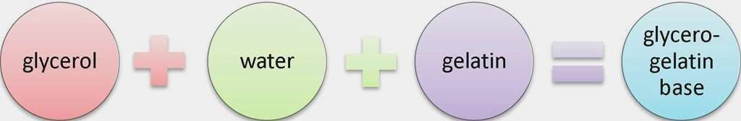
Glycero – gelatin bases (Water Soluble Bases)
These are compirse a mixture of glycerol and water, which is stiffened with gelatin. The commonest in use is glycerol suppositories BP which has 14 % w/w gelatin and 70 % w/w glycerol. In hot climates, the gelatin content can be increased to 18 % w/w.
Stiffer masses containing a higher proportion of gelatin are also used when the product contains more than about 20 % of semi – liquid or liquid because such additions make the pervious mass to soft.

Slide 7
The glycero – gelatin base have some properties:
glycero– gelatin bases have a physiological effect (laxative effect).
They are much more difficult to prepare and handle.
The solution time depends on the content and quality of the gelatin and the gas of the suppository.
Theyare hygroscopic and therefore, require careful storage and may cause rectal irritation.
Because of the water content, microbial contamination is more likely than with the fatty bases. Preservatives may require to be added to the product.
Gelatin is incompatible with protein precipitants such as tannic acid

Slide 8
Rx
Glycerin suppositories (U.S.P.) Glycerol
Sodium stearate Purified water To make about Ft. supp.
Mitt. 5 supp. using 2 g mold. Sig. one supp. at night.
91 g
9 g
5 g
100 g

Slide 9
Macrogol (PEG)
These are polyethylene glycols which are blended together to produce suppository bases which vary in melting points, dissolution rates and physical characteristics. High polymers produce preparations, which release the drug slowly. They are also brittle, less brittle products, which release the drug more readily can be prepared by mixing high polymers with medium and low polymers. Drug is released as the base dissolves in the rectal contents.
Macrogols have several properties, which make them ideal suppository bases:
They have no physiological effect, e.g. do not produce a laxative effect.
They are not prone to microbial contamination.
Some polymers have at a high melting point. These are useful for drugs, which lower the melting point of other bases.
They have a high water –absorbing capacity.

Slide 10
The disadvantages of macrogols:
They are hygroscopic which means they must be carefully stored. Irritation of the rectal mucosa can also occur.
They areincompatible with several drugs e.g. benzocaine penicillin, tannins, phenol and bismuth salts.
They became brittle if cooled too quickly and may become brittle on storage.
Crystal growth occurs with some active ingredients.

Slide 11
Rx
PEG1000 PEG400 PEG4000
Ft. supp.
35 %
40 %
25 %
Mitt. 5 supp. Using 2 g mold.

