Slide 1
Experiment 4
DISTILLATION

Slide 2
Distillation :
is process of purification of liquid organic compounds by the heat and condensation of the vapors state to the liquid state.
The temperature at which the liquid distills is definite value (at a given pressure)for every pure organic compound and is known as the boiling point.

Slide 3
Aim of the experiment:
  Purification of liquid organic substances.
  Determination of the boiling point.
  Separation of liquid organic substances from each other or from a nonvolatile compound.
Distillation limited because some organic compounds decompose when an attempt is made to distill them at a normal atmospheric pressure.

Slide 4
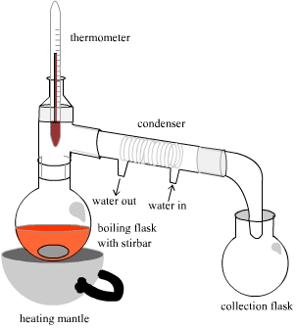
Types of Distillation:
  Simple distillation: This method is used for the separation of liquids having boiling points ranging from 30 °C to 150 °C and is stable to heat.

Slide 5
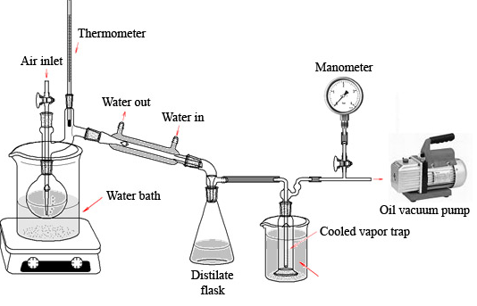
  2.Vacuum distillation. (Distillation under reduced or diminished pressure): This method is used for the separation of liquids with high boiling points or is unstable to heat. These difficulties may be overcome by lowering the pressure over the substance, thus lowering the boiling point and the temperature necessary to effect the distillation (diminished-pressure distillation).

Slide 6
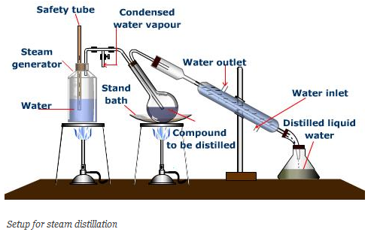
3.Steam distillation: This method is used for the purification of
non-volatile organic compounds and which are immiscible with water.

Slide 7
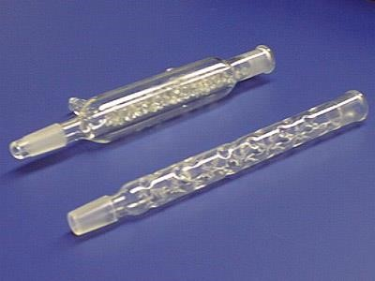
  5.Fractional distillation: This method is used for the separation of two or more liquids with different boiling points. Fractional distillation is the process of collecting separate fractions according to controlled boiling ranges during the distillation of a mixture of substances.
condensers for Fractional distillation

Slide 8
Azeotropic mixture is a mixture composed of two or more liquids that form a constant-boiling mixture that boils at a certain temperature. It is impossible to separate them by fractional distillation. For example, a mixture of approximately 95% ethyl alcohol and 5% water produces a constant-boiling mixture (Azeotropic mixture) which boils at 78.15 °C.
Other examples of Azeotropic mixtures include:
• Benzene and ethanol
• Carbon tetrachloride and methanol
• Amine and phenol
• Formic acid and water
• Toluene and acetic acid
• Ethanol, Benzene, and water

Slide 9
Simple distillation:
A single, individual organic substance is readily distilled with ordinary distillation apparatus which consists of a distillation flask fitted with a thermometer and water-cooled condenser. Two or three pieces of broken porcelain chips are placed in the flask with the substance to be distilled; they prevent bumping by producing a constant stream of bubbles that keeps the liquid in motion. If the liquid is quite volatile (low boiling), the flask is heated by a water bath rather than by a flame.

Slide 10
Procedure:
Put (100 ml) of ethanol in a boiling flask.
Add 2-3 pieces of boiling chips.
Start the water running slowly through the condenser.
Heat until boiling.
Adjust the temperature so that distillation proceeds at 2-3 drops per second.
Discard the first 2-3 ml of the distillate.
Continue distillation until you collect 30-60 ml.
Record the boiling point of your liquid, ethanol.

Slide 11
Useful notes:
• Pure compound distill over a very narrow range of temperatures.
• The boiling point is affected by impurities; some may increase the boiling point, others may decrease it, and some may not affect it. For example the addition of sodium chloride to water results in raising the boiling point of water. The effect observed here is the lowering of the vapor pressure of water that is, the tendency of the molecules to escape has been diminished.
• Usually the first few milliliters contain water or volatile impurities; the second portion contains the pure substance.

Slide 12
