Slide 1
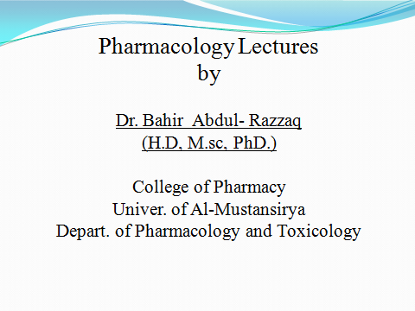

Slide 2
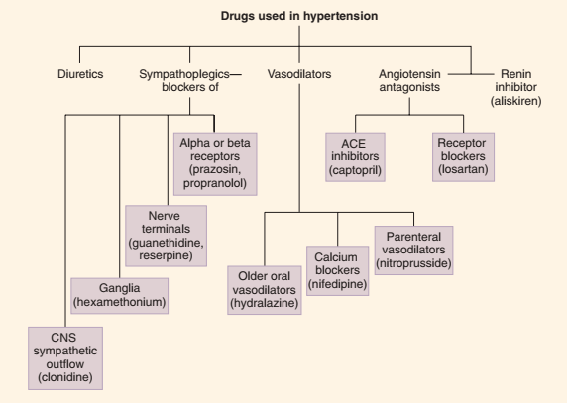

Slide 3
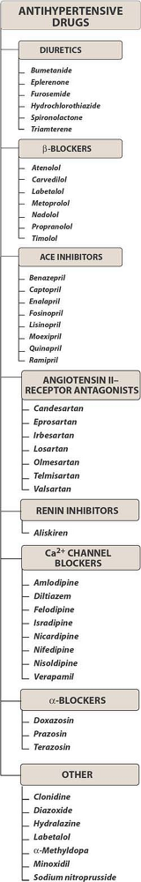

Slide 4
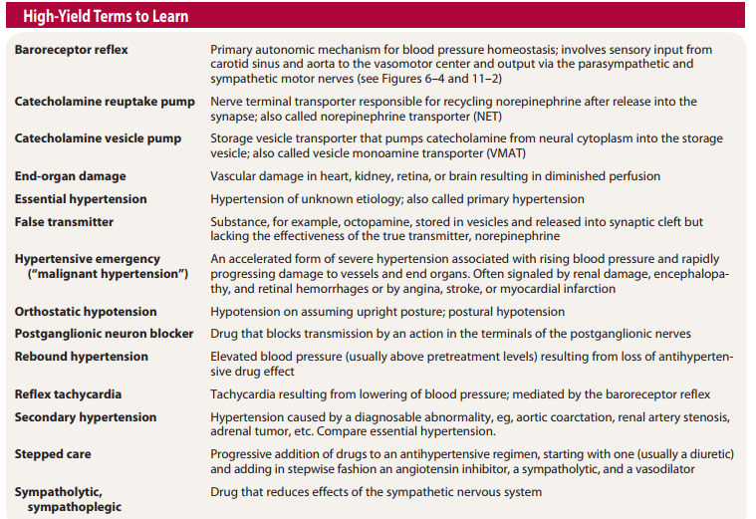

Slide 5
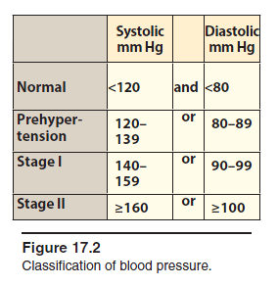

Slide 6
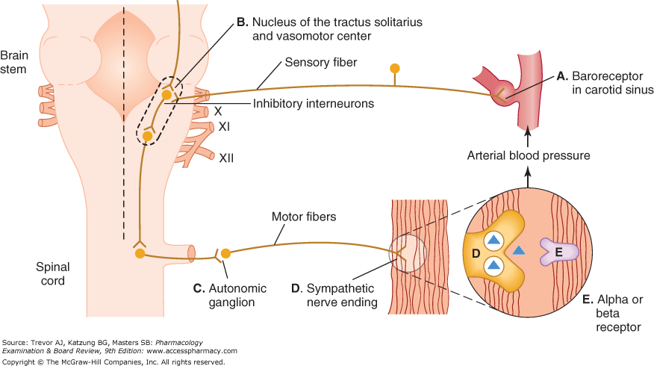

Slide 7
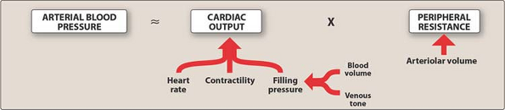

Slide 8
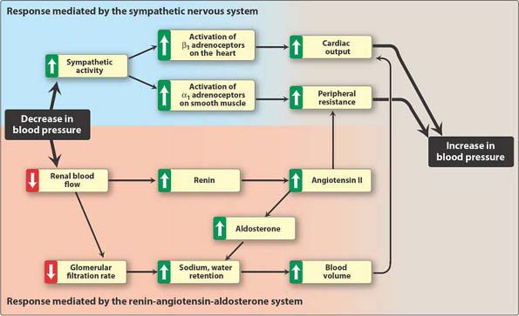

Slide 9
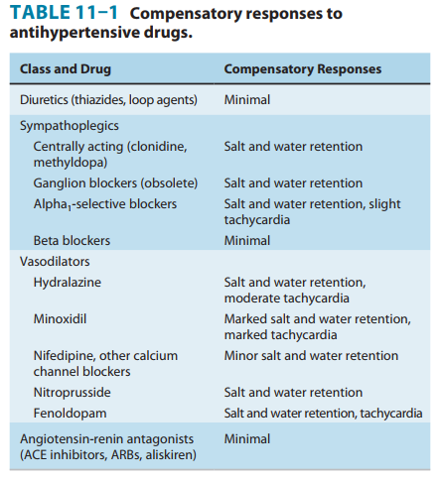

Slide 10
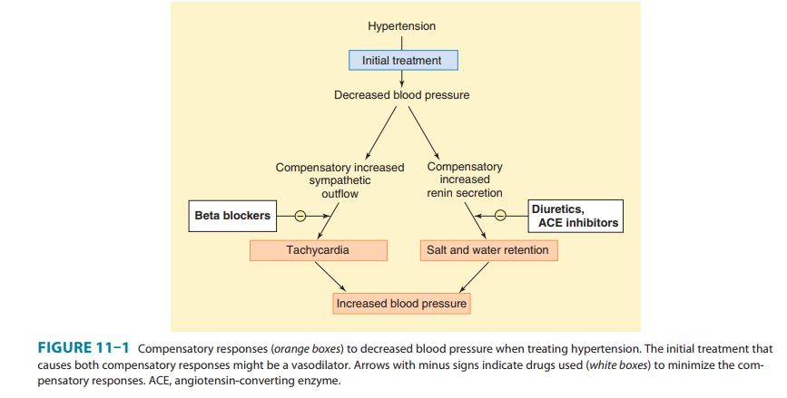

Slide 11
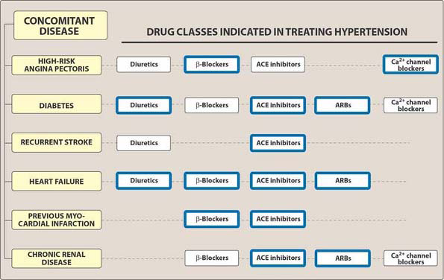

Slide 12
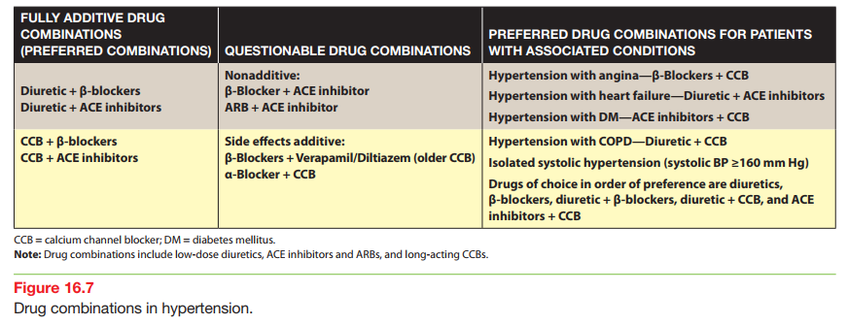

Slide 13
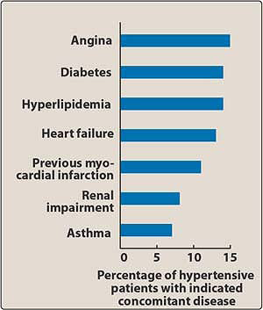

Slide 14
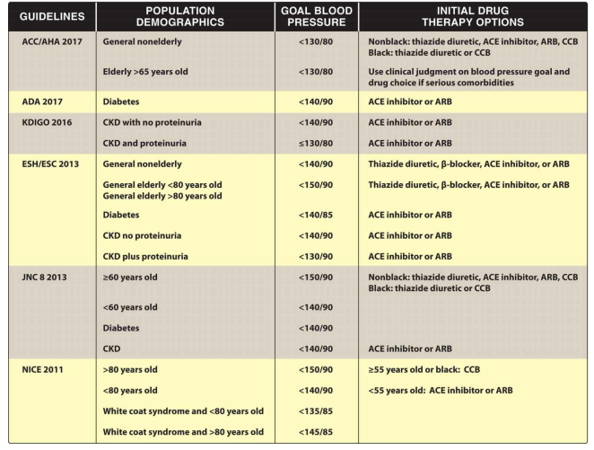

Slide 15
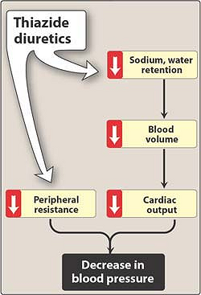

Slide 16
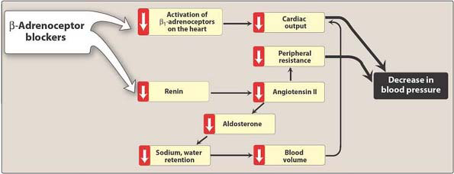

Slide 17
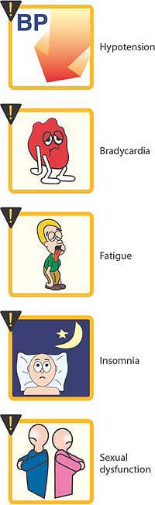

Slide 18
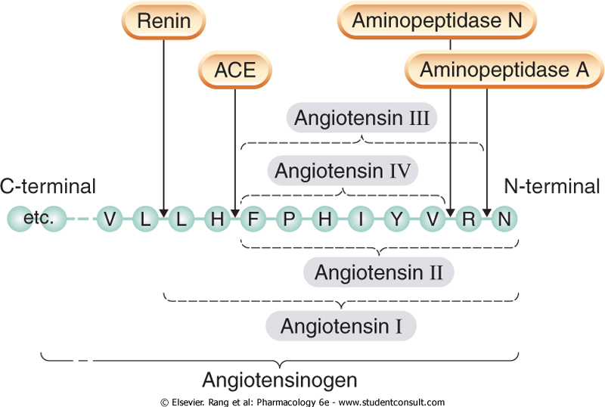

Slide 19
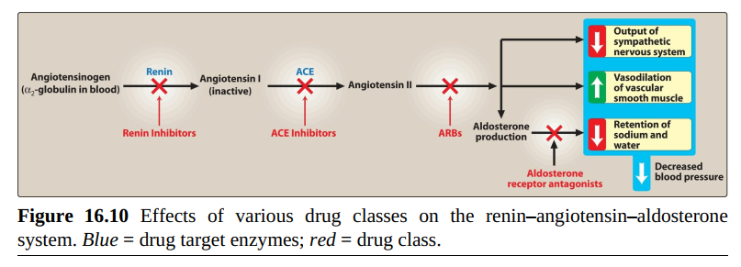

Slide 20
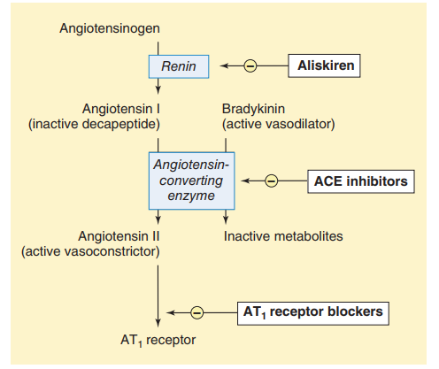

Slide 21
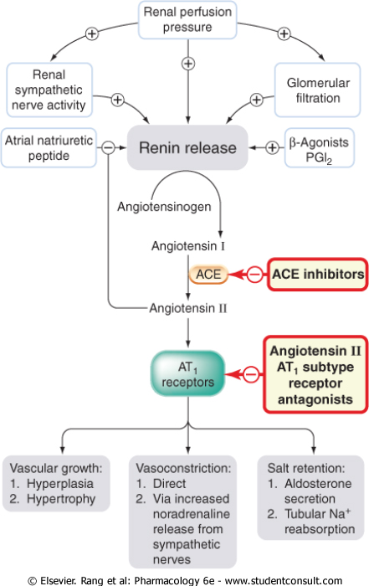

Slide 22
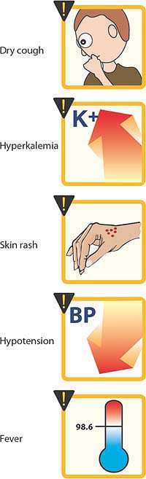

Slide 23
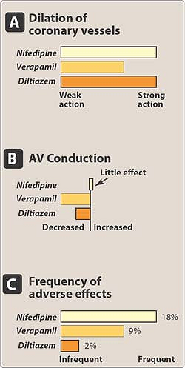

Slide 24
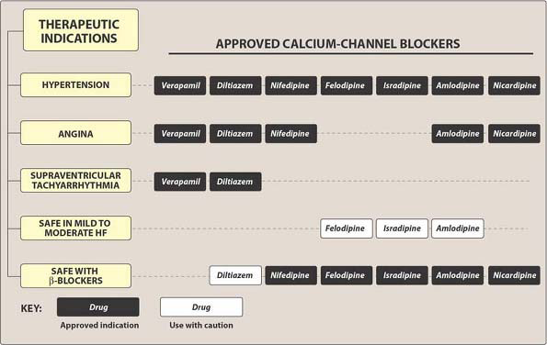

Slide 25
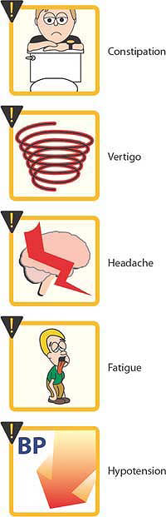

Slide 26
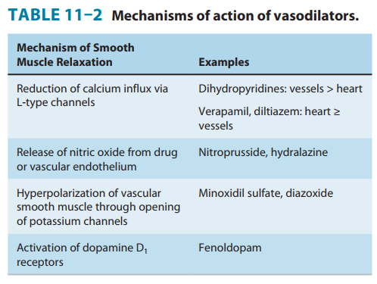

Slide 27
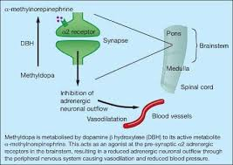

Slide 28
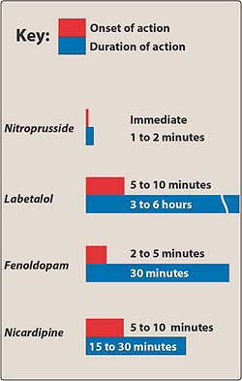

Slide 29
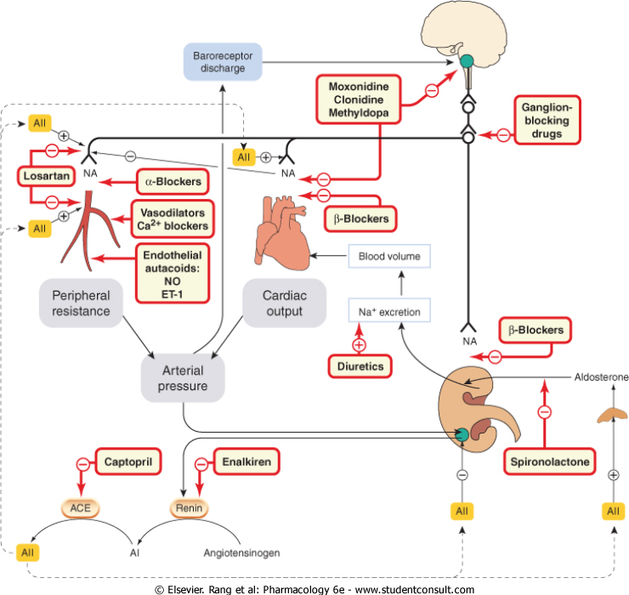

Slide 30
Checklist
When you complete this chapter, you should be able to:
List the 4 major groups of antihypertensive drugs, and give examples of drugs in each group. (Renin inhibitors are not considered an independent major group; can you name the drug that acts by this mechanism?)
Describe the compensatory responses, if any, to each of the 4 major types of antihypertensive drugs.
List the major sites of action of sympathoplegic drugs in clinical use, and give examples of drugs that act at each site.
List the 4 mechanisms of action of vasodilator drugs.
List the major antihypertensive vasodilator drugs and describe their effects.
Describe the differences between the 2 types of angiotensin antagonists.
List the major toxicities of the prototype antihypertensive agents.

Slide 31
Checklist
When you complete this chapter, you should be able to:
Name an antagonist of angiotensin at its receptor and at least 2 drugs that reduce the formation of angiotensin II.
Outline the major effects of bradykinin and brain natriuretic peptide.
Describe the functions of converting enzyme (peptidyl dipeptidase, kininase II).
List 2 potent vasoconstrictor peptides.

Slide 32
Which one of the following drugs may cause a precipitous fall in blood pressure and fainting on initial
administration?
A. Atenolol.
B. Hydrochlorothiazide.
C. Nifedipine.
D. Prazosin.
E. Verapamil.

Slide 33


