Slide 1
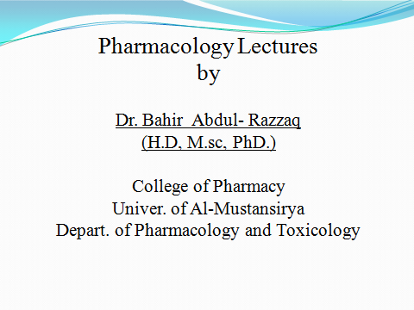

Slide 2
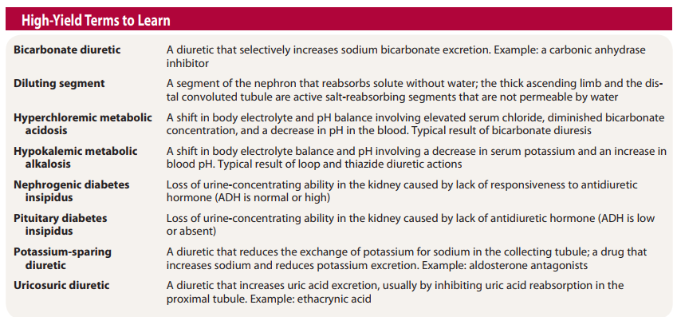

Slide 3
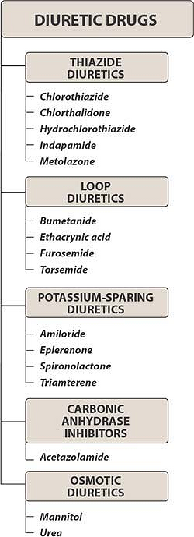

Slide 4
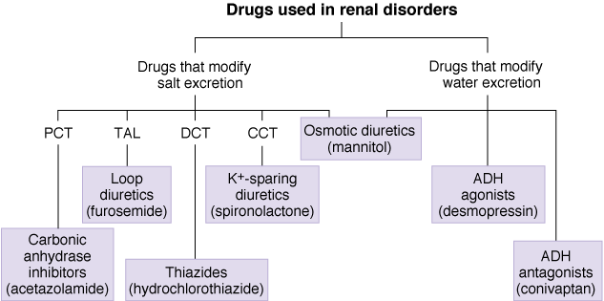

Slide 5
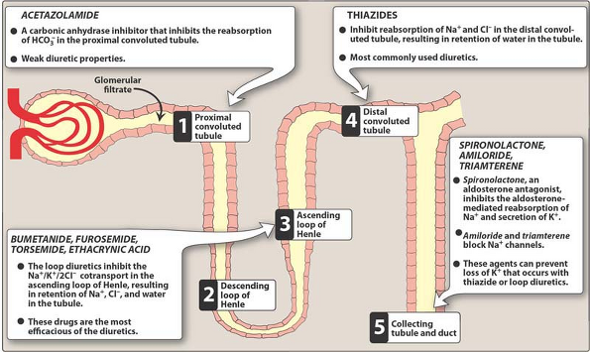

Slide 6
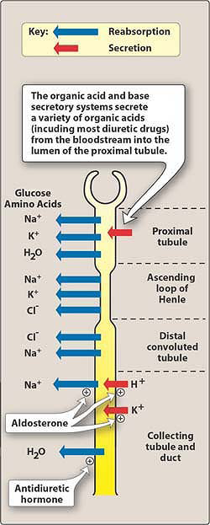

Slide 7
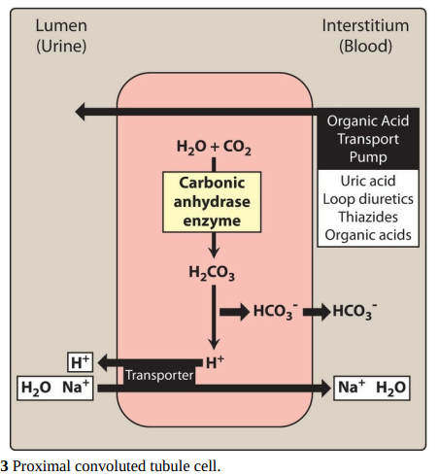

Slide 8
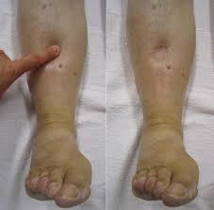

Slide 9
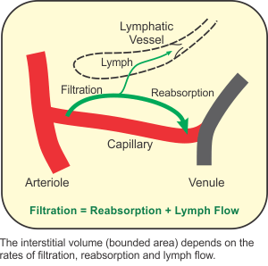

Slide 10
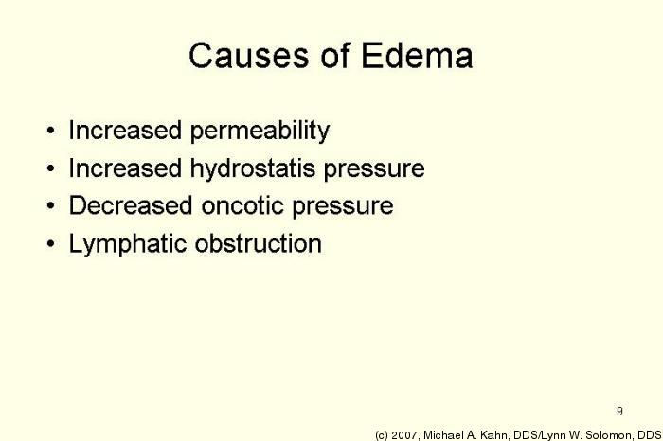

Slide 11
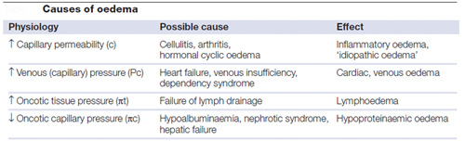

Slide 12
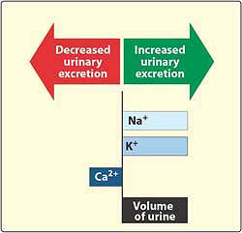

Slide 13
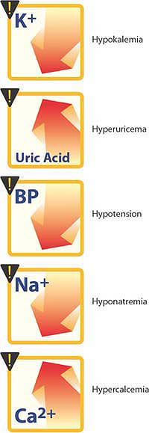

Slide 14
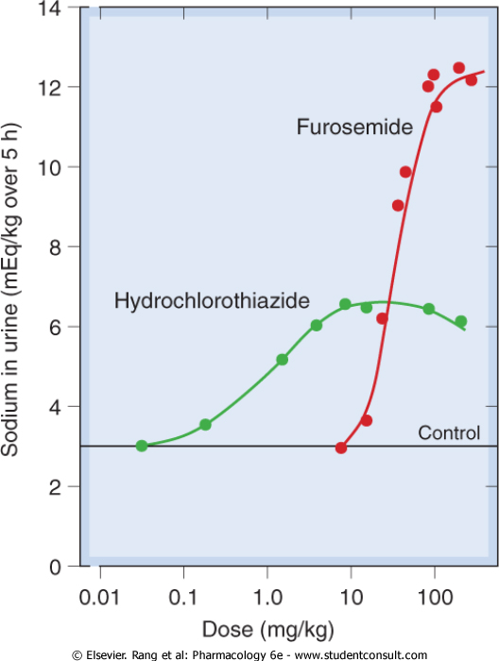

Slide 15
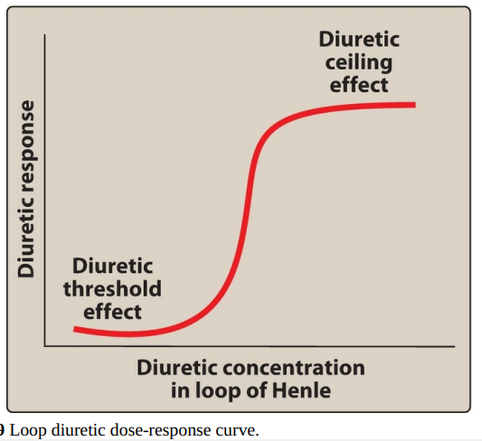

Slide 16
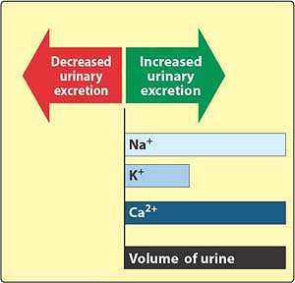

Slide 17
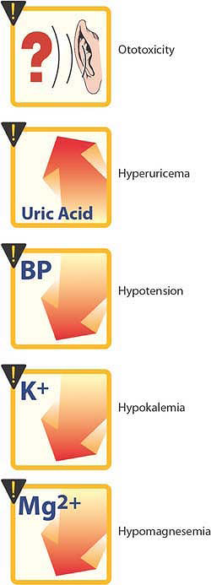

Slide 18
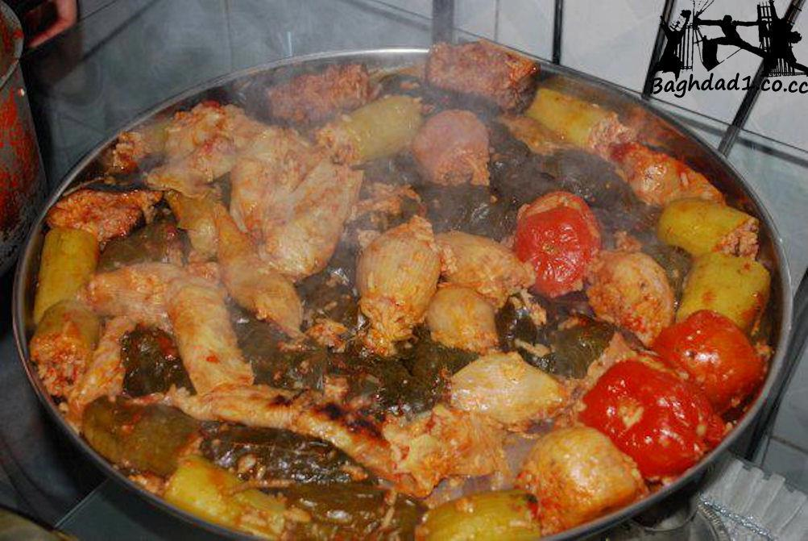

Slide 19
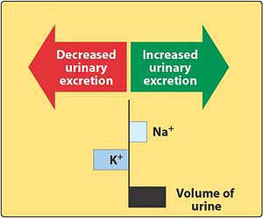

Slide 20
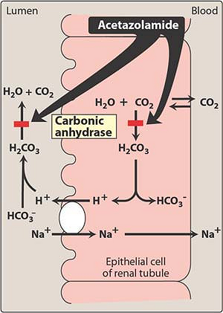

Slide 21
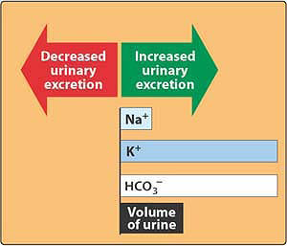

Slide 22
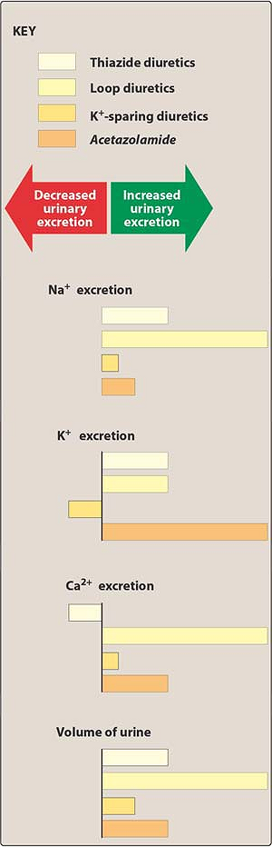

Slide 23
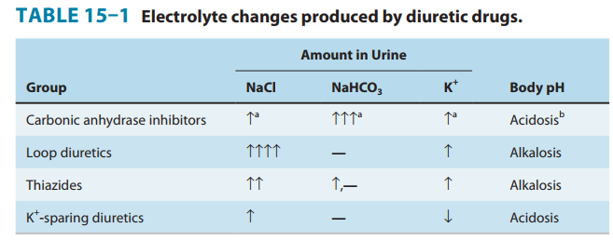

Slide 24
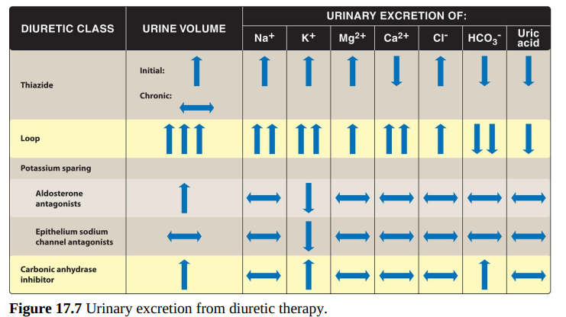

Slide 25
Checklist
When you complete this chapter, you should be able to:
List 5 major types of diuretics and relate them to their sites of action.
Describe 2 drugs that reduce potassium loss during sodium diuresis.
Describe a therapy that reduces calcium excretion in patients who have recurrent urinary stones.
Describe a treatment for severe acute hypercalcemia in a patient with advanced carcinoma.
Describe a method for reducing urine volume in nephrogenic diabetes insipidus.
List the major applications and the toxicities of acetazolamide, thiazides, loop diuretics, and potassium-sparing diuretics.

Slide 26
An alcoholic male has developed hepatic cirrhosis. To control the ascites and edema, he is prescribed
which one of the following?
A. Hydrochlorothiazide.
B. Acetazolamide.
C. Spironolactone.
D. Furosemide.
E. Chlorthalidone.

Slide 27


