Slide 1
Pharmacognosy
The word Pharmacognosy formed from two Greek words
pharmakon
gnosis
which means acquire knowledge.
which means drug

Slide 2
Pharmacognosy covering all information on medicine from natural sources (plants, animals, and microorganisms)
Pharmacognosy is closely related to both botany and plant chemistry.
The classification of vegetable drugs are usually arranged for study in one or other of the following five ways:
1- Alphabetical: using either Latin or English names
2- Taxonomic: families, genera and species
3- Morphological: either organized drugs (leaves, flowers, seed, herbs……..etc) or unorganized (extracts, gums, resins, oils …etc.)
4- Pharmacological or therapeutic uses
5- Chemical e.g. alkaloids, glycosides, volatile oils ……etc.

Slide 3
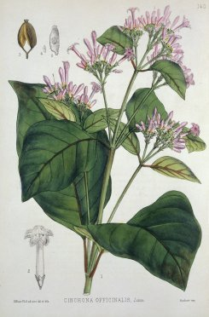
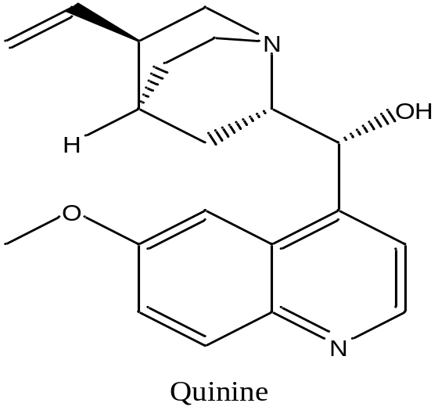
1- Cinchona
Botanical name: Cinchona succirubra
Family name: Rubiaceae
Local name: الكينة
Active compound: Alkaloid quinine
Part used: bark
Basic structure :
Dosage form: tablets
Therapeutic use: malaria

Slide 4
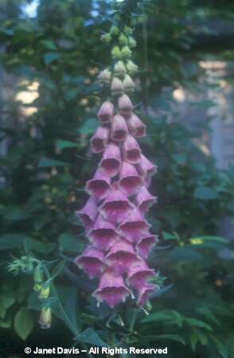
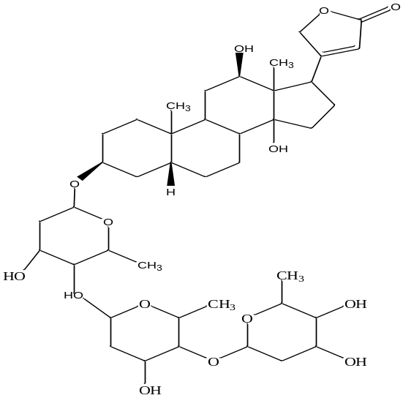
2-DIGITALIS
Botanical name: Digitalis lanata
Family name: scrophulariaceae
Part used: Dried leaves
Local name: زهرة الكشتبان Active compound: Cardio tonic glycoside
(Digoxin)
Basic structure :
Dosage form: tab., drops, injection.
Therapeutic use: cardio tonic glycoside (increase the tone of heart muscle)

Slide 5

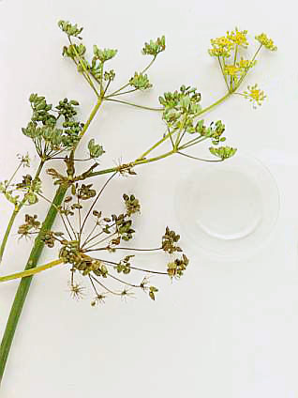
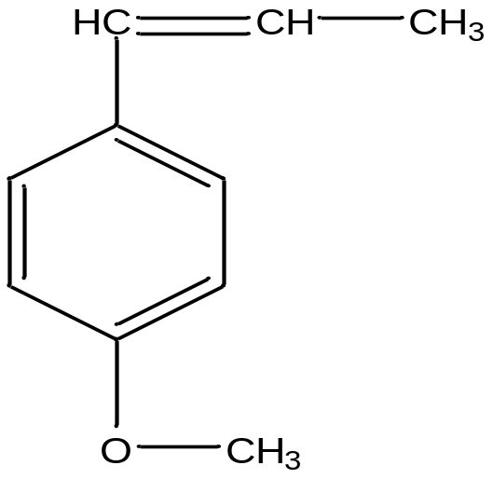
3- FENNEL
Botanical name: Foeniculum vulgarae
Family name: Umbelliferae
Part used: Fruit, seeds
Local name: حبة حلوة
Active compound: Volatile oil
Basic structure :
Dosage form: syrup
Therapeutic use: Flavoring agent and carminative

Slide 6
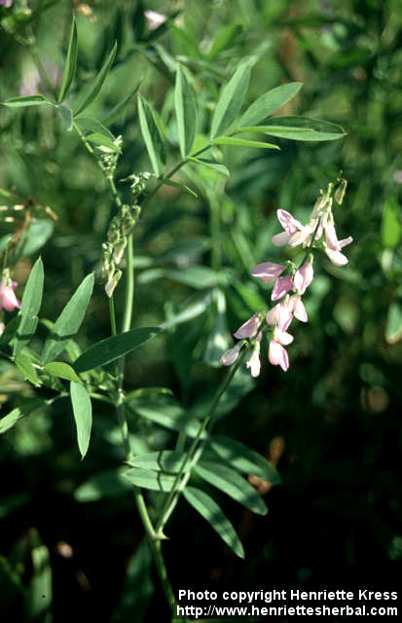
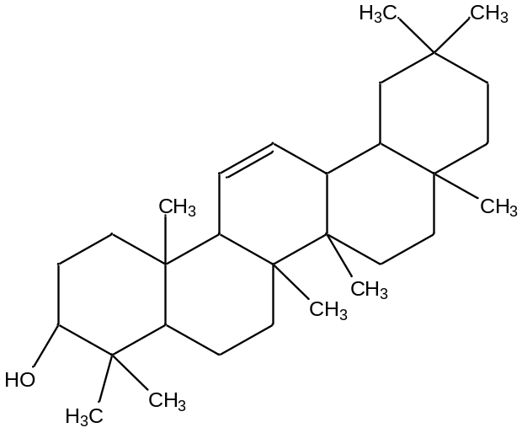
4- GLYCYRRHIZA
Botanical name: Glycyrrhiza glabra
Family name: Leguminosae
Part used: ROOT
Local name: السوس
Active compound: saponin glycoside
(glycyrrhizin)
Basic structure :
Therapeutic use: demulcent, expectorant, laxative

Slide 7
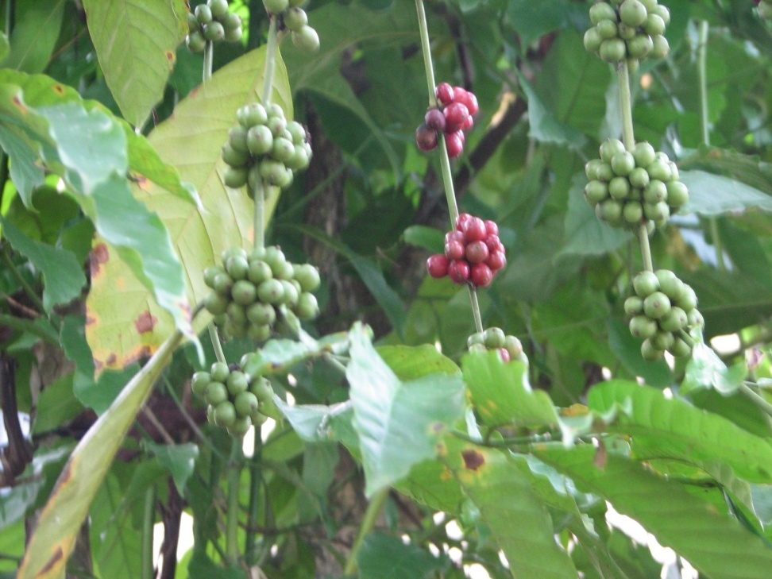
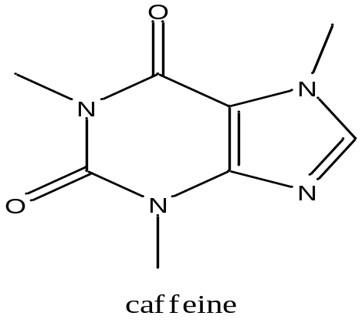
5-COFFEE
Botanical name: Coffea arabica
Family name: Rubiaceae
Part used: seeds
Local name: القهوة
Active compound: caffeine
Basic structure :
Therapeutic use: CNS stimulant

Slide 8
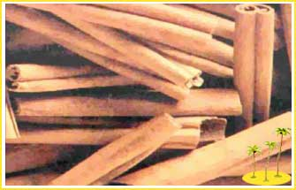
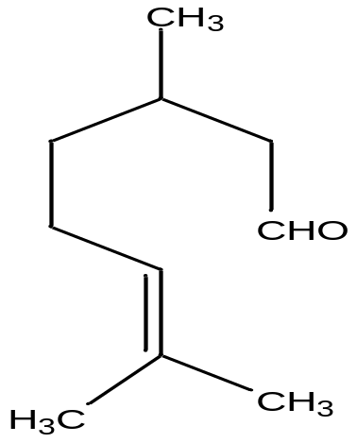
6-cinnamon
Botanical name: Cinnamonum zeylanicum
Family name: Lauraceae
Part used: bark
Local name:الدارسين
Active compound: aldehyde Volatile oil
Basic structure :
Dosage form: solution and ointment
Therapeutic use: carminative

Slide 9
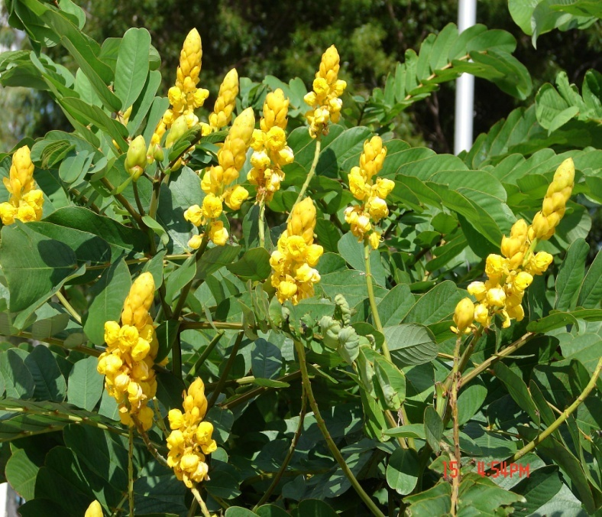
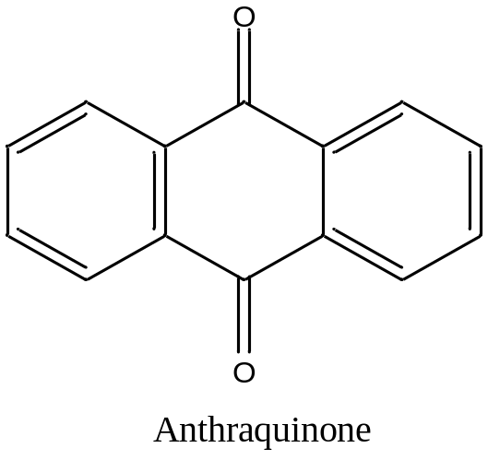
7- SENNA
Botanical name: Cassia acutifolia
Family name: Leguminosae
Part used: leaf and pods
Local name: السنامكي
Active compound: Anthraquinone glycoside
Basic structure :
Dosage form: tablet
Therapeutic use: cathartic or laxative

Slide 10

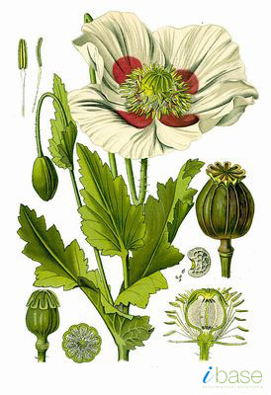
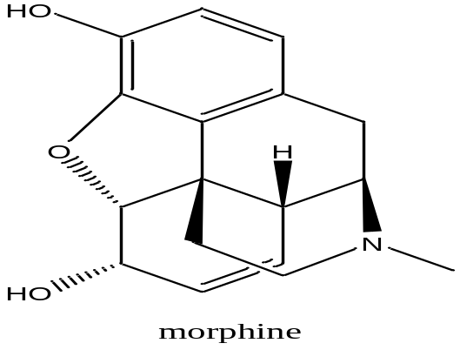
8-Papaver
Botanical name: Papaver somniferum
Family name: Papaveraceae
Part used: ripe capsules
Local name: الخشخاش
Active compound: alkaloid e.g. morphine, papaverine, codeine
Basic structure
Dosage form: tab, syrup.
Therapeutic use: narcotic, analgesic, antitussive and antispasmodic

Slide 11

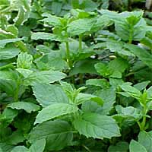
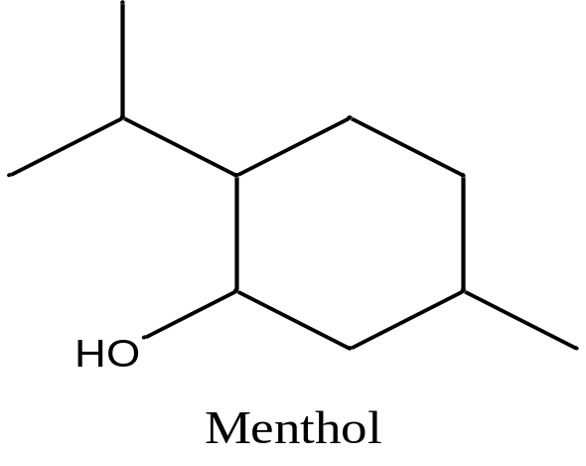
9-MENTHA
Botanical name: Mentha piperita
Family name: Labiatae
Part used: leaves
Local name: النعناع
Active compound: Volatile oil (menthol)
Basic structure :
Dosage form: ointment, syrup.
Therapeutic use: flavor, carminative, counter irritant

Slide 12

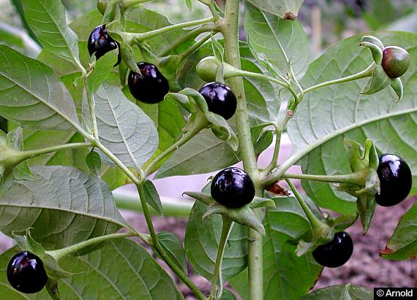
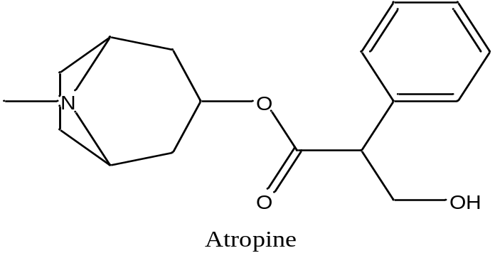
10-Belladonna
Botanical name: Atropa belladonna
Family name: Solanaceae
Part used: leaves
Local name:ست الحسن
Active compound: atropine, hyosine, hyoscyamine
Basic structure :
Dosage form: tab., Inj., drops, syrup.
Therapeutic use: antispasmodic, mydriatic

Slide 13

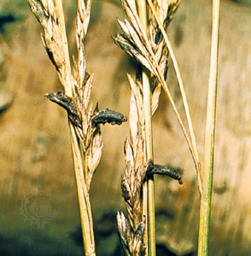
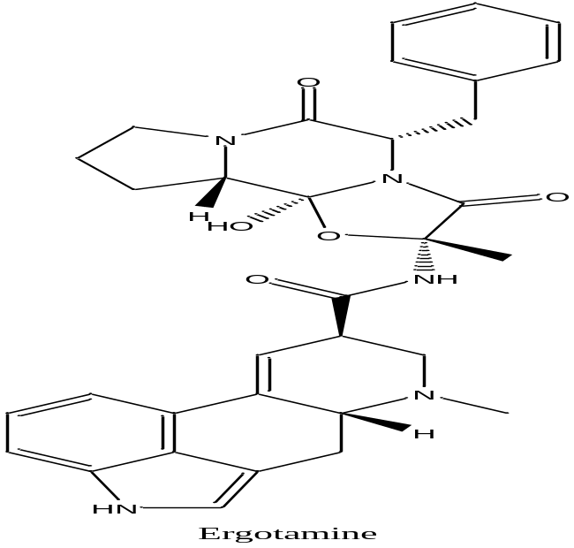
11-ERGOT
Scientific name: Claviceps purpurea
Family name: Claviceptaceae
Part used: dried sclerotium
Local name:المهماز
Active compound: indole alkaloid (Ergotamine)
Basic structure :
Dosage form: tab., Inj.
Therapeutic use: oxytocic ,
migraine treatment

