Slide 1
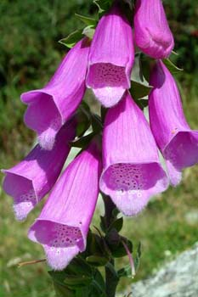
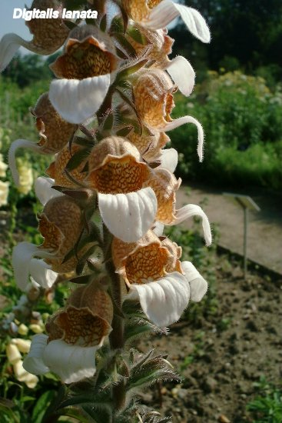
GLYCOSIDES
Cardio active glycosides
Lab.2

Slide 2
Introduction
Glycosides are compounds that yield on hydrolysis , one or more sugar .
Thus the glycoside composes of two parts: the sugar and the aglycone. The aglycon may be a terpene, a flavonoid, a coumarine or any other natural product.
Glycosides are soluble in water and alcohols.
Inside the body the glycoside will be cleaved to glycone and aglycone parts.
Glycone part (Sugar): water soluble, insoluble in the organic solvents.
Increase number of sugars increase water solubility.
Aglycone part: water insoluble, soluble in the organic solvents.

Slide 3
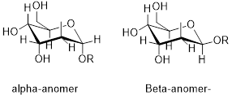
Two forms of glycosides are present the α-form and the β- form, but the β-form is the one that occur in plants .

Slide 4
Chemically, glycosides are usually mixed acetals in which the hydroxyl group on the anomeric carbon is replaced by a moiety possessing a nucleophilic atom. Thus the
sugar moiety of a glycoside can be joined to the aglycone via
Oxygen atom (O-glycosides -1)
Carbon atom (C-glycosides -2)
Nitrogen atom (N-glycosides- 3
Sulfur atom (S-glycosides-4)

Slide 5
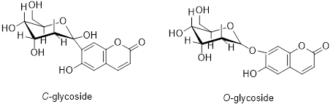

Slide 6
CARDIO ACTIVE GLYCOSIDES
They are named as cardio active glycosides due to their action on the heart muscle.
The aglycone part here is a steroid. Which is chemically cyclopenta phenanthrene .
The steroidal aglycones are two types:
Cardenolide (α-β unsaturated-5 member lactones' ring).
Bufadienolide(doubly unsaturated 6-member lactones' ring)
The more prevalent in nature is the cardenolide type.

Slide 7
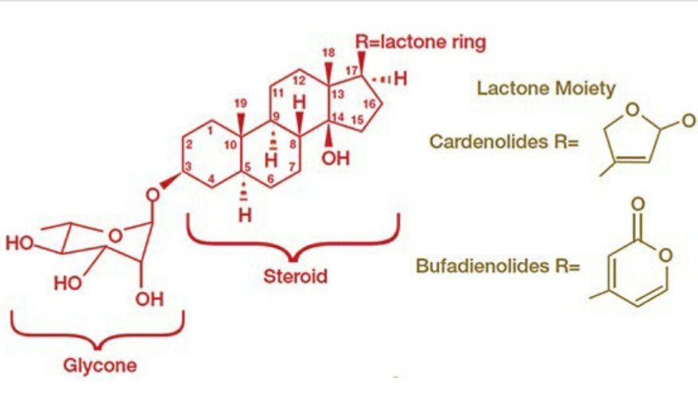

Slide 8
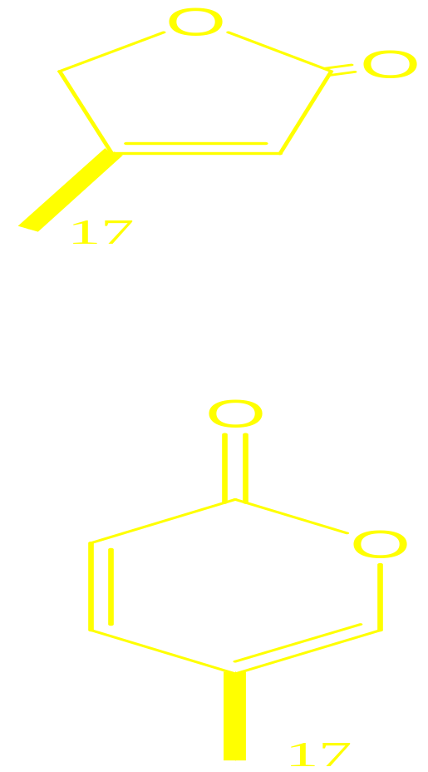
Cont…
The presence of lactone ring at 17-β:
According to the type of lactone ring Cardiac Glycosides are classified into:
  1) Cardinolides:
  Containing 5-membered unsaturated lactone ring
  e.g. Digitalis .
  2) Bufadienolides:
  Containing 6-membered unsaturated lactone ring
  e.g. Squill

Slide 9
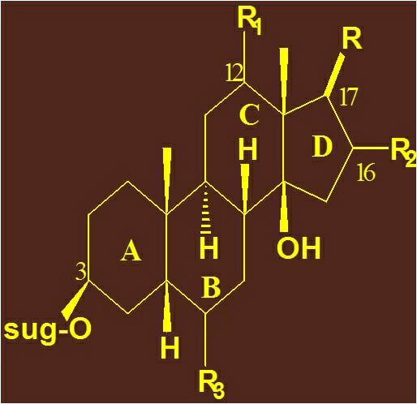
Cont…
For maximum activity of the cardio active glycosides the following points are important :
3b-OH group involved in glycosidic linkage.
14b-OH group at C-14.
A/B ring junction cis
B/C ring junction trans
C/D ring junction cis
Cis means on the same side.
Transe means on the other side or across .

Slide 10
Plants containing cardio active glycosides
1) Digitalis (digitalis or fox glove) Digitalis purpurea .
The family Scrophulariaceae.
The name digitalis is from the Latin digitus which means finger refers to finger- shaped.
While purpurea refers to the purple color of the their flower.
This plant contains a number of glycosides as digitoxin , gitoxin and gitaloxin.
2) Digitalis lanata of the same family, from which the digoxin is obtained.

Slide 11
Cont…
Digitalis purpurea

Slide 12
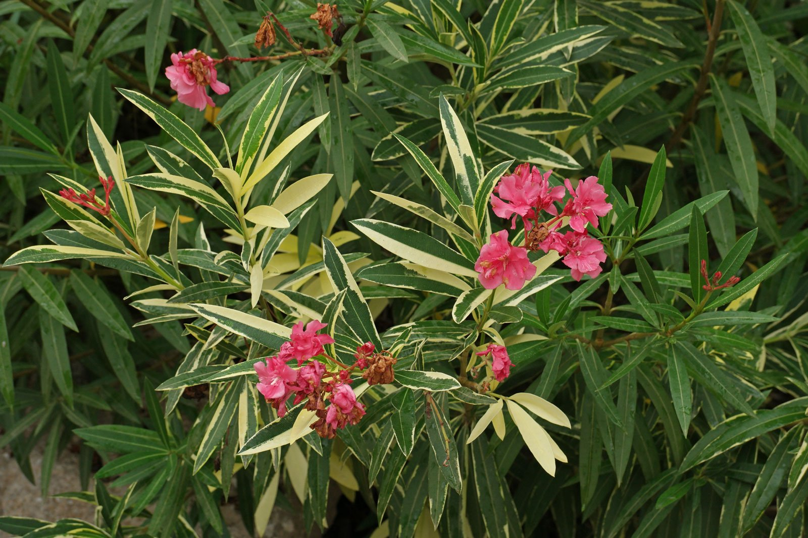
Cont…
3) Nerium oleander of the family Apocyanaceae. Here the glycoside is oleanderin .

Slide 13
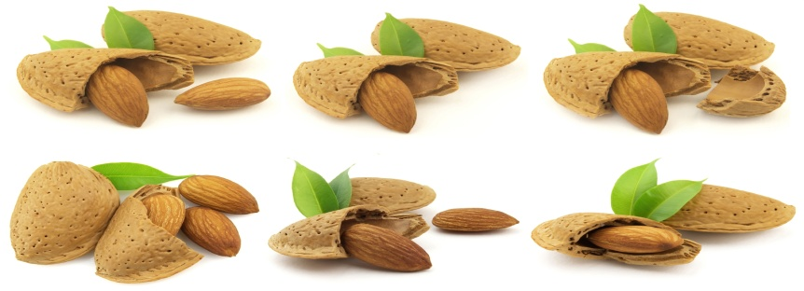
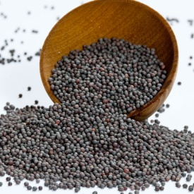
Cont…
Glycosides hydrolyzed by using mineral acids and temperature or by using enzymes such as:
Emolsin enzyme which is present in Bitter almond seeds.
Myrosin or Myrosinase enzyme which is present in black mustard seeds.

Slide 14
Generally in the extraction of the glycosides we need the following points
A polar solvent, which is mostly alcohol, but not water, since water may induce fermentation , in addition water needs high temperatures due to its high boiling point.
Neutralization of the extract with base, since the presence of acid lead to hydrolysis of the glycoside.
Use of heat is to inhibit the activity of the hydrolytic enzyme that is present in the plant cell.

Slide 15
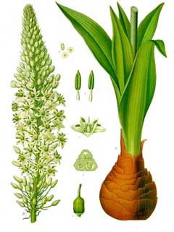
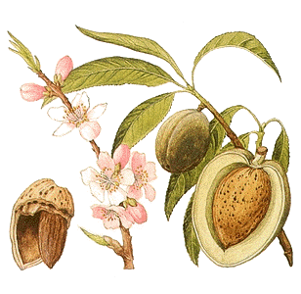
Thank you

