Slide 1
Pharmacognosy
3rd Class, 1st Semester
ISOLATION OF PODOPHYLLOTOXIN FROM Podophyllum emodi
Lab.1

Slide 2
Lignans
Lignans are low molecular weight polymers
Podophyllotoxin (abbreviated as PPT) is a lignan extracted from the roots and rhizomes of Podophyllum species :
Podophyllum Emodi
Podophyllum hexandrum
Podophyllum peltatum

Slide 3
Podophyllum
Botanical Name : Podophyllum Emodi
Family Name : Berberidaceae
Common Name : Indian Podophyllum,
Himalayan , May Apple.
Part Used : Rhizomes, Roots, Fruits.
Habitat : Distributed in northern himalayan region .

Slide 4
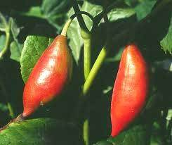
Podophyllum Emodi

Slide 5
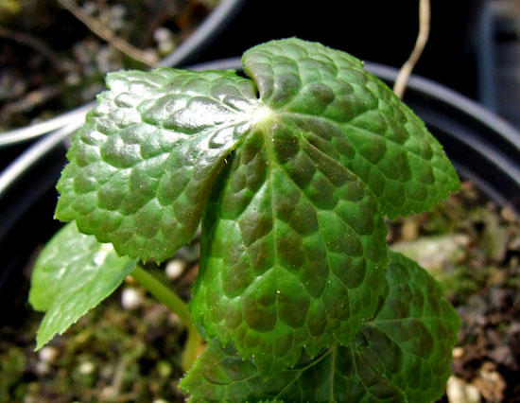
Podophyllum hexandrum

Slide 6
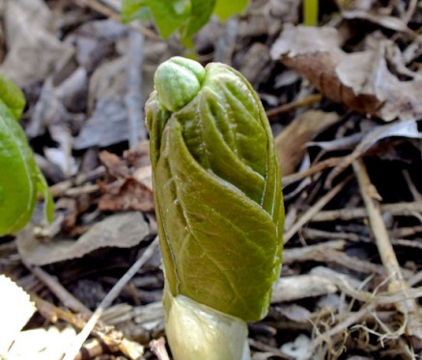
Podophyllum peltatum

Slide 7
Mechanism of action
This compound inhibits the enzyme tubulin polymerase which is needed for the synthesis of tubulin, a protein that is a vital component of cell division (mitosis).
Podophyllotoxin is highly toxic and not used clinically for the treatment of cancers, but this class of compounds was an excellent template on which to base the semisynthetic analogue etoposide and tenoposide.

Slide 8
Medicinal Uses :
Podophyllotoxin (abbreviated as PPT) is a lignan extracted from the roots and rhizomes of Podophyllum species.
Genital warts by applying podophyllum resin, also called podophyllin directly to the affected area is effective for the removal of warts caused by human papillomavirus
PPT and its derivatives display a wide selection in medical applications such as antirheumatic, antiviral, and antitumor agents(including lung cancer, lymphomas, and genital tumors).
.

Slide 9
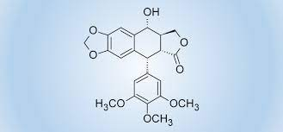
Podophyllotoxin structure

Slide 10
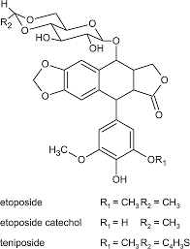

Slide 11
Aim: - to isolate the Podophyllotoxin from Podophyllum.
Extract 4gm powdered Podophyllum emodi root by stirring and heating with 100 ml of ethanol for about 10 minutes
Cool and filter the mixture
Re-extract the residue with further 100 ml of ethanol
Combine the extracts and evaporate to about 20 ml

Slide 12
add the ethanolic solution into 100 ml of water, and extract three times with 50 ml of ethyl acetate.
Combine the extract and evaporate to dryness
Isolate the Podophyllotoxin by preparative TLC.
crystallizing at 0 C° for several days

Slide 13


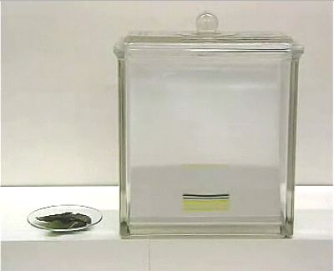
IDENTIFICATION OF PODOPHYLLOTOXIN BY CHROMATOGRAPHY (T.L.C)
Making the tank
The mobile phase= Chloroform : methanol (90:10)
Dichloromethane :methanol (95:5)
Making the silica gel plates
Spotting :- Sample and standard .
Podophyllotoxin
Detection : U.V 254 nm
Or 50% ethanolic H₂SO₄
Or concentrated H₂SO₄
Or vanillin –sulphuric acid

Slide 14
Thank you

