Slide 1
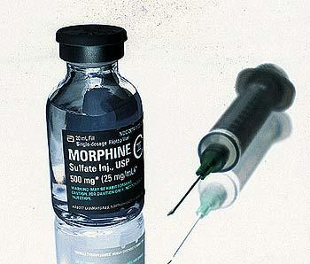
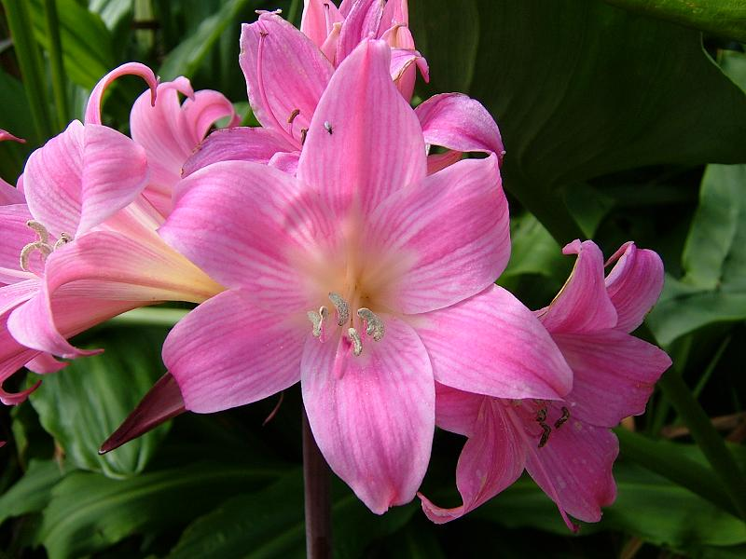
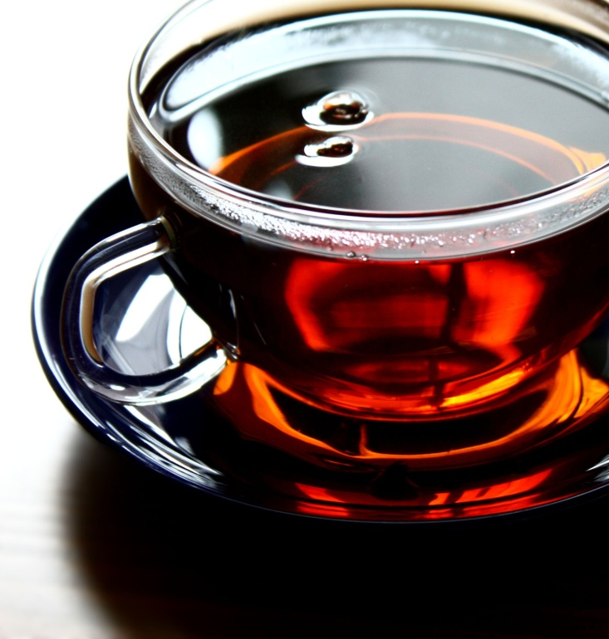
ALKALOIDS
Pharmacognosy
3rd stage, 2nd Semester
Lab.1

Slide 2
Introduction
Are defined as organic nitrogenous compounds of plant origin that are physiologically active.
In addition to carbon, hydrogen and nitrogen, alkaloids may also contain oxygen, sulfur and more rarely other elements such as chlorine, bromine, and phosphorus.
The following families represent good examples:-
Leguminosae
Papaveraceae
Ranunculaceae
Rubiaceae
Solanaceae
Berberidaceae

Slide 3
Sources of Alkaloids
Natural sources
Plants (ephedrine) Ephedra sinica
Animal (bufotenin) from skin
Bacteria
Fungi (psilocybin) from Psilocybe
Industrial sources
Nicotinic acid can be synthesized from tryptophan or aspartic acid.

Slide 4
The names of alkaloids are obtained in various ways:-
From the generic name of the plant as atropine Atropa belladonna
From the specific name of the plant as cocaine Erythroxylum coca.
From the common name of the drug ergotamine(ergot) .
From their physiologic activity as emetine producing emesis.
From the discoverer as pelletrine.
Other – e.g. morphine derived from ancient Greek mythology – Morpheus – god of dreams

Slide 5
Classification
True alkaloids characterized by a heterocyclic ring with a nitrogen atom, and are derived from amino acids for example: are atropine, nicotine, and morphine.
Proto alkaloids characterized by absence of the heterocyclic ring but also derived from amino acids for example: adrenaline and ephedrine .
Pseudo alkaloids characterized by a heterocyclic ring with a nitrogen atom, but are not derived from amino acids.

Slide 6
In general the alkaloids are classified according to the chemical
structure in two broad divisions:-
A) Non-heterocyclic or atypical alkaloids or biological amines.
B) Heterocyclic or typical alkaloids, divided into (14) group according to their structure, as the following:-

Slide 7
Pyrrol and Pyrrolidine.
Pyrrolizidine.
Pyridine and Piperidine.
Tropane.
Quinoline.
Isoquinoline.
Aporphine
Norlupinane.
Indole.
Indolizidine.
Imidazole.
Purine.
Steroid.
Terpenoid

Slide 8
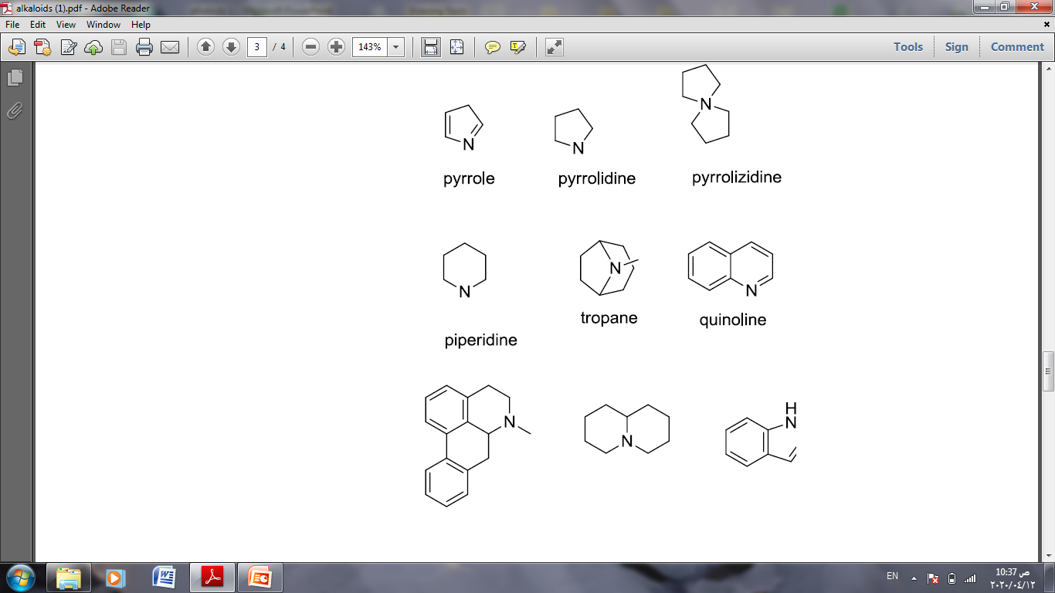

Slide 9
Alkaloid Description
Contains nitrogen - usually derived from an amino acid
Bitter taste.
Usually colorless
Some alkaloids are colored, yellow or orange.
Generally solids (except - nicotine is a brown liquid).
They give a precipitate with heavy metal iodides, except Caffeine.

Slide 10
Most alkaloids are weak bases, but some are amphoteric, for example theobromine and theophyllin.
Most alkaloids are poorly soluble in water but its dissolve in organic solvents, such as diethyl ether, chloroform. However, caffeine dissolves well in boiling water
Toxic ex cyclopamine which is present in the leaves of corn lily.

Slide 11
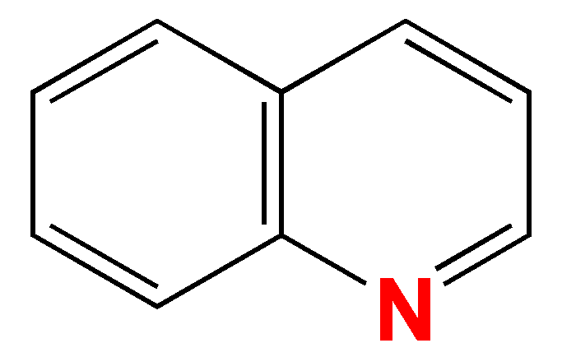
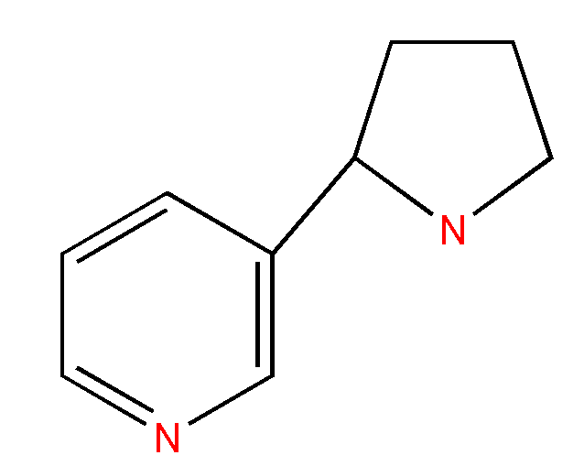
Chemistry of Alkaloids
Alkaloids usually contain one nitrogen atom, but some may contain up to (5) the nitrogen may exist as a primary amine (RNH₂), as a secondary amine(R₂NH), or as tertiary amine (R₃N) .

Slide 12
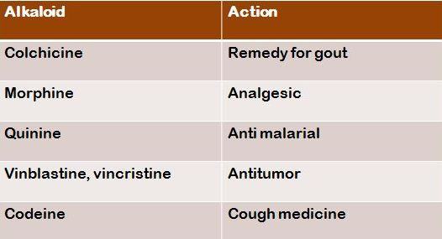
Applications
In medicine

Slide 13
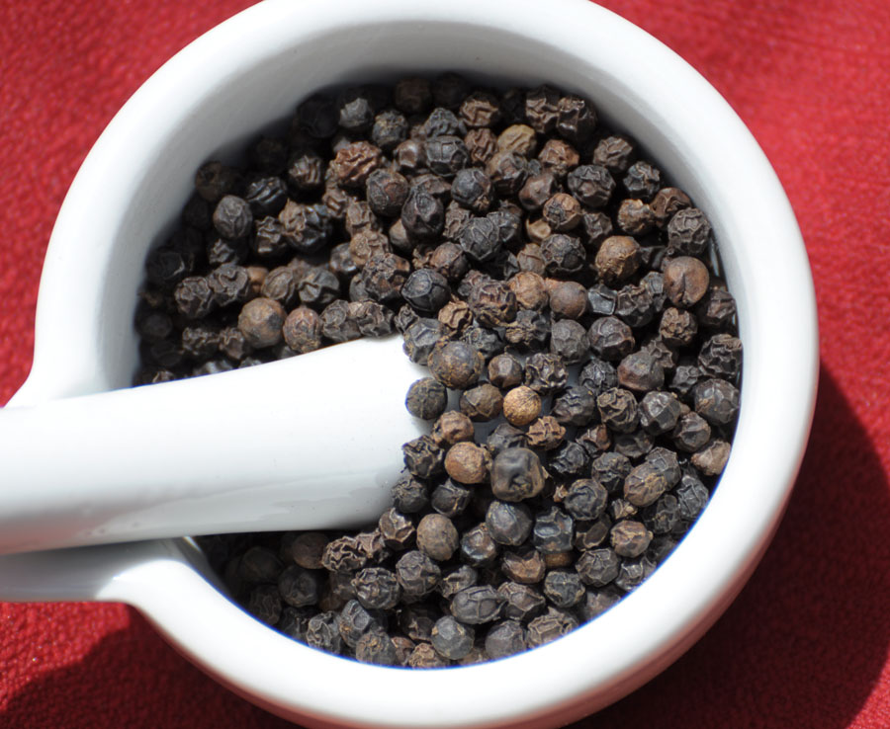
Black pepper
Botanical name Piper nigrum
Family name Piperaceae

Slide 14
It belongs to the third group of the typical alkaloids, which is the pyridine and piperidine group.
This plant is a perennial plant producing berry-like and aromatic pungent fruits, that are green when unripe and become red at mature, then the dried berries become black and wrinkled producing black pepper.
The pepper yields both, black and white pepper according to the method of drying.
In that when the ripe and the unripe fruit are dried directly under the sun, black pepper is the result. While if the fruit is soaked, and then removed the outer skin, before drying and then the result is white pepper.

Slide 15
Cont…
The alkaloid extracted from the black pepper is piperine.
Piperine alkaloid is a solid substance essentially insoluble in water. It is a weak base that is tasteless at first, but leaves a burning after taste.
The molecular formula is C17H19O3.

Slide 16
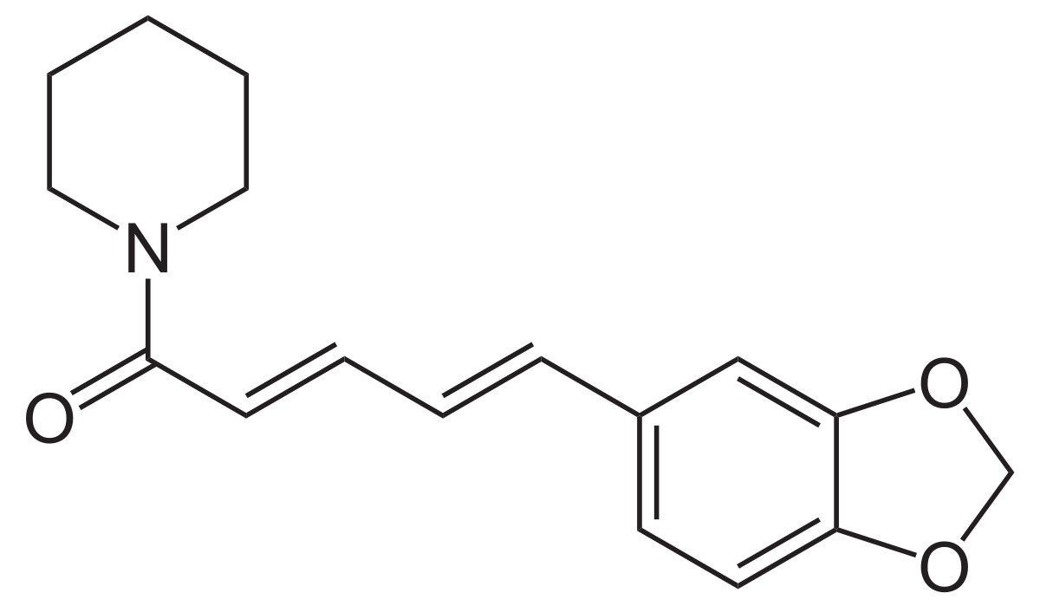
Piperine

Slide 17
The Pharmacological Activity of Piperine
Piperine aid in the digestion of food due to its stimulation to the digestive enzymes.
There is some evidence that it has an anticonvulsant activity in the treatment of epilepsy.
There is some evidence that it has an anticancer and anti-inflammatory activity due to its antioxidant property.

Slide 18
Isolation of Piperine from Black Pepper
Aim: - Isolation the piperine alkaloid from black pepper
Equipments and reagents:-
Large beaker and medium size beaker
Soxhlet instrument
Water bath
Filter paper and funnel
90% ethanol
10% alcoholic potassium hydroxide

Slide 19
Procedure:-
10gm of black pepper are ground to a fine powder.
Extracted with 150 ml of 90% ethanol in Soxhlet extractor for two hours.
The solution is concentrated .
Add 10ml of 10% alcoholic potassium hydroxide to the filtrate residue and after a while decanted from the insoluble residue .
The alcoholic solution is left over night.

Slide 20
Results:-
Yellow needles with melting point of 125ºC are deposited. Yielding 0.3 gm of piperine alkaloid.
Discussion :-
The plant is affected by heat therefore Soxhlet apparatus is used in its extraction.
The use of 90% ethanol is to extract both, the alkaloid and the alkaloidal salt that might be present.
The use of alcoholic KOH is to precipitate the isomers of piperine that are chuvacine, isochuvacine and piperic acid.
Alcohol was used in the preparation of KOH instead of water, since water will hydrolyze piperine into piperidine and piperic acid.

Slide 21
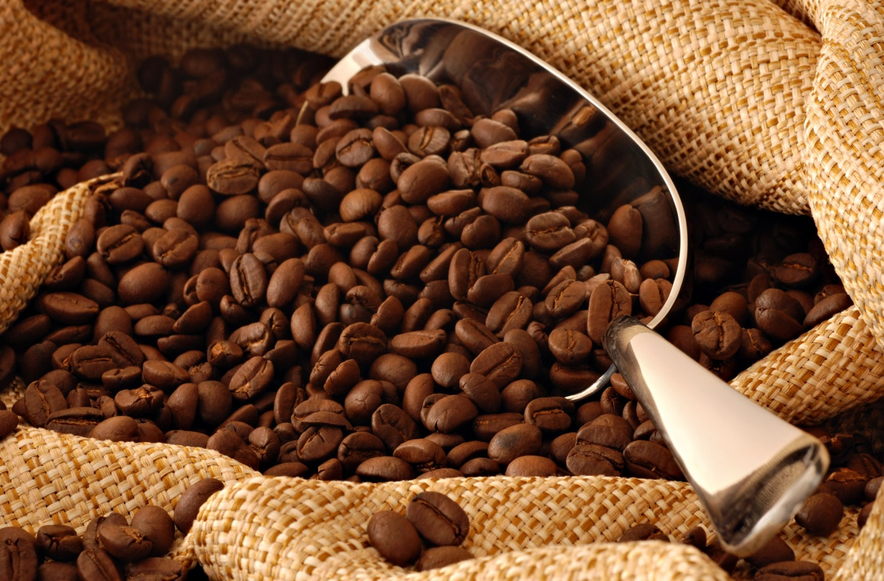
THANK YOU

