Slide 1
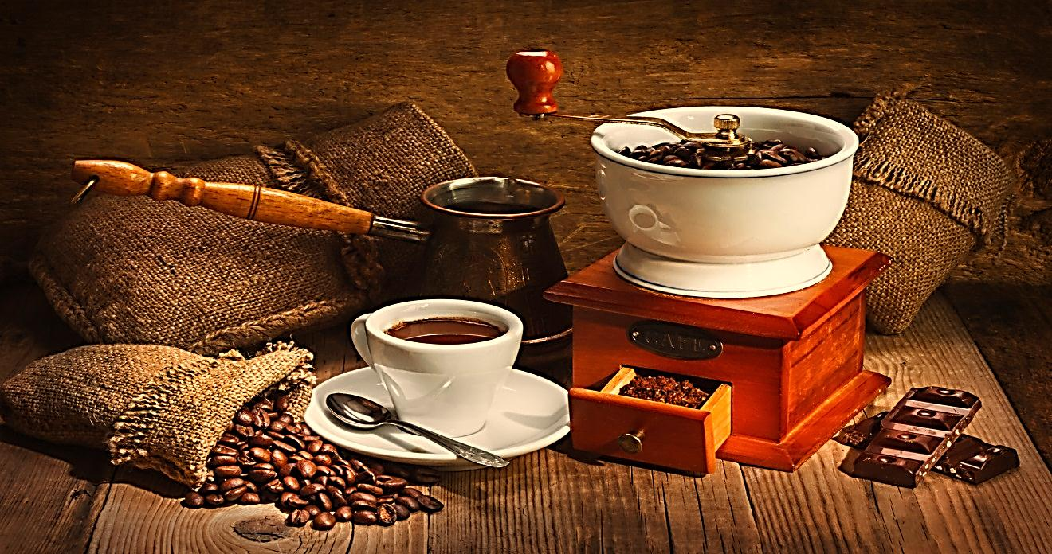
Pharmacognosy
3rd Class, 2nd Semester
LAB.5
Purine alkaloids

Slide 2
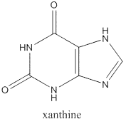
Introduction
Purines nucleus is a heterocyclic nucleus consisting of pyrimidine ring fused to 5-membered imidazole ring known as xanthine.

Slide 3
Cont…
Amphoteric Character
Purines unlike other alkaloids do not give positive results with general tests of alkaloids; instead murexide test (Purple Color) is used in its identification.
Purines are present as methylated compound, which are:-
Caffeine (1, 3, 7-tri methylxanthine).
Theophylline (1, 3,-dimethylxanthine).
Theo bromine (3, 7-dimethylxanthine).

Slide 4
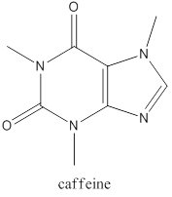
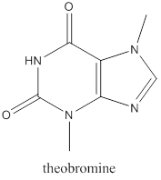
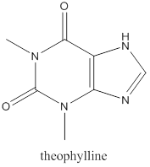

Slide 5
Caffeine: stimulates CNS and has a weak diuretic action.
Theobromine: it has particularly no stimulant effect on CNS
Theophylline: relaxes involuntary muscles more effectively than caffeine or theobromine
Caffeine: does not precipitate like most alkaloids.

Slide 6
Generally the pharmacological activities of the Purine Alkaloids
Stimulation of the CNS.
Diuretic effect.
Increase gastric acid secretion.
Relaxation of the bronchial smooth muscle (theophylline).
Positive inotropic and chronotropic effect on the heart.

Slide 7
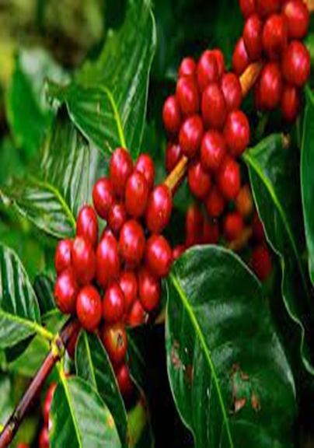
The most important plants in this group are:-
Coffee (Coffea arabica of the family Rubiaceae) contain about 1-2% of caffeine.

Slide 8
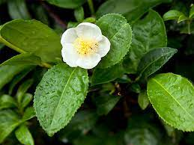
Tea (Camellia sinensis of the family Theaceae) contain about 1-4% of caffeine.

Slide 9
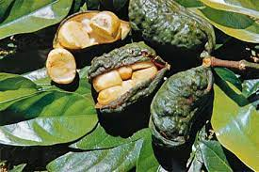
Cola (Cola nitida of the family Sterouliaceae) contain about3.5% of caffeine.

Slide 10
Isolation Of Caffeine From Tea
AIM: - To isolate the caffeine alkaloid from tea.
Equipments and reagent:-
Large beaker and small beaker
Hot plate
Evaporating dish
Boiling water
Separatory funnel
Sodium carbonate (why?)
Chloroform(why?)

Slide 11
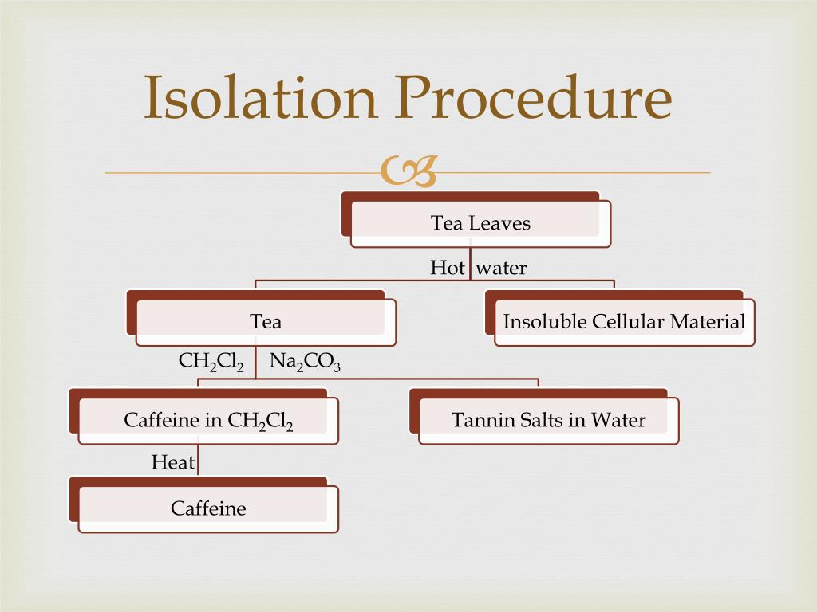

Slide 12
Take 50 gm. of coarsely powder tea
Add 250 ml of D.w water and boil gently for 15 min.
Add 5g of Sodium carbonate and boiled gently
Cool, transfer to a separatory funnel and shake out with three successive 10 ml portion of chloroform

Slide 13
Transfer the combined chloroform extract to a small evaporating dish.
Evaporate the chloroform on steam bath in the hood.
Scrap out the residue, transfer to a small beaker and dissolve in the smallest quantity of hot 60 c ethanol necessary to affect the solution.
Allow the solution to stand overnight.

Slide 14
Results:-
Pure crystals with a white color will be obtained.
Discussion:-
Purines differ from other alkaloids in that they are soluble in hot water, which is used in it is extraction, and this is the cause why all the time you should heat the mixture ( to prevent the precipitation of caffeine in cold water).
Addition of sodium carbonate to the water and the tannins will be converted to phenolic anions, which are not soluble in the dichloromethane but are soluble in highly polar water.
Addition of charcoal is for the decolorization, so that the crystals will take its normal white color.
Use of chloroform is to extract the caffeine from other component of the mixture.
Use of hot ethanol is for the recrystallization process.

Slide 15
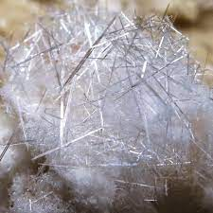
Crystals of caffeine

Slide 16
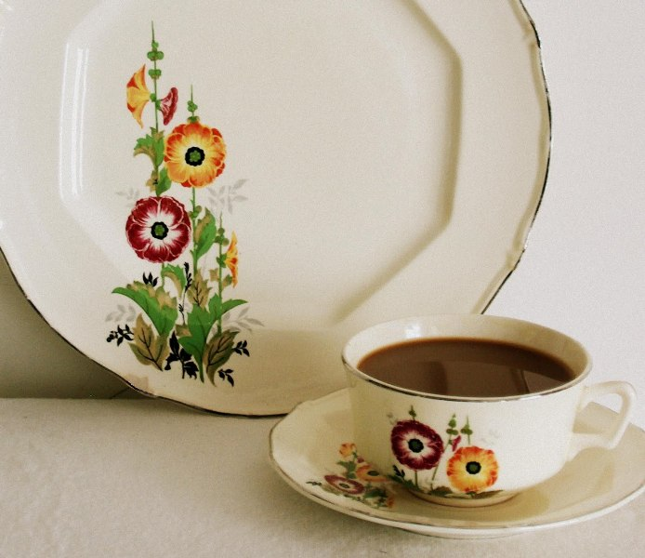
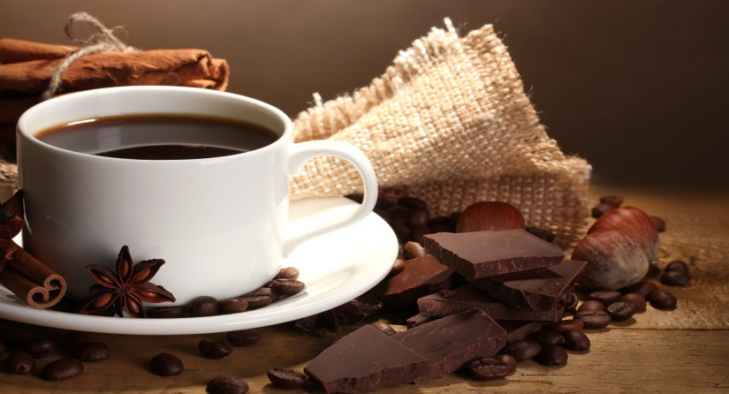
THANK YOU

