Slide 1
IR Spectra of organic compounds
أ.م. علي رسول محمود البكاء

Slide 2
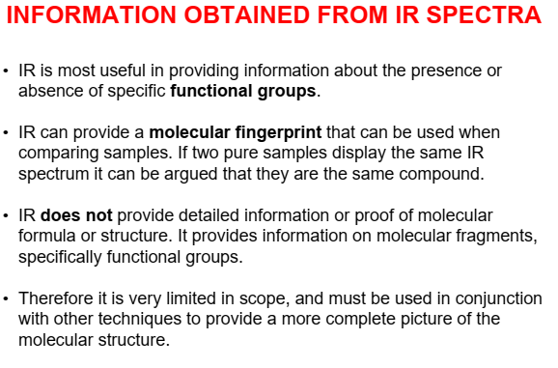

Slide 3
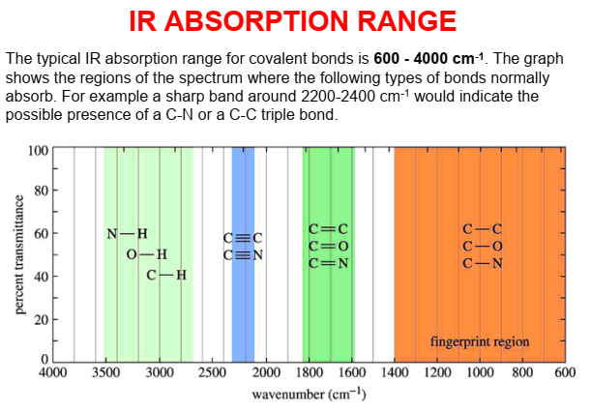

Slide 4
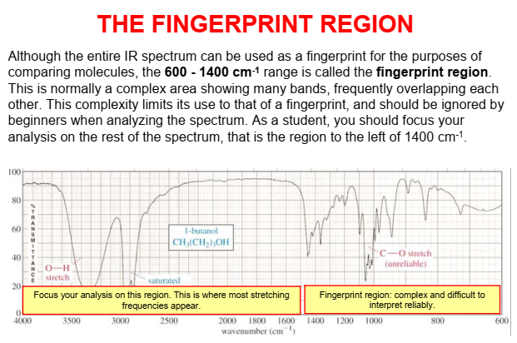

Slide 5
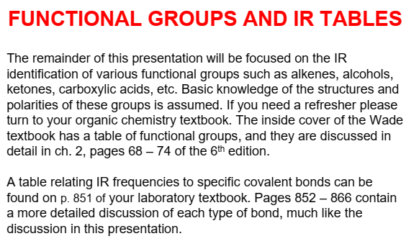
Bond Class of compound Range / cm⁻¹ Intensity
C-H Alkane 2965 - 2850 strong
C-C Alkane 1200 - 700 weak
C=C Alkene 1680 - 1620 variable
C=O Ketone 1725 - 1705 strong
    Aldehyde 1740 - 1720 strong
Carboxylic acid 1725 - 1700 strong
Ester 1750 - 1730 strong
Amide 1700 - 1630 strong
C-O Alcohol, ester, acid, ether 1300 - 1000 strong
O-H Alcohol (monomer) 3650 - 3590 variable, sharp
Alcohol (H-bonded) 3420 - 3200 strong, broad
Carboxylic acid (H-bonded) 3300 - 3250 variable, broad
N-H Amine, Amide 3500 (approx) medium
C≡N Nitrile 2260 - 2240 medium
C-X Chloride 800 - 600 strong
Bromide 600 - 500 strong
Iodide 500 (approx) strong

Slide 6
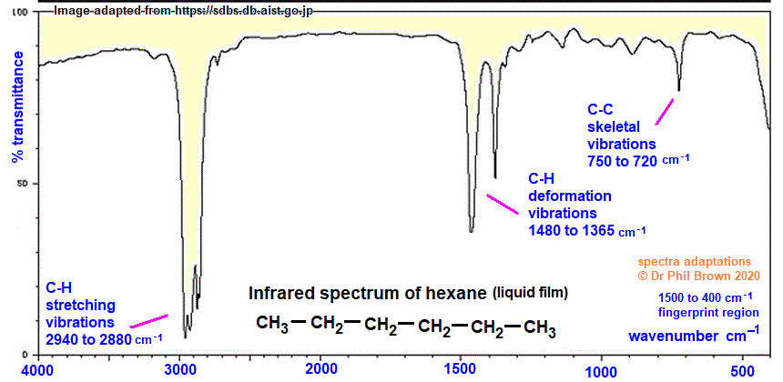

Slide 7
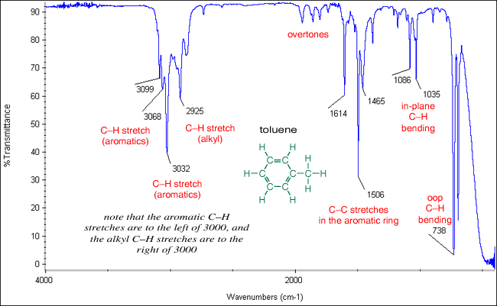

Slide 8
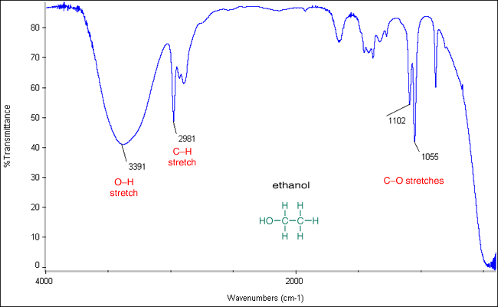

Slide 9
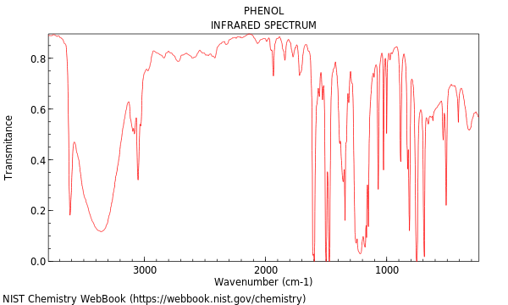

Slide 10
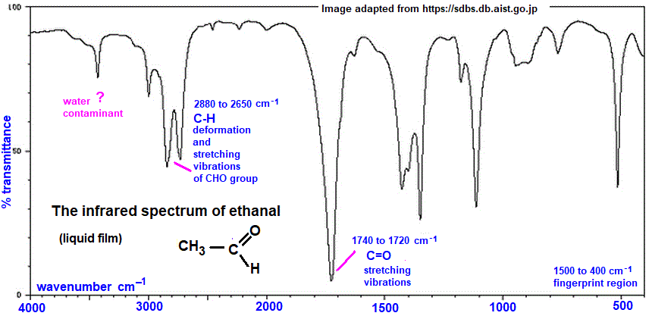

Slide 11
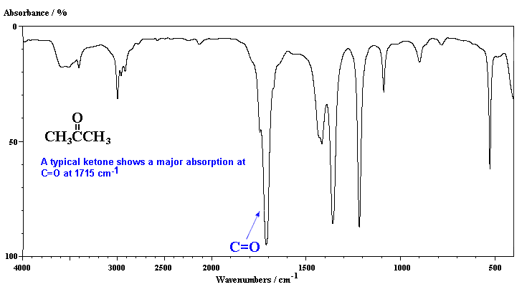

Slide 12
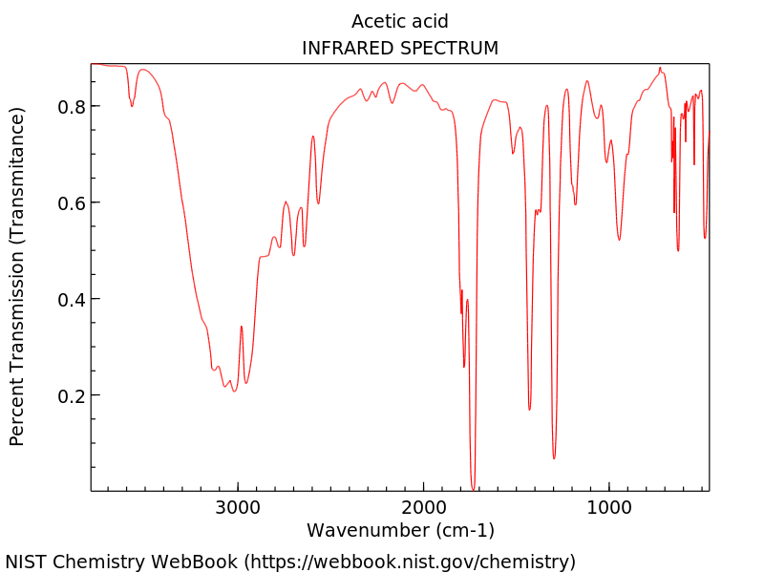

Slide 13
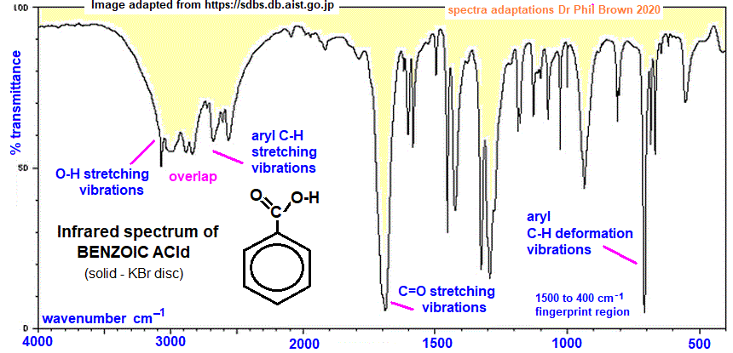

Slide 14
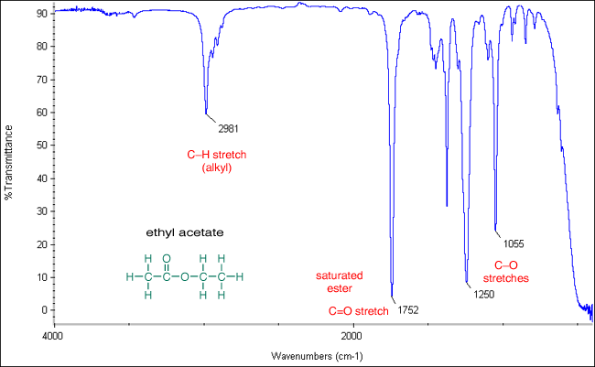

Slide 15
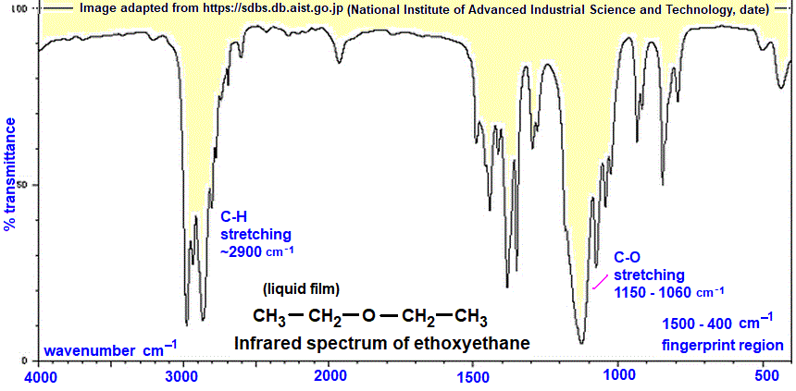

Slide 16
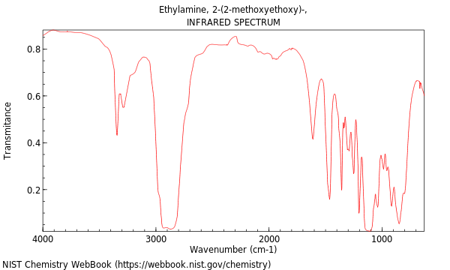

Slide 17
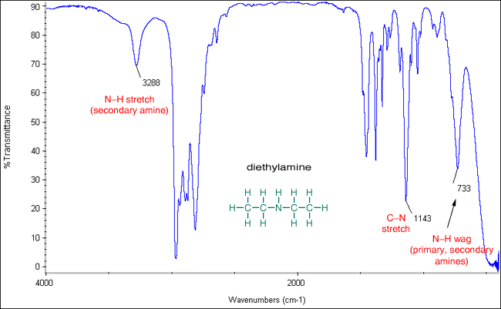

Slide 18
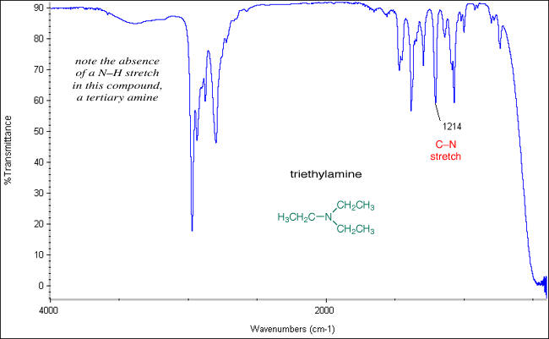

Slide 19
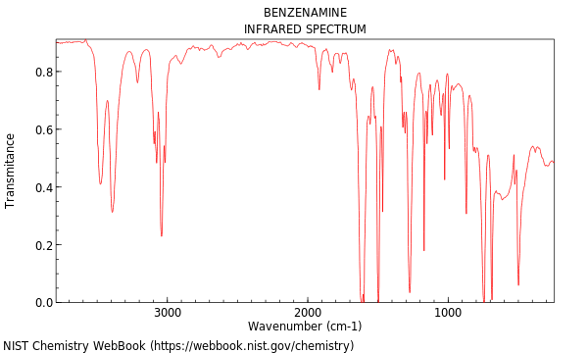

Slide 20
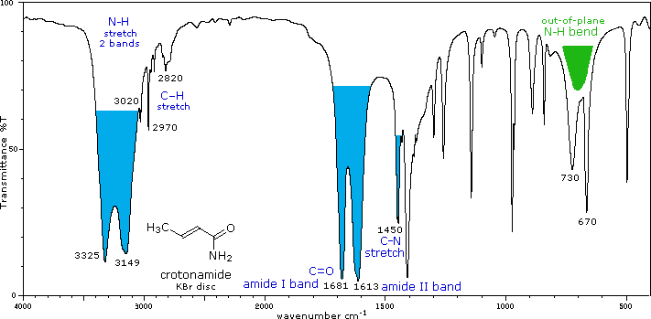

Slide 21
Thank you for listening

