Slide 1

Introduction to Networking: Concepts, Components, and Security
College of Pharmacy – 2nd Year Computer Lab

Slide 2

Objectives
Understand what a computer network is
Identify different types of networks
Recognize basic networking components
Grasp network security principles
Apply network troubleshooting techniques

Slide 3
What is a Network?
A network is two or more devices connected to share data and resources.
Examples: PCs, smartphones, printers, routers.

Slide 4
Why Networks Matter in Pharmacy
Network benefits
• Electronic health records
• Lab equipment integration
• Internet access for research
• Shared printers and storage

Slide 5
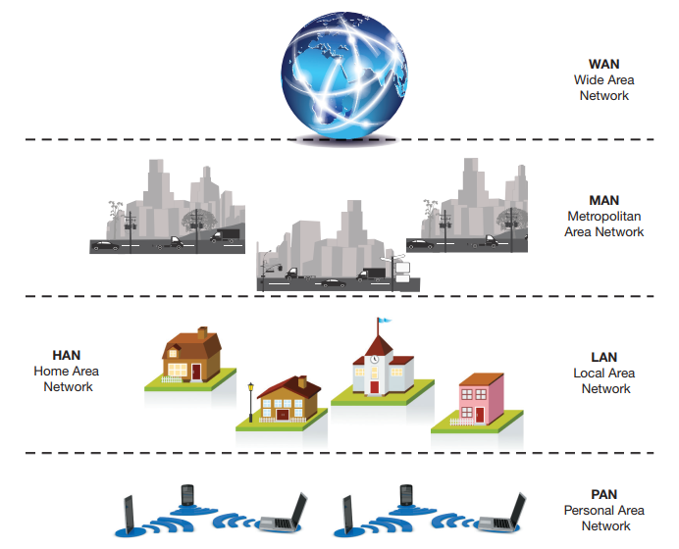
Types of Networks

Slide 6
Activity 1
Activity 1
Identify types of networks you encounter daily (Bluetooth headset, home Wi-Fi, college LAN, etc.)

Slide 7
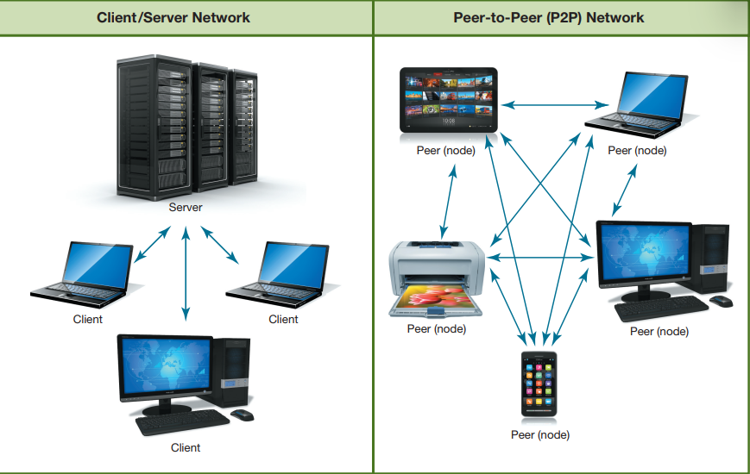
Network Designs

Slide 8
Basic Network Components
Router
Switch
Modem
Network Interface Card (NIC)
Access Point

Slide 9
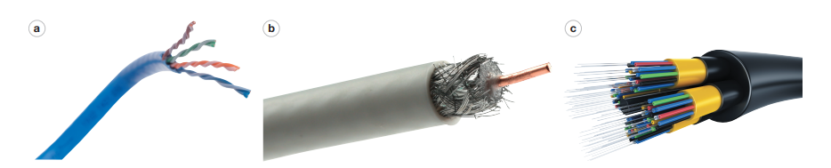
UTP or STP Cables
Coaxial Cables
Fiber Optical Cable
UTP Cable
Coaxial Cable
Fiber Optic Cable
Wireless (Wi-Fi)

Slide 10
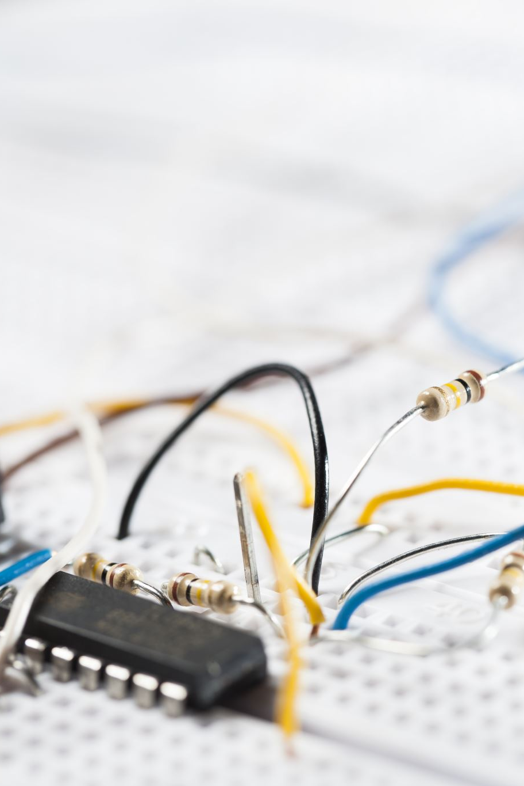
Activity 2
Hands-on: Inspect UTP cables and identify RJ-45 connectors.
Use Wi-Fi settings to view connected devices.

Slide 11
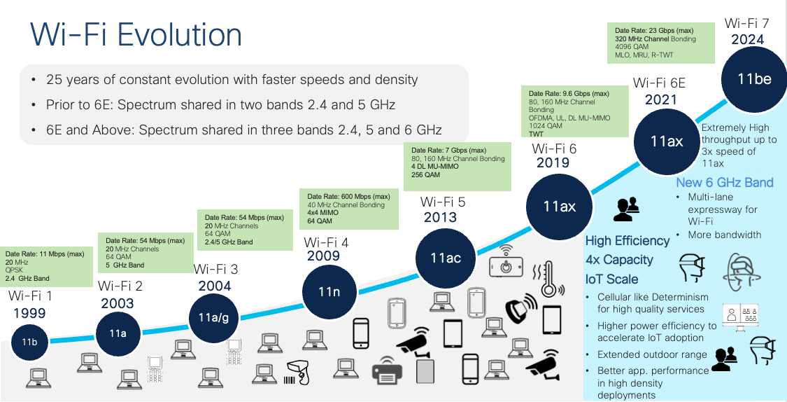

Slide 12
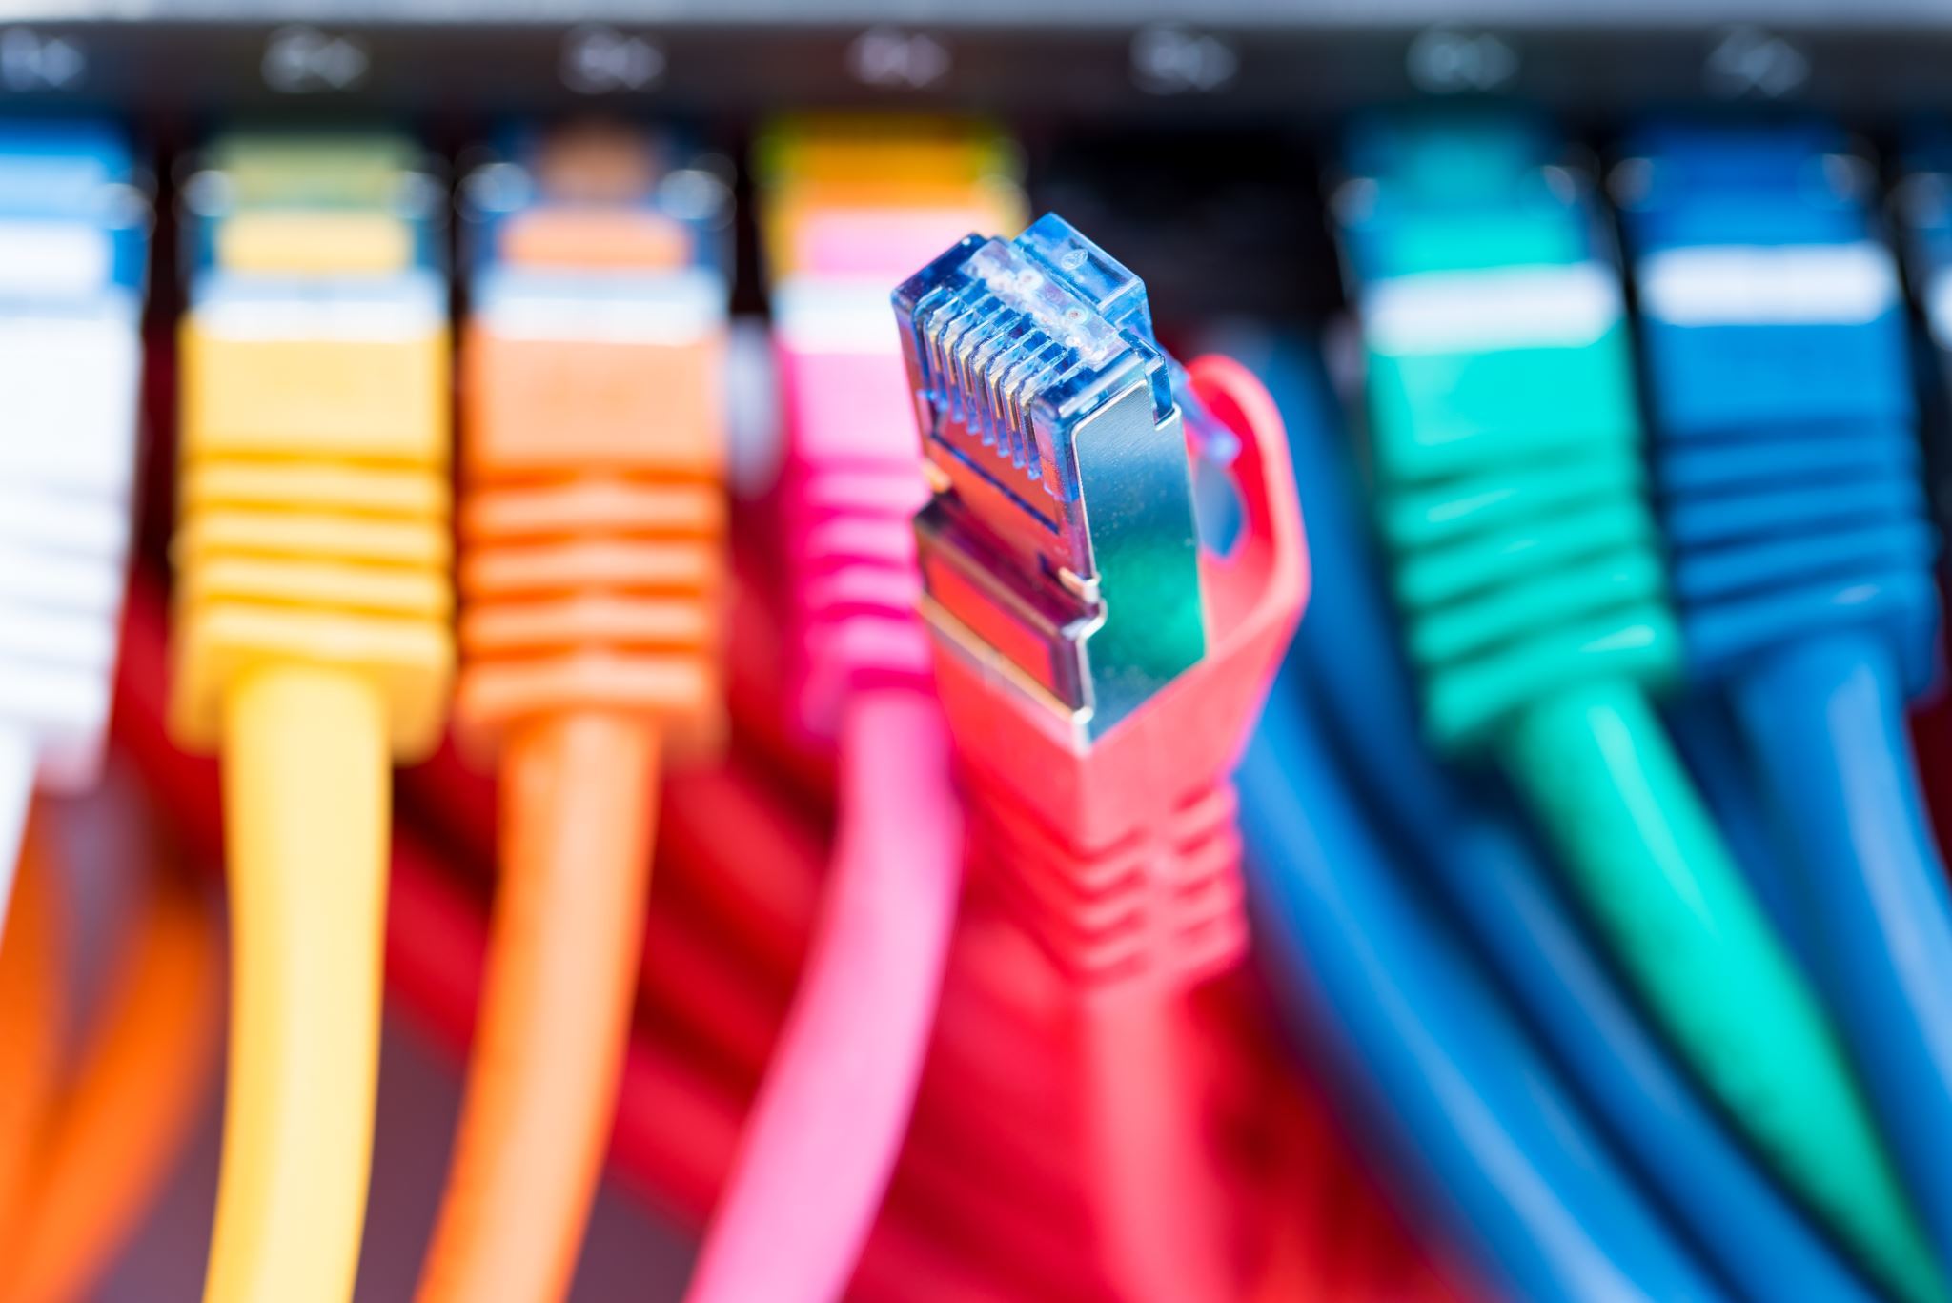
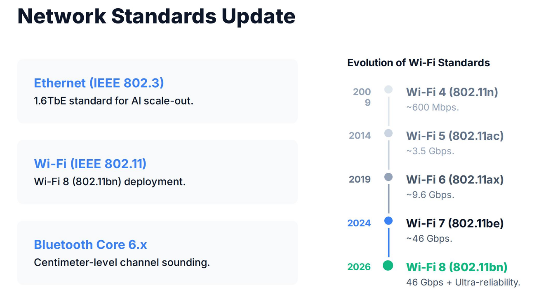

Slide 13
Installing a Basic Network
Network Connection Steps
• Connect Modem → Router → Devices
• Use wired or wireless links
• Secure your SSID and password

Slide 14
Activity 3
Use SpeedOf.Me to test your network speed.
Check your network adapter via Device Manager.

Slide 15

Network Security Basics
Keep networks safe from unauthorized access
Use firewalls and antivirus software

Slide 16
Common Network Threats
Piggybacking
Malware
Packet sniffing
Unauthorized access
Notes:
What is another term for piggyback?
adverb. on the back or shoulder or astraddle on the hip. “she carried her child piggyback” synonyms: pickaback, pig-a-back. unauthorized use of someone else’s Wi-Fi network without permission.

Slide 17
Securing Wireless Networks
Use WPA2 or WPA3 encryption
Change default SSID and passwords
Use strong passphrases

Slide 18
Troubleshooting Networks
Network Troubleshooting
Check cables and adapters
1
Restart router/modem
2
Use IPConfig or Ping commands
3

