Slide 1
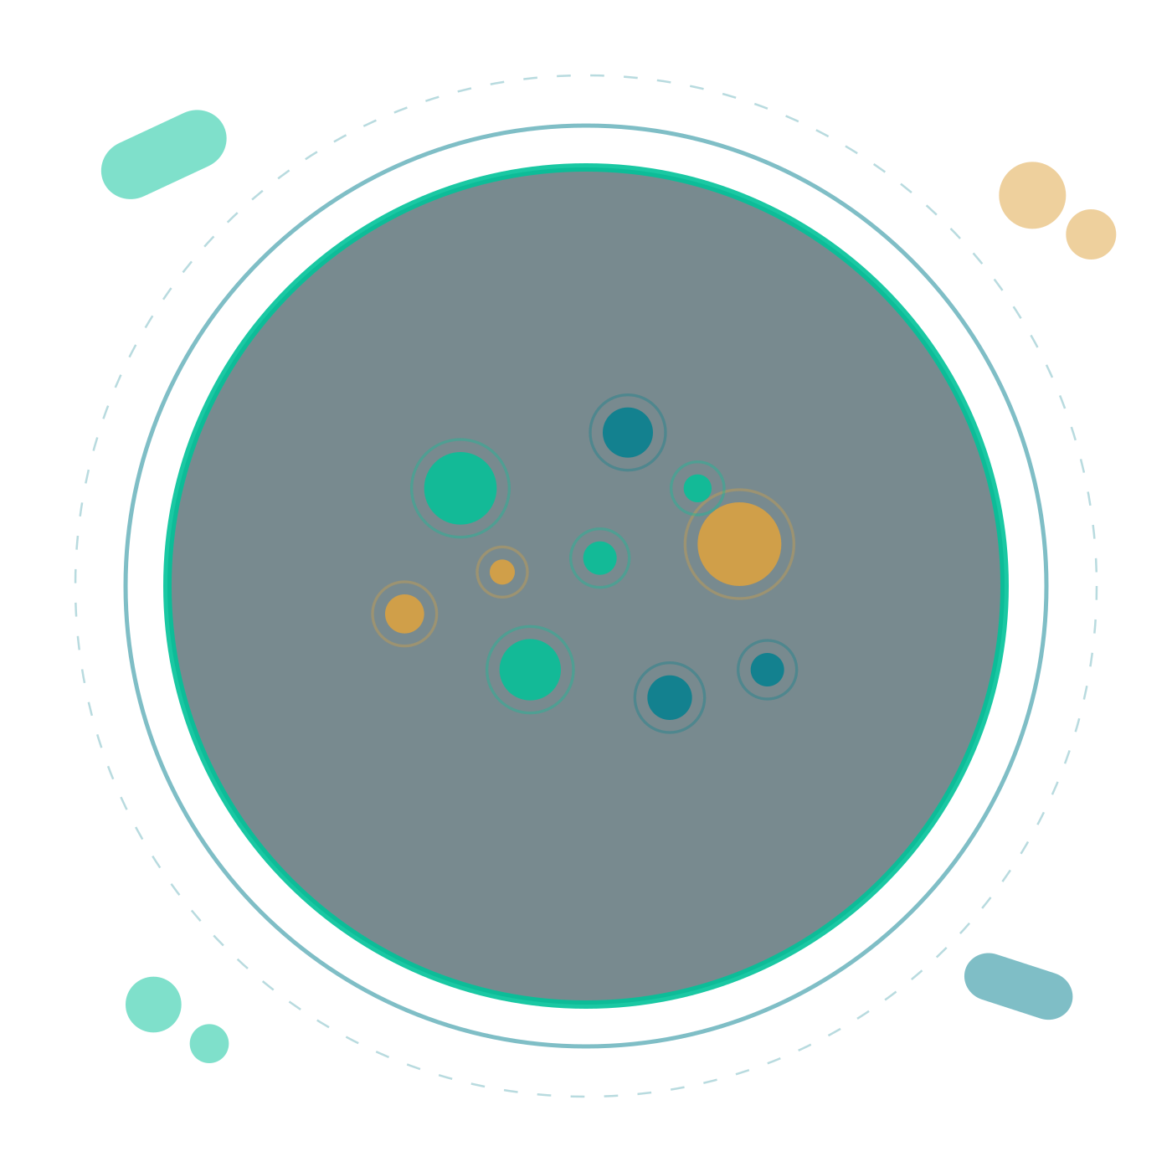
Introduction to Microbiology
Dr. Ahmed E. Salman
Clinical Laboratory Department, College of Pharmacy
Mustansiriyah University,
Notes:
Opening slide. State the aim of the lecture: to define the discipline, survey the agents it studies, and set out the principles that organise the rest of the course.

Slide 2

DEFINITION AND SCOPE
What is microbiology?
Microbiology is the study of organisms too small to be seen with the unaided eye — bacteria, archaea, fungi, protozoa, helminth stages, viruses— together with the techniques used to detect, cultivate and control them.
It asks four practical questions: what is the organism, how does it cause disease, how is it identified in the laboratory, and how is the infection treated or prevented.
Basic science
Diagnosis
Control
Structure, metabolism, genetics and ecology of microbes
Microscopy, culture, serology and molecular detection
Antimicrobials, vaccines, sterilisation and infection control
Notes:
Stress that medical microbiology is an applied science: every structural or genetic fact eventually connects to diagnosis, treatment or prevention.

Slide 3
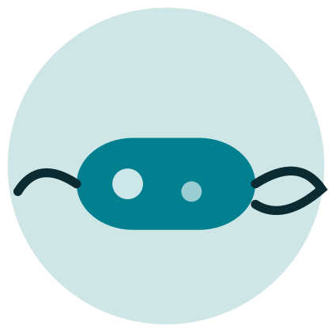




MAJOR GROUPS
The agents we study
Bacteria
Fungi
Protozoa
Prokaryotes with a peptidoglycan wall; most cultivable and the largest group of human pathogens.
Eukaryotes: yeasts and moulds. Chitinous wall, ergosterol membrane — both are drug targets.
Single-celled eukaryotes such as Plasmodium and Entamoeba; complex life cycles.
Helminths
Viruses
Multicellular worms. Diagnosis usually rests on eggs or larvae rather than culture.
Obligate intracellular parasites: a nucleic acid genome in a protein coat, no metabolism of their own.
Bacteriology, virology, mycology and parasitology are the four teaching divisions of the discipline.
Notes:
Ask the class which of these six groups can be grown on an inanimate culture medium — only bacteria, fungi and some protozoa. That single fact shapes the whole diagnostic workflow.

Slide 4
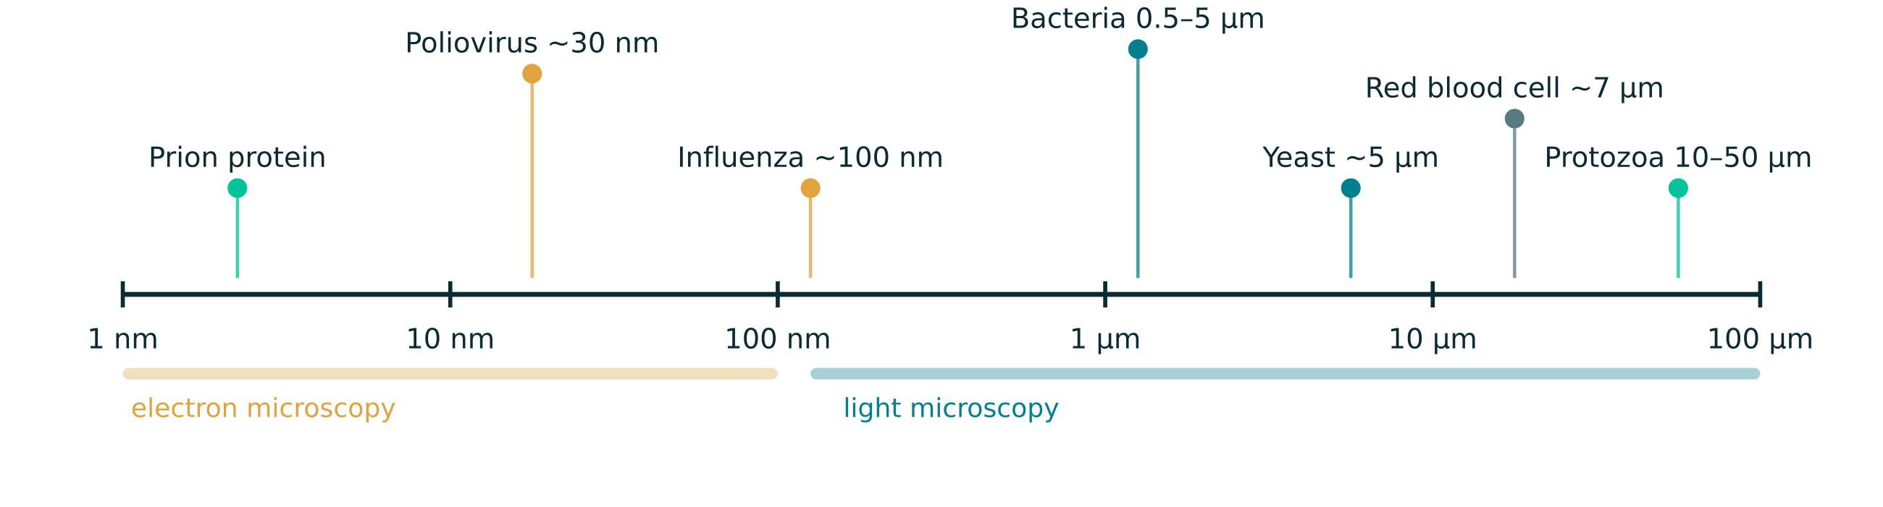
DIMENSIONS
How small is small?
Notes:
Anchor the scale with the red blood cell at about 7 µm — students already have a feel for that object from histology.

Slide 5
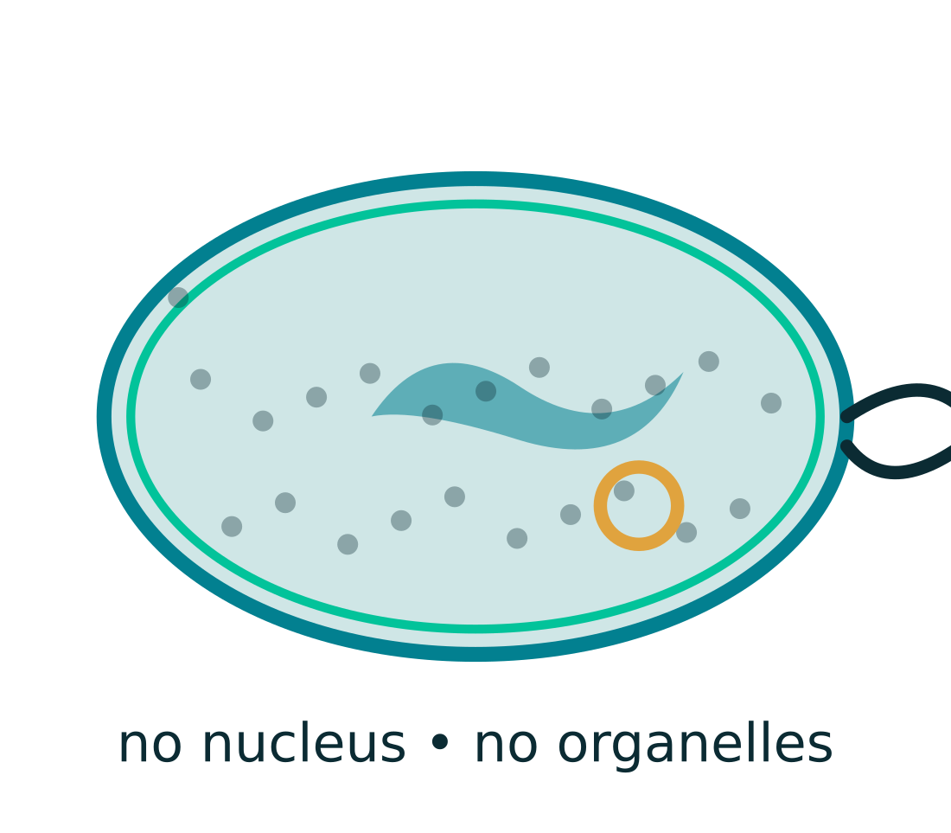
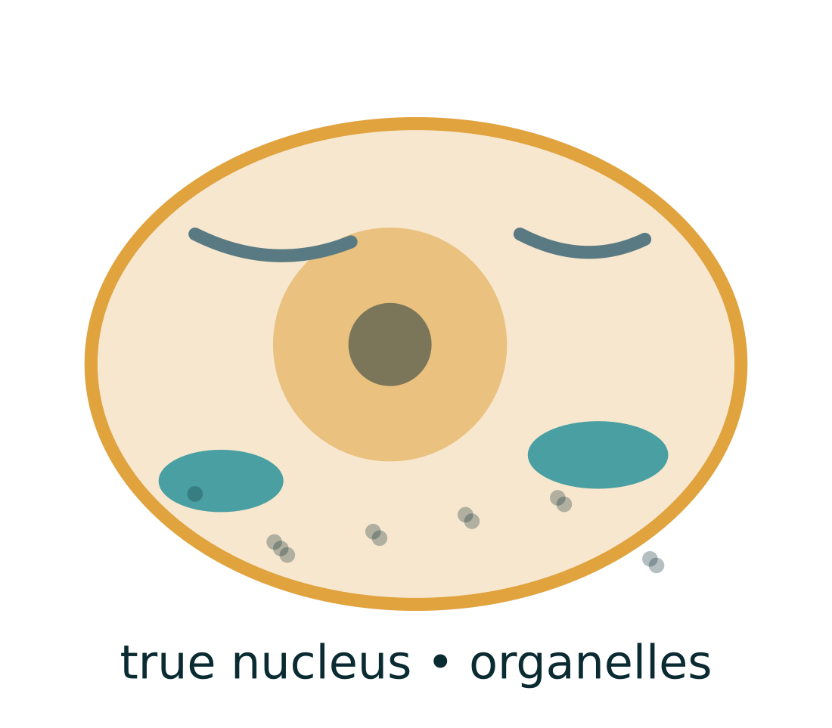
FUNDAMENTAL DIVISION
Two cellular blueprints
Prokaryotic cell
Eukaryotic cell
No nuclear membrane: a single circular chromosome lies free in the cytoplasm as the nucleoid
No mitochondria, ER or Golgi; the plasma membrane carries respiratory enzymes
70S ribosomes — the target of aminoglycosides, macrolides and tetracyclines
Peptidoglycan wall, often with plasmids, pili and flagella
Chromosomes enclosed in a true nuclear membrane; mitosis and meiosis
Membrane-bound organelles compartmentalise metabolism
80S ribosomes — selective toxicity depends on this difference
Sterol-containing membrane; wall absent, or chitinous in fungi
Notes:
Selective toxicity is the practical pay-off: antibacterial drugs exploit structures absent from human cells, which is why antifungal and antiparasitic therapy is inherently harder.

Slide 6
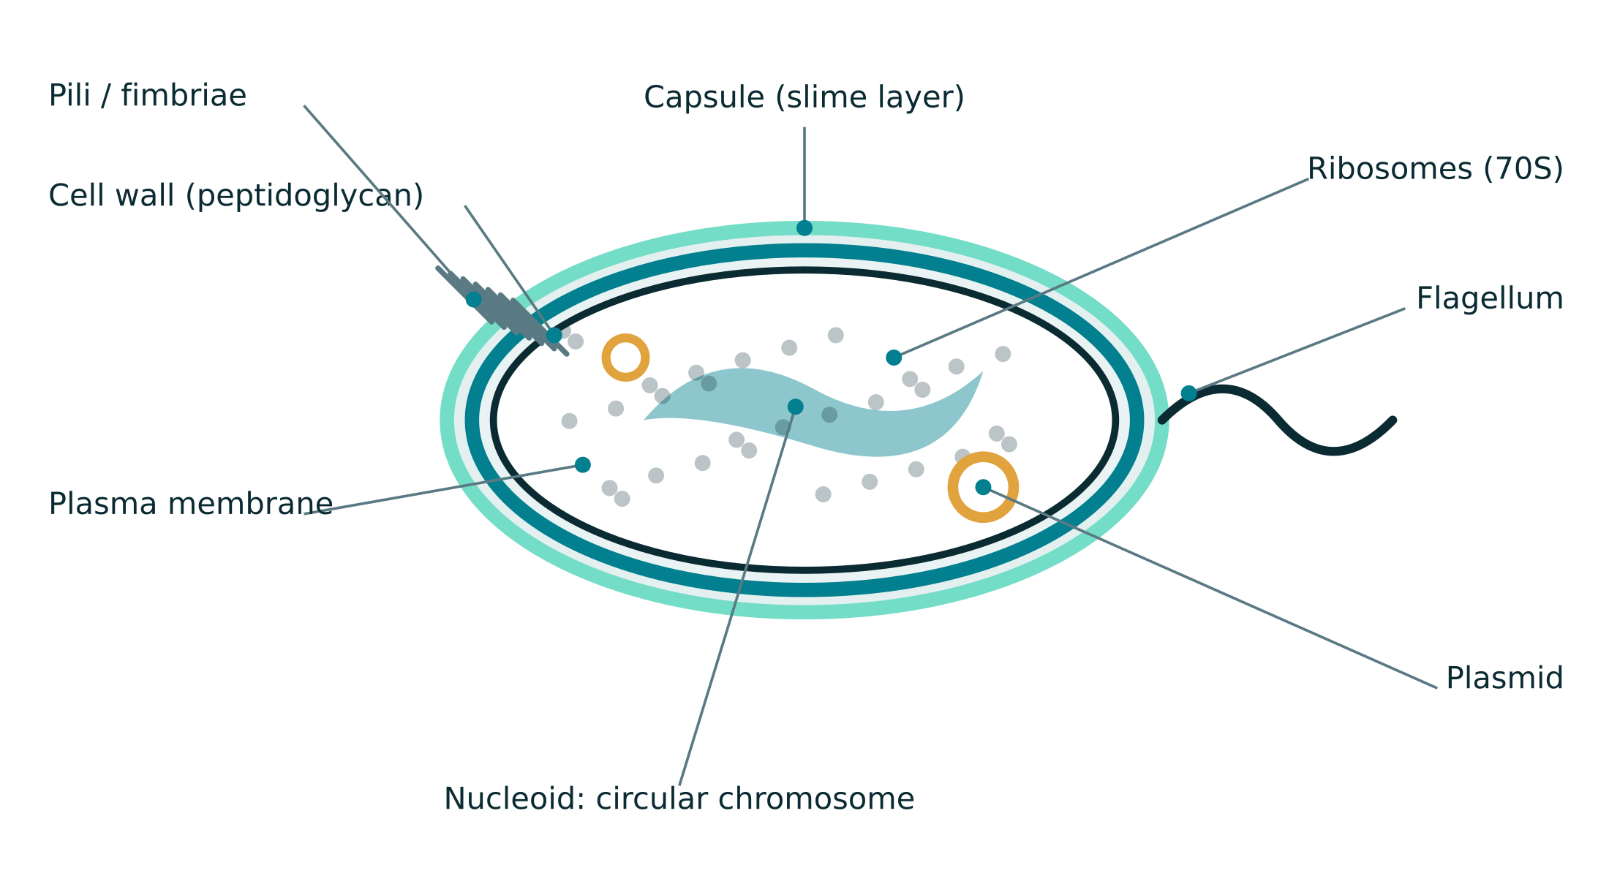
STRUCTURE AND FUNCTION
Anatomy of a bacterial cell
Why each part matters
Cell wall
Gram stain divides bacteria at the first step; the wall is the target of β-lactams.
Capsule
Resists phagocytosis; the basis of polysaccharide vaccines.
Nucleoid & plasmids
Plasmids carry resistance and toxin genes and move between cells.
Ribosomes (70S)
Distinct from the human 80S ribosome — a selective drug target.
Flagella & pili
Motility, adherence and conjugation; also serotyping antigens.
Notes:
Walk the diagram from outside in. Emphasise that almost every structure here has a diagnostic or therapeutic consequence.

Slide 7
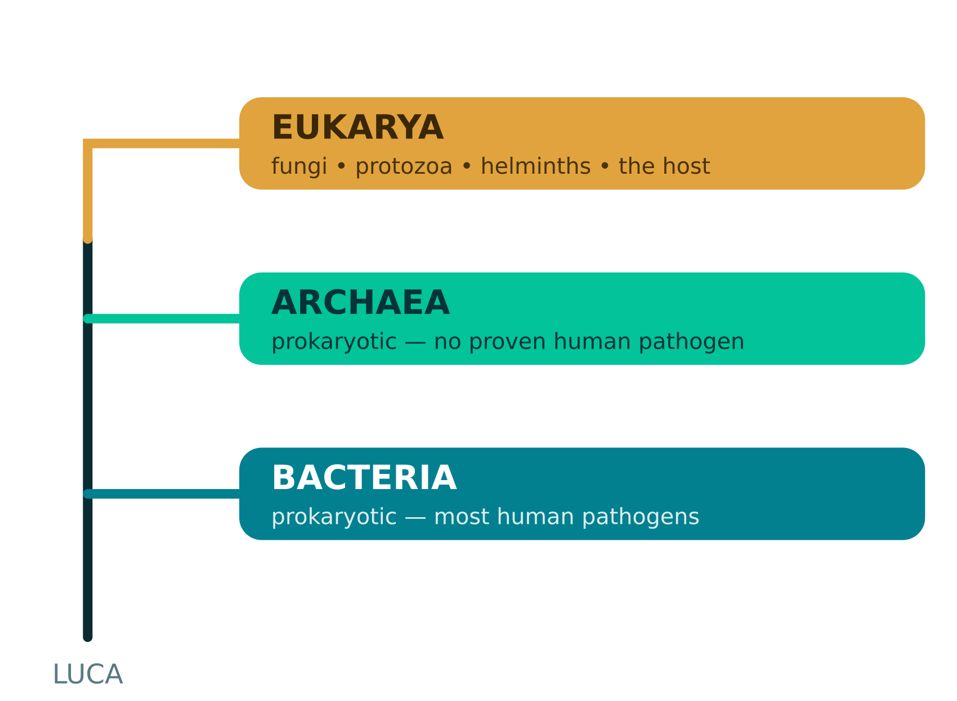
TAXONOMY
Classifying the living world
Naming and ranking
Three domains — Bacteria, Archaea, Eukarya — were defined by comparing ribosomal RNA sequences rather than appearance.
Binomial nomenclature: genus capitalised, species lower case, both italicised (Staphylococcus aureus, then S. aureus).
Ranks run domain, phylum, class, order, family, genus, species; strains and serotypes subdivide a species clinically.
A bacterial species is a pragmatic grouping based on shared phenotype and genome similarity, not on interbreeding.
Sequencing of 16S rRNA and whole genomes now settles identification that phenotype alone leaves ambiguous.
Viruses and prions fall outside this tree: they are acellular, have no ribosomes, and are classified in separate systems.
Notes:
Note that viruses are classified in a separate system based on genome type, symmetry and the presence of an envelope.

Slide 8
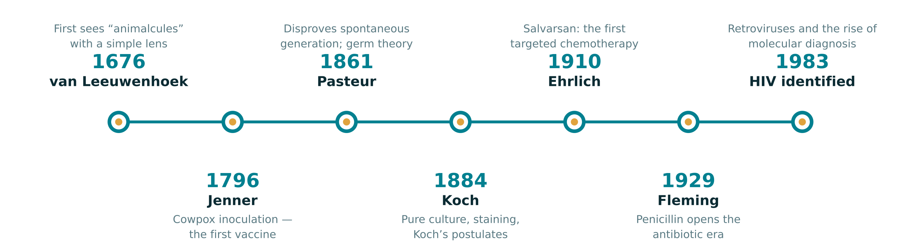
HISTORICAL LANDMARKS
How the discipline was built
Pure culture
Asepsis & sterilisation
The molecular era
Solid media and streak plates made it possible to study one organism at a time.
Heat, filtration and disinfection turned germ theory into surgical practice.
Amplification and sequencing detect organisms that were never cultivable.
Notes:
The through-line: every conceptual advance followed a technical one. Lenses, then solid media, then amplification.

Slide 9
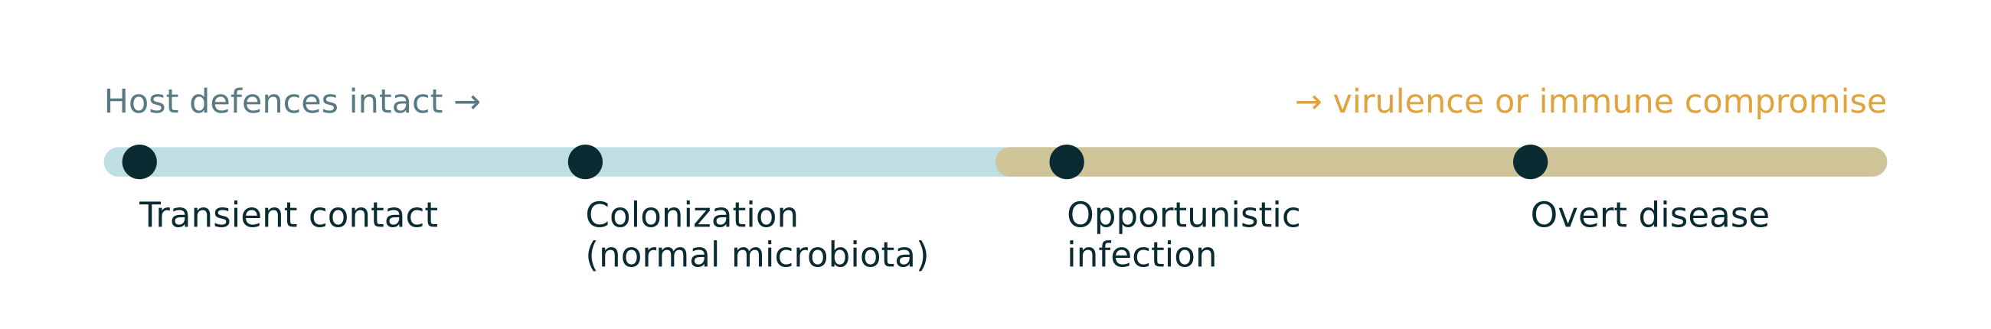
OUTCOME OF CONTACT
Microbes and the human host
Normal microbiota
Opportunists
Frank pathogens
Resident populations of the skin, gut, mouth and genital tract compete with pathogens, aid digestion and shape immunity. They outnumber host cells and only rarely cause disease in place.
Ordinary residents that become pathogens once defences fail — after surgery, catheterisation, broad-spectrum antibiotics, neutropenia or immunosuppression.
Organisms whose virulence factors — adhesins, invasins, capsules, toxins and secretion systems — allow them to cause disease in an otherwise healthy host.
Notes:
Infection is not a property of the organism alone: it is the product of microbial virulence, inoculum size, route of entry and host defence.

Slide 10
SUMMARY
Key points to carry forward
1
Microbiology covers cellular organisms and the acellular agents — viruses and prions — that fall outside the tree of life.
2
The prokaryote–eukaryote divide underlies selective toxicity and therefore most antimicrobial therapy.
3
Size determines method: what the light microscope cannot resolve must be detected by antigen or nucleic acid.
4
Causation is established by evidence, from Koch’s postulates to their molecular restatement.
5
Most host–microbe contact ends in colonisation, not disease; outcome depends on virulence and on host defence.
.
Notes:
Close by linking these five points to the structure of the course: bacteriology, virology, mycology and parasitology each revisit them in turn.

