Slide 1
Hypertension
Assist.prof. Abeer Aljuburi

Slide 2
Introduction
1-Hypertension is defined as persistently elevated arterial blood pressure (BP). (SeeTable -1 for the classification of BP in adults).
2-Isolated systolic hypertension is diastolic blood pressure (DBP) <80 mm Hg andsystolic blood pressure (SBP) ≥130 mm Hg.
3-Hypertensive crisis (BP >180/120 mm Hg) is categorized as hypertensive emergency(extreme BP elevation with acute or progressing end-organ damage) or hypertensive urgency (extreme BP elevation without acute or progressing end-organ injury).

Slide 3
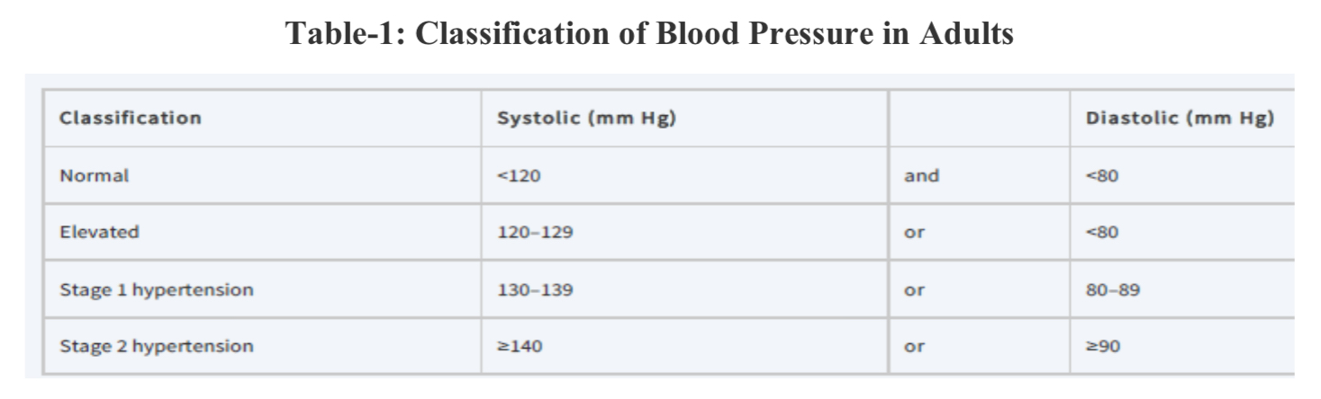

Slide 4
Pathophysiology
1-Hypertension may result from an unknown etiology (primary or essential hypertension)or from a specific cause (secondary hypertension).
2-Secondary hypertension (<10% of cases) is usually caused by chronic kidney disease(CKD) or renovascular disease.
3-Examples of drugs that may increase BP include corticosteroids, estrogens, NSAIDs,cyclosporine, erythropoietin, and venlafaxine.
4-Major causes of death include cerebrovascular events, cardiovascular (CV) events, andrenal failure.

