Slide 1
Introduction to Nanotechnology
Dr. Raouf Mahmood Raouf
Notes:
Introduction to Nanotechnology:
Last updated February 1, 2008.
Biography of Dr. Alberto Quiñonez:
Alberto Quiñonez is a Professor of Electronics Technology and Assistant Department Chair for the Department of Electronics and Advanced Technologies at Austin Community College (ACC). Dr. Quiñonez joined ACC after 10 years in the Semiconductor Industry. Alberto worked as a Process Engineer at SEMATECH and as a Senior Field Process Engineer at SVG/Thermco (now Avisa Technology).
As a Field Process Engineer, Quiñonez was responsible for worldwide process startup and qualification of furnace capital equipment at customer sites. Alberto enjoys teaching students the skills they need to be successful in high-tech manufacturing. Alberto is co-project investigator for the Nanoelectronics Project Grant. Alberto has been involved in recruiting college students from across the state for Nanoscholar internship opportunities to be held at SEMATECH the nation’s premier Nanoelectronics Research Consortium located in Austin, Texas. In addition, Alberto and the team from ACC have put together presentations that introduce educators and students to the emerging nanotechnology field.
Alberto received his Bachelor of Science in Electronics Engineering Technology from Devry University, his Master of Science in Industrial Manufacturing Technology from Texas State University and his Ph.D. in Higher Education Administration with a concentration in Community College Leadership.

Slide 2
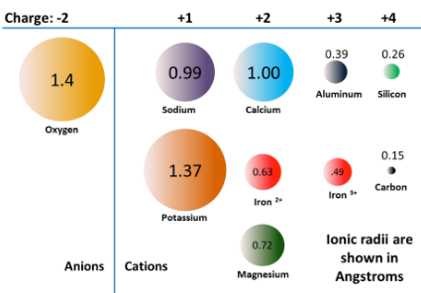
What is Nano
Nano-technology is an advanced technology, which deals with
the synthesis of nano-particles, processing of the nano materials
and their applications. Normally, if the particle sizes are in the 1-100
nm ranges, they are generally called nano-particles or materials.
In order to give an idea on this sizerange, let us look at some
dimensions :
1 nm = 10 Å = 10–9 meter and 1 μm (i.e., 1 micron) = 10–4 cm =
1000 nm.
For oxide materials, the diameter of one oxygen ion is about 1.4 Å.
So, seven oxygen ions will make about 10 Å or 1 nm, i.e., the
‘lower’ side of the nano range. On the higher side, about 700 oxygen
ions in a spatial dimension will make the so-called ‘limit’ of the nano
range of materials.
Notes:
Preface:
Is nanotechnology the gateway to the future for human beings on Earth?
Will the technologies and science developed with nanotechnology lead to monumental breakthroughs such as extended quality of life, access to quality food and water for all, the end of most debilitating diseases, or access to abundant energy sources free of dependence on oil, gas or other fossil fuels?
Will everyone have access to an abundance of information via extremely powerful computers? Will there be artificial intelligence? Will factories produce goods and products with solely the work of robots and computers ? Will we be able to populate other terrestrial settings like space stations, the moon or beyond? Many think so.
Fig. 1.1 – Microsoft Office Online Clip Art.

Slide 3
Why Nano Technology
In the materials world, particularly in ceramics, the trend is always to prepare finer powder for the ultimate processing and better sintering to achieve dense materials with dense fine-grained microstructure of the particulates with better and useful properties for various applications. The fineness can reach up to a molecular level (1 nm – 100 nm), by special processing techniques. More is the fineness, more is the surface area, which increases the ‘reactivity’ of the material. So, the densification or consolidation occurs very well at lower temperature than that of conventional ceramic systems, which is finally ‘cost-effective’ and also improves the properties of materials like abrasion resistance, corrosion resistance, mechanical properties, electrical properties, optical properties, magnetic properties, and a host of other properties for various useful applications in diverse fields.

Slide 4
Scope of Applications
The deviations from the bulk phase diagram may be exploited to form certain compositions of alloys that are otherwise unstable in the bulk form. In addition, the thermal stability of interfacial regions is typically less than that of the bulk material : thus the nano-phase materials are often sintered or undergo phase transformation at temperatures below those of the bulk material. This is a characteristic which has numerous applications to material processing.
By improving material properties, we are able to find the applications as varied as semiconductor electronics, sensors, special polymers, magnetics, advanced ceramics, and membranes. We need to improve our current understanding of particle size control and methodologies for several classes of Nano phase materials and address the issues of their characterization. We should also explore the fields in which there are foreseeable application of nano-phase materials to long standing materials problems, since these ‘issues’ have to be tackled by us.
As said earlier, there is a scope of wider applications in different fields such as :

Slide 5
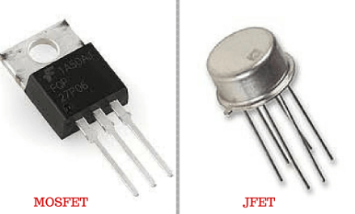
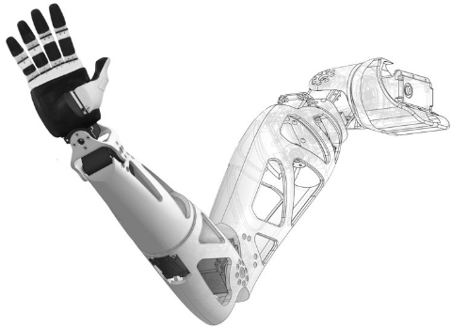
Scope of Applications
Electronics in terms of Thin Films, Electronic Devices like MOSFET, JFET and in Electrical Ceramics,
Bionics,

Slide 6
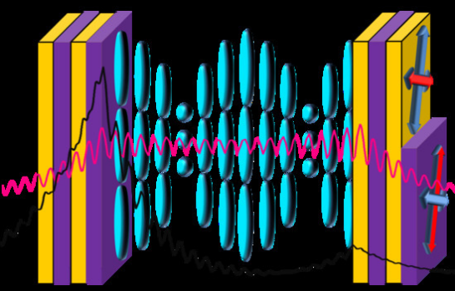
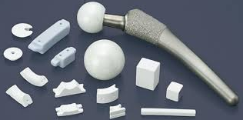
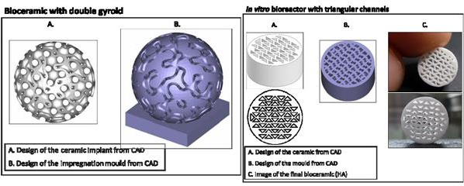
Scope of Applications
Photonics,
Bio-Ceramics,

Slide 7
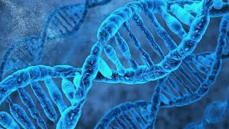
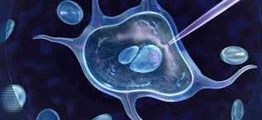
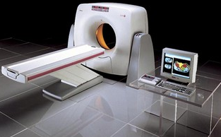
Scope of Applications
Bio-Technology,
Medical Instrumentation
etc.

Slide 8
Definition
“Nanotechnology is the understanding and control of matter at dimensions of roughly 1 to 100 nanometers, where unique phenomena enable novel applications, nanotechnology involves imaging, measuring, modeling, and manipulating matter at this length scale.”
7
Notes:
Definition:
Most research universities and centers as well as private and government entities working with nanotechnology provide their own similar but distinct definition of nanotechnology. Therefore, the first lesson about nanotechnology is to understand that it is a broad multidisciplinary field encompassing all branches of science, engineering and technology as well as medical, business, finance, economics, social sciences and many other disciplines.
A general definition of nanotechnology is provided in the National Nanotechnology Initiative (NNI) website which is a federal government website (http://www.nano.gov). The NNI agency was created to foster worldwide advancement and leadership in nanotechnology within the United States. The NNI definition for nanotechnology is:
“Nanotechnology is the understanding and control of matter at dimensions of roughly 1 to 100 nanometers, where unique phenomena enable novel applications.”
“Encompassing nanoscale science, engineering and technology, nanotechnology involves imaging, measuring, modeling, and manipulating matter at this length scale.”

Slide 9
How do properties change at the Nano scale?
When particle sizes of solid matter in the visible scale are compared to what can be seen in a regular optical microscope, there is little difference in the properties of the particles. But when particles are created with dimensions of about 1–100 nanometres (where the particles can be “seen” only with powerful specialized microscopes), the materials’ properties change significantly from those at larger scales. This is the size scale where so-called quantum effects rule the behaviour and properties of particles. Properties of materials are size-dependent in this scale range. Thus, when particle size is made to be Nano scale, properties such as melting point, fluorescence, electrical conductivity, magnetic permeability, and chemical reactivity change as a function of the size of the particle.

Slide 10
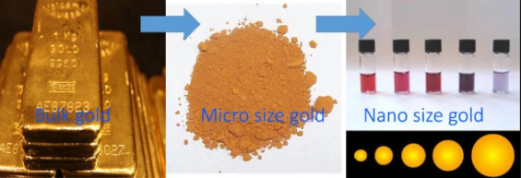
How do properties change at the Nano scale?
Nanoscale gold illustrates the unique properties that occur at the nanoscale. Nanoscale gold particles are not the yellow color with which we are familiar; nanoscale gold can appear red or purple. At the nanoscale, the motion of the gold’s electrons is confined. Because this movement is restricted, gold nanoparticles react differently with light compared to larger-scale gold particles. Their size and optical properties can be put to practical use: nanoscale gold particles selectively accumulate in tumors, where they can enable both precise imaging and targeted laser destruction of the tumor by means that avoid harming healthy cells.

Slide 11
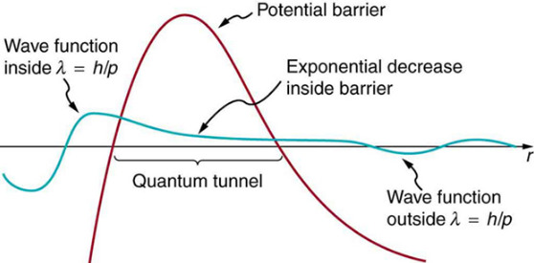
How do properties change at the Nano scale?
A fascinating and powerful result of the quantum effects of the nanoscale is the concept of “tunability” of properties. That is, by changing the size of the particle, a scientist can literally fine-tune a material property of interest (e.g., changing fluorescence color; in turn, the fluorescence color of a particle can be used to identify the particle, and various materials can be “labeled” with fluorescent markers for various purposes). Another potent quantum effect of the nanoscale is known as “tunneling” which is a phenomenon that enables the scanning tunneling microscope and flash memory for computing.

Slide 12
References
Murday, James F. (2005). Nanotechnology: Hype and Hope in Aerospace Applications. Advanced Materials and Processes. Vol. 163, Issue 12, P. 21.
Rappaport, Tatiana Gabriela (2006). Semiconductors: Nanostructures and applications in spintronics and quantum computation. Vol. 809 issue 1, p.326.
Wong, H.S. Philip (2006, March). Nanoelectronics – Opportunities and Challenges. International Journal of High Speed Electronics and Systems. Vol. 16, Issue 1, p. 83, 12p.
Yamaguchi, Tomohiko; Epstein, Irving; Shimomura, Masatsugu; & Kunitake, Toyoki (2005, December). Vol. 15, Issue 4, p. N, 3 p.
Notes:
References, Continued:
See Slide 23 for full reference citations.
12

