Slide 1
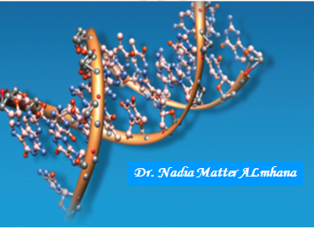

Slide 2

Important notes about concentration of substrate:
a) Explanation of effect of substrate concentration:
1) At low substrate concentration, not all enzymes are saturated. So the rate of reaction will Increase.
2) At higher substrate concentration, all enzymes get saturated with substrates and any more Increase of substrate concentration will result in no increase in the rate of the reaction.
b) Michaelis-Menten Equation:
1) This equation describes the dependence of reaction velocity on substrate concentration.
2) Michaelis and Menten proposed that in any enzymatic reaction, the enzyme (E) combines with substrate (S) to form an enzyme-substrate (ES) complex.
3) ES then breaks down either to enzyme and substrate again or to enzyme and product (P).

Slide 3

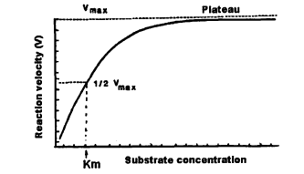
4) Michaelis and Menten equation describes how reaction velocity varies with substrate concentration as follows:
Where: Vi = Initial reaction velocity
Vmax = maximal velocity
Km = Michaelis constants = (k₁+k₂)/k₋₁
[S] = Substrate concentration
c) Michaelis constant (Km):
1) From the above equation, when substrate concentration (S) is equal to Km.
thus Km can be defined as: substrate concentration that produces half maximum velocity.

Slide 4
d) Important conclusions about Michaelis-Menten kinetics:
1) Substrates are usually present in physiological fluids in amounts nearly equal to Km values.
2) Km is a constant characteristic of an enzyme and its particular substrate. Km reflects the affinity of the enzyme for the substrate.
3) The smaller the Km value, the more active the enzyme:
i- Small (low) Km reflects a high affinity of the enzyme for substrate i.e. low concentration of substrate is needed to half saturate the enzyme.
ii- Large (high) Km reflects a low affinity to the enzyme for substrate i.e. high concentration of substrate is needed to half saturate the enzyme.

Slide 5
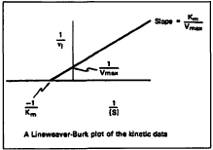
e) Lineweaver-Burke plot:
1) Here, the reciprocal of V i.e. 1/V is plotted versus the reciprocal of S i.e. 1/S.
2) The curve is a straight line.
3) The curve more practical to estimate Km because a few enzymes give the saturation curve.

Slide 6
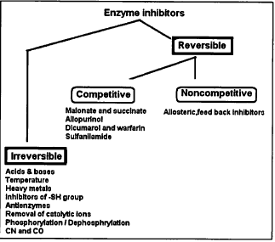
Enzyme inhibitors
These are substances that can diminish the velocity of enzymatic reactions. The Inhibition of enzymes can be classified either as reversible or Irreversible.

