Slide 1











Characteristics of Logic Families : I-V Requirements
Voltage and Current parameters:
V_{IH} {
logic 1
VIH (max)
Intermediate
Level
VIH (min)
V_{IL}{
logic 0
VIL(max)
VIL(min)
Fig.1 (a) Input logic levels
V_{OH} {
logic 1
VOH (max)
Intermediate
Level
VOH (min)
V_{OL}{
logic 0
VOL(max)
VOL(min)
Fig.1 (b) Output logic levels
V_{IH} -High-Level Input Voltage:
It is the range of voltage in a gate for the input to be treated as logic 1
Range = VIH(max) - VIH(min)
V_{IL(max)} -Low-Level Input Voltage:
It is the range of voltage in a gate for the input to be treated as logic 0
Range = VIL(max) - VIL(min)
V_{OH} -High-Level Output Voltage:
It is the range of voltage in a gate for the output to be treated as logic 1
Range = VOH(max) – VOH(min)

Slide 2
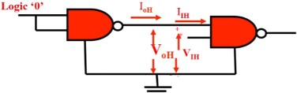
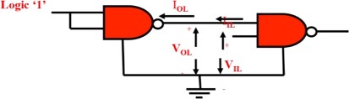
V_{OL}- Low Level Output Voltage:
It is the range of voltage in a gate for the output to be treated as logic 0
Range = VOL(max) – VOL(min)
I_{IH} - High Level Input Current:
It is the current that flows in the input when voltage of V_{IH}
applied.
range (logic1) is
I_{IL}- Low Level Input Current:
It is the current that flows in the input when voltage of V_{IH}
applied.
range (logic0) is
I_{OH} - High Level Output Current:
It is the current that flows from in the output when voltage of V_{OH}
is obtained under given load.
range (logic1)
I_{OL}- Low Level Output Current:
It is the current that flows from in the output when voltage of V_{OL}
is obtained under given load.
range (logic0)
Fig.2: Currents and voltages in the two logic states

Slide 3


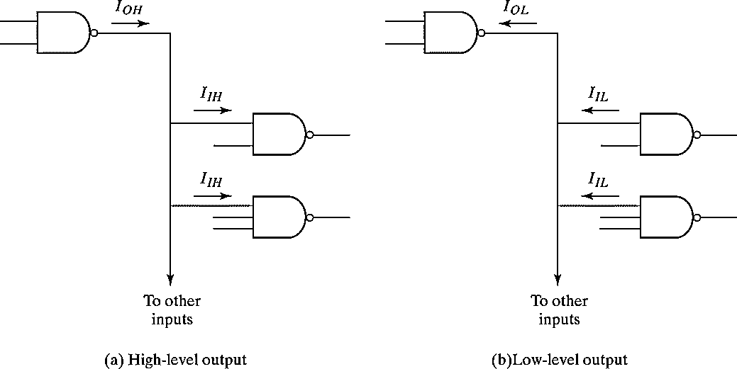
Fan-in and Fan-out:
Fan-in: the number of inputs of a gate that it can handle without impairing its normal operation.
1
2
3
Fan-in = number of inputs
Propagation delay increases with number of inputs. Therefore a 2 input NAND gate is faster than 4 input NAND gate.
Fan-out: The number of standard loads can be connected to the output of the gate without affecting its normal operation. Sometimes the term loading is used.
Fig.3: fan-out computation
130

Slide 4
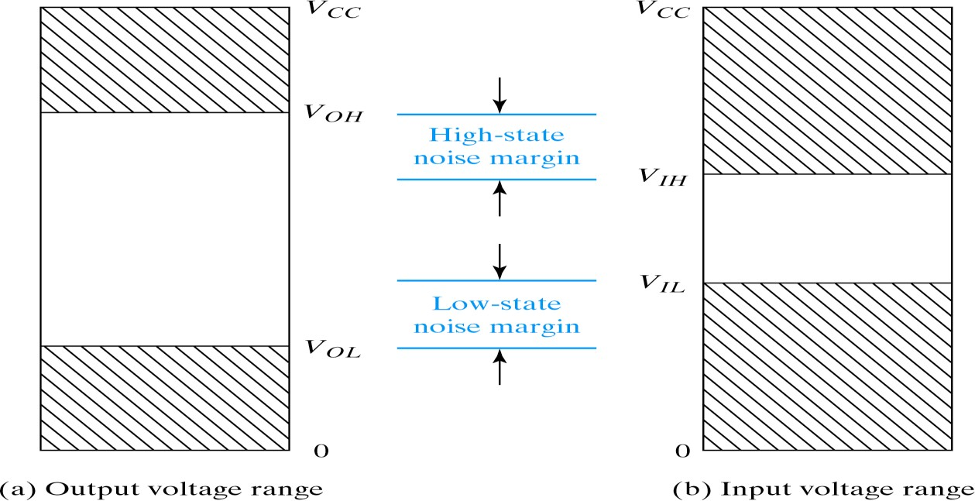
Fan − out = min( ^{IOH} , ^{IOL} )
^{I} IH ^{I} IL
High state fan-out = ^{IOH (max)}
^{I}IH
Low state fan-out = ^{IOL (max)}
^{I}IL
For TTL gate:
High state fan-out = ^{400µ𝐴} = 10
40µ𝐴
Low state fan-out = ^{16mA} = 10
1.6mA
Noise margin:
-The unwanted signals are referred to as noise.
- Noise margin is the maximum noise added to an input signal of a digital circuit that does not cause an undesirable change in the circuit output.
Fig.4: Noise margins
131

Slide 5
High state noise margin:
V = V (min) – V (min)
NH OH IH
Low state noise margin:
V = V (max) – V (max)
NL IL OL
Propagation delay:
The average transition-delay time for the signal to propagate from input to output when the binary signal changes in value
t_{PLH} : It is the delay time measured when output is changing from logic 0 to logic 1 state (LOW to HIGH).
t_{PHL}: It is the delay time measured when output is changing from logic 1 to logic 0 state (HIGH to LOW).
When t_{PHL} and t_{PLH} are not equal, the larger value is considered as a propagation delay time for that logic gate, i.e.
t_{p} = max (t_{PLH}, t_{PHL})
Sometimes propagation delay tp is taken to be the simple average of the two :
t = ¹ (t + t )
P PHL
PLH
2
Figure 5 shows logic gates with different fan-outs and their corresponding propagation delays.
132

Slide 6
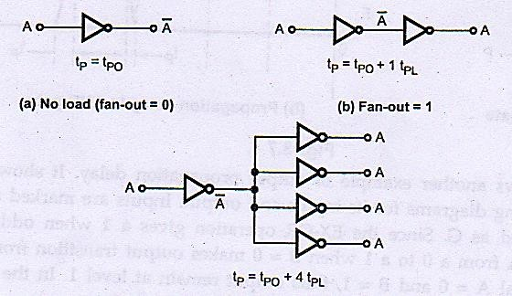
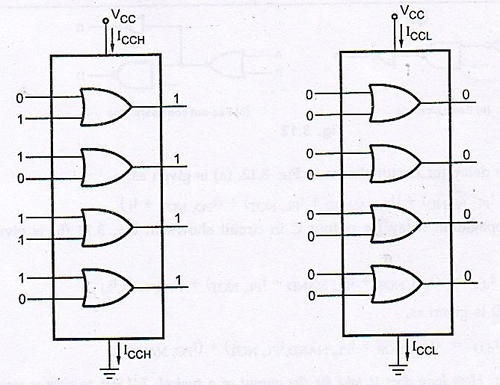
Fig.5: Fan-outs and corresponding propagation delays
Power dissipation:
-The power needed by the gate is expressed in mW.
^{I}CCL
I (avg) = ^{ICCH}
CC
2
P_{D} (avg) = I_{CC} (avg) ×V_{CC}
Fig.6: Currents l_{CCH} and I_{CCL}
133

Slide 7
Example 2: A certain gate draws 1.8 mA when its output is HIGH and 3.2 mA when its output is LOW. What is its average power dissipation if V_{CC} is 5 V and it is operated on a 50 % duty cycle?
Solution: The average Ice is given as,
I
CC(avg)
₌ ^{I}CCH^{+I}CCL
=
= 2.5 mA
2
Then average power dissipation is given as, PD (avg) = I_{CC(avg)} X V_{CC} = 2.5 mA x 5 V = 12.5 mW
Speed-power product(J)=Propagation delay (Seconds) x Power dissipation
(joules/seconds)
Example 3: For a certain IC family, propagation delay is 10 ns with an average power dissipation of 6 mW. What is its speed power product?
Solution: The speed- power product is given as,
SPP = Propagation delay x Average power dissipation
= 10 ns x 6 mW x 60 pico joules (pJ)
Example 4:
If V cc = 5V_{CC}= 5V, ICC ₍₀₎ 22 mA, 1_{CC (1}) = 8mA, V_{OH} = 2.4 V, V_{IH} =2 V,
V_{OL} = 0.45 V, V_{IL} = 0.8 V, t_{PHL} = 15_{nsec}, t_{PLH} = 22 _{nsec}, I_{IH} = 40𝜇A, I_{OH} = 5.2 mA.
calculate :
Noise margin logic 1 and logic 0.
Power dissipation.
Propagation delay and figure of merit.
Fan-out.

Slide 8
Solution:
i) Noise margin logic 1
VNH = VOH(min) - VIH(min)
= 2.4 V — 2 V
V_{NH} = 0.4 V
Noise margin logic 0
VNL = VIL(max) — VOL(max)
= 0.8 V — 0.45 V
VNL = 0.35 V
ii) Power dissipation
ICC(avg) XVCC
I
CC(avg)
^{𝐼}𝐶(0)+𝐼_{𝐶𝐶(1)}
=
2
= 15 mA
∴ Power dissipation = 15 mA x5 V
= 75 mwatts
iii) Propagation delay
t_{p} = max (t_{PLH} t_{PHL})
tp = tPGL = 22nsec
t = ¹ (t t )
p PLH PHL
2
= ¹ (22+15)nsec
2
= 18.5nsec
Figure of merit = SPP = Delay x Power dissipation
=18.5 nsec x 75 mwat
=1387.5 pico joule
iv)Fan-out =
^{I}OH(max)
^{I}IH(MAX)
₌ 5.2mA ₌ ₁₃₀
40μA

Slide 9
