Slide 2
Applications of Nano Materials
Dr. Raouf Mahmood

Slide 3
1. Nanotechnology Applications in Medicine
Because of their small size, nanoscale devices can readily interact with biomolecules on both the surface of cells and inside of cells.
By gaining access to so many areas of the body, they have the potential to detect disease and the deliver treatment.
Nanoparticles can can deliver drugs directly to diseased cells in your body.
Nanomedicine is the medical use of molecular- sized particles to deliver drugs, heat, light or other substances to specific cells in the human body.

Slide 4
Quantum dot- that identify the location of cancer cells in the body.
Nano Particles - that deliver chemotherapy drugs directly to cancer cells to minimize damage to healthy cells.
Nanoshells - that concentrate the heat from infrared light to destroy cancer cells with minimal damage to surrounding healthy cells.
Nanotubes- used in broken bones to provide a structure for new bone material to grow.

Slide 5
Nano shells as Cancer Therapy
Nano shells are injected into cancer area and they recognize cancer cells. Then by applying near-infrared light, the heat generated by the light-absorbing Nano shells has successfully killed tumor cells while leaving neighboring cells intact.

Slide 8
Nanowires – used as medical sensor
In this diagram (next page), Nano sized sensing wires are laid down across a micro fluidic channel. As particles flow through the micro fluidic channel, the Nanowire sensors pick up the molecular identifications of these particles and can immediately relay this information through a connection of electrodes to the outside world.
These Nanodevices are man-made constructs made with carbon, silicon Nanowire.
They can detect the presence of altered genes associated with cancer and may help researchers pinpoint the exact location of those changes

Slide 10
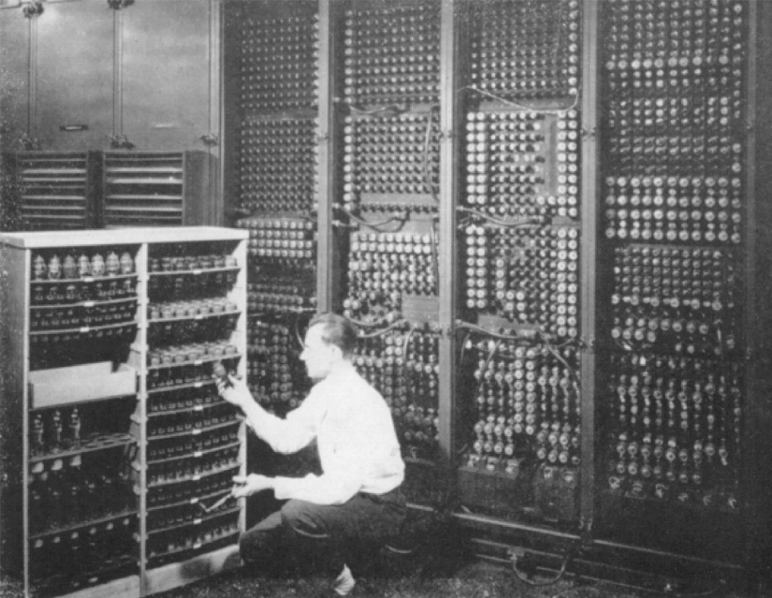
2. Nano Computing Technology
Past
Shared computing thousands of people sharing a mainframe computer
Present
Personal computing
Future
Ubiquitous computing thousands of computers sharing each
and everyone of us; computers embedded in walls, chairs, clothing,
light switches, cars….; characterized by the connection of things in
the world with computation.

Slide 11
3. Sunscreens and Cosmetics
Nanosized titanium dioxide and zinc oxide are currently used in some sunscreens, as they absorb and reflect ultraviolet (UV) rays.
Nanosized iron oxide is present in some lipsticks as a pigment.
4. Fuel Cells
The potential use of nano-engineered membranes to intensify catalytic processes could enable higher-efficiency, small-scale fuel cells.
5. Displays
Nanocrystalline zinc selenide, zinc sulphide, cadmium sulphide and lead telluride are candidates for the next generation of light-emitting phosphors.
CNTs are being investigated for low voltage field-emission displays; their strength, sharpness, conductivity and inertness make them potentially very efficient and long-lasting emitters.

Slide 12
6. Batteries
With the growth in portable electronic equipment (mobile phones, navigation devices, laptop computers, remote sensors), there is great demand for lightweight, high-energy density batteries.
Nanocrystalline materials are candidates for separator plates in batteries because of their foam-like (aerogel) structure, which can hold considerably more energy than conventional ones.
Nickel–metal hydride batteries made of nanocrystalline nickel and metal hydrides are envisioned to require less frequent recharging and to last longer because of their large grain boundary (surface) area.
7. Catalysts
In general, nanoparticles have a high surface area, and hence provide higher catalytic activity.

Slide 13
8. Magnetic Nano Materials applications
It has been shown that magnets made of nanocrystalline yttrium–samarium–cobalt grains possess unusual magnetic properties due to their extremely large grain interface area (high coercivity can be obtained because magnetization flips cannot easily propagate past the grain boundaries).
This could lead to applications in motors, analytical instruments like magnetic resonance imaging (MRI), used widely in hospitals, and microsensors.
Nanoscale-fabricated magnetic materials also have applications in data storage.
Devices such as computer hard disks storage capacity is increased with Magnetic Nano materials

Slide 14
9. Medical Implantation
Unfortunately, in some cases, the biomedical metal alloys may wear out within the lifetime of the patient. But Nano materials increases the life time of the implant materials.
Nanocrystalline zirconium oxide (zirconia) is hard, wear resistant, bio-corrosion resistant and bio-compatible.
It therefore presents an attractive alternative material for implants.
Nanocrystalline silicon carbide is a candidate material for artificial heart valves primarily because of its low weight, high strength and inertness.
.
10. Water purification
Nano-engineered membranes could potentially lead to more energy-efficient water purification processes, notably in desalination process.

Slide 15
11. Military Battle Suits
Enhanced nanomaterials form the basis of a state-of- the-art ‘battle suit’ that is being developed.
A short-term development is likely to be energy-absorbing materials that will withstand blast waves;
longer-term are those that incorporate sensors to detect or respond to chemical and biological weapons (for example, responsive nanopores that ‘close’ upon detection of a biological agent).

Slide 17
Physisorption vs Chemisorption
PHYSISORPTION | CHEMISORPTION
WEAK, LONG RANGE BONDING Van der Waals interactions | STRONG, SHORT RANGE BONDING Chemical bonding involved.
NOT SURFACE SPECIFIC Physisorption takes place between all molecules on any surface providing the temperature is low enough. | SURFACE SPECIFIC E.g. Chemisorption of hydrogen takes place on transition metals but not on gold or mercury.
ΔH_{ads} = 5 ….. 50 kJ mol-1 | ΔH_{ads} = 50 ….. 500 kJ mol⁻¹
Non activated with equilibrium achieved relatively quickly. Increasing temperature always reduces surface coverage. | Can be activated, in which case equilibrium can be slow and increasing temperature can favour adsorption.
No surface reactions. | Surface reactions may take place:- Dissociation, reconstruction, catalysis.
MULTILAYER ADSORPTION BET Isotherm used to model adsorption equilibrium. | MONOLAYER ADSORPTION Langmuir Isotherm is used to model adsorption equilibrium.
http://www.soton.ac.uk

