Slide 1
4CREEP
الجامعة المستنصرية
كلية الهندسة – قسم الهندسة الميكانيكية
مادة موا هندسية
د. ناظم مجبل فالح

Slide 2
1.Primary or Transient Creep
The material experience an increase in creep resistance or strain hardening.
Occur quickly
Can be treated in much the way that elastic deflection is allowed for in a structure.

Slide 3
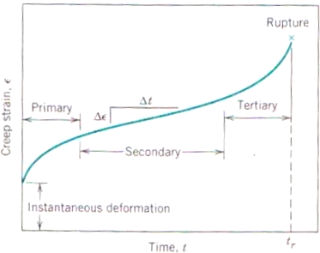

Slide 4
2.Secondary or Steady-State Creep
As the name itself, the line became linear or constant.
The most longest duration.
Steady-state creep rate (∆ε/∆t) is the most important parameter from a creep test.
Engineer must consider creep curve for long-time applications (such as nuclear power plant component) that is scheduled to operate for several decades, and when failure or too much strain is not an important.

