Slide 1
5CREEP
الجامعة المستنصرية
كلية الهندسة – قسم الهندسة الميكانيكية
مادة موا هندسية
د. ناظم مجبل فالح

Slide 2
3.Tertiary Creep
There is an acceleration of the rate and ultimate failure.
Termed as rupture, or fracture.
If the test is using tensile loads, a ‘neck’ may form.
For many relatively short-life creep situation (e.g. turbine blades, rocket motor nozzles, etc), time of rupture, t_{r}, is the dominant design consideration.

Slide 3
Stress and Temperature Effects
Influence the creep characteristic.
These characteristic are:
The instantaneous strain at the time of stress application increase.
The steady-state creep rate is increase.
The rupture lifetime is diminished.
The result of creep rupture test commonly presented as the logarithm of stress vs the logarithm of rupture lifetime.

Slide 4
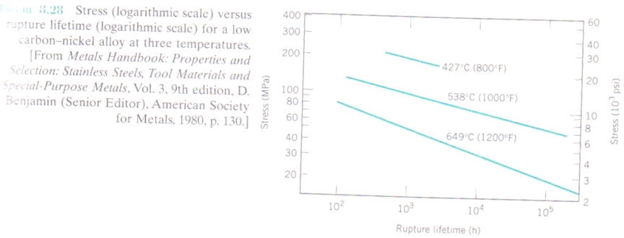
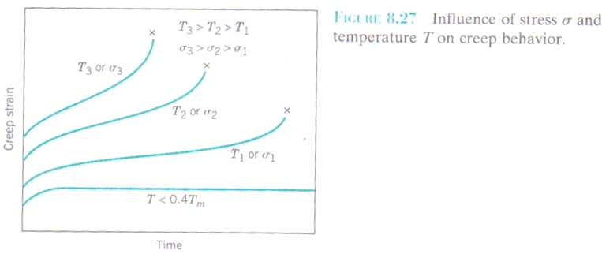

Slide 5
Empirical relationships have been developed in which the steady-state creep rate as a function of stress and temperature is expressed.
ε = K¹σ^{n}
Where K¹ and n are material constant. A plot of the logarithm of ε vs the logarithm of σ yields a straight line with the slope of n.

Slide 6
