Slide 1
CREEP
الجامعة المستنصرية
كلية الهندسة – قسم الهندسة الميكانيكية
مادة موا هندسية
د. ناظم مجبل فالح

Slide 2
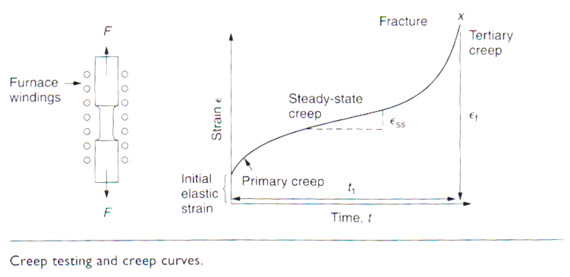
Result from Creep test

Slide 3
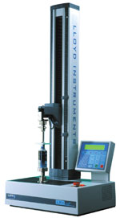
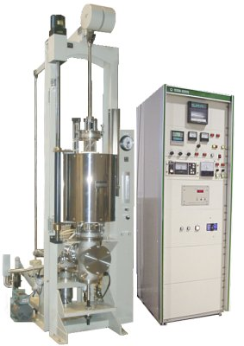

Slide 4
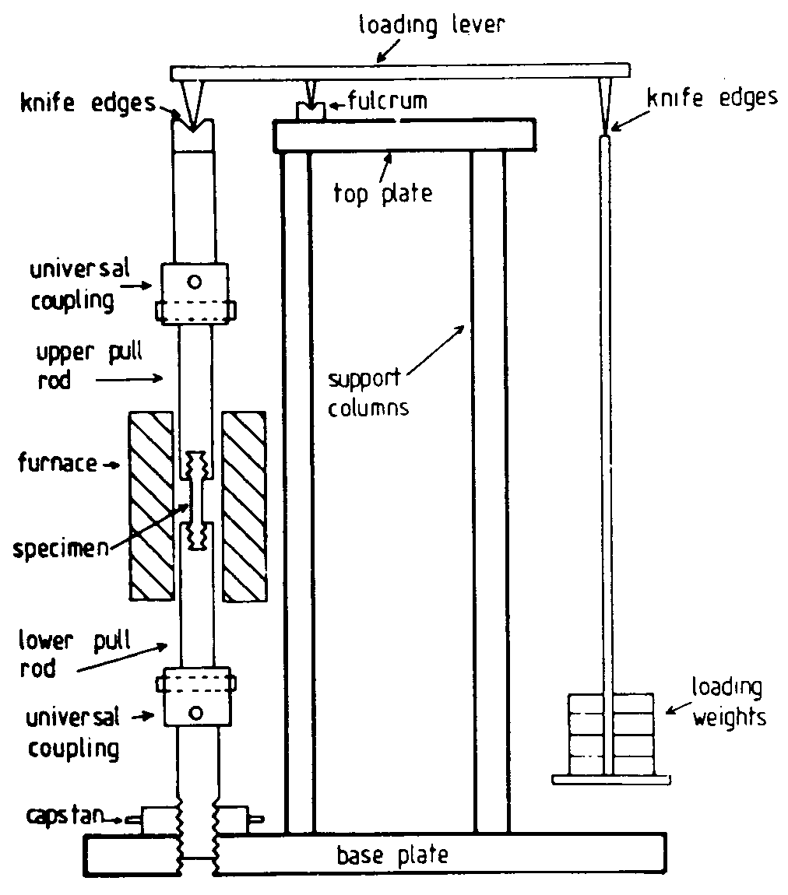

Slide 5
1.Primary or Transient Creep
The material experience an increase in creep resistance or strain hardening.
Occur quickly
Can be treated in much the way that elastic deflection is allowed for in a structure.

Slide 6
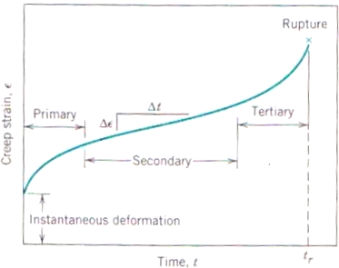

Slide 7
2.Secondary or Steady-State Creep
As the name itself, the line became linear or constant.
The most longest duration.
Steady-state creep rate (∆ε/∆t) is the most important parameter from a creep test.
Engineer must consider creep curve for long-time applications (such as nuclear power plant component) that is scheduled to operate for several decades, and when failure or too much strain is not an important.

Slide 8
3.Tertiary Creep
There is an acceleration of the rate and ultimate failure.
Termed as rupture, or fracture.
If the test is using tensile loads, a ‘neck’ may form.
For many relatively short-life creep situation (e.g. turbine blades, rocket motor nozzles, etc), time of rupture, t_{r}, is the dominant design consideration.

Slide 9
Stress and Temperature Effects
Influence the creep characteristic.
These characteristic are:
The instantaneous strain at the time of stress application increase.
The steady-state creep rate is increase.
The rupture lifetime is diminished.
The result of creep rupture test commonly presented as the logarithm of stress vs the logarithm of rupture lifetime.

Slide 10
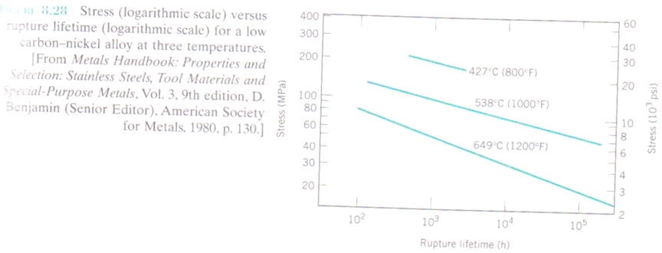
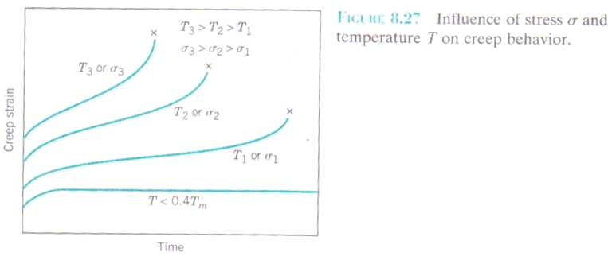

Slide 11
Empirical relationships have been developed in which the steady-state creep rate as a function of stress and temperature is expressed.
ε = K¹σ^{n}
Where K¹ and n are material constant. A plot of the logarithm of ε vs the logarithm of σ yields a straight line with the slope of n.

Slide 12
