Slide 1
1CREEP
الجامعة المستنصرية
كلية الهندسة – قسم الهندسة الميكانيكية
مادة موا هندسية
د. ناظم مجبل فالح

Slide 2
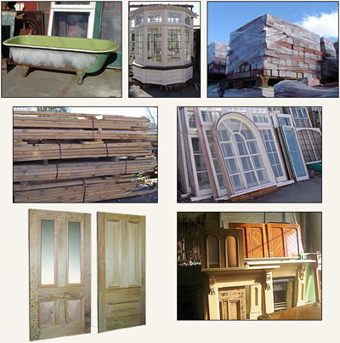
Engineering Materials
Material Engineering 17

Slide 3
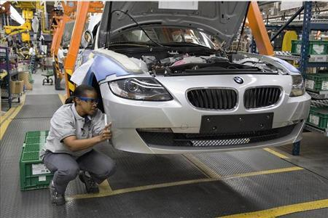
Materials
Over 70,000 different kinds and grades of engineering materials
This number grows daily
1,000 different materials
make up an
automobile

Slide 4
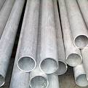
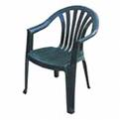
The Three Basics:
Metals
Polymers
Composites
Ceramics

Slide 5
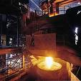
Metal
Cast Iron
Steel
Mild steel, medium carbon steel, high carbon steel
Specialty steel
Stainless (tin plated or galvanized)
Alloys (two or more pure metals)
Steel= iron & carbon
Brass= copper & zinc
Bronze= copper & tin

Slide 6
Polymers
Natural
Animal cellulose
Synthetic-
Thermoplastics
Thermosets

Slide 7
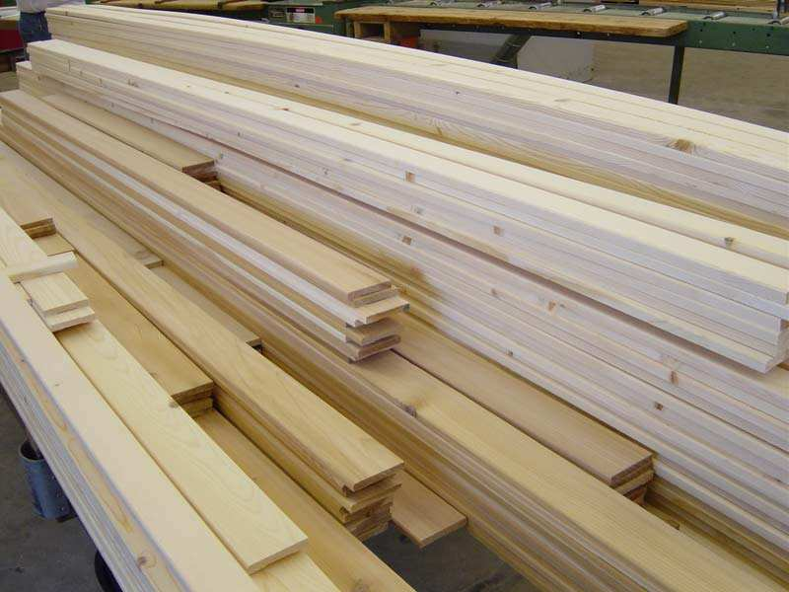
Natural Composites
Hardwood
Deciduous Trees
Softwood
Coniferous

Slide 8
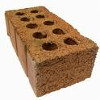
Ceramics
Clay based
Structural clay-tile, brick
Porcelain
Refractories
Heat resistant (fire bricks)
Glasses
Inorganic cements

Slide 9
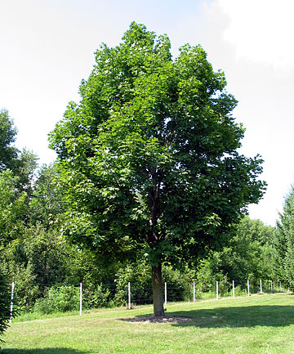
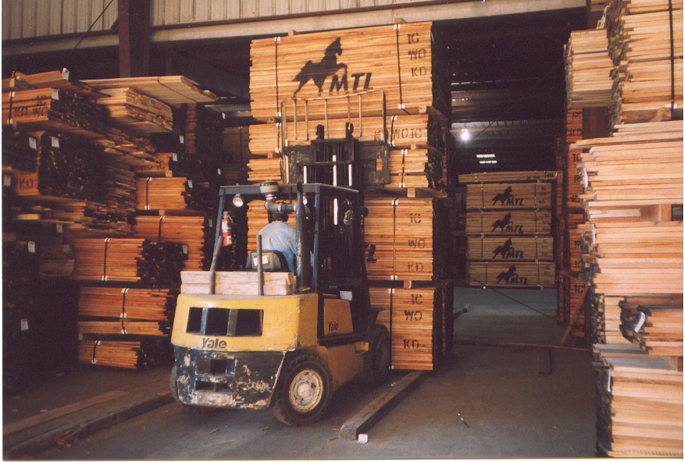
Hardwoods
Ash
Beech
Birch
Cherry
Mahogany
Maple
Oak
Poplar
walnut

Slide 10
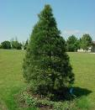
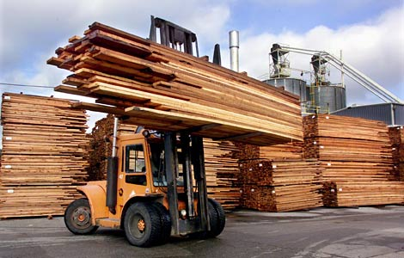
Softwoods
Cedar
Cypress
Fir
Pine
Redwood
Spruce

Slide 11
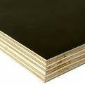
Manufactured Wood
Particle Board
flake board, particle board
Laminar
plywood, laminated beams

Slide 12
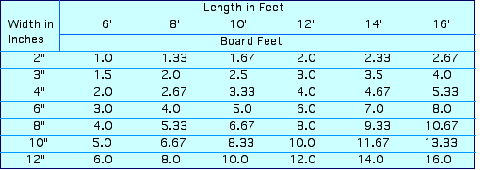
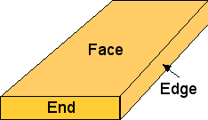
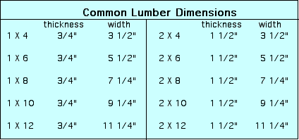
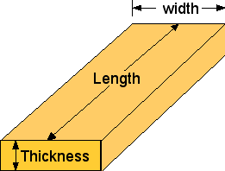
Lumber Facts

