Slide 1
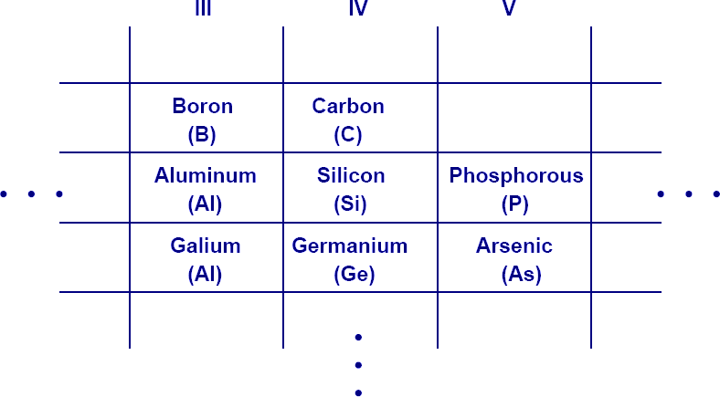
Electronic Physics
Dr. Ghusoon Mohsin Ali
Semiconductors
Intrinsic
In term of energy bands model, semiconductors can defined as that
material which have almost an empty conduction band and almost filled valence band with a very narrow energy gap (≈1eV). Common examples of such semiconductors are germanium and silicon which have forbidden
energy gaps of 0.7eV and 1.1eV respectively. Another example for compound semiconductors III-V such as GaAs, GaN and II-VI compound semiconductors such as ZnO.
Fig. 4.1 Group semiconductor materials.
Fig. 4.2 Silicon semiconductor materials.

Slide 2
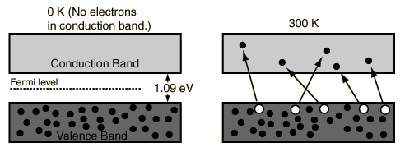
Electronic Physics Dr. Ghusoon Mohsin Ali
At 0 K there no electrons in conduction band and the Valence band is completely filled, with increase temperature some of the electrons are liberated into conduction band.
Fig. 4.3 Band diagram Si at 0 K and 300 K
Conductivity of semiconductor increase with temperature. Moreover for each electron(e) liberated into conduction band a positively charged hole(h) is created in the valence band.
Semiconductor current consists of movement of electrons and holes in opposite directions, suppose the covalent bond is broken at A and the
electron has moved through the crystal lattice leaving behind a hole in the covalent bond. An electron at B may jump into the vacant hole at A and later, an electron at C may jump into the hole at B and so on. In this way, by a succession of electron movements, a hole will appear at G and a negative charge would have moved from G to A It would, however be more convenient to regard positive charge to have moved from A to G and this conception gives rise to a hole as a positive charge carrier. It should be clearly understood that these holes are due to the movement of electrons in the valence band and. The drift velocity of holes is, much less than the drift velocity of electrons.
An intrinsic semiconductor may be defined as one in which the number of conduction electrons is equal to the number of holes.

Slide 3
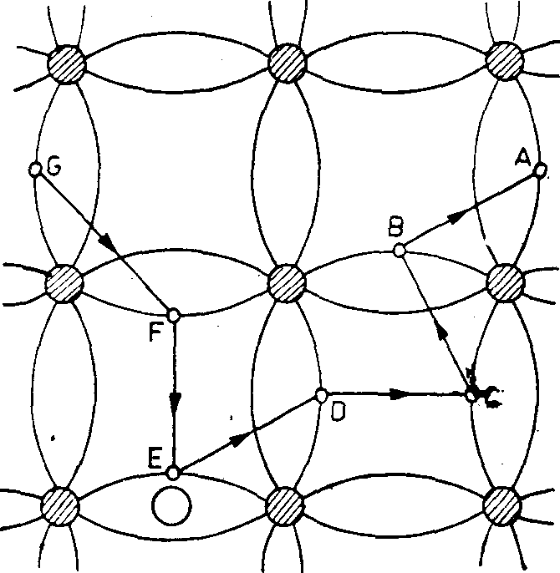
Electronic Physics
Dr. Ghusoon Mohsin Ali
Fig. 4.4 Movement of holes in valance band
n = p
i i
where ni is the number of electrons in the conduction band
pi is the number of holes in the valence band
n² = n p
i i i
The forbidden energy gap Eg is
E = E − E
g c v
Ec
Eg
Ev
Fig. 4.4 Conduction band and valance band
Where Ec is the conduction band edge and
Ev is the valence band edge

Slide 4
Electronic Physics Dr. Ghusoon Mohsin Ali
In a semiconductor, charge carriers are both electrons and holes (these are called thermally-generated charge carriers) then the current flow due to the movement of electrons and holes in opposite direction. Even though the number of electrons equals the number of holes, hole mobility (μp) and electron mobility (μn) are different.
ο = n eμ + p eμ = n e(μ + μ )
i n i p i n p
J = σE = n e(μ + μ )E
i n p
_{ρv =} 1 _{E}
Dn σ^{= μ}n
v = μ E
Dp p
Example
Calculate σ for pure Silicon if only one electron liberated from 10¹³ valence electrons, if density 2.33×10³kg/m³, atomic weight 28.086, μn=0.135 m²/Vs, μp=0.048 m²/Vs .
Solution
N × Density
N = ^{Avo} = 5×10²⁸ / m³ Atomicweight
No. of valence electrons= 4×5×10²⁸=2×10²⁹/ m³
No. of conduction electrons=2×10²⁹/ 10¹³=2×10¹⁶/ m³
ni=pi=2×10¹⁶/ m³

Slide 5
Electronic Physics
Dr. Ghusoon Mohsin Ali
ο = n e(μ + μ ) = 5.8×10⁻⁴ S / m
i n p
Example
A potential difference of 10 V is applied longitudinally to a rectangular
specimen of intrinsic Ge of length 2.5cm, width 0.4cm and thickness 0.15cm. Calculate
(i) electron and hole drift velocities, (ii) σ of Ge if intrinsic carrier density is 2.5×10¹⁹/ m³, and (in) the total current, Given μn=0.38m²/Vs, μp=0.18m²/Vs .
Solution
(i)
v = μ E = 0.38
Dn n
10
= 152ms⁻¹
2.5 *10⁻²
v = μ E = 018
Dp p
10
= 72ms⁻¹
2.5 *10⁻²
(ii)
ο = n e(μ + μ ) = 2.24S / m
i n p
(iii)
I = σEA = 2.24
⎛
10
⎞
(0.4 × 0.15×10⁻⁴ ) = 5.38mA
⎜
2.5×10
−2
⎟
⎝ ⎠
Physical constants
Boltzmann's constant k=1.38×10⁻²³ J/K =8.62×10⁻⁵ eV/K Plank's constant h=6.625×10⁻³⁴ J.s =4.135×10⁻¹⁵ eV.s
kT=0.0259 eV

Slide 6
Electronic Physics
Dr. Ghusoon Mohsin Ali
The concentration of electrons in the conduction and is
n = ∫∞ N (E) f (E,T )dE
E_{c}
n = N_{c} exp(−(E_{c} − E_{F} ) / kT)
3
⎛ 2πm*kT ⎞²
N = 2^{⎜ n ⎟}
c
⎜
_{h}2
⎟
⎝ ⎠
where the parameter Nc is called the effective density of states function in the conduction band and its value is 2.8×10²⁵/m³ for Silicon and 1.04×10²⁵/m³ for Germanium and mn* is the effective mass of the electron.
Similarly the concentration of holes in the valence and is
p = N_{v} exp(−(E_{F} − E_{v} ) / kT)
3
⎛ 2πm* kT ⎞²
N = 2^{⎜ p ⎟}
v
⎜
_{h}2
⎟
⎝ ⎠
The parameter Nv is called the effective density of states function in the valence band and its value is 1.04×10²⁵/m³ for Silicon and 6×10²⁴/m³ for Germanium, and mn* is the effective mass of the hole.
For intrinsic semiconductor
ni=pi
N_{c} exp(−(E_{c} − E_{F} ) / kT) = N_{v} exp(−(E_{F} − E_{v} ) / kT)

Slide 7
Electronic Physics
Dr. Ghusoon Mohsin Ali
N_{v}
= exp((−(E_{c} − E_{F} ) + (E
− E ))/ kT )
N
c
F
v
N_{v}
= exp((−E_{c} + E_{F} + E_{F} − E_{v} ) / kT )
N
c
N
ln ^{v} = (−E − E + 2E ) / kT
N
c
c v F
N
kT ln ^{v} = −E − E + 2E
N
c
c v
F
E + E
kT
N
_{ln} v
E
₌ c v
2
+
F
2 N
c
The first term (Ec+Ev/2) is the energy exactly midway between Ec and Ev
or the midgap energy
E + E
E
₌ c v
2
midgap
3
⎛ 2πm*kT ⎞²
N = 2^{⎜ n ⎟}
c
⎜
_{h}2
⎟
⎝ ⎠
3
_{m}*
⎛ 2πm* kT ⎞²
E + E
3
N = 2^{⎜ p ⎟}
E
₌ c v
2
kT ln ^{p}
v
⎜
_{h}2
⎟
F
4
_{m}*
⎝
⎠
n
3
⎛ m* ⎞
E − E = kT ln^{⎜ p ⎟}
F
midgap
4
⎜ _{m}* ⎟
⎝
n ⎠

Slide 8
Electronic Physics Dr. Ghusoon Mohsin Ali
where m* is the effective mass, take into account the particle mass and also takes into account the effect of the internal forces. If m *= m * then the
n p
intrinsic Fermi level is exactly in the center of the bandgap. If m *> m * the
n p
intrinsic Fermi level is slightly below the center. If mn*< mp* it is slightly above the center. Hence, the Fermi level of intrinsic semiconductor generally lies very close to the middle of band gap.
Example
Calculate the position of the intrinsic Fermi level with respect to the center of the bandgap in silicon at T=300 K. The effective mass in silicon are mn*= 1.08m0 and mp*= 0.56m0 .
Solution
The intrinsic Fermi level with respect to the center of the bandgap is
⎛ m* ⎞
3 3 ⎛ 0.56 ⎞
E − E = kT ln^{⎜ p ⎟} = (0.0259)ln⎜
⎟
F
midgap
4
⎜ _{m}* ⎟
4
⎝ 1.08 ⎠
⎝
n ⎠
E − E = −0.0128eV = −12.8meV
F midgap
The intrinsic Fermi level in silicon is -12.8meV below the midgap energy. If we compare 12.8 meV to (1.12/2)=0.56eV =560meV. We may approximate that the intrinsic Fermi level to be in the center of the bandgap.
The probability of the states not occupied by an electron is given as 1-
f(E,T). The function f(E,T) is symmetrical with the function 1-f(E,T) about the Fermi energy EF as shown in the figure below

Slide 9
Electronic Physics
Dr. Ghusoon Mohsin Ali
1 − f (E,T ) =
1
⎛ E − E ⎞
1 + exp⎜ ^{F} ⎟
⎝
kT
⎠
Example
Determine the temperature at which there is a 1 percent that an energy
state 0.3 eV below the Fermi level is empty.
Solution
1 − f (E,T ) =
1
1 + exp⎜
⎛ E_{F} − E ⎞
⎝
kT
⎟
E = E_{F} − 0.3
⎠
1
=
1
100
1 +
⎛ E_{⎛F0}−_{.3}E_{⎞F} + 0.3 ⎞
99e=^{xp}e⎜xp⎜ _{k}⎟_{T}
⎟
⎝ ⎝ kT ⎠
⎠
4.58512= ^{⎛ 0.3 ⎞}
⎜ ⎟
⎝ kT ⎠
Solving for kT, we find kT=0.0652 eV, so that the temperature is T=756.
==============================================

Slide 10
Electronic Physics
Dr. Ghusoon Mohsin Ali
E
N(E)
E
E
Ec
EF
f(E,T)
1-f(E,T)
Ev
N(E)
E
E
N(E) f(E,T)
N(E)
Electrons
Ec
EF
N(E)(1-f(E,T))
Holes
N(E)
Fig. 4.5 The density of states function N(E), the Fermi-Dirac distribution function f(E), and areas representing electron and hole concentrations for the case when EF is near the mid gap
energy.
We are assuming that the Fermi energy is within the forbidden energy band gap. For electrons in the conduction band. If we have, (E-Ec)>>kT. The Fermi probability function reduces to the Boltzmann approximation.
1
⎛
(E − E )⎞
f (E,T ) =
⎛ E − E ⎞
F
≈ exp⎜− ^{F} ⎟
1+ exp⎜
⎝
⎟
⎠
⎝
kT
⎠
kT

Slide 11
Electronic Physics Dr. Ghusoon Mohsin Ali
For energy states in the valence band, E<Ev. If (EF-Ev)>>kT. The Fermi probability function reduces to the Boltzmann approximation.
1
⎛
(E − E)⎞
1− f (E,T ) =
⎛ E − E ⎞
F
≈ exp⎜− ^{F} ⎟
1+ exp⎜
⎝
⎟
⎠
⎝
kT
⎠
kT
Example
Calculate the probability that a state in the conduction band is occupied by an electron and calculate the thermal equilibrium electron concentration in Si at T=300 K. If the Fermi energy is 0.25 eV below the conduction band. The value of Nc=2.8×10²⁵/m³ at T=300K.
Solution
The probability that an energy state E=Ec is occupied by an electron is given by
1
⎛
(E − E )⎞
f (E,T ) =
⎛ E − E ⎞
F
≈ exp⎜− ^{F} ⎟
1+ exp⎜
⎝
⎟
⎠
⎝
kT
⎠
kT
f (E ,300) = exp⎜
⎛₋
0.25
⎞
= 6.43×10
−5
⎟
c
⎝
0.0259⎠
The
electron concentration is given by
n = N_{c} exp(−(E_{c} − E_{F} ) / kT)
n = (2.8×10²⁵ )exp(− 0.25/ 0.0259)
n = 1.8 ×10²¹ / m³
Example

Slide 12
Electronic Physics
Dr. Ghusoon Mohsin Ali
Calculate the thermal equilibrium hole concentration at T=400 K. Assume that the Fermi energy is 0.27 eV above the valence band energy. The value of Nv at T=300 K is 1.04×10²⁵/m³.
Solution
The parameter values at T=400K are found as
_{⎛ 400⎞}3 / 2
N = 1.04×10²⁵ ⎜
⎟
= 1.6 ×10²⁵ / m³
v
⎝ 300 ⎠
kT = 0.0259⎜
⎛ 400⎞
⎟ = 0.03453eV
⎝ 300 ⎠
p = N_{v} exp(−(E_{F} − E_{v} ) / kT)
p = (1.6×10²⁵ ) exp(− 0.27/ 0.03453)
p = 6.43×10¹⁹ / m³
==============================================
The intrinsic carrier density is obtained from law mass of action
ni²=n p
2
(E − E_{F} + E_{F} − E_{v} )₎
n = N N exp(−
c
i c v
kT
n_{i} = N_{v} N_{c} exp(−(E_{c} − E_{v} ) / 2kT )
n_{i} = N_{v} N_{c} exp(−E_{g} / 2kT )

Slide 13
Electronic Physics Dr. Ghusoon Mohsin Ali
Example
Calculate the intrinsic carrier concentration in gallium arsenide (GaAs) at T=300K and at T=450K. The values of Nc and Nv for GaAs are
4.7×10²³/m³ and 7×10²⁴/m³, respectively. Both Nc and Nv vary as T^{3/2}. If Eg of GaAs is 1.42 eV .
Solution
n_{i} = N_{v} N_{c} exp(−E_{g} / 2kT )
n = 4.7 ×10²³ × 7 ×10²⁴ exp(−1.42/(2× 0.0259))
i
n = 2.26×10¹² m⁻³
i
At T=450 K
kT = 0.0259⎜
⎛ 450⎞
⎟ = 0.03885eV
⎝ 300 ⎠
⎛ 450⎞³
n = 4.7 ×10²³ × 7 ×10²⁴ ×⎜ ⎟ exp(−1.42/(2 × 0.03885))
i
⎝ 300 ⎠
n = 3.85×10¹⁶ m⁻³
i

Slide 14
Electronic Physics Dr. Ghusoon Mohsin Ali
Problems
Q1: A bar of intrinsic silicon having a cross section area of 3×10⁻⁴ m² has an ni=1.5×10¹⁶m⁻³. If µn=0.14 m²/V.s and µp=0.05 m²/V.s. Find the long of the bar if the current is 1.2mA and the applied voltage is 9V.
(Ans: 1.026mm)
Q2: Calculate the thermal equilibrium electron and hole concentration in silicon at T=300K for the case when the Fermi energy level is 0.22 eV below the conduction band energy. Eg= 1.12 eV. The values of Nc and Nv are 2.8×10²⁵/m³ and 1.04×10²⁵/m³, respectively.
(Ans: n=5.73×10²¹/m³, p=8.43×10⁹/m³)
Q3: Find the intrinsic carrier concentration in silicon at (a) T=200K, (b) T=400K. The values of Nc and Nv are 2.8×10²⁵/m³ and 1.04×10²⁵/m³, respectively.
(Ans: (a) 7.68×10¹⁰/m³, (b) 2.38×10¹⁸/m³)
Q4: Determine the position of the intrinsic Fermi level with respect to the center of the bandgap in GaAs at T=300K. mn*=0.067 m0, mp*=0.48 m0 (Ans: -38.2meV)

