Slide 1
Principles of Environmental Engineering and Sustainability
Lecture Ten: Wastewater Treatment Plant
Department of Environmental Engineering

Slide 2
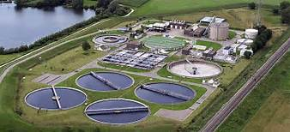
Wastewater Treatment Plant
Purpose:
To manage water discharged from homes, businesses, and industries to reduce the threat of water pollution.

Slide 3
Wastewater Treatment
Pre-treatment
Preliminary treatment
Primary treatment
Secondary treatment
Sludge (biosolids) disposal
Pre-treatment
- Occurs in business or industry prior to discharge
- Prevention of toxic chemicals or excess nutrients being discharged in wastewater

Slide 4
Wastewater Treatment
Water discharged from homes, businesses, and industry enters sanitary sewers
Water from rainwater on streets enters storm water sewers
Combined sewers carry both sanitary wastes and storm water
Wastewater moves toward the treatment plant primarily by gravity flow
Lift stations pump water from low lying areas over hills

Slide 5
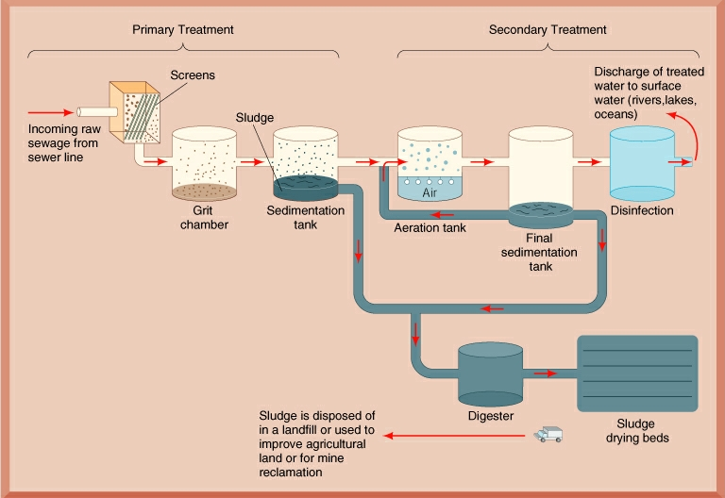
Wastewater Treatment

Slide 6
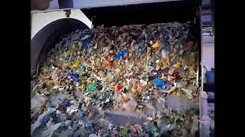
Wastewater Treatment
Preliminary Treatment
- removes large objects and non-degradable materials
- protects pumps and equipment from damage
- bar screen and grit chamber

Slide 7
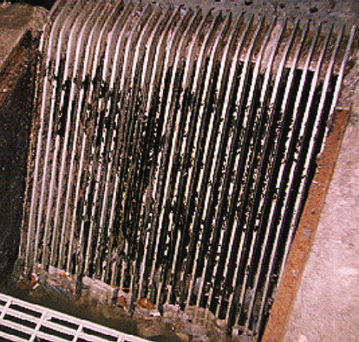
Wastewater Treatment
Bar Screen
- catches large objects that have gotten into sewer system such as bricks, bottles, pieces of wood, etc.

Slide 8
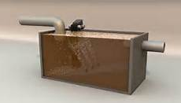
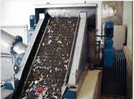
Wastewater Treatment
Grit Chamber
- removes rocks, gravel, broken glass, etc.
Mesh Screen
- removes diapers, combs, towels, plastic bags, syringes, etc.

Slide 9
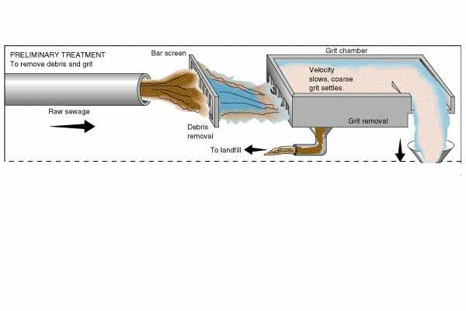
Wastewater Treatment
Preliminary Treatment

Slide 10
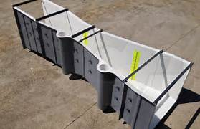
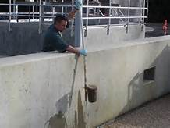
Wastewater Treatment
Measurement and sampling at the inlet structure
- a flow meter continuously records the volume of water entering the treatment plant
- water samples are taken for determination of suspended solids and BOD.

Slide 11
Wastewater Treatment
Suspended Solids – the quantity of solid materials floating in the water column
BOD = Biochemical Oxygen Demand
- a measure of the amount of oxygen required to aerobically decompose organic matter in the water
Measurements of Suspended Solids and BOD indicate the effectiveness of treatment processes
Both Suspended Solids and BOD decrease as water moves through the wastewater treatment processes

Slide 12
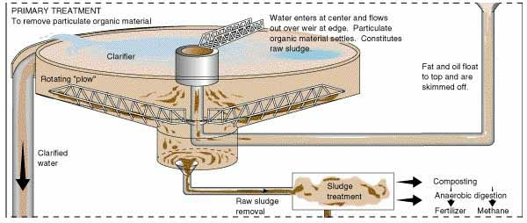
Wastewater Treatment
Primary Treatment
-- a physical process
-- wastewater flow is slowed down and suspended solids settle to the bottom by gravity
-- the material that settles is called sludge or biosolids
Primary Treatment

Slide 13
