Slide 1
Lecture 2-1
Electric
Potential and Capacitance

Slide 2

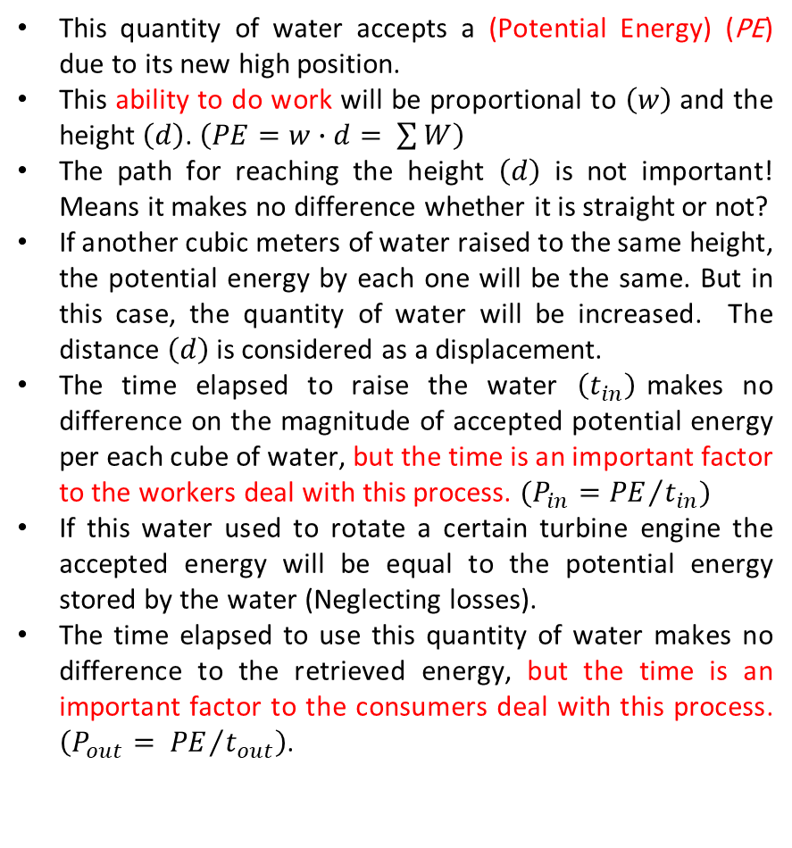
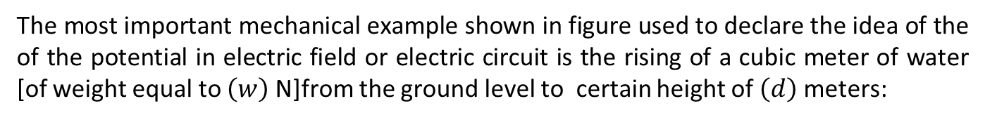


The most important mechanical example shown in figure used to declare the idea of the of the potential in electric field or electric circuit is the rising of a cubic meter of water [of weight equal to $\left(w\right)$ N]from the ground level to certain height of $\left(d\right)$ meters:
This quantity of water accepts a (Potential Energy) (PE) due to its new high position.
This ability to do work will be proportional to $\left(w\right)$and the height $\left(d\right)$. $\left(PE=w∙d= \sum{W}\right)$
The path for reaching the height $\left(d\right)$ is not important! Means it makes no difference whether it is straight or not?
If another cubic meters of water raised to the same height, the potential energy by each one will be the same. But in this case, the quantity of water will be increased. The distance $\left(d\right)$is considered as a displacement.
The time elapsed to raise the water $\left(t_{in}\right)$makes no difference on the magnitude of accepted potential energy per each cube of water, but the time is an important factor to the workers deal with this process. $(P_{in}={PE}/{t_{in}})$
If this water used to rotate a certain turbine engine the accepted energy will be equal to the potential energy stored by the water (Neglecting losses).
The time elapsed to use this quantity of water makes no difference to the retrieved energy, but the time is an important factor to the consumers deal with this process. $\left(P_{out}= {PE}/{t_{out}}\right)$.
PE Level
Path 1
$$w$$
Ground Level
$$d$$
$$w$$
Path 2

Slide 3
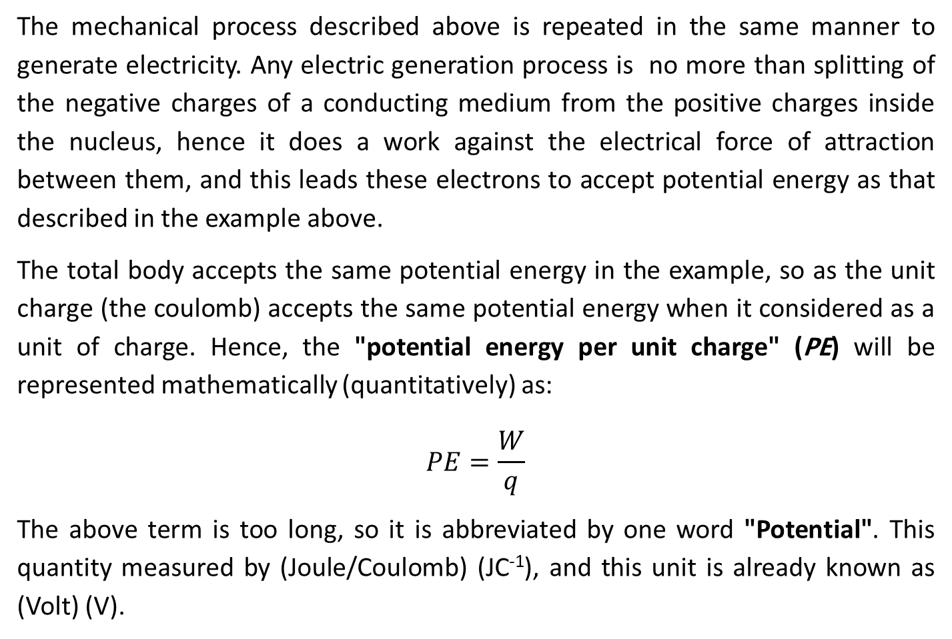
The mechanical process described above is repeated in the same manner to generate electricity. Any electric generation process is no more than splitting of the negative charges of a conducting medium from the positive charges inside the nucleus, hence it does a work against the electrical force of attraction between them, and this leads these electrons to accept potential energy as that described in the example above.
The total body accepts the same potential energy in the example, so as the unit charge (the coulomb) accepts the same potential energy when it considered as a unit of charge. Hence, the "potential energy per unit charge" (PE) will be represented mathematically (quantitatively) as:
$$PE=\frac{W}{q}$$
The above term is too long, so it is abbreviated by one word "Potential". This quantity measured by (Joule/Coulomb) (JC⁻¹), and this unit is already known as (Volt) (V).

Slide 4
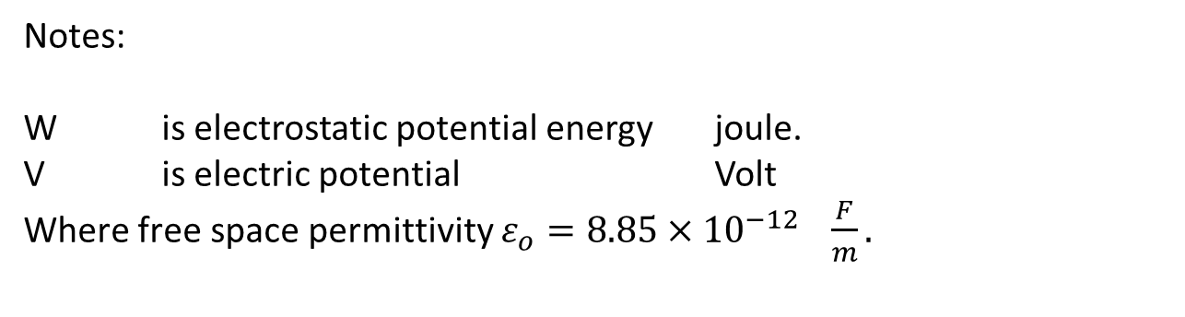
Notes:
W is electrostatic potential energy joule.
V is electric potential Volt
Where free space permittivity $ε_{o}=8.85×{10}^{−12} \frac{F}{m}.$
Assume there are two +ve test charge are place by distance of b.
The two charges are repealing each other by a force Fb.
To bring those two charges together, an external force F is required. Which mean a work W should be done.
+q2
Fb
∞
+q2
+q1 R
p
Ffw
r

Slide 5
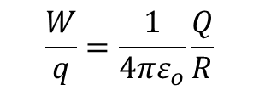

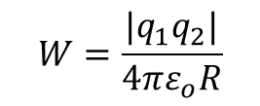

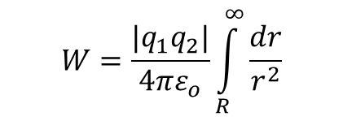
$$W=\int_{∞}^{R}{\overline{F_{fw}} dr}=\int_{R}^{∞}{\overline{F_{b}} dr}$$
Where $\overline{F_{fw}}$ = $\overline{F_{b}}$ = $\frac{q_{1}q_{2}}{4πε_{o}r^{2}}$ but they are opposing each other
$$W=\frac{{|q}_{1}q_{2}|}{4πε_{o}}\int_{R}^{∞}{\frac{dr}{r^{2}}}$$
By substitute $R=\frac{−1}{r}$ then
$$W=\frac{{|q}_{1}q_{2}|}{4πε_{o}R}$$
(joule, Electrostatic potential energy)
While the electric potential per unit charge
$$\frac{W}{q}=\frac{1}{4πε_{o}}\frac{Q}{R}$$
(Volt, Electric potential)

Slide 6
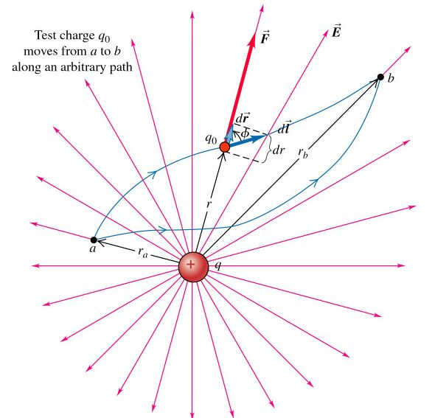

Slide 7
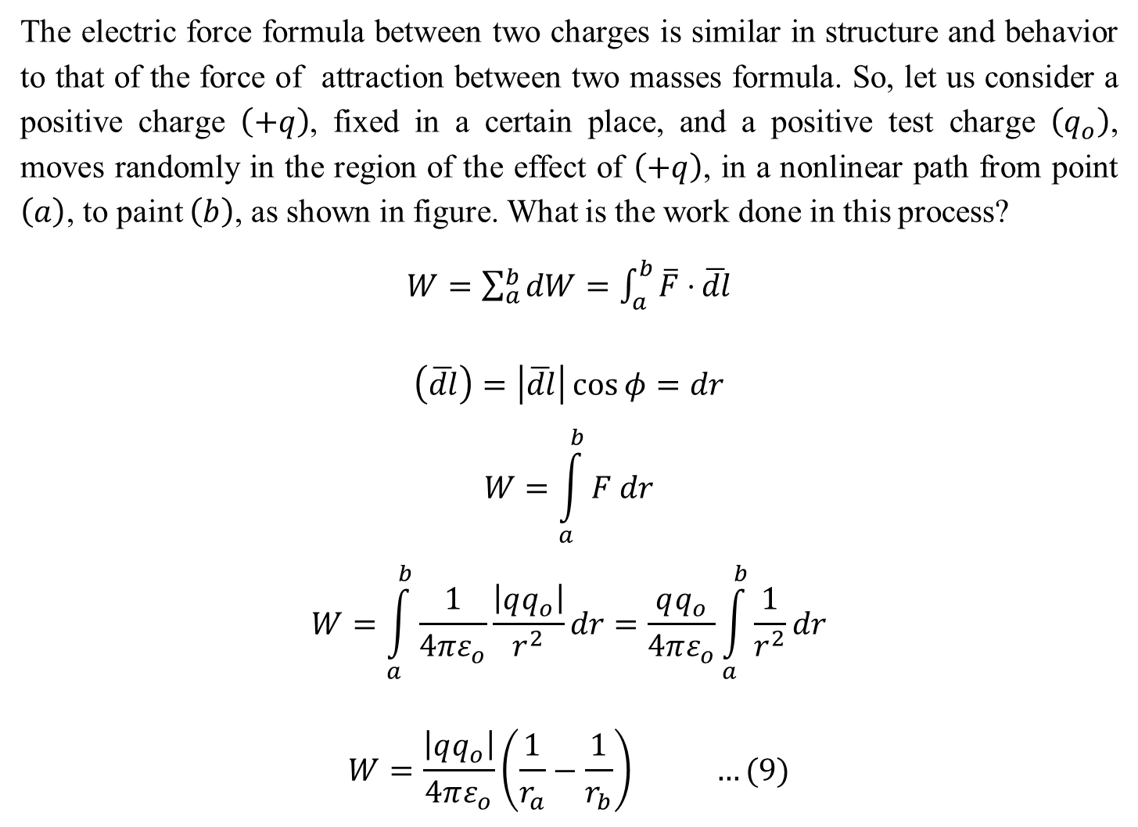
The electric force formula between two charges is similar in structure and behavior to that of the force of attraction between two masses formula. So, let us consider a positive charge $\left(+q\right)$, fixed in a certain place, and a positive test charge $\left(q_{o}\right)$, moves randomly in the region of the effect of $\left(+q\right)$, in a nonlinear path from point $\left(a\right)$, to paint $\left(b\right)$, as shown in figure. What is the work done in this process?
$W=\sum_{a}^{b}{dW}=\int_{a}^{b}{\overline{F}⋅}\overline{dl}$
$$\left(\overline{dl}\right)=\left|\overline{dl}\right|\cos{φ=dr}$$
$$W=\int_{a}^{b}{F dr}$$
$$W=\int_{a}^{b}{\frac{1}{4πε_{o}}\frac{\left|qq_{o}\right|}{r^{2}}dr}=\frac{qq_{o}}{4πε_{o}}\int_{a}^{b}{\frac{1}{r^{2}}dr}$$
$$W=\frac{\left|qq_{o}\right|}{4πε_{o}}\left(\frac{1}{r_{a}}−\frac{1}{r_{b}}\right) …(9)$$

Slide 8
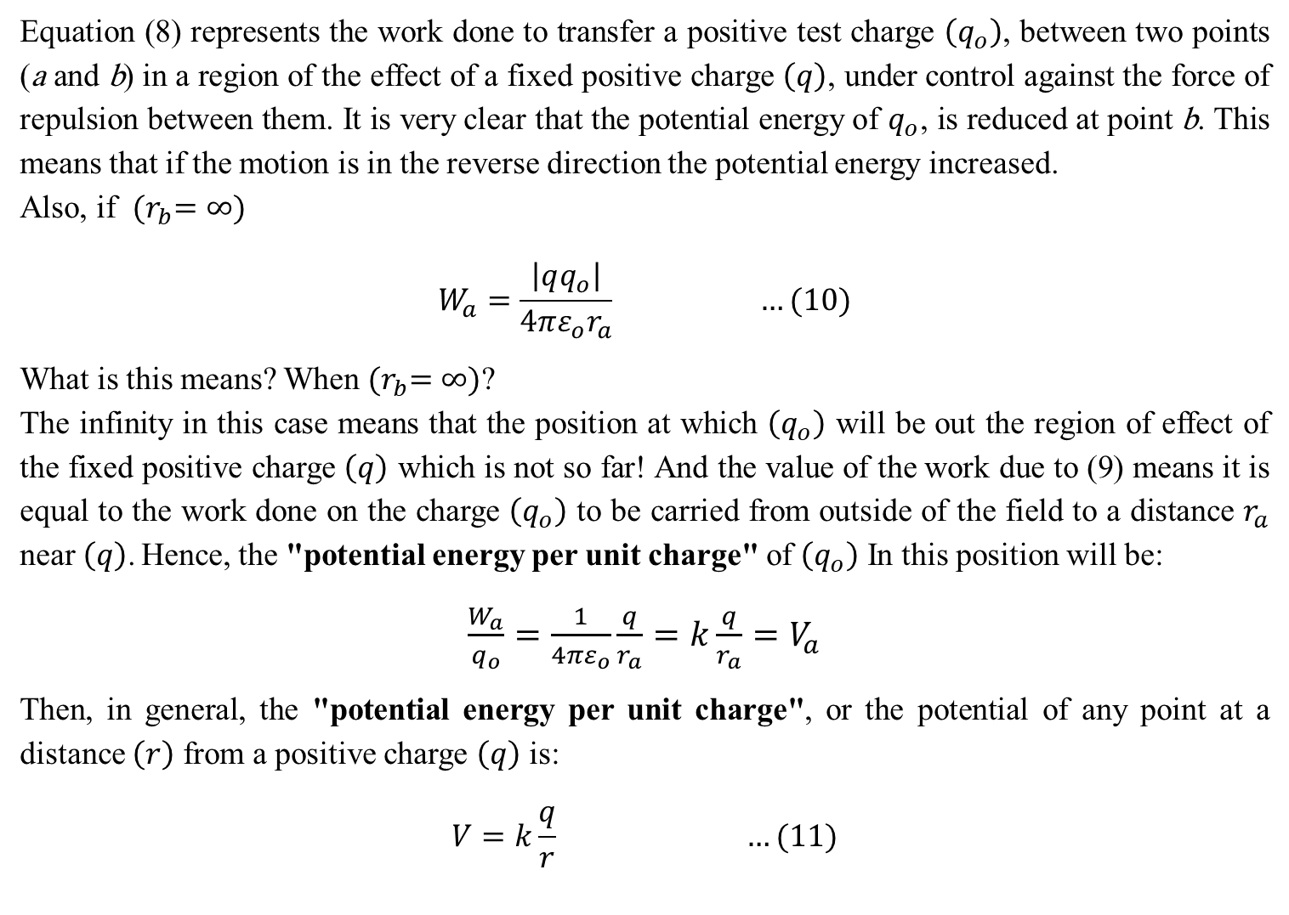
Equation (8) represents the work done to transfer a positive test charge $\left(q_{o}\right)$, between two points (a and b) in a region of the effect of a fixed positive charge $\left(q\right)$, under control against the force of repulsion between them. It is very clear that the potential energy of $q_{o}$, is reduced at point b. This means that if the motion is in the reverse direction the potential energy increased.
Also, if ${(r}_{b}=∞)$
$$W_{a}=\frac{\left|qq_{o}\right|}{4πε_{o}r_{a}} …(10)$$
What is this means? When ${(r}_{b}=∞)$?
The infinity in this case means that the position at which $\left(q_{o}\right)$ will be out the region of effect of the fixed positive charge $\left(q\right)$ which is not so far! And the value of the work due to (9) means it is equal to the work done on the charge $\left(q_{o}\right)$ to be carried from outside of the field to a distance $r_{a}$ near $\left(q\right)$. Hence, the "potential energy per unit charge" of $\left(q_{o}\right)$ In this position will be:
$\frac{W_{a}}{q_{o}}=\frac{1}{4πε_{o}}\frac{q}{r_{a}}=k\frac{q}{r_{a}}=V_{a}$
Then, in general, the "potential energy per unit charge", or the potential of any point at a distance $\left(r\right)$ from a positive charge $\left(q\right)$ is:
$$V=k\frac{q}{r} …(11)$$
(Volt, Electric potential)

Slide 9

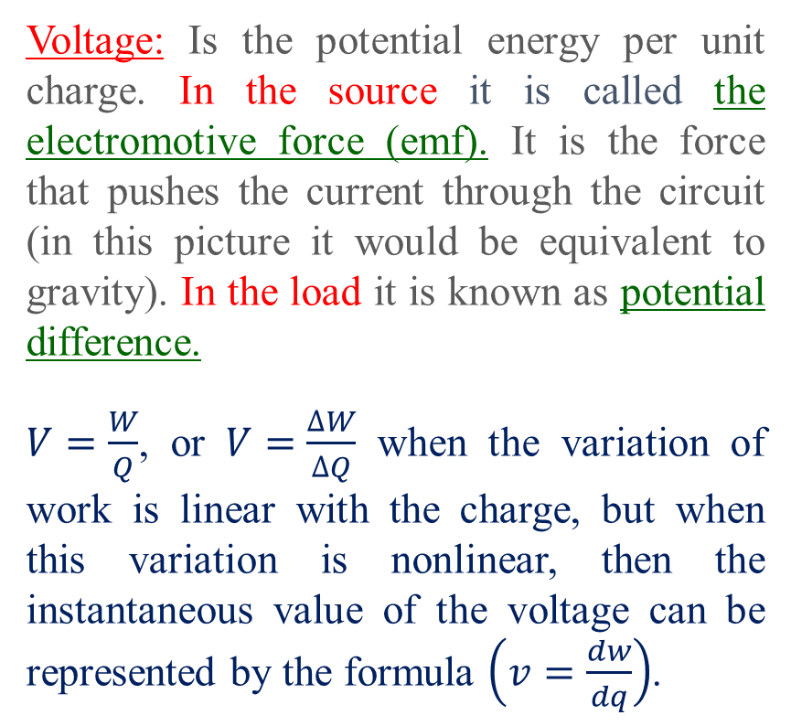
The pervious derivation deals with two charges in free space. But charges inside a conducting medium leads to accept potential energy in the source side and dissipate it in the load side.
Voltage: Is the potential energy per unit charge. In the source it is called the electromotive force (emf). It is the force that pushes the current through the circuit (in this picture it would be equivalent to gravity). In the load it is known as potential difference.
$V=\frac{W}{Q}$, or $V=\frac{∆W}{∆Q}$ when the variation of work is linear with the charge, but when this variation is nonlinear, then the instantaneous value of the voltage can be represented by the formula $\left(v=\frac{dw}{dq}\right)$.

Slide 10
Capacitor and Capacitance

Slide 11



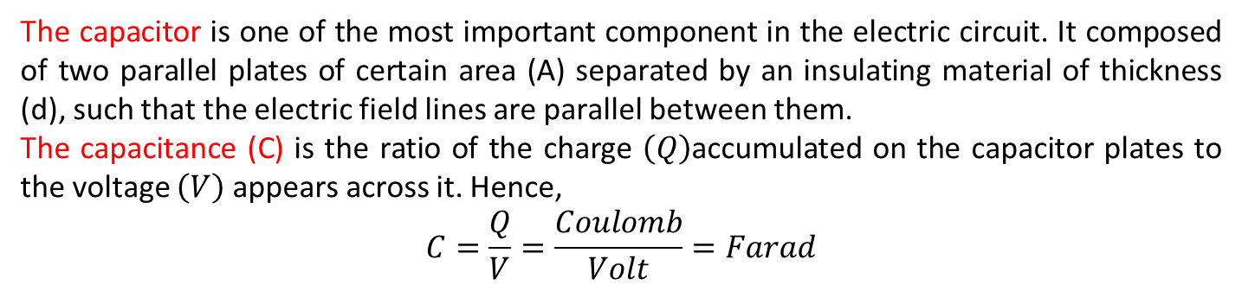






Capacitor and Capacitance
The capacitor is one of the most important component in the electric circuit. It composed of two parallel plates of certain area (A) separated by an insulating material of thickness (d), such that the electric field lines are parallel between them.
The capacitance (C) is the ratio of the charge $\left(Q\right)$accumulated on the capacitor plates to the voltage $\left(V\right)$ appears across it. Hence,
$$C=\frac{Q}{V}=\frac{Coulomb}{Volt}=Farad$$
Electric Field Lines= Electric Flux $\left(ψ\right)$
Conducting Plate of Area $A \left(m^{2}\right)$
Insulating Material
$$+Q$$
$$−Q$$
$$−Q$$
Conducting Plate of Area $A \left(m^{2}\right)$
Air Capacitor
$$+Q$$
$$d$$
$$d$$
Dielectric Capacitor

Slide 12
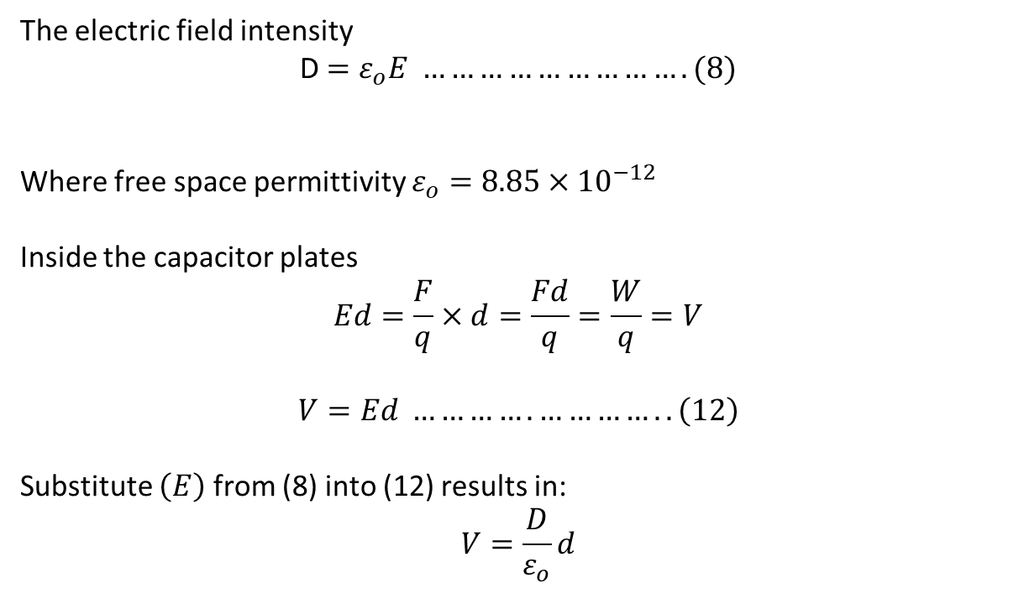
The electric field intensity
D $=ε_{o}E ……………………….(8)$
Where free space permittivity $ε_{o}=8.85×{10}^{−12}$
Inside the capacitor plates
$$Ed=\frac{F}{q}×d=\frac{Fd}{q}=\frac{W}{q}=V$$
$$V=Ed ………….………….. \left(12\right)$$
Substitute $\left(E\right)$ from (8) into (12) results in:
$$V=\frac{D}{ε_{o}}d$$

Slide 13
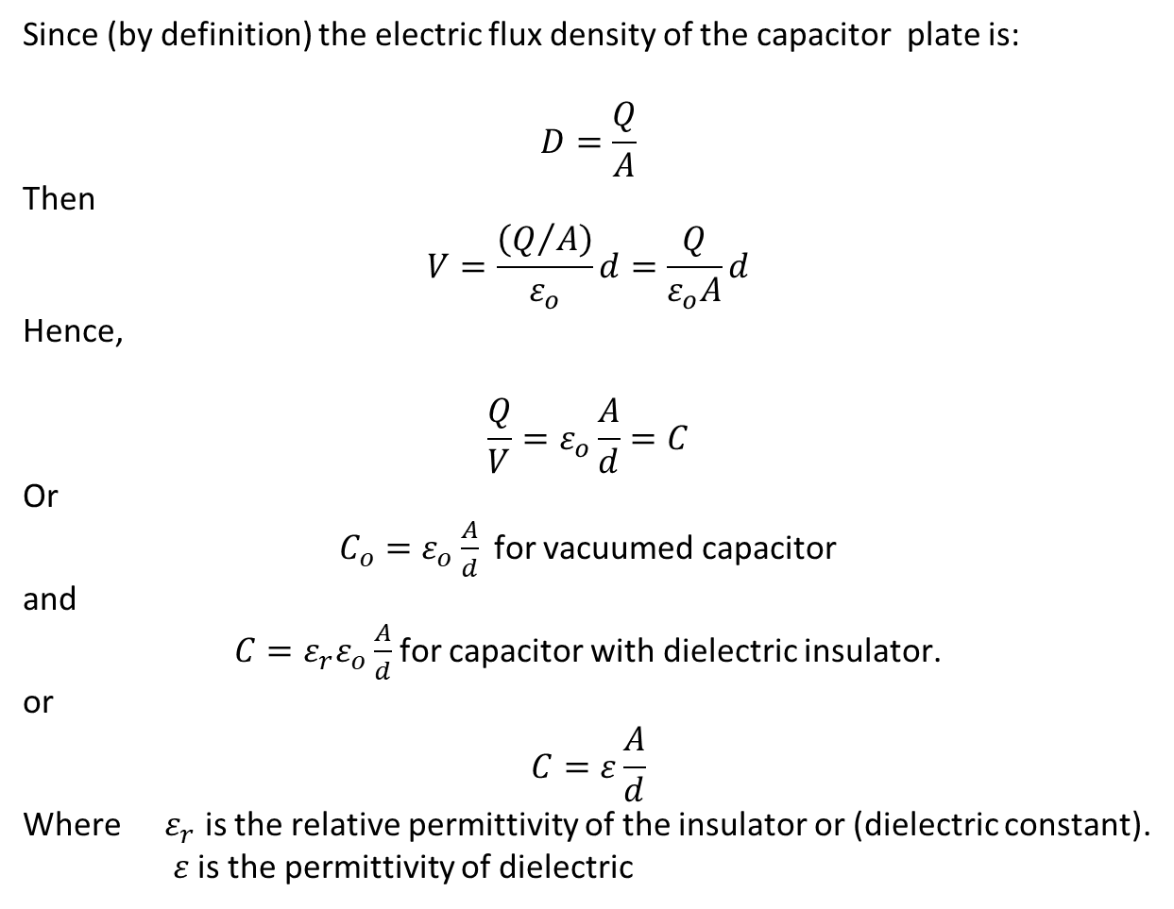
Since (by definition) the electric flux density of the capacitor plate is:
$$D=\frac{Q}{A}$$
Then
$$V=\frac{\left(Q/A\right)}{ε_{o}}d=\frac{Q}{ε_{o}A}d$$
Hence,
$$\frac{Q}{V}=ε_{o}\frac{A}{d}=C$$
Or
$C_{o}=ε_{o}\frac{A}{d}$ for vacuumed capacitor
and
$C=ε_{r}ε_{o}\frac{A}{d}$ for capacitor with dielectric insulator.
or
$$C=ε\frac{A}{d}$$
Where $ε_{r}$ is the relative permittivity of the insulator or (dielectric constant).
$ε$ is the permittivity of dielectric

Slide 15
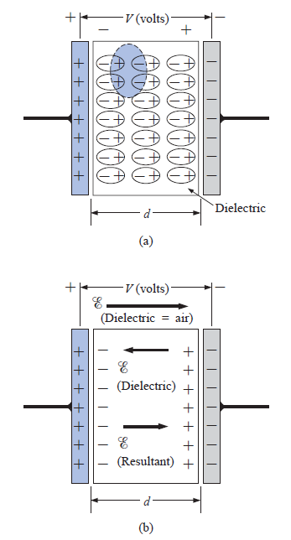
The Charging Process
The Electric Field Distribution
The Dielectric Effect

