Slide 1
Lecture 6
Hydraulic circuit design and analysis
Objectives
After reading this chapter the student will be able to:
Identify all the symbols used in hydraulic schematics
Understand various hydraulic circuits
Understand and explain hydraulic schematics effectively
Introduction
As we have seen earlier, a hydraulic circuit comprises a group of components such as pumps, actuators, control valves and conductors arranged to perform a useful task. When analyzing or designing a hydraulic circuit, the following considerations must be taken
into account:
Safety of operation
Performance of the desired function
Efficiency of operation.
Symbols of hydraulic components
It is very important for a fluid power technician or a designer to have knowledge of each of the hydraulic components and their functions in a hydraulic circuit. Hydraulic circuits are developed by using graphical
symbols for all of the components. Therefore it is pertinent to know the symbols of each and every component used in a hydraulic system.
The symbols discussed here conform to the American National Standard Institute (ANSI) standards and are tabulated below.

Slide 2
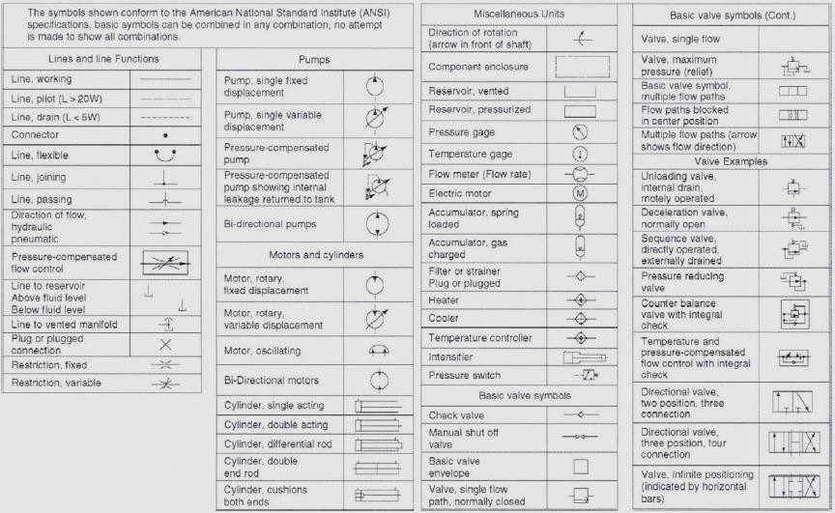
Hydraulic circuits
In this section we shall take a look at how various types of hydraulic circuits are designed for efficient operation. We shall examine the following circuits:
Control of a double acting hydraulic cylinder
Regenerative circuit
Pump unloading circuit
Counterbalance valve application
Hydraulic cylinder sequencing circuit
Speed control of a hydraulic motor
Control of a double acting hydraulic cylinder circuit
This circuit is designed as shown in Figure. When the four-way valve is in
its spring-centered position, the cylinder is hydraulically locked. Also the pump is loaded back to the tank at atmospheric pressure.

Slide 3
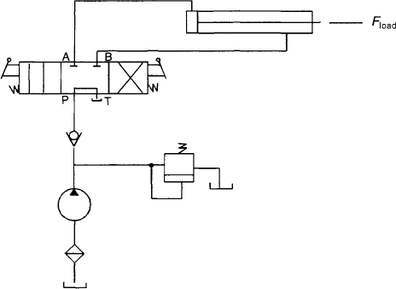
Control of a double acting hydraulic cylinder
When the four-way valve is actuated into the flow path configuration of the left envelope, the cylinder is extended against its force load (Fload) as oil flows from port P through port A. The oil at the rod end of the cylinder is free to flow back into the reservoir through the four-way valve from port B through port T. The cylinder will not extend if the oil in the rod end is not allowed to flow back to the reservoir. When the four- way valve is de-activated, the spring-centered envelope prevails, and the cylinder is once again hydraulically locked. When the four-way valve is actuated in the right envelope configuration, the cylinder retracts, as oil flows from port P through port B. Oil in the blank end is allowed to flow back to the reservoir from port A through port T of the four-way valve. At the end of the stroke, there is no system demand for oil. Therefore the pump flow goes through the relief valve at its set pressure, unless the four-way valve is de-activated. In any event, the system is protected from cylinder overloads. The check valve prevents the load from retracting the cylinder, while it is being extended using the left envelope flow path configuration.
Regenerative circuit
Figure shows a regenerative circuit used to accelerate the extending speed of the double acting hydraulic cylinder. In this system, both ends
of the hydraulic cylinder are connected in parallel and one of the ports of the four-way valve is blocked. The operation of the cylinder during the retraction stroke is the same as that of a regular double acting cylinder.

Slide 4
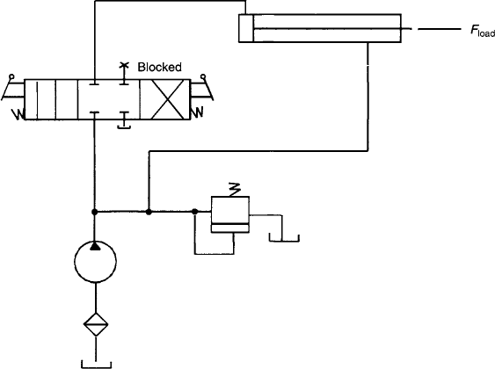
Regenerative circuit
Fluid flows through the DCV (direction control valve) via the right envelope during the retraction stroke. In this mode the fluid from the pump bypasses the DCV and enters the rod end of the cylinder. Fluid in the blank end drains back to the tank through the DCV as the cylinder retracts. When the DCV is shifted to the left envelope configuration, the cylinder extends. The speed of extension is greater than that for a regular double acting cylinder. This is because the flow from the rod end (QR) regenerates with the pump flow (Qp) to provide a total flow rate (QT), which is greater than the pump flow rate to the blank end of the cylinder.
The equation for extending speed can be obtained as follows:
The total flow rate entering the blank end of the cylinder equals the pump flow rate plus the regenerative flow rate coming from the rod end
of the cylinder.
QT=QP + QR
The regenerative flow rate equals the difference of the piston and rod areas (Ap –AR) multiplied by the extending speed of the piston (Vpext).
Qp=ApVpext-(Ap-AR) Vpext
Solving for the extending speed of the piston, we have
Vpext =QP/AR
The retracting speed of the piston equals the pump flow divided by the
difference of the piston and rod areas. VPret=QP/(AP-AR)
It should also be borne in mind that the load-carrying capacity of a regenerative cylinder during its extension stroke is less than that
obtained for a regular double acting cylinder.

Slide 5
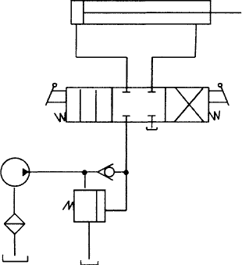
Pump unloading circuit
Figure depicts a circuit used for unloading a pump using an unloading valve.
Pump unloading circuit
In this circuit, the unloading valve opens as the cylinder reaches the end of its extension stroke. This is because the check valve keeps the high- pressure oil in the pilot line of the unloading valve. When the DCV is shifted to retract the cylinder, the motion of the cylinder reduces the pressure in the pilot line of the unloading valve. This resets the unloading valve until the cylinder is fully retracted at the point where the unloading valve unloads the pump. It is thus seen that the unloading valve unloads the pump at the end of the extending and retracting strokes as well as in the spring-centered position of the DCV.
Counterbalance valve application
Figure illustrates the use of a counterbalance or backpressure valve to keep a vertically mounted cylinder in upward position during pump
idling. The counterbalance valve is set to open at a pressure slightly above the pressure required to hold the piston up. This permits the cylinder to be forced downward, when pressure is applied on the top. The open center direction control valve unloads the pump.
The DCV used here is a solenoid-actuated, spring-centered valve with an
open center flow path configuration.

Slide 6
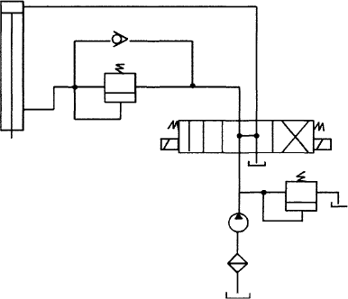
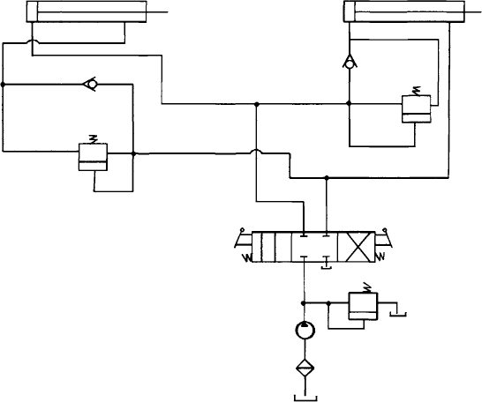
Counterbalance valve application
Hydraulic cylinder sequencing circuit
From our earlier discussions, we have seen how a sequence valve can be used to create sequential operations in a hydraulic circuit. The circuit depicted in Figure 10.6 contains a hydraulic system in which two sequence valves are used to control the sequence of operation of two double-acting cylinders.
Hydraulic cylinder sequence circuit
When the DCV is shifted into its left envelope mode, the left cylinder extends completely and then the right cylinder extends. If the DCV is shifted into its right envelope mode, the right cylinder retracts fully followed by the left cylinder. This sequence of the cylinder operation is
controlled by the sequence valves. The spring centered position of the
DCV locks both the cylinders in place.

Slide 7
The best example of this circuit is the case of a production operation. The left cylinder should extend in order to accomplish the job of clamping a work piece with the help of a power vice jaw. The right cylinder extends to drive a spindle to drill a hole in the work piece. After the hole has been drilled, the right cylinder retracts first and then the left one. The sequence valve installed in the circuit ensures that these operations occur in a predefined fashion.

