Slide 1
Stream function in polar coordinate
$$For cardizian coordinate ψ=f(x,y)$$
With ${u=V}_{x}=\frac{∂ψ}{∂y} and {v=V}_{y}=−\frac{∂ψ}{∂x}$
$dψ=\frac{∂ψ}{∂x}dx+\frac{∂ψ}{∂y}d$y = -v dx + u dy
$ψ=\int{\frac{∂ψ}{∂x}dx}+\int{\frac{∂ψ}{∂y}d\text{y}}$ + C = $\int{−v dx}$+ $\int{\text{u} \text{dy}}+C$
$$For \text{polar} \text{coordinate} ψ=f(r,θ)$$
With $V_{r}=\frac{∂ψ}{r∂θ} and V_{t}=−\frac{∂ψ}{∂r}$
$dψ=\frac{∂ψ}{r∂θ}rdθ+\frac{∂ψ}{∂r}dr$= $V_{r}$ $rdθ$- $V_{t}$dr
$ψ=\int{\frac{∂ψ}{r∂θ}rdθ}+\int{\frac{∂ψ}{∂r}dr}$ + C= $\int{V_{r}}$ $rdθ$- $\int{V_{t}}$ dr + C

Slide 2
Basic fields Flow 1- Rectilinear flow
For the following field flow
${u=V}_{x}=\frac{dψ}{dx}=U and {v=V}_{y}=−\frac{dψ}{dy}=0$
$ψ=\int{\frac{∂ψ}{∂x}dx}+\int{\frac{∂ψ}{∂y}d\text{y}}$ + C
= $\int{−v dx}$+ $\int{\text{u} \text{dy}}+C$
= $\int{0 dx}$+ $\int{\text{U} \text{dy}}+C$
= U y + C
Let $ψ$=0 at y = 0 $∴$ 0 = U 0 + C C = 0
which means that $ψ$= U y
In polar coordinates where y = r sin $θ$
$∴$ $ψ$= U r sin $θ$

Slide 3
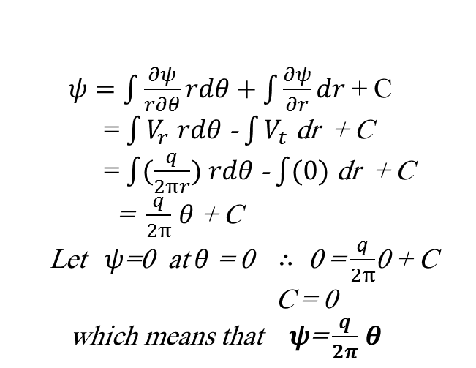
Basic Flowfields 2- Source and Sink 2-1 Source
$ψ$= $\frac{q}{4π}$
Source
For the following flowfield
$v_{r}=\frac{∂ψ}{r∂θ}=\frac{q}{2πr} and V_{t}=0$
$ψ$= $0$
$ψ=\int{\frac{∂ψ}{r∂θ}rdθ}+\int{\frac{∂ψ}{∂r}dr }$+ C
= $\int{V_{r}}$ $rdθ$- $\int{V_{t}}$ dr + C
= $\int{(\frac{q}{2πr})}$ $rdθ$- $\int{(0)}$ dr + C
= $\frac{q}{2π}$ $θ$ + C
Let $ψ$=0 at $θ$ = 0 $∴$ 0 = $\frac{q}{2π}$0 + C
C = 0
which means that $ψ$= $\frac{q}{2π}$ $θ$
$ψ$= $\frac{3q}{4}$
$ψ$= -$\frac{q}{4π}$
Sink
2-2 Sink
In this case the stream function will be the inverse of source function
$∴$ $ψ$= - $\frac{q}{2π}$ $θ$
$ψ$=- $\frac{q}{2}$
$ψ$= $0$
$ψ$= $\frac{−3q}{4}$

